Slide 1
Census Mapping Training for
A Small Census
Notes:
Welcome to the Office of Financial Management census mapping training.
As mentioned in the Census Worker Training, maps are very important for a successful census. Maps help make sense and order of the census area. They are used to keep track of progress, define the census area, and help eliminate confusion.
All maps in this training are real maps. Outlined annexation areas may not be real and are just for demonstration purposes. Basic map terminology and definitions have been presented in the Census Worker Training and are not repeated here.
If you have questions, you can always contact OFM Forecasting and Research. Contact information is found at the end of this presentation.
During this training, our agency name is abbreviated OFM.

Slide 2
NOTE: This training contains visual elements including data forms and geographical maps. To meet accessibility standards, visual elements are tagged and/or described in readable text. If you have any difficulty or need assistance accessing any of the information contained in this training, please contact the Office of Financial Management, Forecasting and Research Division, by phone at 360-902-0599, or by email at pop.annexations@ofm.wa.gov
Notes:
NOTE: This training contains visual elements including data forms and geographical maps. To meet accessibility standards, visual elements are tagged and/or described in readable text. If you have any difficulty or need assistance accessing any of the information contained in this training, please contact the Office of Financial Management, Forecasting and Research Division, by phone at 360-902-0599, or by email at pop.annexations@ofm.wa.gov

Slide 3
Maps
Usually, for a small census only one map is needed.
Notes:
Usually, for a small census only one map is needed.

Slide 4
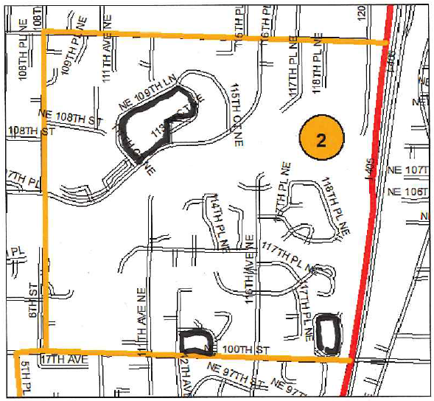
Marking Enclosed Blocks
Notes:
After the boundaries of the annexation have been drawn, the individual blocks need outlining in black.
A good practice is to look for and outline all enclosed blocks first. The majority of enclosed blocks are square or rectangle, but some can be in different shapes. (If you need to refresh your memory, block information can be found in the census worker training, slides 34 to 38.) Get out your black Sharpie and go to an enclosed block. On the inside parallel line, trace around the block. Be sure to follow around cul-de-sacs and other dead end streets.
The black line should represent the path of the census worker as they travel clockwise from the northeast corner around the block. Remember the census worker should be able to stop at the same place they started without crossing a street. Exceptions to path rules are made for safety reasons. For example, when a one-way street is a boundary you may decide to go in the direction of traffic particularly if you are enumerating by car because of the distance between houses.

Slide 5
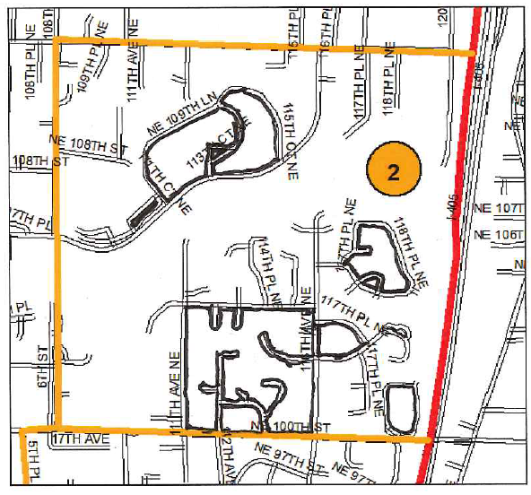
Marking Enclosed Blocks
Notes:
This map shows all enclosed blocks marked in black. The outlining follows the shape of the block. The marking follows all streets, including the cul-de-sacs and other dead end streets that extend into the block.
Notice that there are some unmarked blocks. These are the unenclosed blocks found in this area.

Slide 6
Marking Unenclosed Blocks
Notes:
On this master control map, all enclosed blocks have been outlined in black first. The unenclosed blocks now need outlining. The majority of unenclosed blocks are not square or rectangle. They are different shapes. (if you need to refresh your memory, block information can be found in the census worker training, slides 34 to 38.)
Get out your black Sharpie and go to the unenclosed block going through the middle of the area. For better viewing definition, the example outlining is shown in blue. This unenclosed block is the largest in this area. There are two non-street boundaries: one on the west and one on the east. Locate them and draw dashed lines. GREEN ARROWS show their location. Finally, connect the ends of the dashed lines with a straight line. This line will be along streets and there are two of them. Since there are two non-street boundaries, you will need two non-dashed lines.

Slide 7
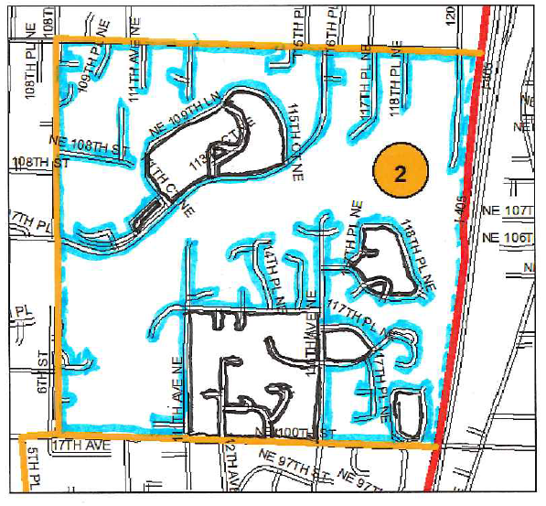
Marking Unenclosed Blocks
Notes:
This map shows all enclosed blocks marked in black and unenclosed marked in blue.
The largest block needs to be subdivided into manageable sections. Evaluate the block. Note areas that would make good boundary places: areas with no housing units, back sides of developments (they are usually fenced and make good dividing lines). Any area with well defined characteristics or devoid of buildings would be good for using as a non-street block boundary. Dividing dashed lines were placed based on a few vacant parcels or back fences of developments.

Slide 8
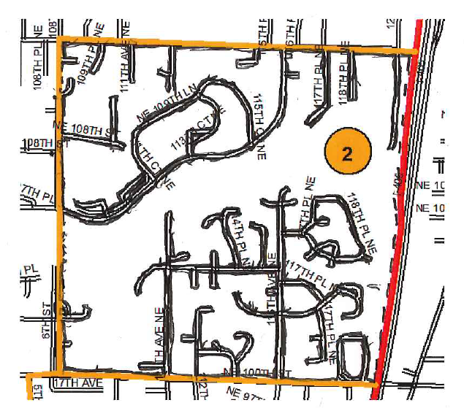
Numbering Blocks
2
1
3
4
7
5
6
8
10
9
11
13
12
14
15
17
18
16
Notes:
After outlining blocks in black, they are numbered in a serpentine manner starting with “1.” In this example, the numerals were written in red to be seen better. Some labels can be written outside their blocks with arrows pointing to the correct block. If you accidentally skip a number, do not worry. These are labels only and do not represent a count. Make a note to remind yourself of a missing block number
A serpentine manner means starting at the upper left or right, with “1”. Then move horizontally incrementing the number. When you reach the opposite side of the map, go down a level and continue numbering in the opposite direction. Continue in this manner until all blocks are numbered. Adjust path as necessary. A perfect serpentine path is not always possible.

Slide 9
Summary
Maps are the major organizational tool of a census,
If there is any sign of potential problems, please contact the Office of Financial Management, Forecasting and Research Division, Population Studies Unit at the following phone number: 360-902-0599
We will assist you in any way we can.
Notes:
Maps are the major organizational tool of a census,
If there is any sign of potential problems, please contact the Office of Financial Management, Forecasting and Research Division, Population Studies unit at the following phone number:
Forecasting and Research Division: 360-902-0599
We will assist you in any way we can.

