Slide 1
aa inclusion within dei work
Dr. Joan King, edD (she/her)
Director of AANAPISI Grant
Shoreline Community College

Slide 2
AGENDA
Introduction​
Learning Targets
​History
Today's Context
​Strategies for Employees
Q/A

Slide 3
LEARNING TARGETS
By the end of this lesson, I hope to achieve:
Comprehension of how historical factors and the Model Minority Myth contribute to AA discrimination.
Comprehension of how to better support my AA colleagues in the workplace

Slide 4
Introduction/ my lens
Korean American (East Asian) cisgendered woman. Intersectional identity (which is commonly associated with Black women, not AA women)
Military veteran
Daughter of immigrants
My family did not have equitable access to employment and resources
My cultural lens shapes the way I communicate and the way I talk about these issues

Slide 5
My privileges: Cisgendered, light skinned, able bodied...
Colorism's impact on AAPI communities:
Yes, I am a person of color

Slide 6
Preface on research & data
The colonial idea of data and research being required in all educational discussions.
We must ask ourselves: Who has access to higher level data and research?
Who is doing the researching? Who are they researching?

Slide 7
We are not a monolith: I do not represent all
AAPI is problematic (PI erasure)
My focus is on East Asian culture because it would be impossible to include all today
I pluralize “community” because there are over 50 cultures in AAPI
“Asian American” is not only Chinese
Asia reaches into parts of Russia, Turkey, etc.

Slide 8
“but if i'm not black, I'm white.”
Jacob King, age 6
The polarization in our discussions around race in this country

Slide 9
History of anti-Asian rhetoric

Slide 10
what racism? You have it good. The erasure caused by m.m.m.
1800s+
1871
1882
1941
1982
Yellow Peril
LA Chinese Massacre of 1871
Chinese Exclusion Act (resulting in AAPI immigration restrictions)
Pearl Harbor/WWII
Vincent Chin

Slide 11
Perpetual foreigner but one of our own defined citizenship
Wong Kim Ark
United States vs. Wong Kim Ark (1898)
This Supreme Court case established the precedent that any person born in the United States is a citizen by birth regardless of race or parents' status.
An Asian American defined American citizenship.
Source: PBS

Slide 12
Today's context: what has changed?

Slide 13
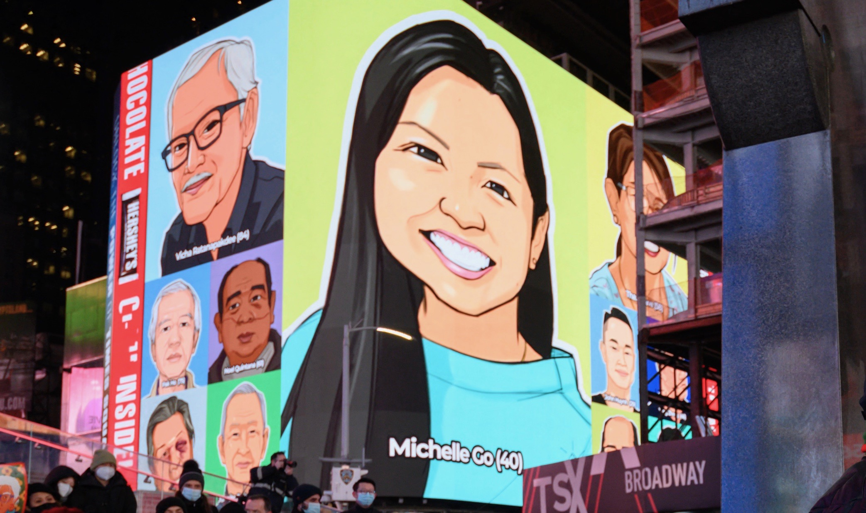
The answer: nothing has changed
Source: https://laist.com/news/stopasianhate-artist-viral-la-jonathan-chang-pandemic-attacks-asians

Slide 14
But how does violence against chinese immigrants result in general asian hate? #wedontalllookthesame

Slide 15
Anti-Asian hate crimes increased 339% nationwide last year, report says
Source: ABC Asian America

Slide 16
Report: mental health, stop asian hate
Source: Stop Asian Hate

Slide 17
Causes of asian hate (dei trainings)
Proficiency stereotypes
Stereotypes w. lethality
Asians are good at math
Asians are bad drivers
Asians are good at tennis
Asians are smart, have 4.0s, etc.
Crazy Rich Asians
These stereotypes (although they exist) completely ignore the mental health element of the Model Minority Myth
Asians brought over Covid (Kung flu, China flu, etc.)
Asian women are Lotus Flowers (Asian women are submissive, quiet, etc.)
Asian women are freaks in bed (the ultimate sexual passport stamp)
Dragon Lady
Asian women are prostitutes (esp. If they work in a massage parlor)
These stereotypes result in sexual violence against women AND anti-Asian hate crimes. Not to mention they are conflicting stereotypes.

Slide 18
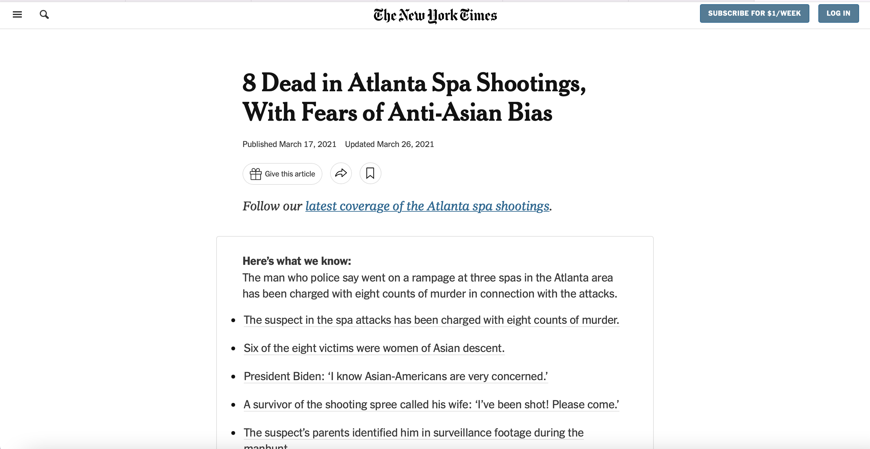
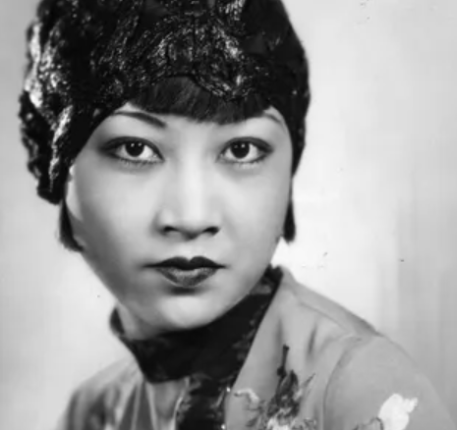
8 dead in atlanta spa shootings, with fears of anti-Asian bias
Source: Headline c/o NYT and headshot c/o Encyclopedia Britannica

Slide 19
March 31, 2022: a faux pas
Source: Facebook c/o The Talk

Slide 20
intersectionality& monolids
“A fascinating little-known fact about the Korean
War is that an American surgeon, David Ralph Millard, stationed there to
treat burn victims, invented a double-eyelid surgical procedure to make Asian
eyes look Western, which he ended up testing on Korean sex workers so they
could be more attractive to GIs. Now, it’s the most popular surgical procedure
for women in South Korea.” –Cathy Park Hong, Minor Feelings
Source: All About Vision

Slide 21
Double eyelid bias
Source: The Cut
Notes:
https://www.thecut.com/2013/09/julie-chen-says-eyelid-surgery-saved-her-career.html
The white western influence on East Asian beauty standards: Rite of passage

Slide 22
Bias disruptors penalized in the workplace
Source: NextShark.com

Slide 23
Gaslighting because we don’t “fight back”?
•Strength in America: Loud, aggressive, physical, push back, to fight, etc.
•Strength in AA communities: Control and mastery over oneself
•Buddhist ideal of protecting your inner peace and conquering yourself OR The Art of War's idea of "crouch to conquer"
•"Keep your head down and don’t cause trouble” = Immigrant assimilation tool for survival (immigrants escaping famine, poverty, war, etc.)
Safety (as mentioned by Cathy Park Hong in Minor Feelings)
Ultimate goal: Coveted American education and rise in the work force.
•The result? “Weak" or "quiet" to describe AAPI communities during the rise in hate crimes

Slide 24
Group identity & “high shame culture”
Confucian culture: "The Face"
Individualism (can be perceived as selfish)
Actions of the part are reflective of the whole
This idea has inadvertently become a barrier for AAs wanting to access community resources
NAMI.org reports that AAPI communities are the #1 “racial group” to be less likely to reach out for mental health resources

Slide 25
Inequitable access to community resources
The erasure of all AAPI folks who do not fit into the Crazy Rich Asian stereotype:
Parentification, where children are now the adults in the family and have to help their parents navigate American systems they know nothing about (mainly because they speak English)
Funding (children of immigrants or immigrants) generally will have lower incomes because they left all their resources in their home country
Which means children have to navigate applications for community resources alone, without the help of their parents (again, not just because of language, but because they are unfamiliar with these American systems).

Slide 26
Cont...
Employment inequities because their parents did not have the knowledge on how to navigate western customs of getting employed:
"I"language on resumes and cover letters when AAs use "We" (group identity)
Leadership verbs: spearheaded, led, managed, facilitated, etc.
Not applying for jobs because they do not meet every single bullet on the minimum qualifications list
Imposter syndrome
Immigrants frequently tell children to work hard, and then your boss will take notice, give you that promotion... in America, the squeaky wheel gets the oil
NETWORKING

Slide 27
Onus of communication
Malcolm Gladwell's Outliers
Korean Air anecdote
Responsibility is placed on the listener and not the speaker
How this relates to how you work with your employees or co-workers

Slide 28
Mental health resources are not inclusive
Asian employees who are experiencing intergenerational trauma need to talk to Asian therapists
Understand immigrant trauma and historical trauma
Loss of culture between generations
Loss of language between parent and child
Referring an AA employee in this situation to a white counselor or a white therapist is NOT culturally competent.

Slide 29
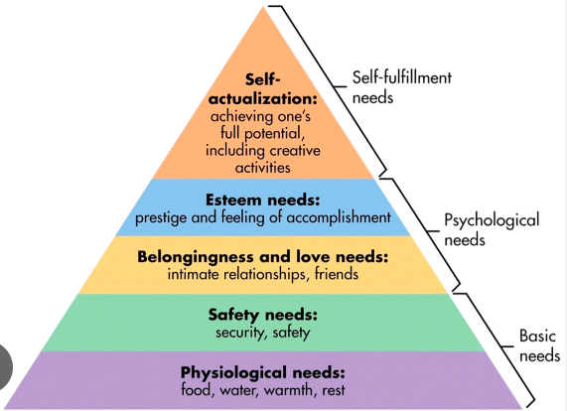
Love languages & employee needs
Words of affirmation
Acts of service (Did you eat?)
Touch
Quality time
Receiving gifts
Note: Stolen then repurposed from the Blackfoot (First Nations People)
Source: Simple Psychology

Slide 30
How white supremacy takes advantage of group identity
Texas A&M publication on white supremacy culture (you can Google it):
PERFECTIONISM
Different than AA culture valuing high standards because perfection is unobtainable and we are set up to fail under impossible standards (also a tool of white supremacy)
HUSTLE
URGENCY
High stakes, little chance of success
Because of our value in group identity, this idea is allowed to thrive in our work places because white systems can capitalize and weaponize our culture
In group identity, members are looking out for group, white supremacy is not

Slide 31
Strategies for professionals

Slide 32
strategies
"We" language to combat high shame culture (example: Can we try to be more mindful of time?)
Onus of communication: LISTEN to your AA colleague and ask them if you are understanding their needs ("I hear you are saying... is that right?")
Take the time to understand their culture (and you'd better know how to pronounce their name correctly). Then reflect on where that person’s' cultural lens sits in relation to your own cultural lens.
NEVER ask for a nickname. We learned how to say Pfizer and you know how to pronounce Aztecan superfoods like quinoa.
Advocate for DEI trainings to be inclusive (NOT polarizing conversations around the Black-white experience).
Proactive outreach

Slide 33
Strategies, cont...
Look at your hiring practices
“They didn’t talk enough about…” use the interview to give them multiple opportunities (Group identity and challenges around individualism— it’s hard to talk about ourselves!)
Are your minimum qualifications actually your minimum qualifications?
Are you placing too much emphasis on higher education when folks of color do not have equitable access to higher education?
Do you value lived experience or are you asking POC to describe how racism impacts marginalized communities?
Are you encouraging folks to apply when they may not meet all qualifications? Are you having a discussion around what are teachable skills and what are not?

Slide 34
Mental health resources
Asians for Mental Health:
Asiansformentalhealth.com
Asian American Psychological Association:
www.aapaonline.org
Asian Mental Health Project:
Asianmentalhealthproject.com
@asianmentalhealthproject
Asian American Mental Health Collective:
www.asianmhc.org
@asianmentalhealthcollective
Asian Pacific Counseling and Treatment Centers:
www.apctc.org/

Slide 35
More resources
Grief circles: Tsuru for Solidarity
Book on immigrant trauma/intergenerational trauma: Permission to Come Home by Dr. Jenny Wang
Remind folks that carrying pepper spray when walking alone can help them feel safer
Right To Be's Guide on de-escalating conflict in public (in collab with Asian Americans Advocating Justice)

Slide 36
access to all resources
Email me for link at joansungwriter@gmail.com OR
QR code:

Slide 37
Want to learn more?
PBS documentary narrated by Sandra Oh,
“One Day in March”

Slide 38
THANK YOU Q/A: NORMS Are we asking to seek understanding or to share opinions? And if the latter, where does your cultural lens sit in relation to mine?
Dr. Joan King
Interested in PD?
Email me at:
Joansungwriter@gmail.com
www.joansungwriter.com

