Slide 1
Data Sovereignty & and Two-Eyed Indigenous Evaluation
Sauncha Romey
Sauncha.Romey@doh.wa.gov
Masters Public Administration

Slide 2
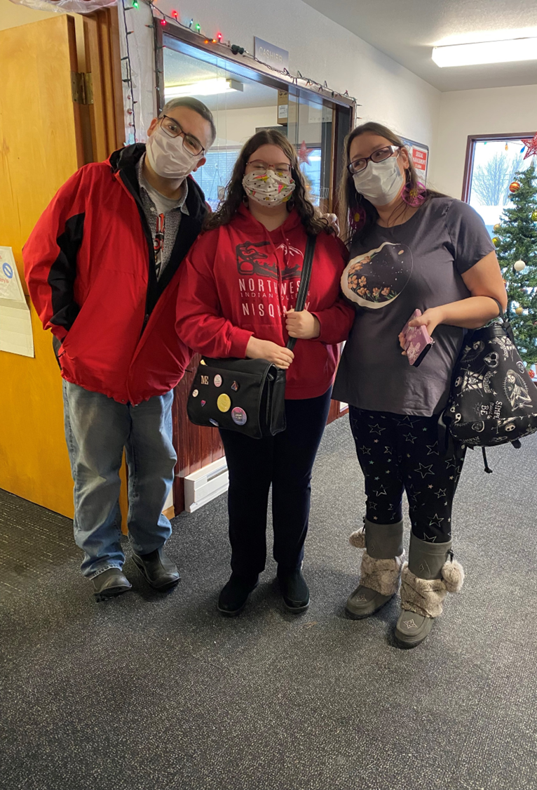
Language Sovereignty
Sauncha Romey di waayu. Laxgibuu di pdeegu. Su Metlakatla, Alaska di wil ‘waatgu. Melanie Guthrie waa di nooyu. Ts’msyenu.
I have shared with you in Sm’algyax that I am Sauncha Romey. My clan crest is the wolf and I am from New Metlakatla, Alaska. Melanie Guthrie is my mother and I am Tsimshian.

Slide 3
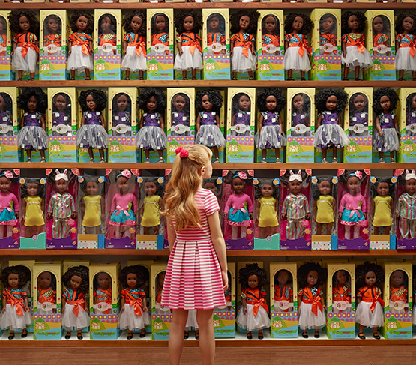
What is White Supremacy?
“Inequity can occur simply through homogeneity; if I am not aware of the barrier you face, then I won’t see them, much less be motivated to remove them... the assumption is that the access enjoyed by the controlling group is universal (DiAngelo, 2018, p. xiii)…The default of the current system is the reproduction of racial inequality; our institutions were designed to reproduce racial inequality and they do so with efficiency. Our schools are particularly effective at this task.” (p. 153)

Slide 4
Racism Spectrum vs Good/bad binary

Slide 5
Cognitive Dissonance - Feedback on racism
Protect worldview and choose racism and micro/macro-
aggressions.
Good/Bad
Binary
Cognitive Dissonance. Discomfort of worldview being challenged. Brain must decide if world view needs to change or if it will clamp down on racists can only be bad people. Therefore I am not a racist.
Use discomfort to learn from the situation. Read or watch the many resources about racism. Thank the person who spoke up.
You said something racially problematic

Slide 6
INDIGENOUS METHODOLOGIES DECENTERING POSITIVISM/WHITENESS
Axiology
Shawn Wilson, “Research is all about unanswered questions, but it also reveals our unquestioned answers.” (p. 6)
Indigenous Paradigm: are Relational to Indigenous communities, to the land, plants, and animals, and to all the people of the world.
Positivism: Everything that is “real” can be proven with the Scientific method. If it can’t be proved this way, it isn’t “real”.
Axiology: values
Ontology: what does it mean to exist (a people, native, in relation to land, people, community) or to be “real”?
Epistemology: how do we know what we know? Scientific methods, researchers, elders, the land?
Paradigm:
Relational or Positivism
Methodology
Ontology
Epistemology

Slide 7
Uncentering Whiteness in Knowledge Systems: Indigenizing versus Decolonizing
Relational
Axiology
White
Axiology
Paradigm:
Indigenous
Relational
Paradigm:
Positivism
Whiteness
Indigenous Methodology
Relational Ontology
(white)
Methodology
White Ontology
Relational
Epistemology
White
Epistemology

Slide 8
Free, Prior, and Informed Consent
Community Based Participatory Research

Slide 9
Indigenous Methodologies: Linda T. Smith
The term ‘research’ is inextricably linked to European imperialism and colonialism. The word itself, ‘research,’ is probably one of the dirtiest words in the indigenous world’s vocabulary. When mentioned in many indigenous contexts, it stirs up silence, in conjures up bad memories, it raises a smile that is knowing and distrustful. It is so powerful that Indigenous people even write poetry about research. The ways in which scientific research is implicated in the worst excesses of colonialism remains a powerful remembered history for many of the world’s colonized peoples. It is a history that still offends the deepest sense of our humanity. Just knowing that someone measured our ‘faculties’ by filling the skulls of our ancestors with millet seeds and compared the amount of millet seed to the capacity for metal thought offends our sense of who and what we are…

Slide 10
Indigenous Methodologies: “Research”
It galls us that Western researchers and intellectuals can assume to know all that it is possible to know of us, on the basis of their brief encounters with some of us. It appalls us that the West can desire, extract, and claim ownership of our ways of knowing, our imagery, the things we create and produce, and then simultaneously reject the people who created and developed those ideas and seek to deny them further opportunities to be creators of their own culture and own nations. It angers us when practices linked to the last century, and the centuries before that, are still employed to deny the validity of indigenous peoples’ claim to existence, to land and territories, to the right of self-determination, to the survival of our languages and forms of culture knowledge, or our natural resources and systems for living within our environments. (Linda T. Smith, p. 1)

Slide 11
Data Sovereignty
“Data do not make themselves. Data are created and shaped by the assumptive determination of their makers to collect some data and not others.” (SIlva & Zuberi, p. 7)
“Being counted is an acknowledgement of both existence and value. It means that one matters.” (p. 194)
“[A] claim is that the data produced through statistic represents a fixed and discoverable social reality, rather that one that is partial and contingent on the researchers, their worldview and their methodologies…It reifies positivism’s investment in the notion of a singular truth…’Data do not tell a story. We use data to craft a story that comports with our understanding of the world.’” (Paine, Cormack, Reid, Harris, & Robson, p. 190-1)

Slide 12
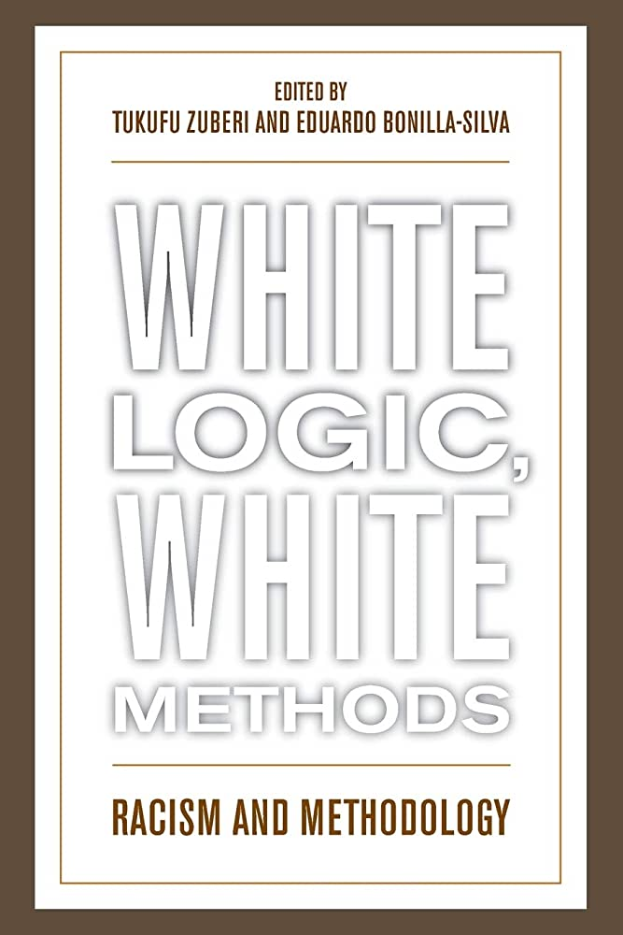
Statistics Founded on Racism
Gillborn, D., Warmington, P., & Demack, S. (2018). QuantCrit: education, policy, ‘Big Data’ and principles for a critical race theory of statistics.
The centrality of racism
Numbers are not neutral
Categories are neither ‘natural’ nor given
Voice and insight: data cannot ‘speak for itself’
Using numbers for social justice

Slide 13
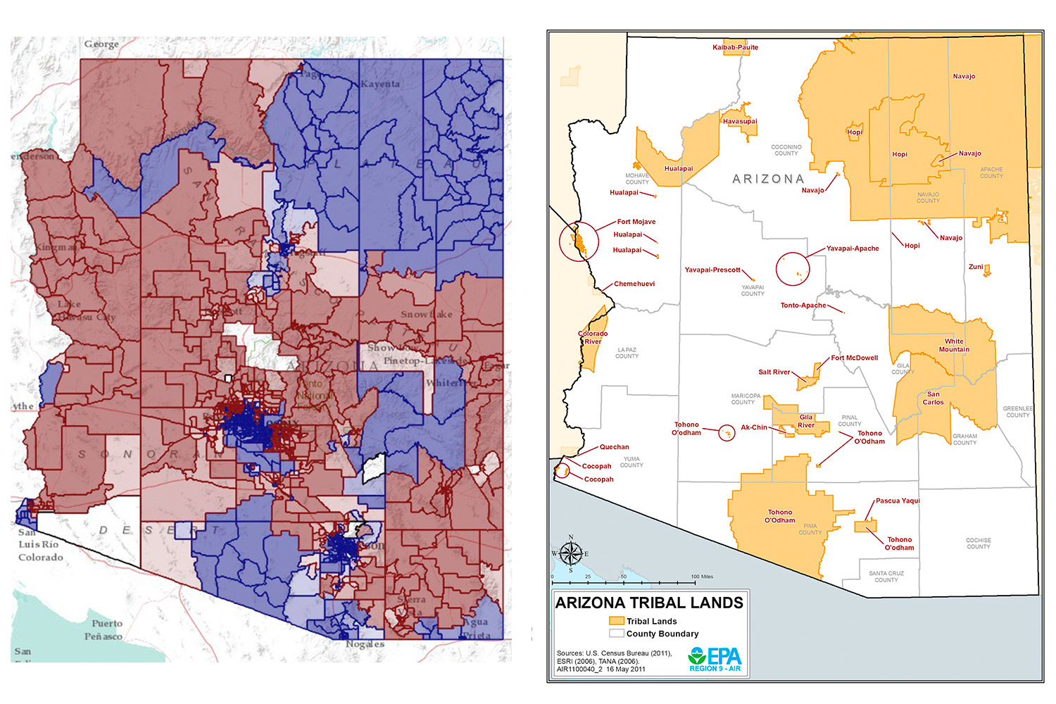
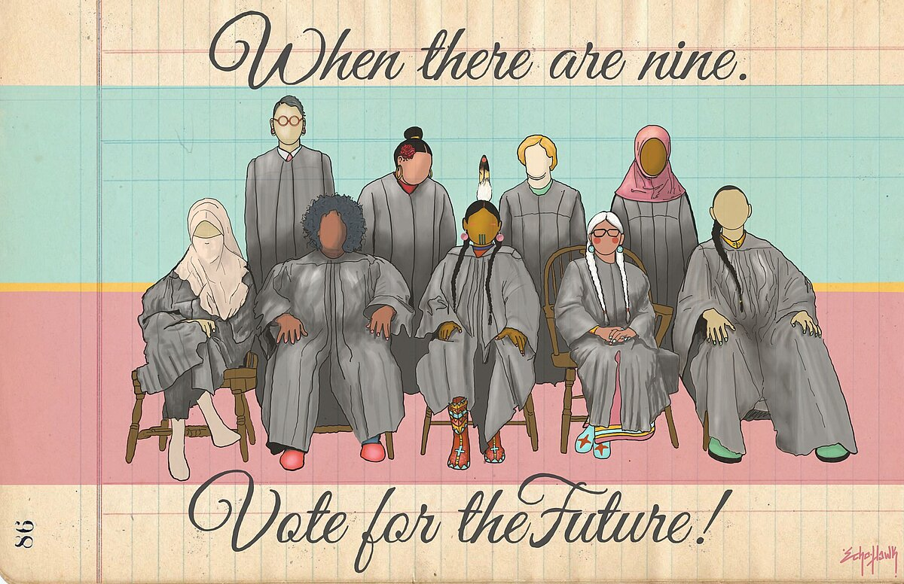
Voting is Sacred: IllumiNative, Tribes, and CBOs
Notes:
Large get out the vote campaign by many CBOs and Illuminative and UIHI
See the voting power of Native in the 2020 election by looking at Araizon and the blue correlates with reservations.

Slide 14
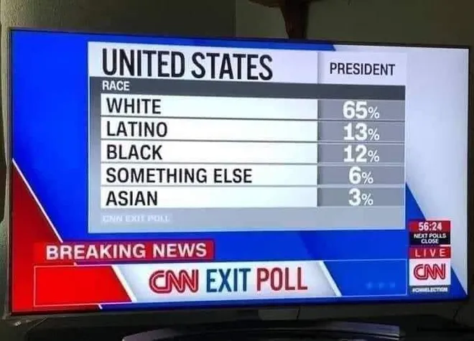
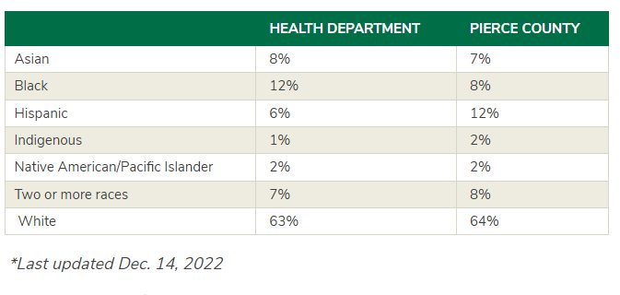
“Indigenous Creatures” and “Something Else”
Notes:
That voting power was depicted as “something else” on CNN which turned into a meme.
But ties into the data problems and even genocide in the data. This was online at a LHJ. I suspected and it was later changed to Native Hawaiian Pacific Islander.

Slide 15
Census data and data genocide
Only people who identify as American Indian/Alaska Native ALONE are counted in the census.
OSPI found that this only captures 24.8% of Native students. Better question but still colonial, are you an enrolled member of a federally recognized Tribe, ANC or Descendant?
Supreme Court has upheld this is a citizenship question, not race based.
Notes:
https://files.eric.ed.gov/fulltext/ED601883.pdf

Slide 16
Traditional Knowledge “Proprietary”
Knowledge may be private and may belong to families or communities. Consent must take into consideration who owns knowledge and is authorized to share it. Consent can be removed at any time during or after sharing of the knowledge. Songs, stories, and experiences are sacred and the sharing of them is a gift and not a right. Reciprocity and respect for the knowledge must be demonstrated or knowledge may and should be withheld to ensure traditional knowledge will not be misappropriated yet again or cause damage to the community.
EPA has a series of Tribal knowledge recordings
Notes:
https://www.epa.gov/environmentaljustice/environmental-justice-tribes-and-indigenous-peoples

Slide 17
Two Eyed Seeing: Co-Creation of knowledge
Reconciling ways of knowing in Canada videos
Hermeneutics fusion of horizons:Meeting of two worldviews and no subsumming one of them.
Shaw Wilson: Research should change you as a person or you are doing it wrong.
Notes:
https://www.waysofknowingforum.ca/online-dialogue-series

Slide 18
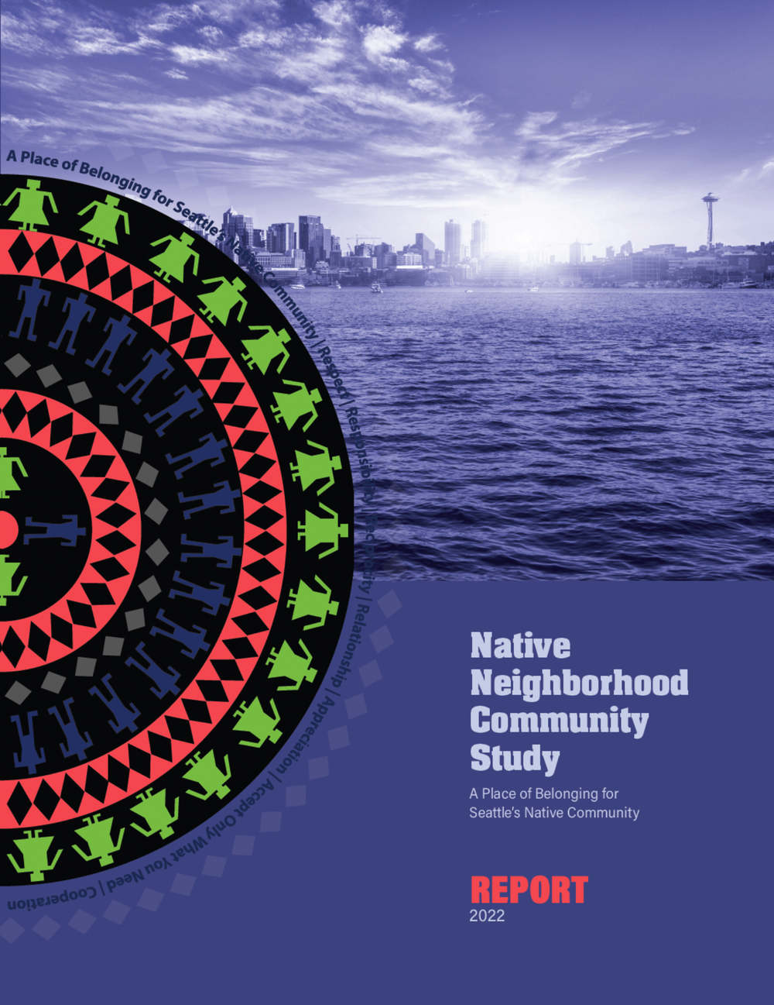
The Hermeneutic Wager
Imagination—Imagining research possibilities.
Humility—Becoming equal collaborators in research.
Commitment—Agreeing to move forward with research.
Discernment—Deciding feasible research paths and weighing risks.
Hospitality—Welcoming all possible outcomes.
(Enhancing Indigenous Health Promotion Research Through Two-Eyed Seeing: A Hermeneutic Relational Process by Hovey et Al, 2017)

Slide 19
Imagination—Imagining Research Possibilities
‘The first hermeneutic conversation to be explored is imagination. The purpose of imagination is for the research team to examine all possible ways that the research question can be explored through “brain storming” sessions where all ideas have value and potential. This is where the foundational strength of diversely based teams is found. Imagination offers little risk to the researchers because it is still hypothetical; however, it provides a means to move from ambiguity to a shared perspective of what a health promotion research team could become. The imagination stage also invites open dialogue, becoming a way to begin to learn how the group interacts, and how individual researchers respond to each other. Imagination is about introductions, professional and personal experiences, expectations, listening and learning about and from others who have different perspectives, understandings, and ways of knowing about the same topic’ (p. 3)

Slide 20
Imagination—Imagining Research Possibilities 5/5
Brought in Native PM, looked to Native Neighborhoods in San Francisco, Canada, Lethbridge Feasibility study.
What would we and Native planners like to see? NWIC site, Indigenous Library, sound studio for music and podcasts, authentic native arts, Native languages and art in urban architecture, food sovereignty, Elder and youth center, water, and canoe access.
On City side, Indigenous Design IO, City of Vancouver City of Reconciliation work

Slide 21
Humility—Becoming Equal Collaborators in Research
“The second conversation engages the capacity of the research team and community members to reflect on their humility. This means everyone is equal, standing at the same height, to have the foresight to see beyond encultured perceptions, professional wants, and needs toward what has been previously imagined about how a research team evolves over time. Humility is reflexivity of oneself with others that either strengthens or interferes with the building of a strong team. Humility invites generosity and ways of thinking that enhance potential through being open to learning from other perspectives, possibilities, and modes of health promotion in practice” (p. 3)

Slide 22
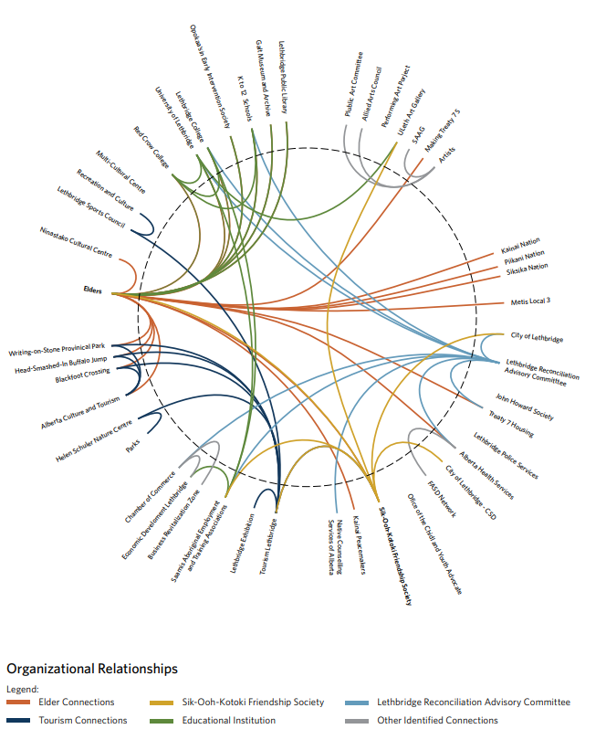
Humility—Becoming Equal Collaborators in Research. 4/5
Funding given to NIF to hire project manager.
Indigenous Intern position.
Indigenous Seattle Workgroup made up of volunteer Native planners unless their jobs allow to attend on work time.
ISW and PM carries out work, design, and data collection.
We pushed back when some City demographers wanted access to raw data.
Thankful for funding support but was budget dust.
Notes:
Lethbridge feasibility study

Slide 23
Commitment—Agreeing to Move Forward with Research
“The third conversation, commitment, requires some element of risk. It is time for the team to make clear their intentions as a commitment to the project. This means all members understand how they will contribute, offer resources, and accept the responsibility of being part of a research team. Without commitment from all participants, the research process would certainly stall in mediocrity or fail altogether. (p. 4)”

Slide 24
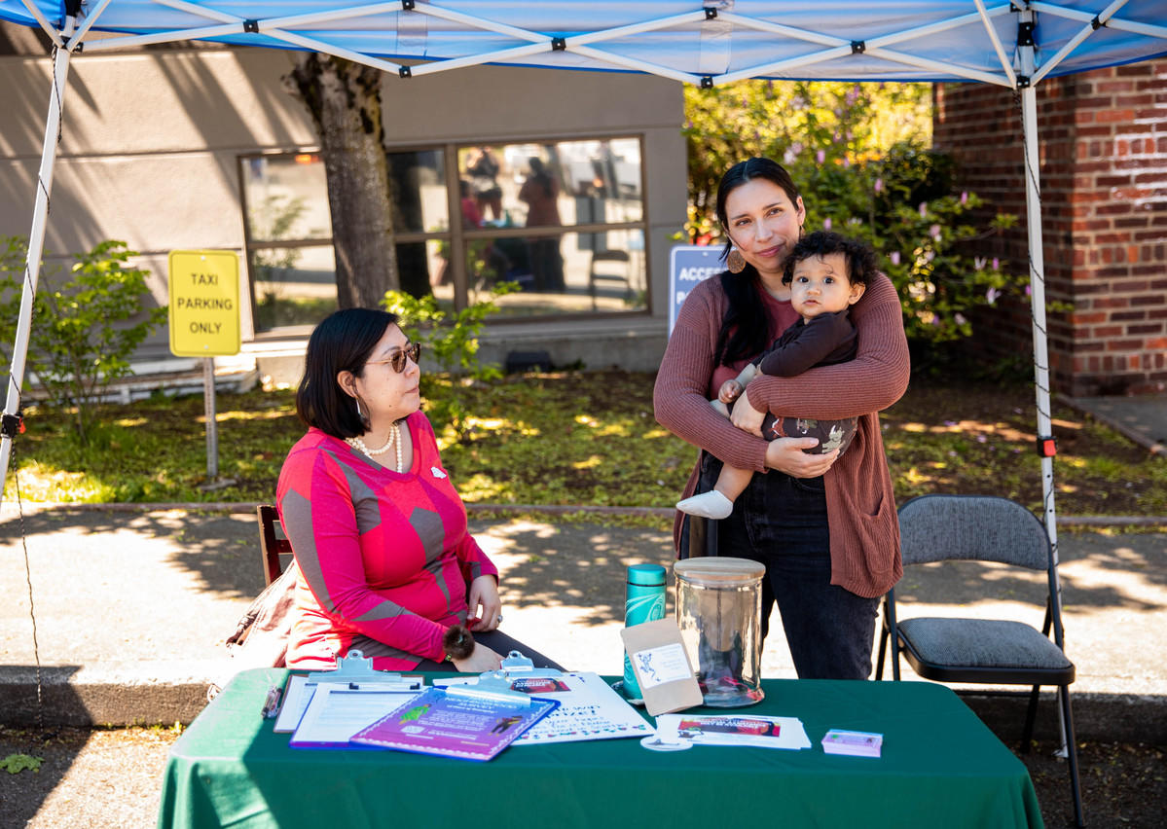
Commitment—Agreeing to Move Forward with Research 3/5
Did not have enough money for a large feasibility study. Project expanded in time and additional funding found by NIF split with another project.
Because of lack of money to pay workgroup beyond PM and intern, capacity of volunteers was hit or miss, rightly so.
Engaged with Native CBOs, Tribal Nations, so that we would not step on toes and they would not find out by seeing the survey.
Project milestones around data and FPIC.

Slide 25
Discernment—Deciding Feasible Research Paths and Weighing Risks 3/5
‘The fourth conversation is the reality check of discernment. It refers to making explicit what is, in reality, possible and makes sense. It regulates imagination because it recognizes that not all possibilities are equal or achievable. This concept also moderates commitment with the reminder that some wagers are not possible due to conditions that may be insurmountable. This is the point where practical understandings are faced, authentic risks are discussed, and then weighed out. We asked ourselves the question, “Is this really Two-Eyed Seeing or are we just calling it Two-Eyed Seeing?” The hermeneutic wager exposes the risk and makes explicit the implications of continuing or not’ (p. 4).

Slide 26
Discernment—Deciding Feasible Research Paths and Weighing Risks 3/5
First, thankful for the City for funding and support!
MONEY: Originally $25k for entire project.
Vocation Awe (Fobazi Ettarh): Doing community work where we share the identity of the work.
Indigenous Planner position took years to hire
Dialog with City planners: grateful for being able to voice and interact.
Extraction of well paid City planners having meeting with unpaid Native planners.
Scope of work compared to Lethbridge study

Slide 27
Hospitality—Welcoming All Possible Outcomes. 4/5
‘The fifth conversation, hospitality, wholeheartedly welcomes the outcomes of the relationship-building endeavors. If the team successfully moves from discernment to hospitality, this indicates the project has committed itself to continue. Future success involves an unconditional openness with all others and a desire to achieve something extraordinary. This condition also describes the relational considerations of being with others in the co-creation of a community of people. Belonging replaces suspicion and new understandings replace previous ways of thinking to ensure the interaction between and among people is just, caring, and leads toward research that keeps community priorities at the forefront throughout’ (p. 4).

Slide 28
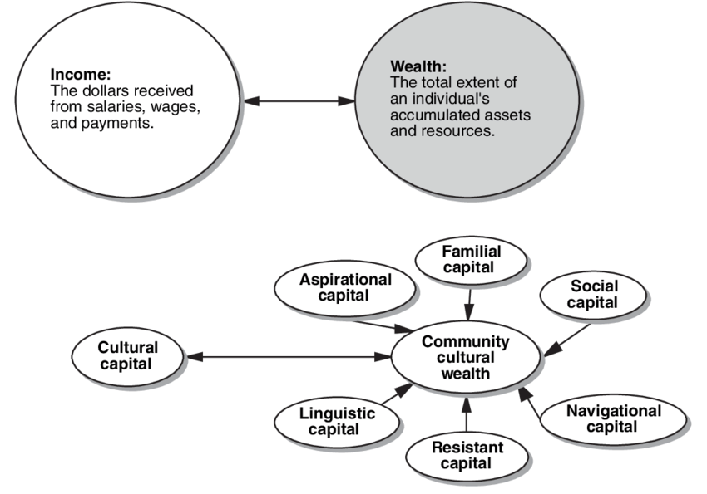
Hospitality—Welcoming All Possible Outcomes. 4/5
Report was made with Indigenous methodologies by Native people.
End product beautiful and usable by community.
Was many of ours's first projects. We did not always know what we were doing.
As community members, we got amazing and authentic responses from a group that deeply distrusts research and government.
Next steps: Deeper feasibility study on siting and funding. Education study. Sharing with other Native CBOs.
Capacity building that happened because of internship (4) and project experience.

Slide 29
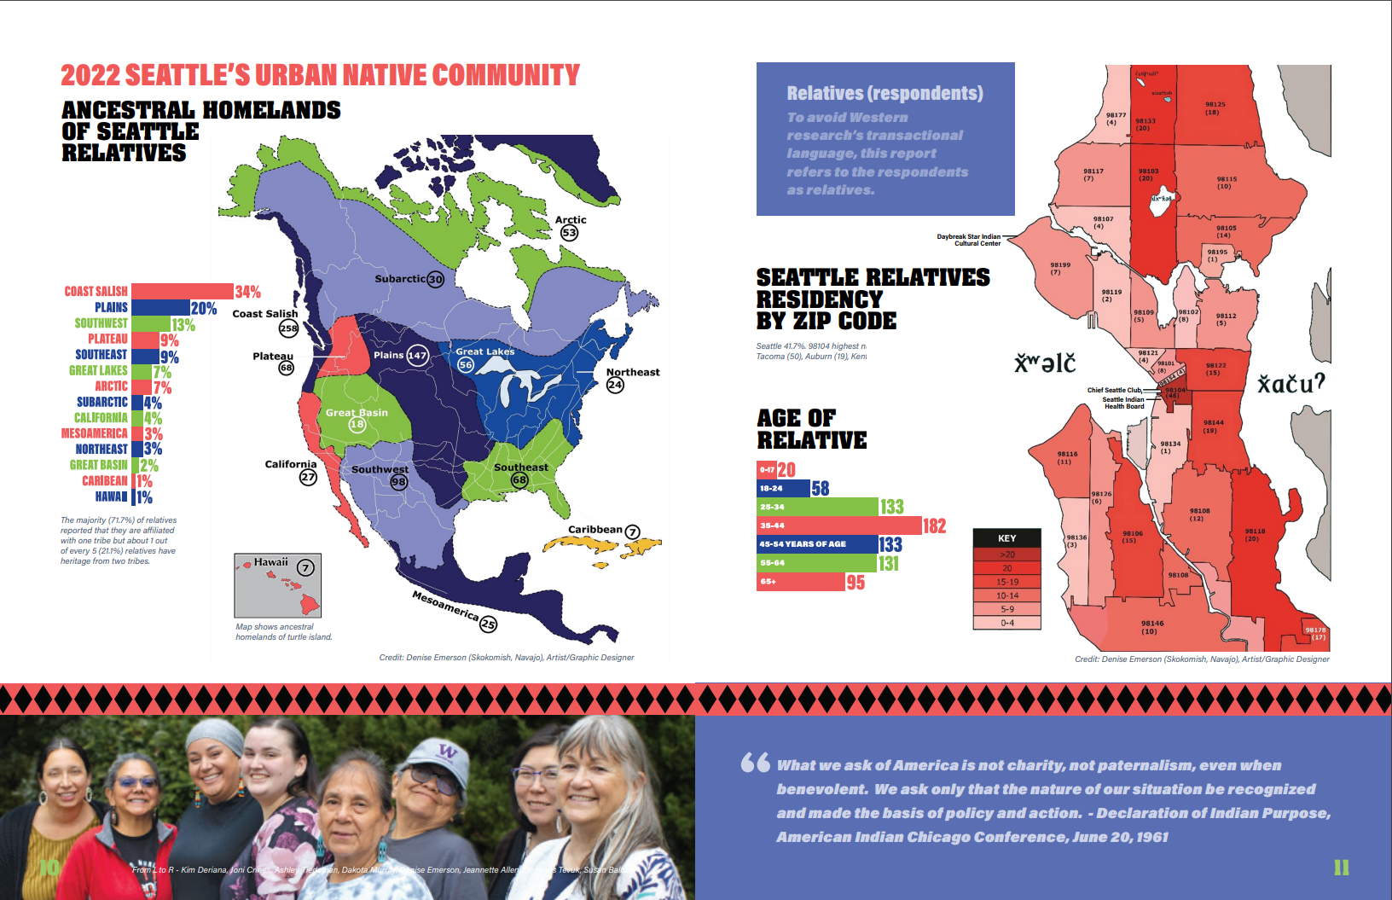
Examples from Report

Slide 30
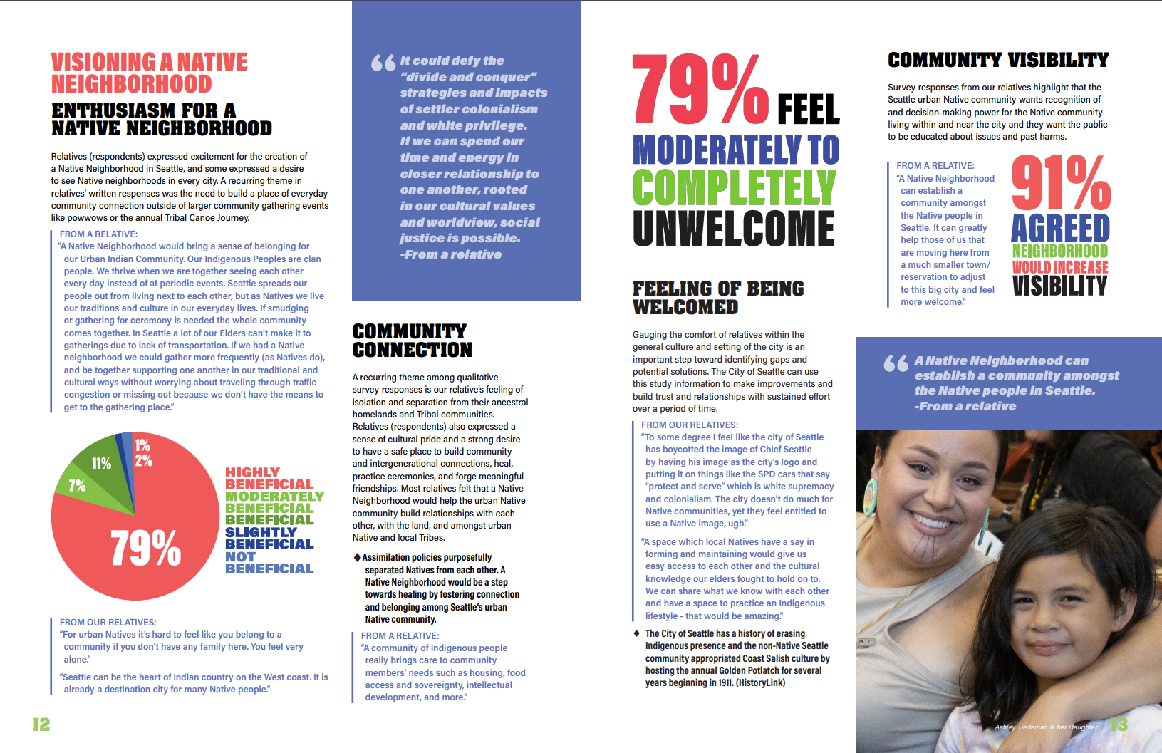
Examples from Report

Slide 31
Importance of Relationships in Results

Slide 32
Importance of Water

Slide 33
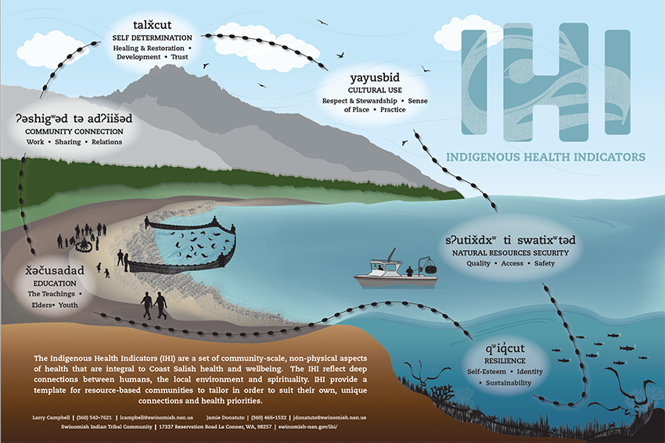
Other Native Projects
Indigenous Health Indicators
Native Transformation Project NWIC
Notes:
https://swinomish-nsn.gov/ihi2/index.html
https://canhr.uaf.edu/research/past-canhr-projects/native-transformations/

Slide 34
Canada Ownership, Control, Access, Possession

