Slide 1



www.willhouseglobal.com
Culture of Belonging Assessment: Disrupting the Status Quo By Identifying Equity Gaps in Policy and Practice Across the Organization

Slide 2

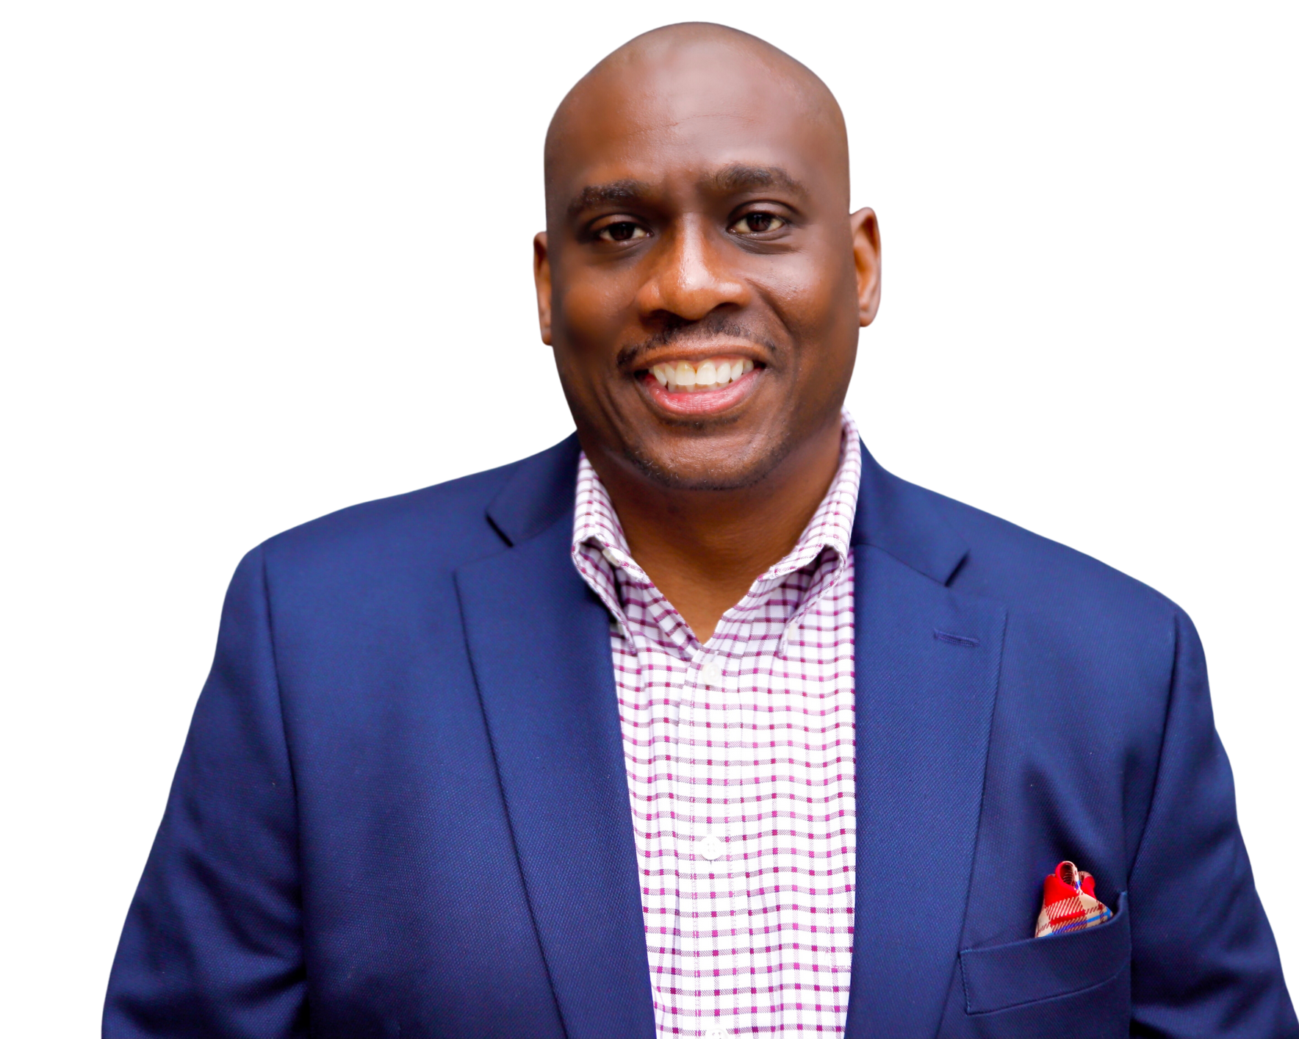

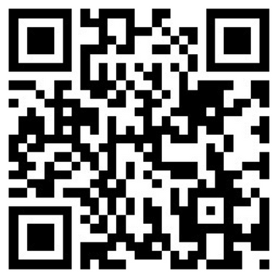

Connect with Dr. William T. Lewis

Slide 3



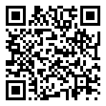
Sweet Potato or Pumpkin Pie

Slide 4
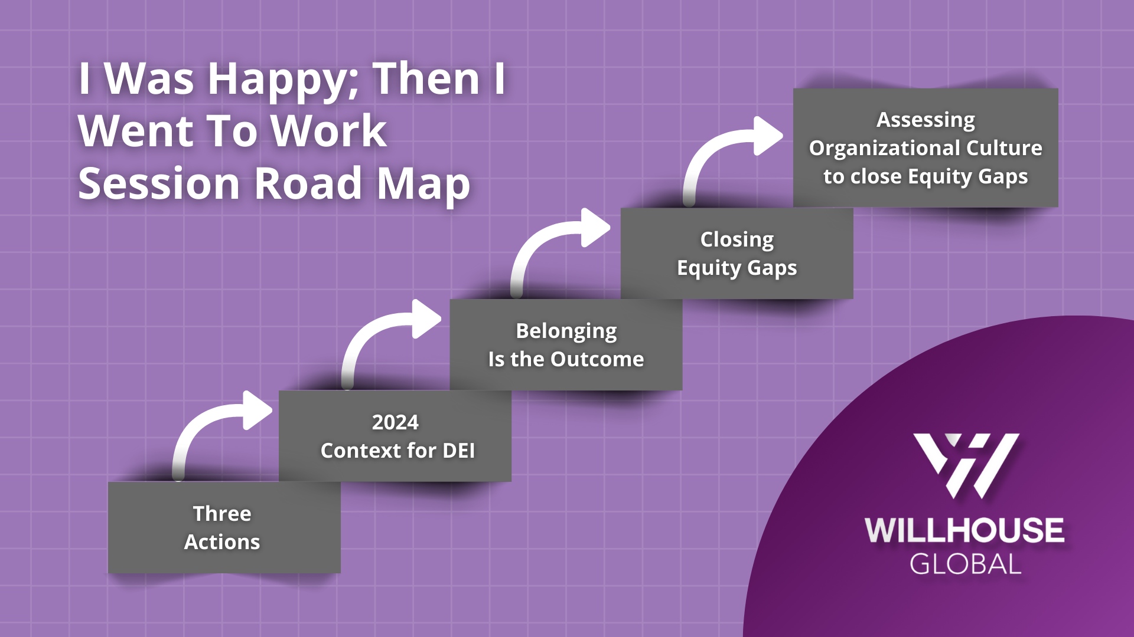
I was Happy; Then I went to Work Session Road Map

Slide 5
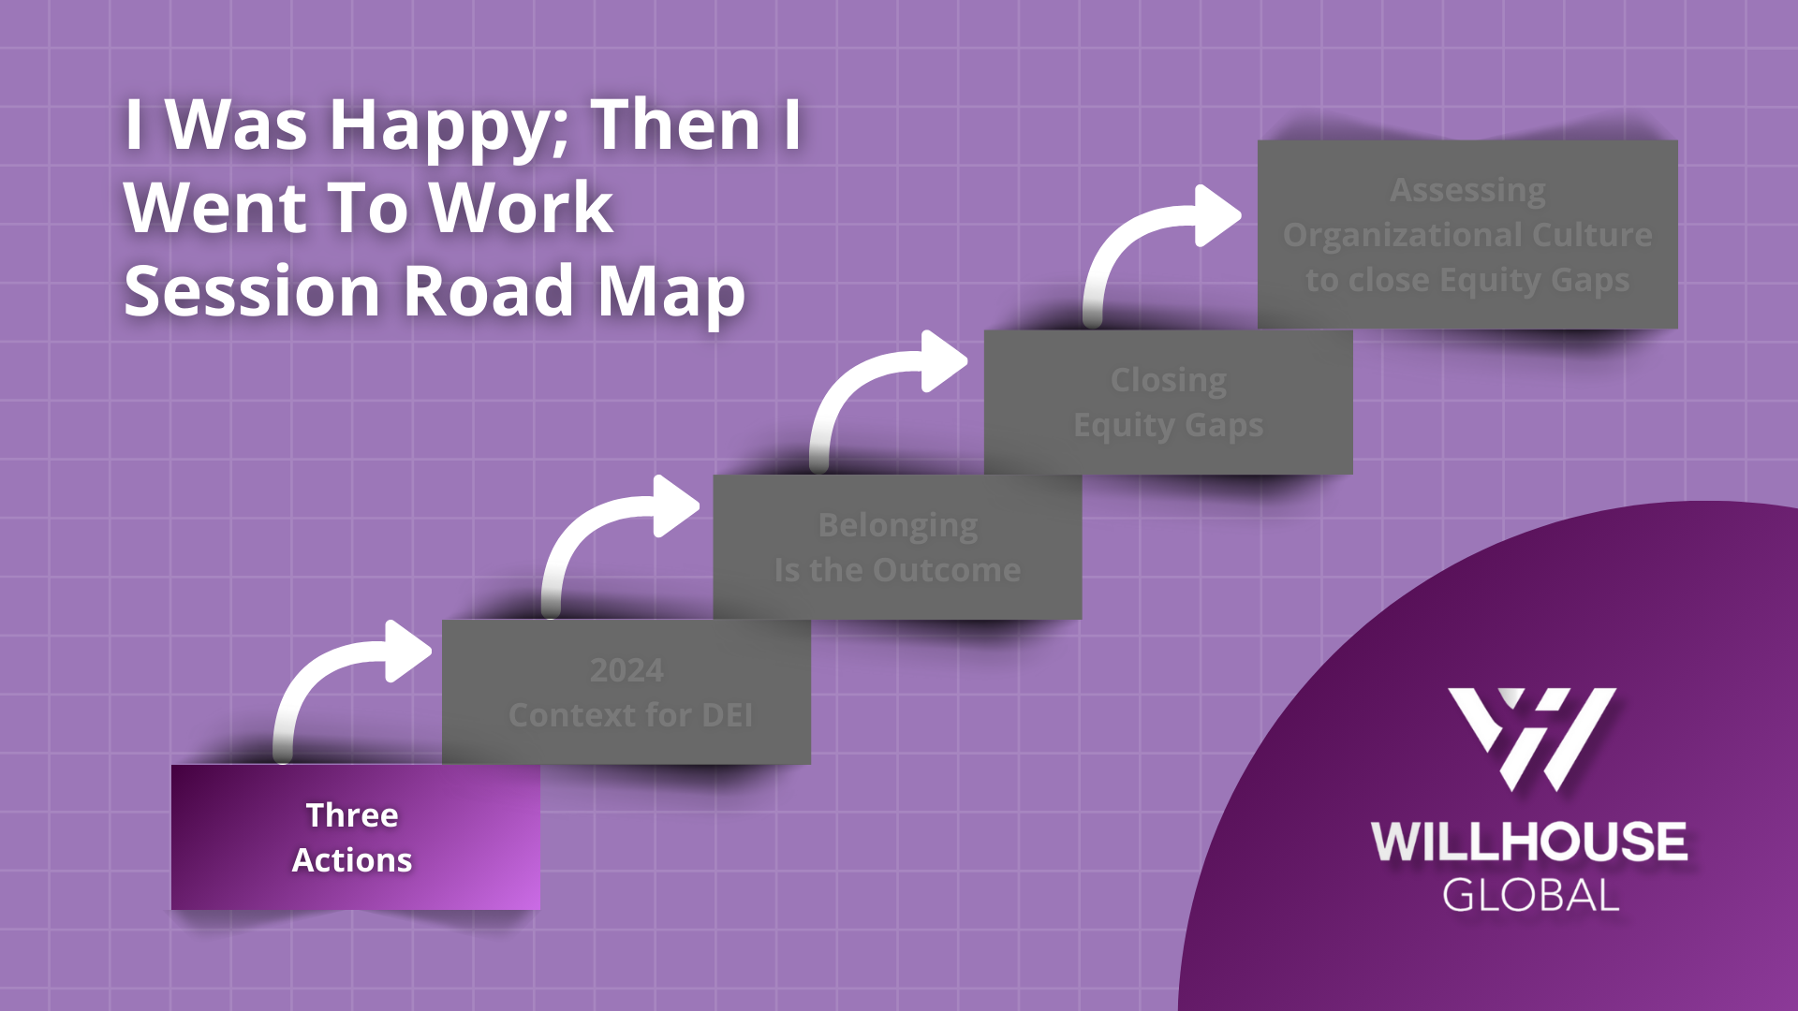
I was happy: then I went to Work Session Road Map

Slide 6
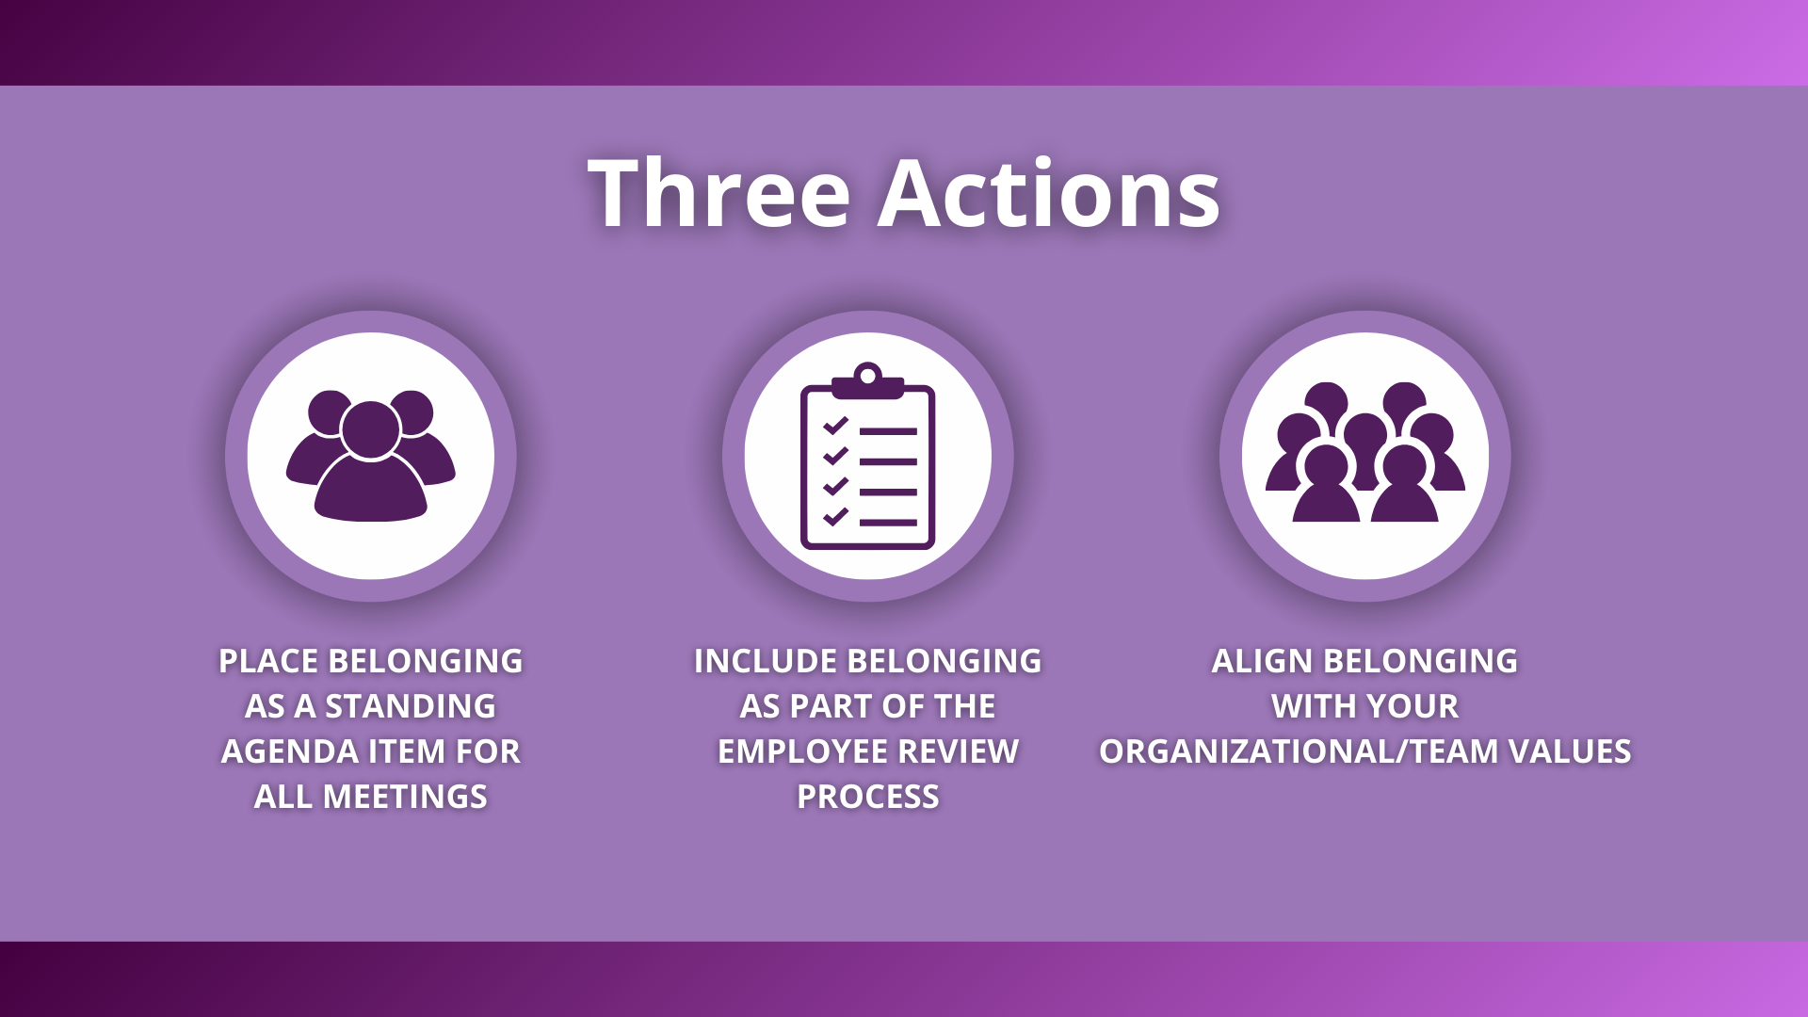
Three Actions

Slide 7
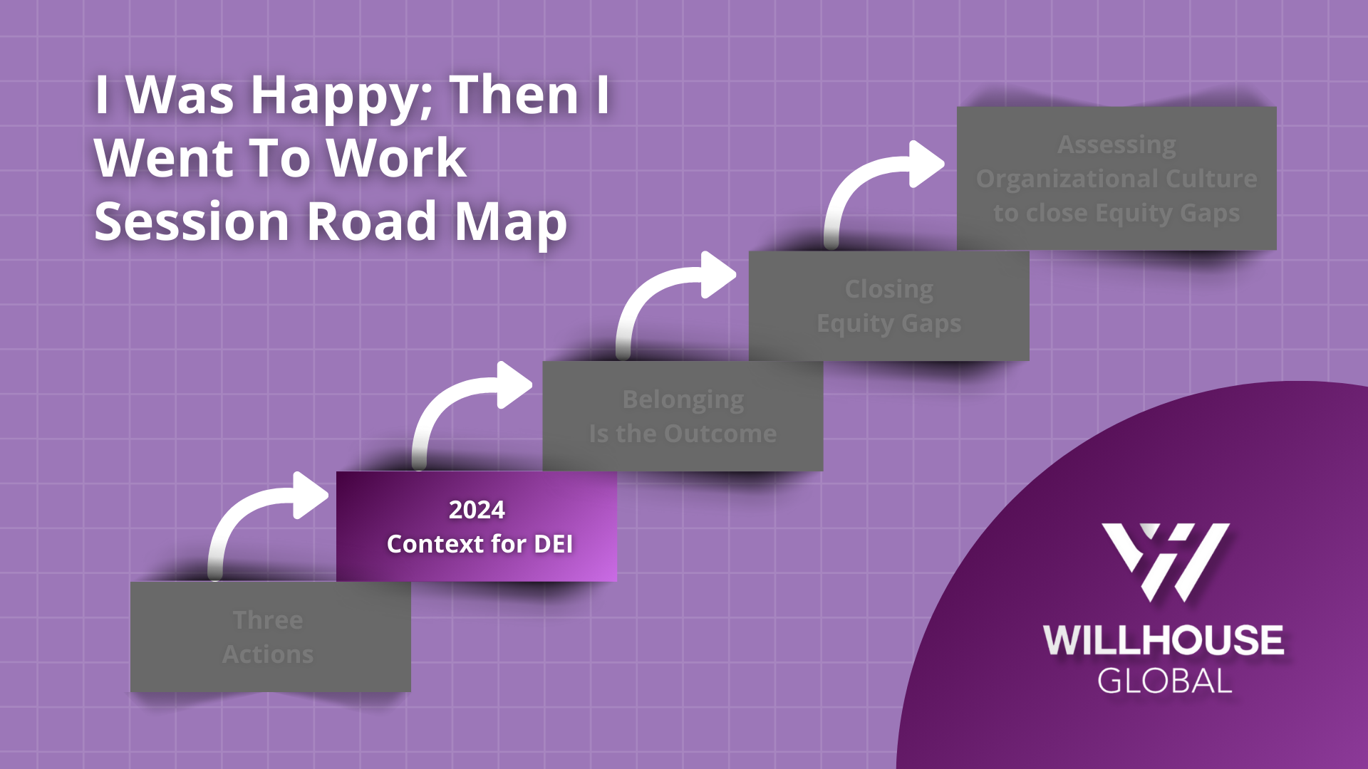
I was Happy; Then I Went to Work Session Road Map – 2024 Context for DEI

Slide 8

Demographic Buying Power
Demographic Buying Power
  Hispanic: $1.9 trillion
  African Americans: $1.6 trillion
  Asian Americans, including Native Hawaiians and Pacific Islanders: $1.3 trillion
  Native Americans: $140 billion
  Women: $5-$15 trillion (US)
  People with Disabilities: $20 billion (US)
  LGBTQ: $3.7 trillion globally

Slide 9






Fiscal Year 2022, The EEOC Workplace Reported Discrimination
Fiscal Year 2022, the EEOC Workplace Reported Discrimination
  Disability: 22,843 or 37.2% of cases
  Race: 20,908 or 34.1% of cases
  Sex: 18,762 or 30.6% of cases
  Age: 12,965 or 21.1% of cases
  National Origin: 6,213 or 10.1% of cases
  Color: 3,516 or 5.7% of cases
  Religion: 2,111 or 3.4% of cases

Slide 10

Bubbles

Slide 11


Strategy to Dismantle DEI
Strategy to Dismantle DEI
Anti-DEI Legislation (Colleges and state government)
DEI described as Indoctrination
Misquote
Civil Rights/Leaders for Change
Attack Precepts and Principles
(Equity)

Slide 12
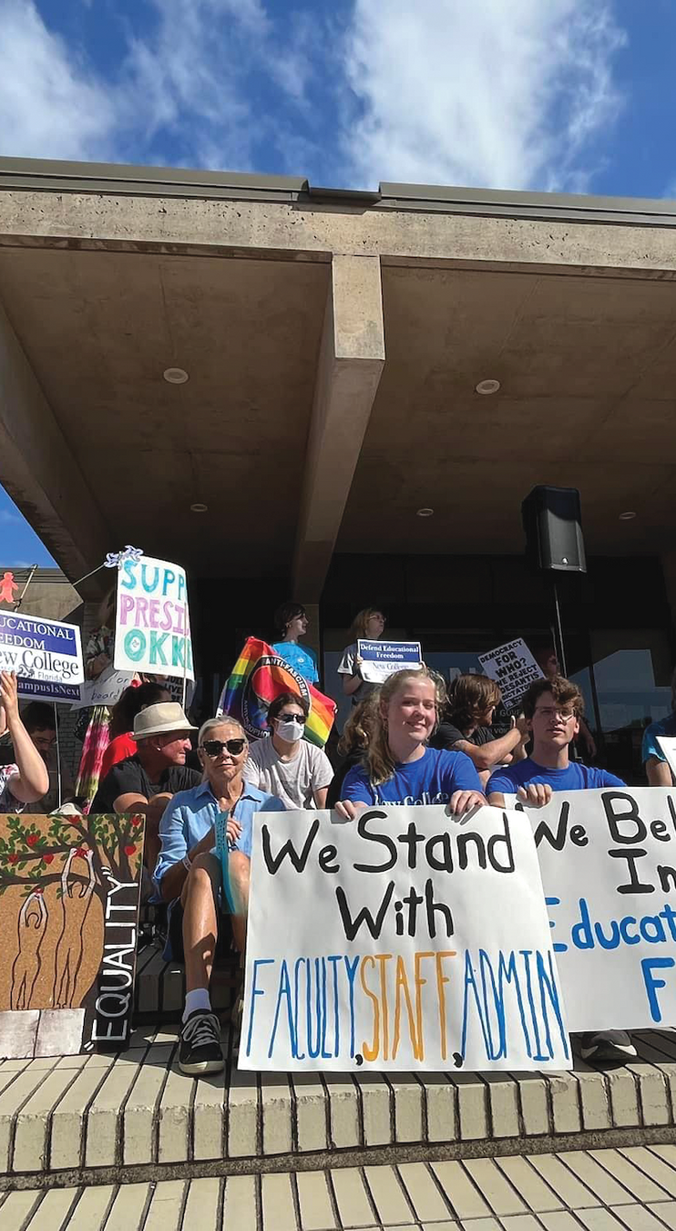
Anti-DEI Legislation
Anti-DEI Legislation
  22 states
  65 bills
    Mandatory Diversity Training
    Diversity Offices/Officers
    Diversity Statements
    Prohibits considering race, ethnicity sexual expression
    College admissions and employment interviews

Slide 13
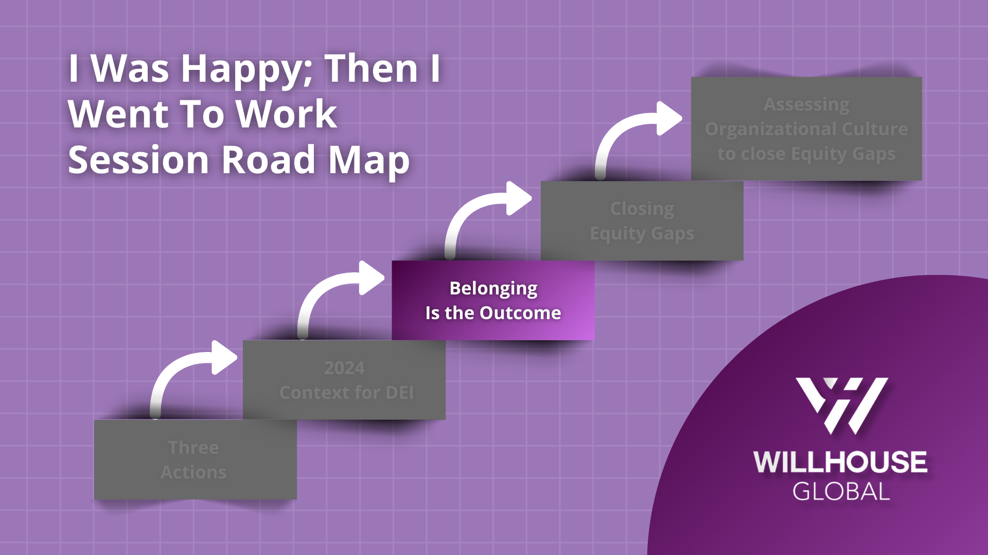
I was Happy; Then I Went To Work Session Road Map – Belonging is the outcome

Slide 14
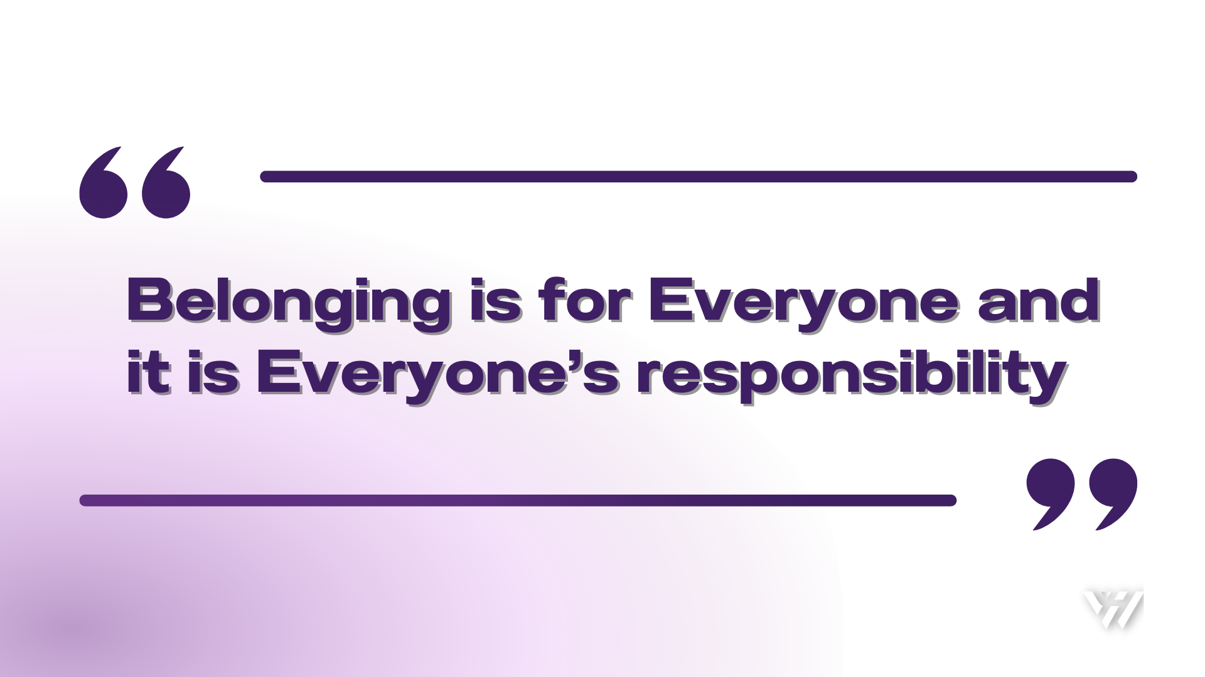
Belonging is for Everyone and it is Everyone’s responsibility

Slide 15
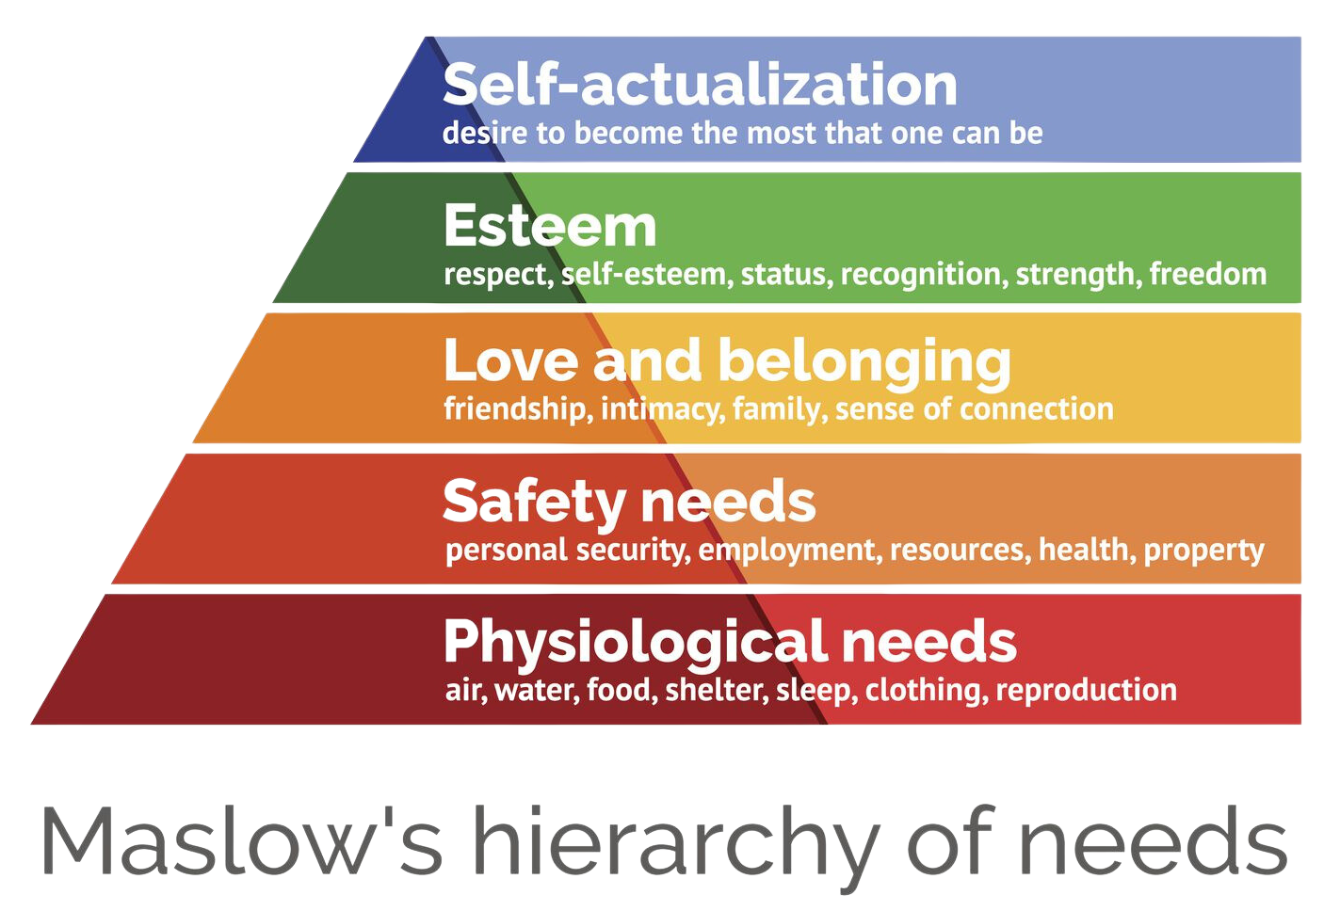
Belonging is a Universal Human Need
Belonging is a Universal Human Need

Slide 16


What does it feel like to belong?
What does it feel like to belong?

Slide 17
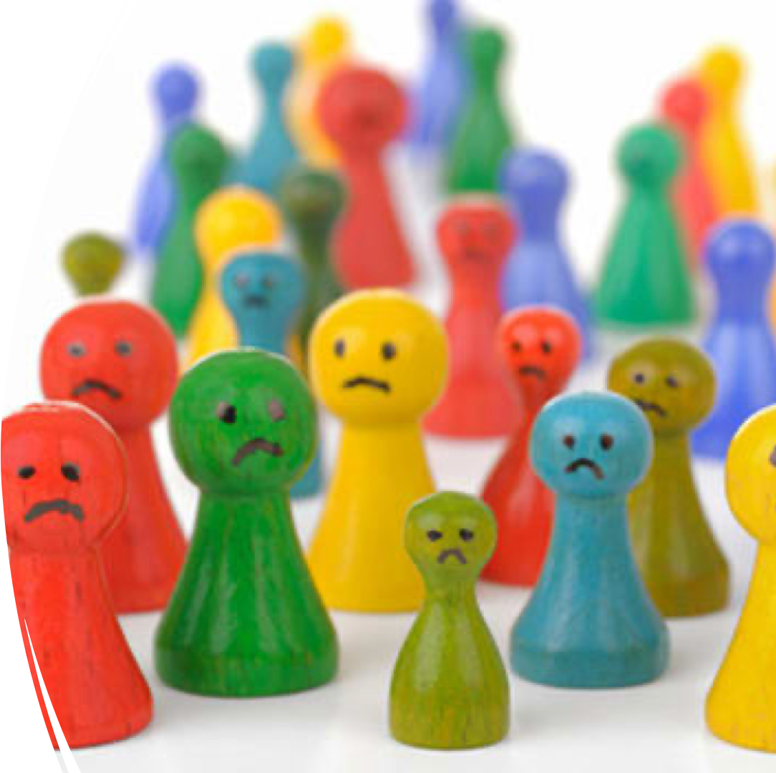
Unhappy Employees and Belonging
Unhappy Employees and Belonging

Slide 18

The Financial Impact to the Company
The Financial Impact to the Company
  Unhappy workers cost U.S. between $450 and $550 billion in lost productivity each year
  Turnover costs are estimated to be 100%-300% of the base salary of the replaced employee

Slide 19


Deloitte’s Human Capital Trends
Deloitte’s Human Capital Trends
‘Belonging’ as the top human capital issue that organizations face today.
73% responded stated that fostering a sense of belonging was important to their organization’s success
93% agreeing that a sense of belonging drives organizational performance
U.S. businesses spend nearly 8 billion dollars each year on diversity and inclusion (D&I) trainings that miss the mark because they neglect our need to feel included. (McKinsey and Company)

Slide 20
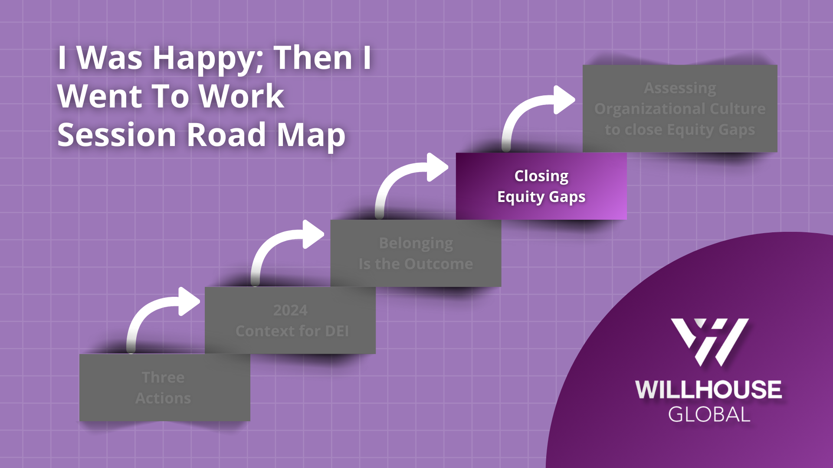
I Was Happy; Then I went to Work Session Road Map – Closing Equity Gaps

Slide 21
What is Equity?
Refers to fairness and justice…
Equity means recognizing that we do not start from the same place and must acknowledge and make adjustments to the imbalances.

Slide 22
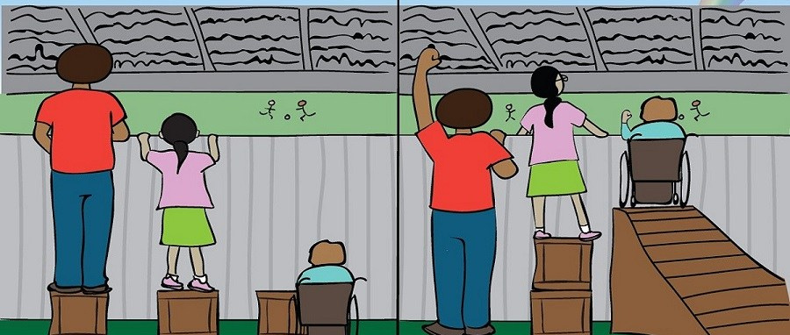
Equality Vs. Equity
Equality
Equity

Slide 23
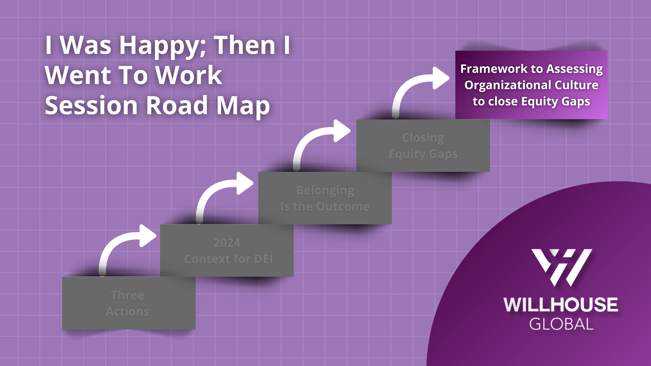
I Was Happy; Then I Went To Work Session Road Map – Framework Assessing Organizational Culture to close Equity Gaps

Slide 24
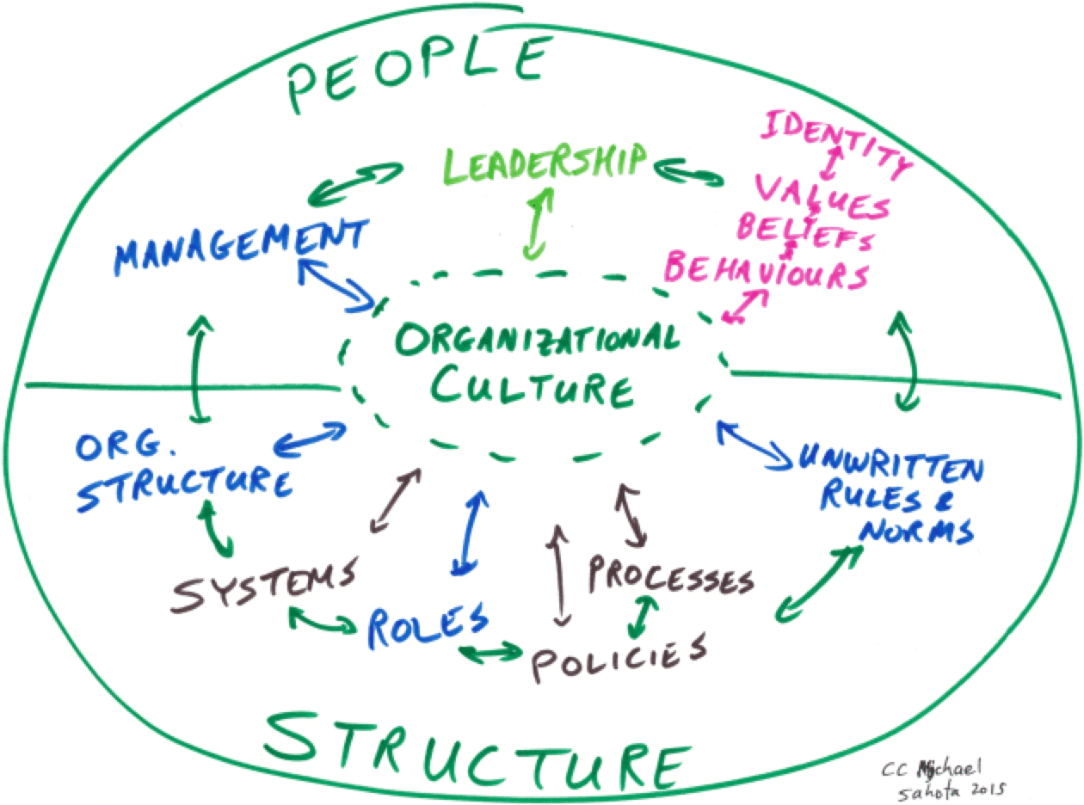
Organizational Culture
Organizational Culture

Slide 25
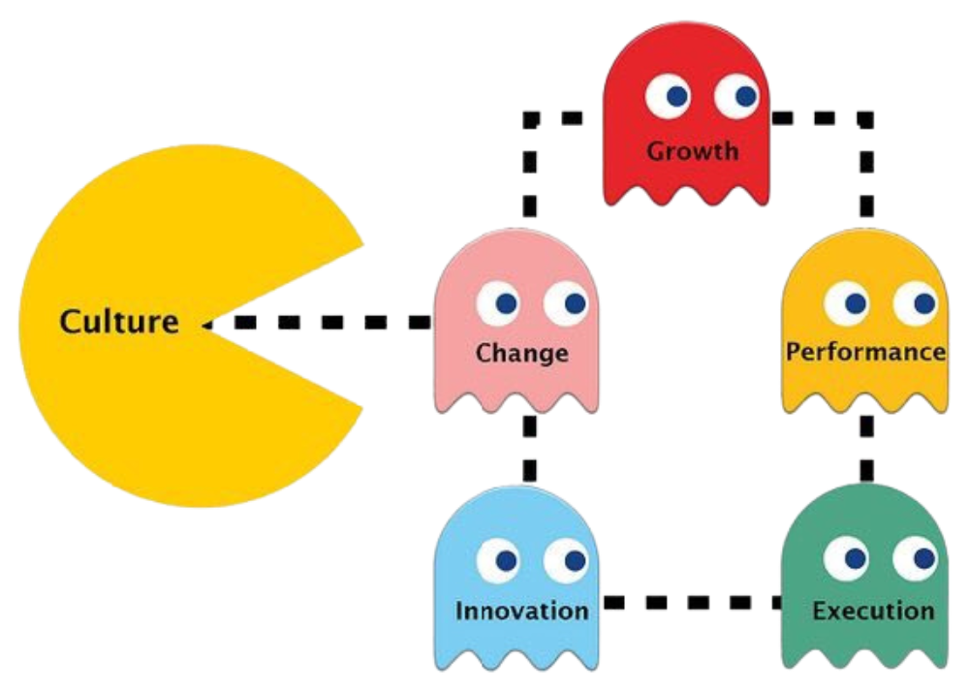
Organizational culture eats strategy for breakfast, lunch, and dinner
Organizational culture eats strategy for breakfast,
lunch, and dinner

Slide 26




A Framework for Transformation
Culture of Belonging Framework
A Framework for Transformation
Culture of Belonging Maturity Model
Culture of Belonging Organizational Assessment

Slide 27

How Do We Identify Equity Gaps?
How Do We Identify Equity Gaps?
Assess Your Organizational Performance

Slide 28


Culture of Belonging Assessment

Slide 29
Assessment will Identify 3 Equity Gaps
To Identify Equity Gaps
Performance Gaps
Lived-Experience Gaps
Resource Gaps
Assessment will identify 3 Equity Gaps

Slide 30
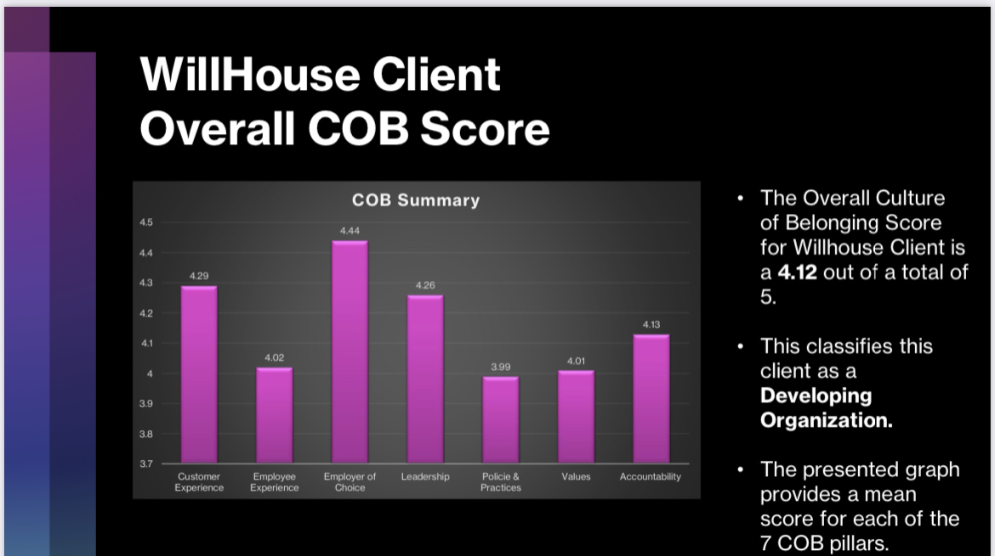
WillHouse Client Overall COB Score

Slide 31
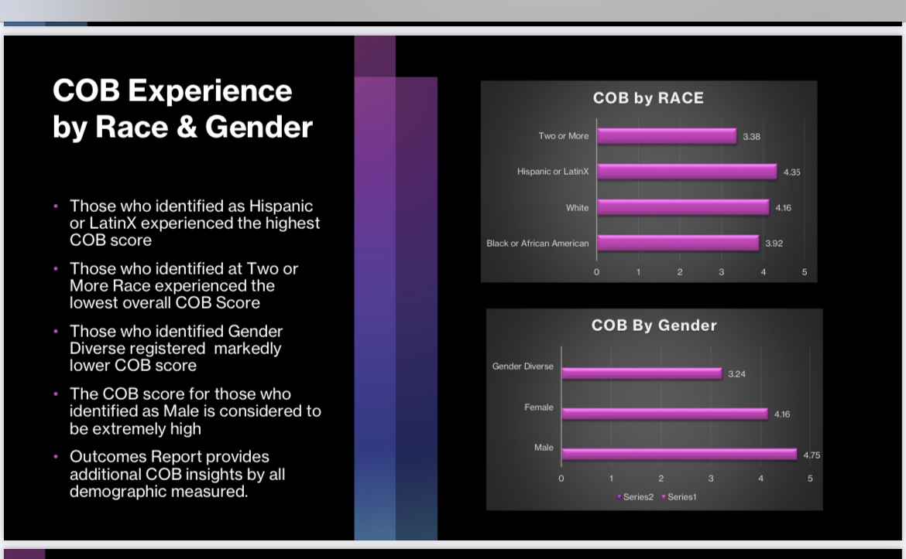
COB Experience by Race & Gender

Slide 32
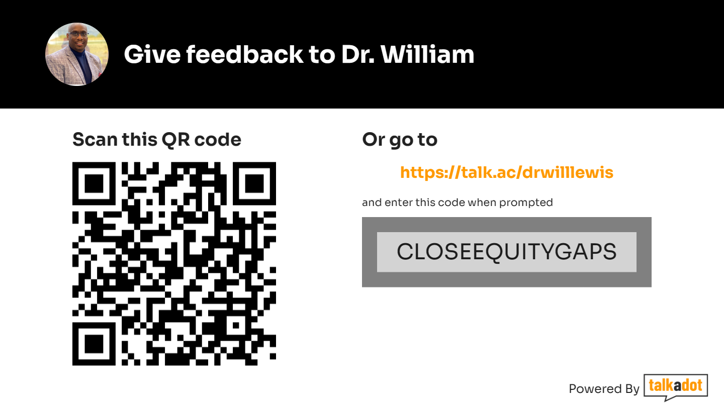
Dr. Wiliiam feedback

Slide 33
I Was Happy; Then I Went To Work Session Road Map Overview

Slide 34
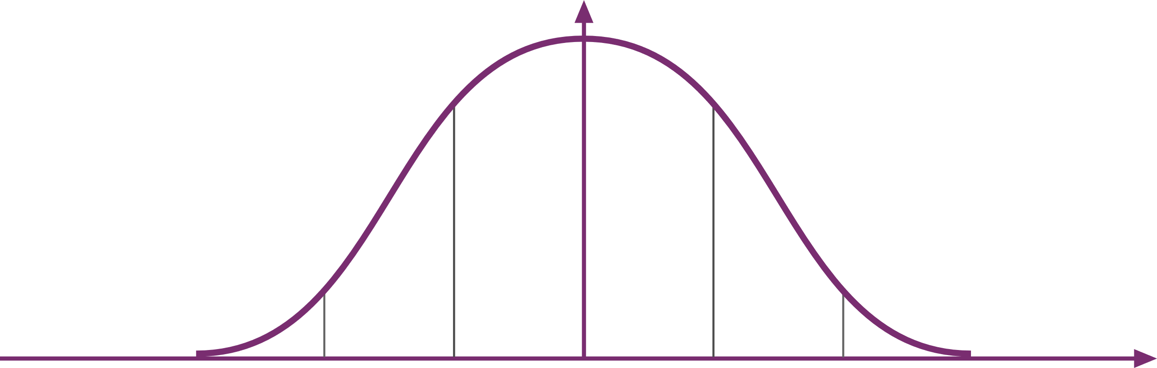
CRITICAL MASS
80%
All Employees
25%
+
10%
10%
Early Adopters
Skeptics
35% =

