Slide 1
Washington State Veterans Employee Resource Group
Notes:
Start on next slide

Slide 2
Introductions
Agenda:
Brief overview of BRGs & VERG, and their goals
Definition of "Veteran" by VERG and State of Washington
Discussion on Total Force: Active Duty, Guard, and Reserves
Veterans Demographics
This activity supports the U.S. military and its veterans; however, it is not officially connected to or endorsed by the U.S. Department of Defense or any of its branches
Notes:
John - Introductions:
Name, veteran affiliation, your 30 second story

Slide 3
Enhancing Veteran Inclusivity in Washington State Workforce
Disrupting current policies for greater equity and belonging
Notes:
John –
Welcome everyone and thank you for joining us today. Our presentation today will include topics that some may find difficult or triggering. We invite you to practice self care as you need to. We will be focusing on enhancing the veteran community's inclusivity within the Washington State agency workforce. We are here to discuss current policies, identify gaps, and propose solutions for greater equity and belonging for our veterans. We will begin by introducing ourselves.

Slide 4
Enhancing Veteran Inclusivity in Washington State Workforce Presenters
Presented by: VERG
Date: 06/12/2024
Presenters:
John Pestinger, Chair
Sarah MacLeod, Co-Chair
Beth Cram, Co-Chair
Angela Petty, Recruitment
Jay Chullanandana, Retention
Notes:
John -
I'm John and joining me here is Sarah. Together we will be laying the groundwork for today's discussion. Our organization, VERG, or the Veterans Employee Resource Group, is committed to veterans' Equity, Recruitment, Retention, Recognition, in accordance with Governor's Executive Order 19-01. We define 'Veteran' not just as recognized by law but as anyone who has served with honor, including active duty, reserve, and national guard. Let's look at the demographics and understand why this inclusivity is important.

Slide 5
VERG Purpose
The VERG exists to help integrate the experience, values, and knowledge of both veterans, service members, and spouses in state employment. The VERG shall provide advice and assistance to state agencies on veteran recruitment, retention, and development strategies in accordance with the Governor’s Executive Order 19-01.
Notes:
John –
The VERG exists to help integrate the experience, values, and knowledge of both veterans, service members, and spouses in state employment. The VERG shall provide advice and assistance to state agencies on veteran recruitment, retention, and development strategies in accordance with the Governor’s Executive Order 19-01.
https://www.dva.wa.gov/councils-committees/washington-veterans-employee-resource-group-verg

Slide 6
What is the VERG?
Recruit
Retain
Recognize
Notes:
John –
The mission of the VERG is to Recruit, Retain and Recognize, Veterans, their Spouses and their families. No one serves alone.

Slide 7
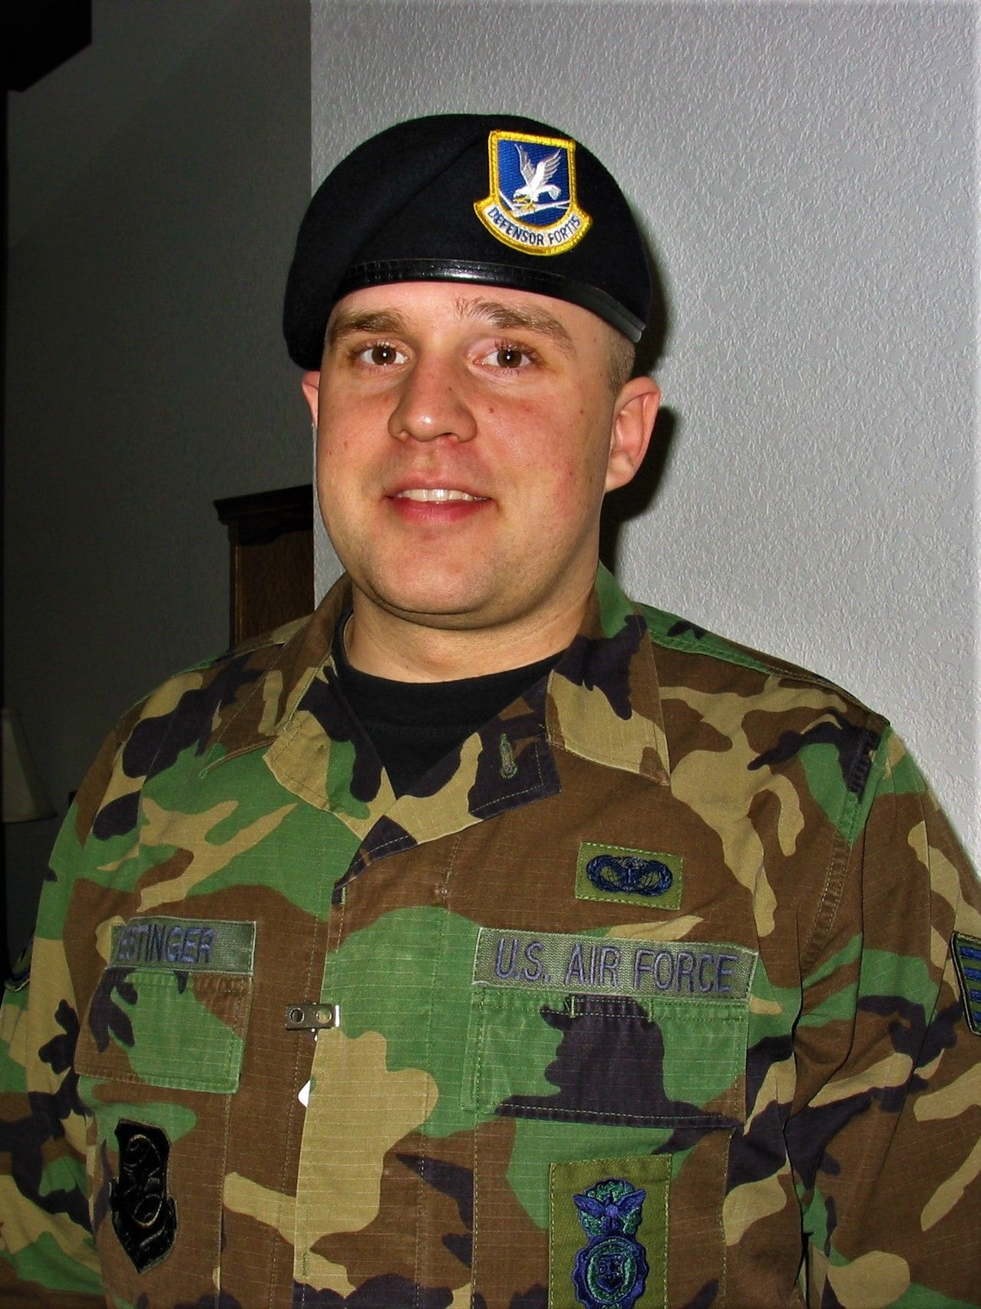
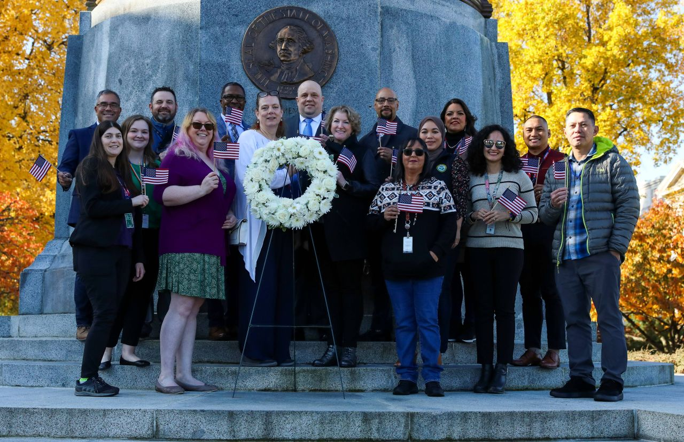
Who is the VERG?
Veterans
Spouses
Families
Community
Notes:
John –
The VERG is made up of Veterans, their Spouses, their families, and the community that supports them.

Slide 8
What is a Veteran?
Notes:
John –
What is a Veteran? It depends on who you ask and why? There are different definitions for the sake of different benefits. For the VERG, it is anyone who took the oath.

Slide 9
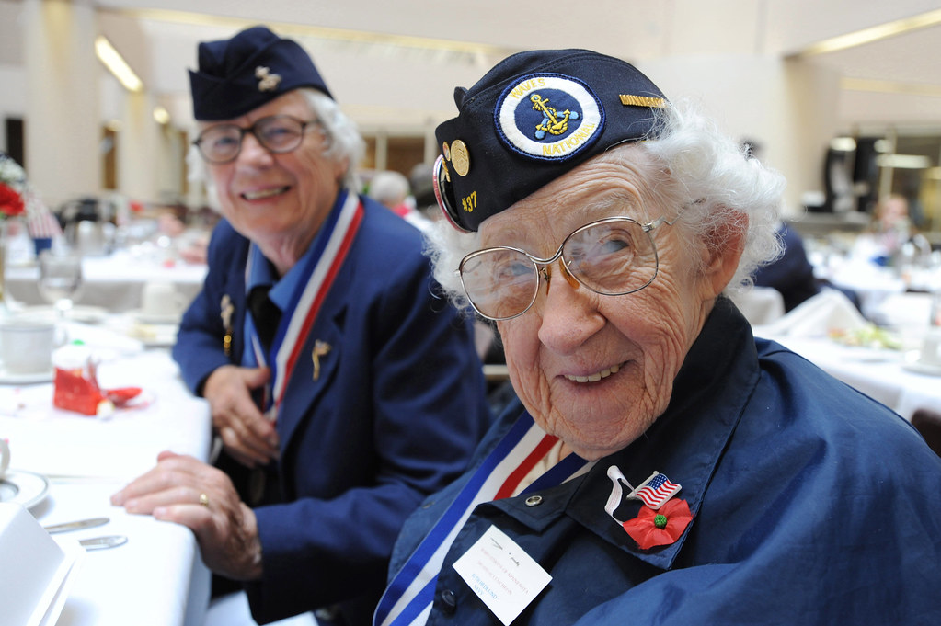
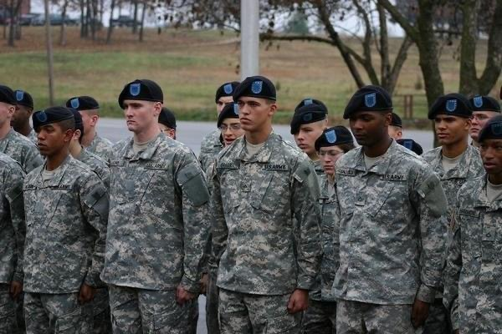
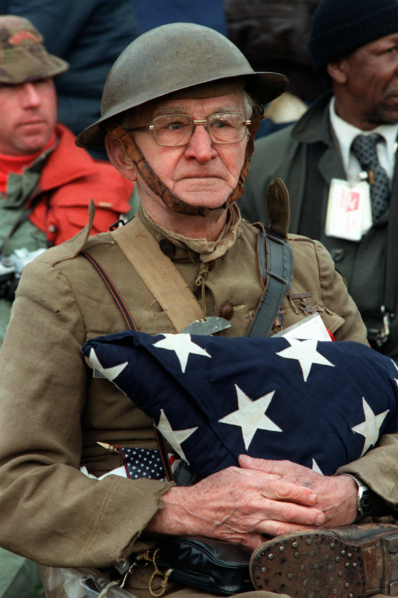
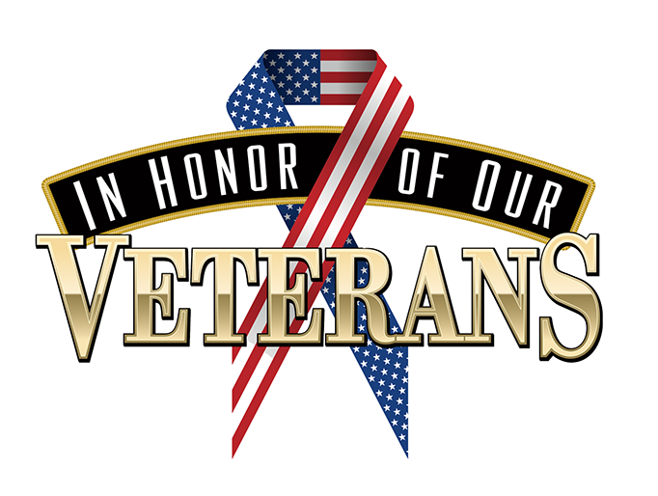
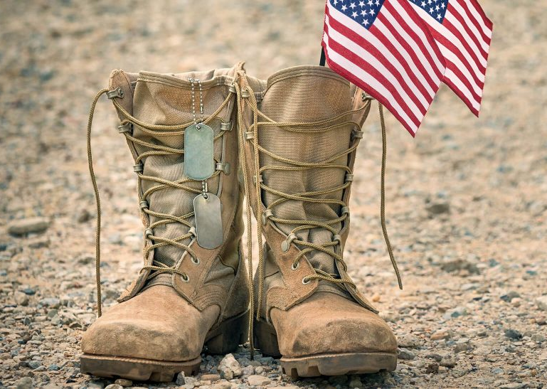
Definitions matter
Notes:
John -
Definitions matter
Definitions change
Benefits are affected
Equitable outcomes
June 6, 2024 the definitions of a Veteran changed
SSHB 2014, signed into law March 18, 2024
SSHB 2014 at leg.wa.gov
Session Law .pdf
Honorable Discharge
or
"Qualifying Discharge"
https://lawfilesext.leg.wa.gov/biennium/2023-24/Pdf/Bills/Session%20Laws/House/2014-S2.SL.pdf?q=20240402163356

Slide 10
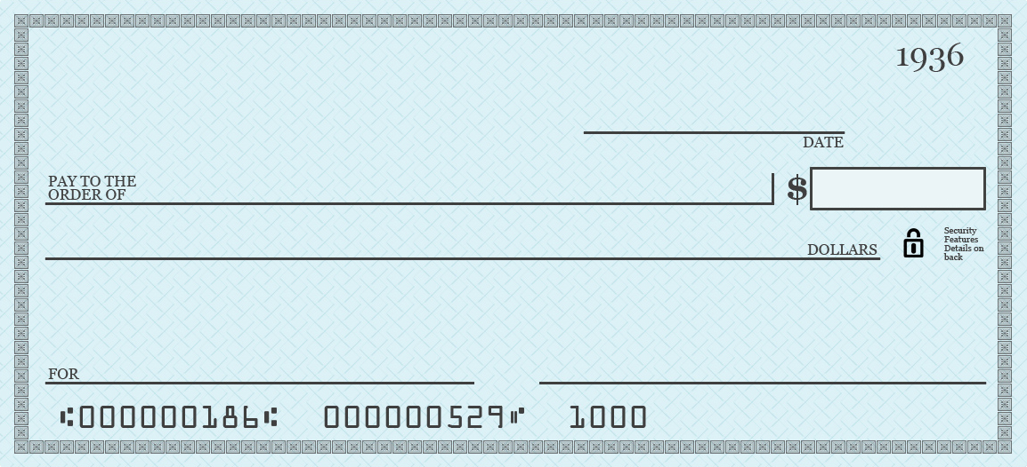
What is Open General?
United States of America
Anything the nation asks! Up to and including my life!
My Enlistment/Commission Oath
Notes:
John –
Taking the oath and signing up for Open General is giving the government:
A blank check for 8 years – long if stop lossed
I will do whatever you ask me to do
I will go wherever you decide to send me
I will give up my freedoms to fight for freedom for others
Up to and including giving my life for my country

Slide 11
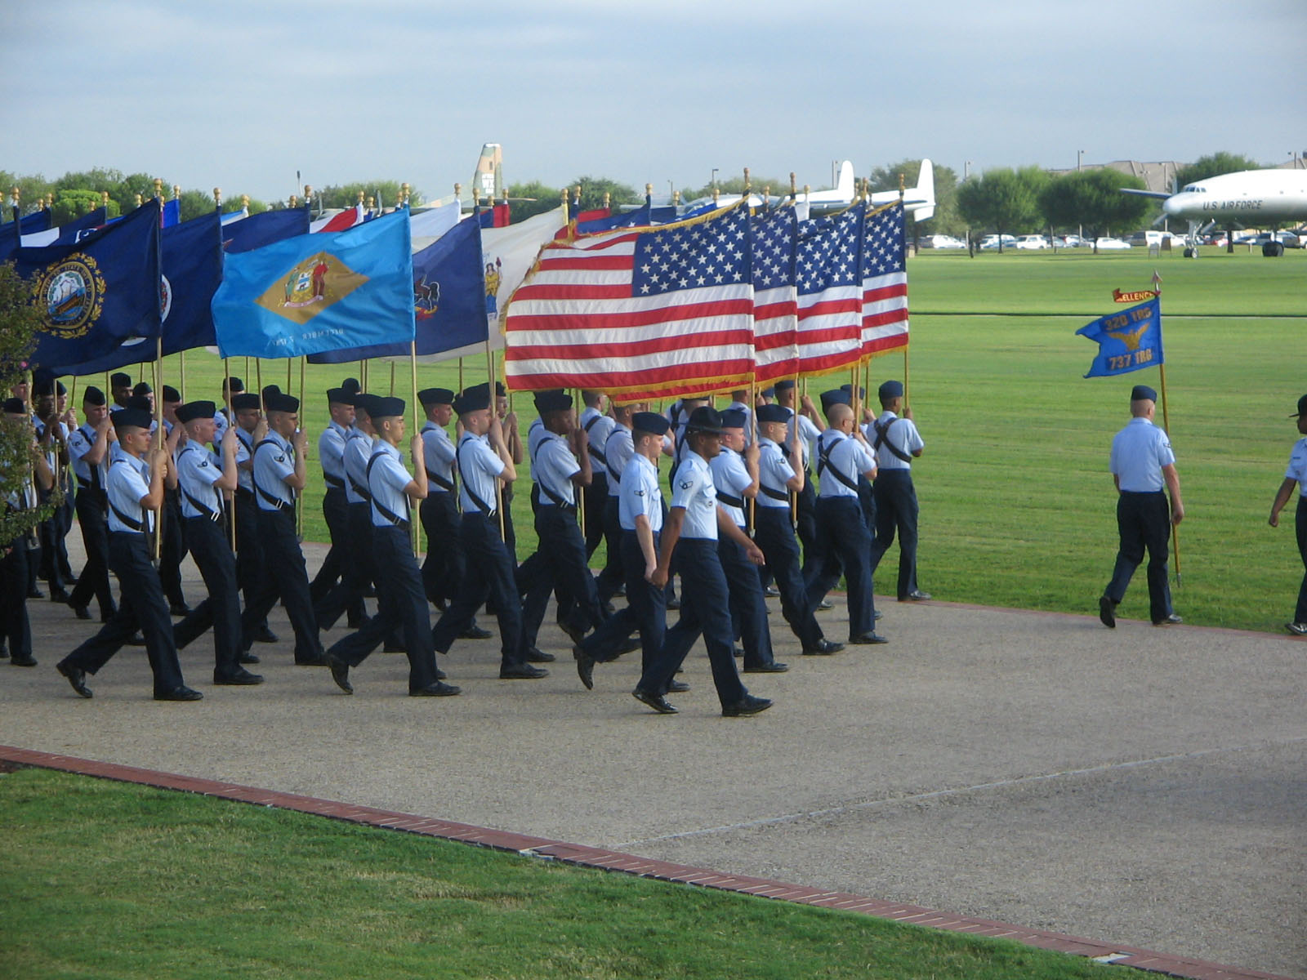
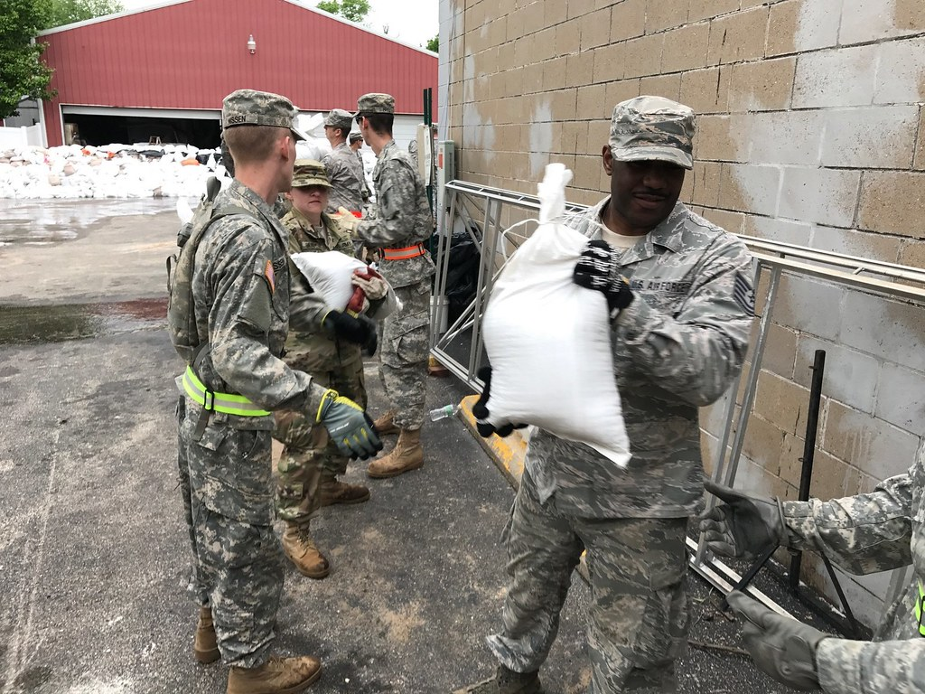
How do we serve?
Notes:
John -
Active Duty
Reserves (Active & Inactive)
National Guard (State)
Disaster response, such as 9/11, Oso Mudslide, COVID-19
And many more ways

Slide 12
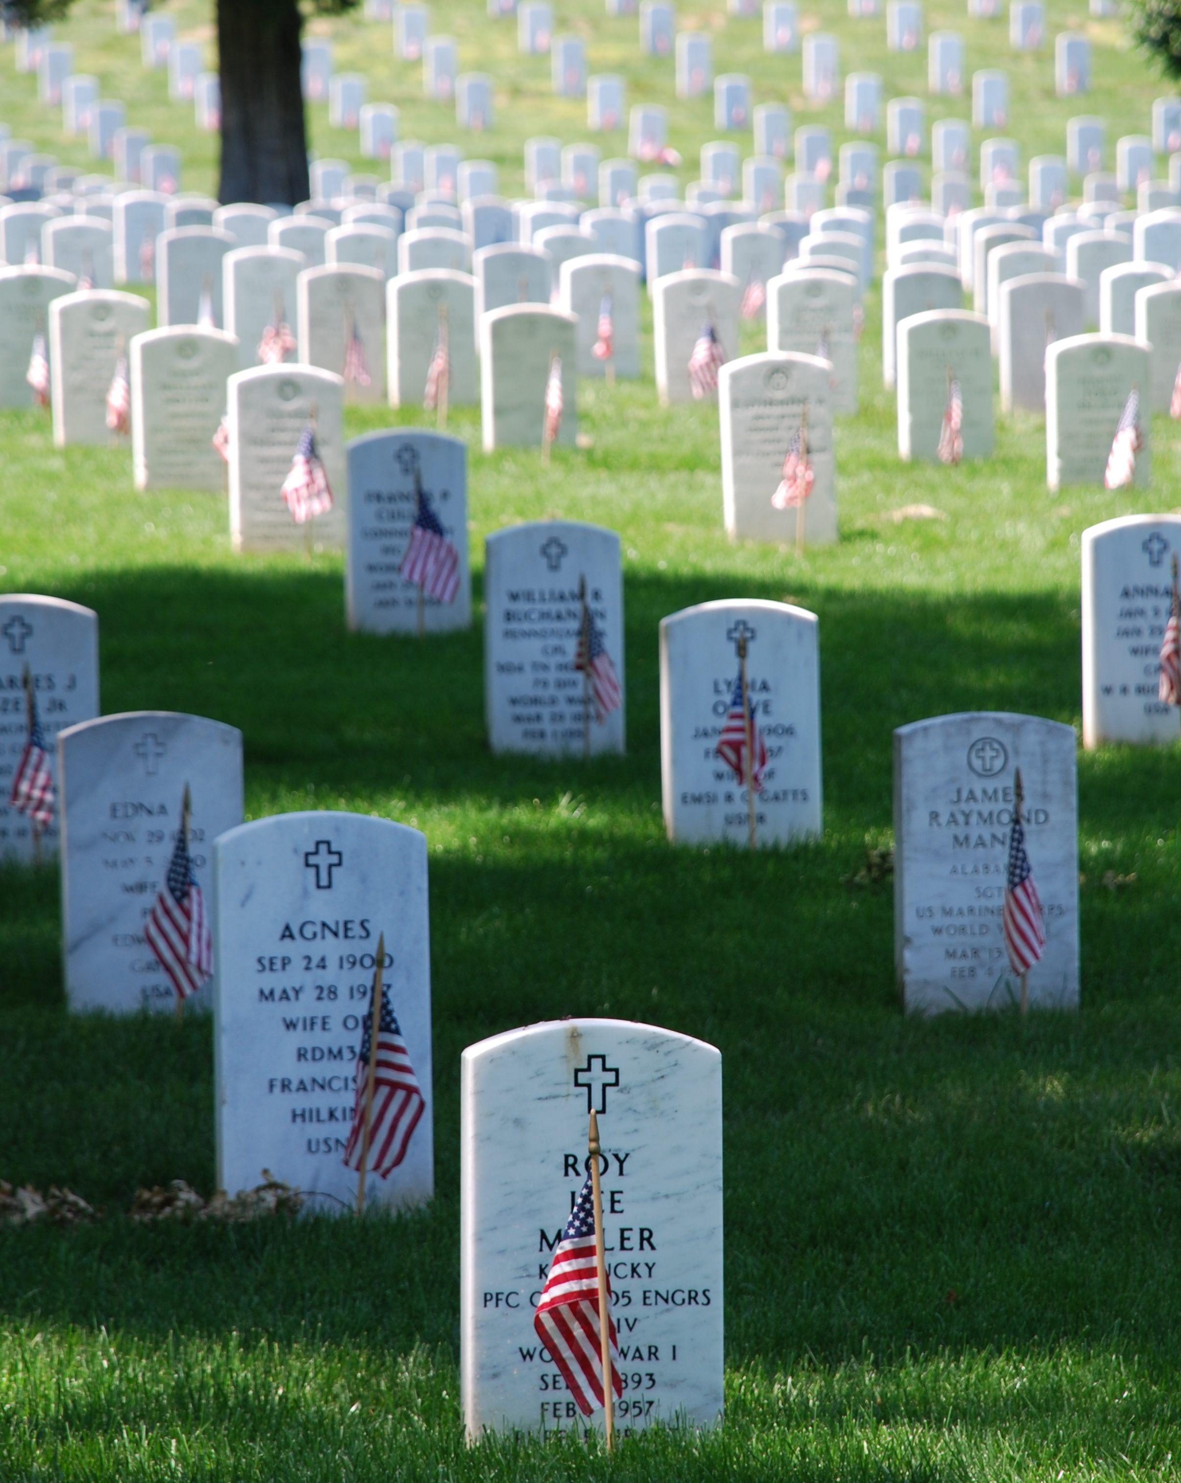
Memorial Day ≠ Veterans Day
Notes:
John -
Memorial Day is a day for mourning the U.S. military personnel who died while serving in the United States armed forces. Observed on the last Monday in May.
Veterans Day is a day for recognizing and celebrating those who served in the United States armed forces. Observed on November 11th each year.

Slide 13
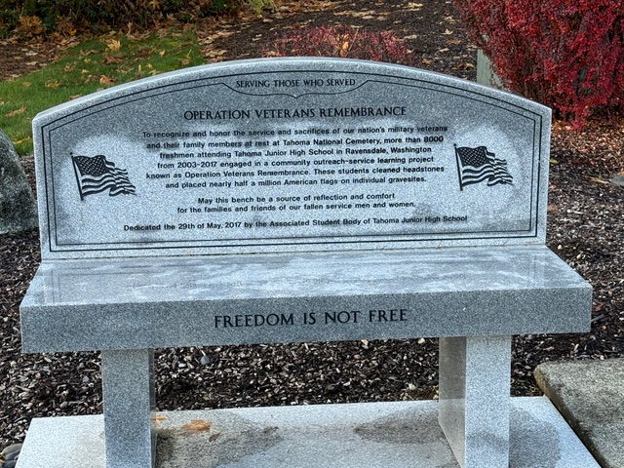
Memorial Day
Notes:
John -
Memorial Day: A day that is not for celebration, but a day for us to remember and honor our fellow service members who made the ultimate sacrifice in the line of duty.
This is a day of collective memory and gratitude, where the cost of freedom and the weight of its price is felt most deeply. For us veterans, it is a time of reflection on the bonds formed during our time in service. Where we remember the moments of fear, bravery, and loss that defined our military life. Each name that we remember, is a stark reminder of how fragile life truly is and the enduring strength of the oath to serve our country, up to and including giving our life.

Slide 14
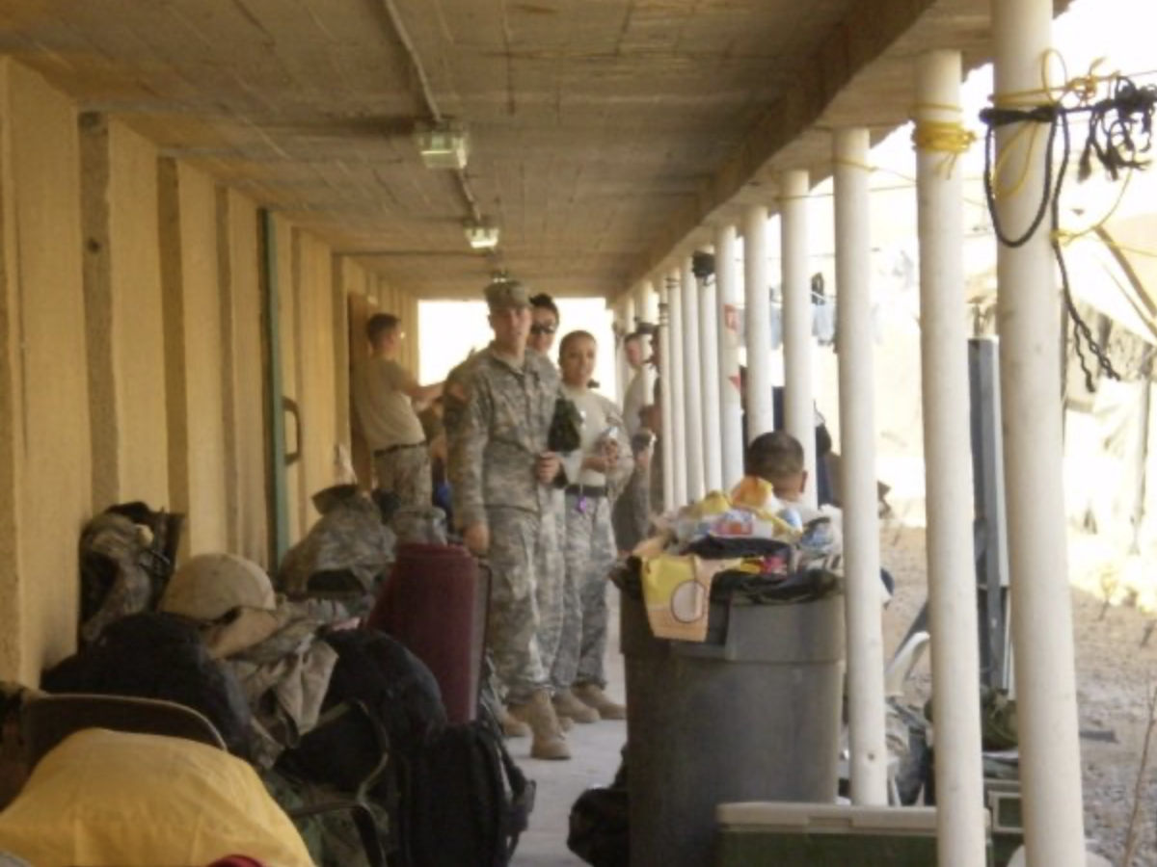
Veteran's Day
Notes:
Veteran's Day: Unlike Memorial Day, where we remember those of us who served and made the ultimate sacrifice, Veteran's Day is a celebration of service. We honor all of the people, past and present, who served regardless of if their service was in time of war or in time of peace.
For members of the public, Veteran's Day is an opportunity to recognize and thank veterans for their service. For the Veteran community, it is much more. It is a day with mixed emotions, ranging from pride in our service to reflection on sacrifices that we and our comrades made. Veteran's Day is a day to remember that while our time of service may have ended, our dedication to our country, our community, and to each other endures.

Slide 15
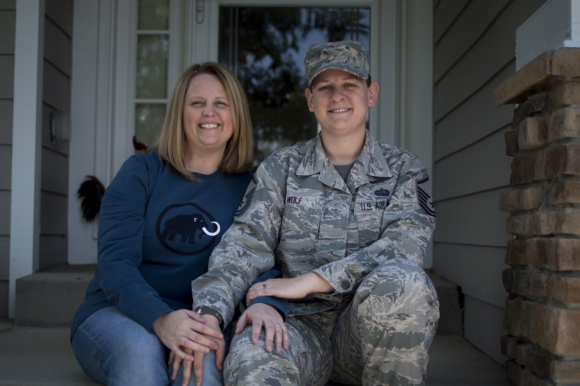
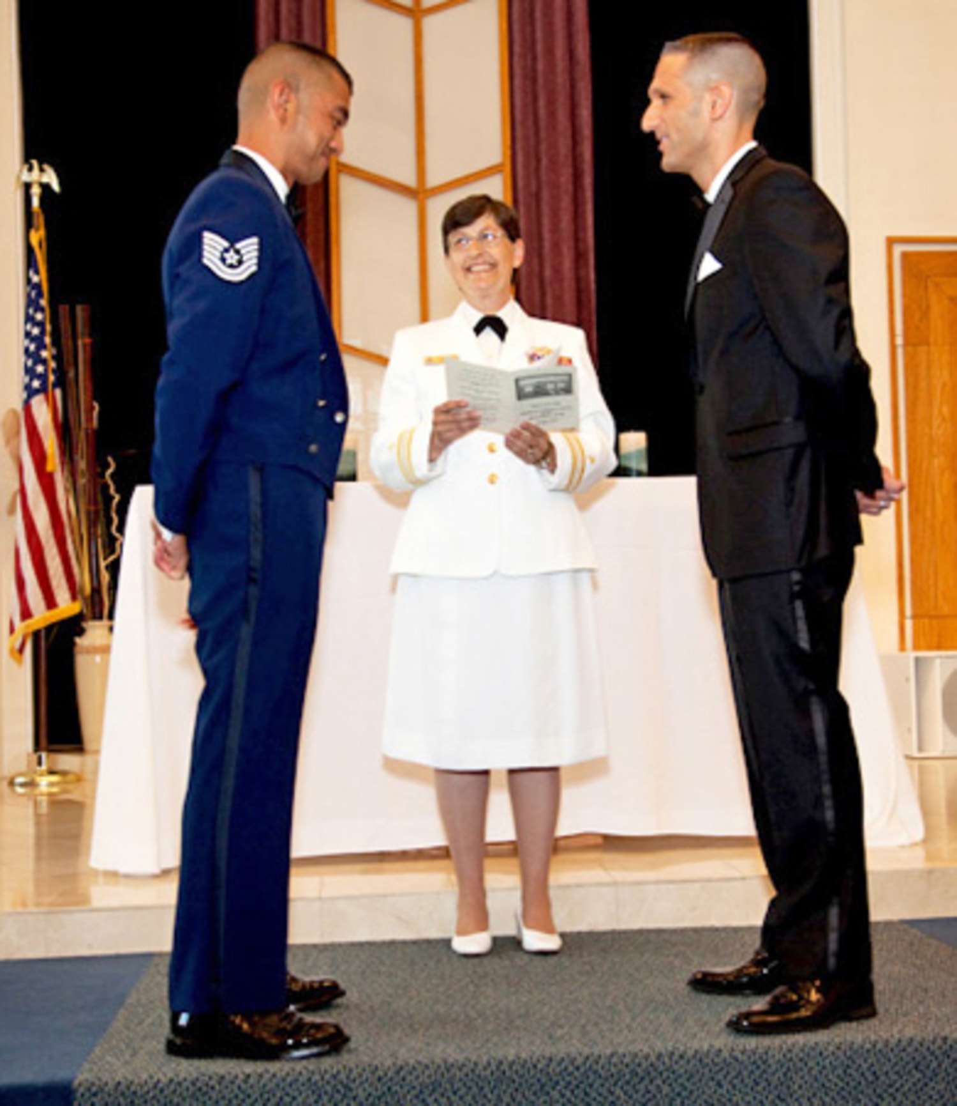
Military Spouses
Notes:
https://www.nationalmilitaryspousenetwork.org/public/images/2021_White_Paper_NMSN.pdf
The toughest job in the military!
In April of 2020 when the unemployment rate peaked at 14.7% it was still 10 percentage points below the 25% rate that military spouses experience. During the pandemic, the rate may have increased to 30%-35%.
92% are female and one third of military spouses are married with children. Two-thirds are under 35 years old.
Highly educated with 40% having a college degree – yet experience 4 times the unemployment rate of peers of whom 30% have a college degree.
Not a federally protected class and are routinely discriminated against.
Washington does better than average in employing military spouses but there is lots of room for improvement.
https://www.militaryonesource.mil/relationships/support-community/lgbtq-in-the-military/
Since 2011, openly gay, lesbian and bisexual men and women have been permitted to serve in the military. Acceptance for LGBTQ in the military expanded with the lifting of the transgender ban in 2021.
Another barrier was lifted in 2013 when spousal and family benefits were extended to same-sex married partners in the military. After ending temporarily in 2016, the ban on transgender individuals was again rescinded in 2021, allowing those who don’t identify with their biological gender to enlist and serve in the armed forces.

Slide 16
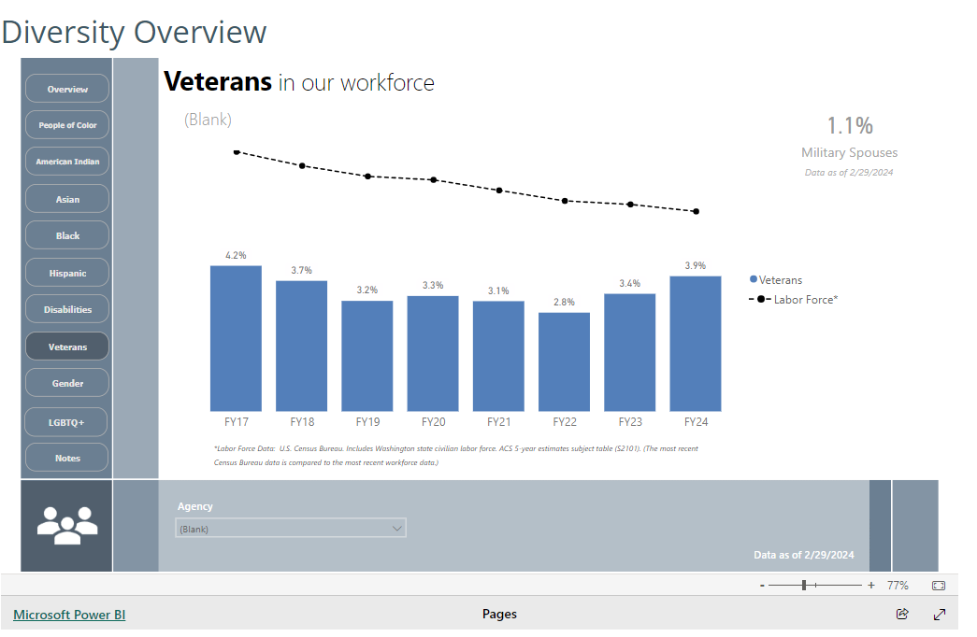
Military Spouses In State Employment
This is current data from Office of Financial Management.
Military Spouses employed with the State of Washington is 1.1%.
This is all self-reported.
Notes:
https://ofm.wa.gov/state-human-resources/workforce-data-and-planning/hr-management-report/diversity-overview
This information can be done by agency if you go to the OFM website.

Slide 17
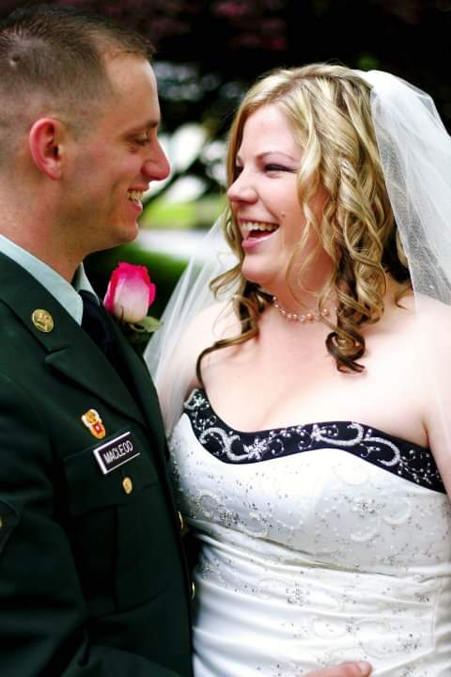
Military Spouses & Family Impact
The 2021 Survey of Active Duty Spouses found that spouse employment remained steady since 2019, while the percentage of spouses employed in their area of education or training rose significantly over the same period. The survey also found that 25% of spouses experienced food insecurity, and only 49% said they were satisfied with military life, down from 56% in 2019. ​
Notes:
Sarah’s lived experience

Slide 18
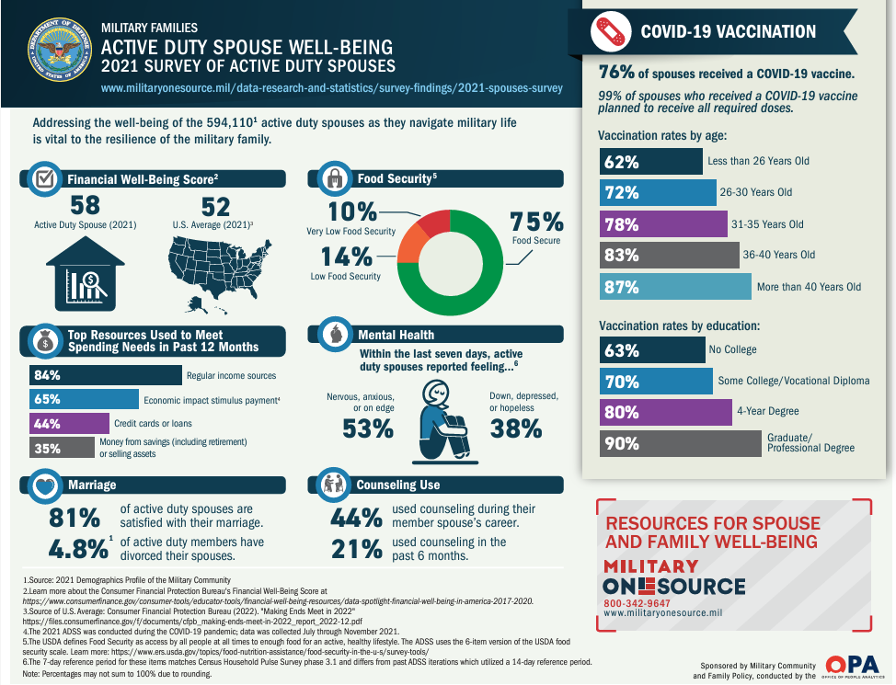
Family Impact
Notes:
Sarah -
chrome-extension://efaidnbmnnnibpcajpcglclefindmkaj/https://download.militaryonesource.mil/12038/MOS/Infographic/2021-adss-spouse-employment-and-education.pdf
https://www.militaryonesource.mil/data-research-and-statistics/survey-findings/2021-spouses-survey/

Slide 19
Veterans Preference Policies
Recognizing that sacrifices are made by those serving in the Armed Forces, Washington State has enacted laws to assist veterans seeking State employment. Veterans of the Armed Forces as defined in RCW 41.04.005 have been given some degree of preference in appointments to state jobs. (WAC 357-16-110)
Notes:
What is Veteran preference?- It is recognizing the sacrifices are made by those serving in the Armed Forces ( Army, Navy, Marines, Air Force, and Coast Coast), Washington State has enacted laws to assist veterans seeking State employment and receiving some degree of preference in appointments to state jobs under Washington State Law.
Who qualifies for Veteran Preference when applying for state employment includes:? RCW 41.04.007 defines Veteran as: A Veteran defined as every person who has received an honorable discharge, received a discharge for medical reasons with an honorable record, where applicable, or is in receipt of discharge paperwork that characterizes their service honorable, and who has served in at least one of the following capacities:
(1) As a member in any branch of the armed forces of the United States, including the national guard and armed forces reserves, and has fulfilled his or her initial military service obligation;
 (2) As a member of the women's air forces service pilots;
 (3) As a member of the armed forces reserves, national guard, or coast guard, and has been called into federal service by a presidential select reserve call up for at least one hundred eighty cumulative days;
 (4) As a civil service crewmember with service aboard a U.S. army transport service or U.S. naval transportation service vessel in oceangoing service from December 7,1941, through December 31,1946;
 (5) As a member of the Philippine armed forces/scouts during the period of armed conflict from December 7,1941, through August 15,1945; or
 (6) A United States documented merchant mariner with service aboard an oceangoing vessel operated by the department of defense, or its agents, from both June 25,1950, through July 27,1953, in Korean territorial waters and from August 5, 1964, through May 7,1975, in Vietnam territorial waters, and who received a military commendation.
Surviving spouses or registered domestic partners of eligible veterans
Preference- Competitive Service:
If an employer administers an examination prior to certification, the employer must grant preference to veterans as defined in RCW 41.04.007, by adding veterans' scoring criteria status in accordance with RCW 41.04.010.
For purposes of complying with RCW 41.04.010, examination is defined as eligible candidate's final examination score, plus any veterans' scoring criteria or other applicable results. Veterans' scoring criteria is only added to passing score. (See WAC 357-01-170)
Veterans' preference is a percentage added to the passing examination score for honorably discharged veterans and disabled veterans. The percent preferences, from RCW 41.04.010 are added as follows:
Ten percent veterans' preference score
Ten percent to a veteran who served during a period of war or in an armed conflict as defined in RCW 41.04.005 and does not receive military retirement. The percentage shall be added to the passing mark, grade, or rating of competitive examinations until the veteran's first appointment. The percentage shall not be utilized in promotional examinations.
Five percent veterans' preference score - Period of war
Five percent to a veteran who did not serve during a period of war or in an armed conflict as defined in RCW 41.04.005 or is receiving military retirement. The percentage shall be added to the passing mark, grade, or rating of competitive examinations until the veteran's first appointment. The percentage shall not be utilized in promotional examinations.
Five percent veterans' preference score - Active duty
Five percent to a veteran who was called to active duty while employed with the state or any of its political subdivisions, or municipal corporations. This percentage shall be added to promotional examinations until the first promotion only. All veterans' scoring criteria may be claimed upon release from active military service, or upon receipt of separation orders indicating an honorable discharge, issued by the respective military department.
Preference - Non-Competitive Service
If no examination is administered prior to certification, the employer must refer eligible veterans eligible veterans' surviving spouses or surviving registered domestic partners, or the spouse or registered domestic partner of an honorably discharged veteran who has a service connected permanent disability or total disability to the employing official under the provisions of RCW 73.16.010 as long as the veteran or veteran's spouse or registered domestic partner meets the competencies and other position requirements.

Slide 20
Veteran’s Preference and Special Hiring Authorities
Notes:
Angela -
M28R.VI.A.8 (va.gov) Veterans’ preference is a tool to assist in the placement of Veterans in federal government positions, providing a “first consideration.” Veterans’ preference was established by the Veterans’ Preference Act of 1944, as amended, and is found in various provisions of 5 U.S.C. 2108. Veterans’ preference applies to permanent and temporary positions in both the competitive and excepted services, which are two classes of jobs in the 8-2 M28R, Part VI, Section A, Chapter 8 Revised July 2, 2014 federal government. For the competitive service, applicants must compete with other individuals for positions that are posted on the USAJOBS website through a structured process. In the excepted service, applicants such as Veterans with disabilities may be noncompetitively considered and hired through a number of special appointing authorities that agencies may utilize to fill jobs. The excepted service contains certain agencies and entities, groups of individuals, and positions that are outside the competitive service.
The Washington legislature unanimously passes a bill to help over 35,000 Veterans access state benefits. Right now Washington does not extend veteran benefits to service members who were less honorably discharged. The House Bill(HB) 2014 will ensure Veterans who qualify for federal benefits also qualify for state benefits. Any Veteran discharged solely for their sexual orientation or gender identity will qualify for state benefits, even if they do not qualify for federal benefits. This will go into affect on June 6, 2024.

Slide 21
Millennial Veterans
Notes:
John -
Let's focus on Millennial Veterans. The average age of a millennial veteran is now 37 according to the 2020 US Census. Their participation in Washington State agency employment is significantly lower than other generations. Understanding the 'why' behind this trend is the first step towards bridging this gap. When we look at the total number of veterans employed in State service millennial veterans are employed with Washington State agencies at around 3%, most other generations of veterans are employed with Washington State agencies at around the 10% level.
Since the beginning of the wars in Afghanistan and Iraq in 2001, over 1.9 million US military personnel have been deployed in 3 million tours of duty lasting more than 30 days (Institute of Medicine (US) Committee on the Initial Assessment of Readjustment Needs of Military Personnel, Veterans, and Their Families. Returning Home from Iraq and Afghanistan: Preliminary Assessment of Readjustment Needs of Veterans, Service Members, and Their Families. Washington (DC): National Academies Press (US); 2010. 2, OPERATION ENDURING FREEDOM AND OPERATION IRAQI FREEDOM: DEMOGRAPHICS AND IMPACT. Available from: https://www.ncbi.nlm.nih.gov/books/NBK220068/)

Slide 22
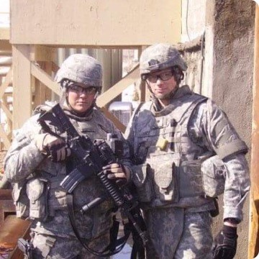
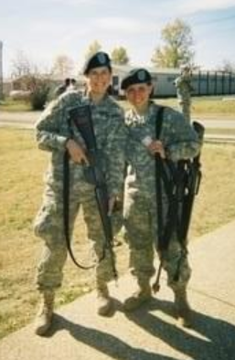
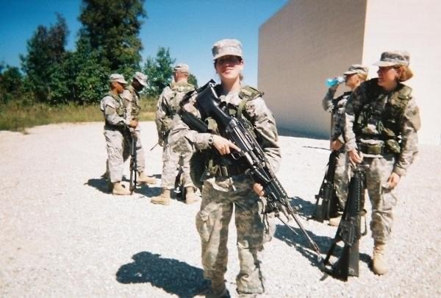
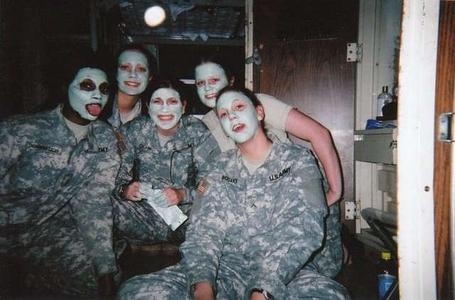
Born 1981-1996
OEF/OIF
Notes:
John -
Women make up a growing share of veterans. About 1.7 million, or 9% of veterans, were women in 2018. It is projected that number will jump to 17% by 2040. Veterans from recent service periods have the highest levels of education. More than three-quarters of Post-9/11 and Gulf War veterans had at least some college experience, and more than one-third of Gulf War veterans had a college degree.
Post-9/11 veterans had a 43% chance of having a service-connected disability, after accounting for differences in demographic and social characteristics among veterans —significantly higher than that of veterans from other periods.
Among veterans who had a service-connected disability, Post-9/11 veterans had a 39% chance of having a disability rating of 70% or more — significantly higher than for veterans from other periods.
This report uses data from the 2018 American Community Survey (ACS).

Slide 23
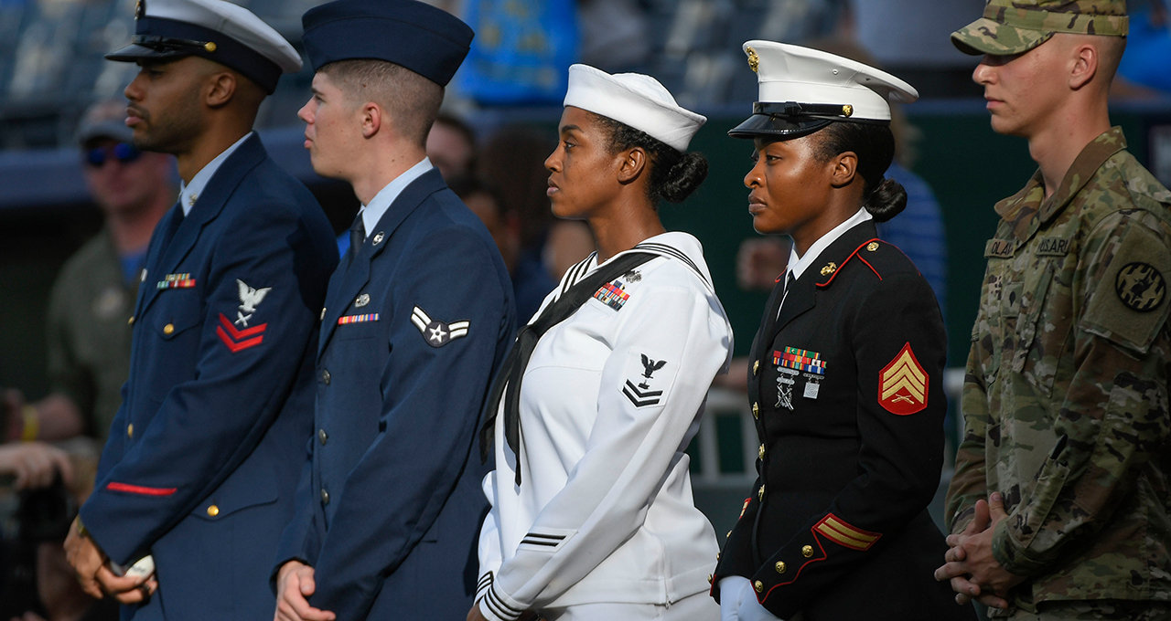
Legal framework and challenges
Notes:
Jay

Slide 24
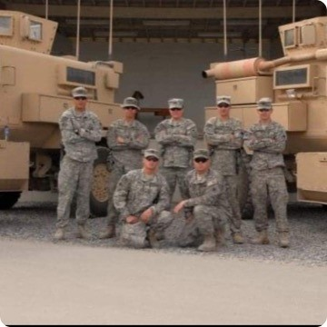
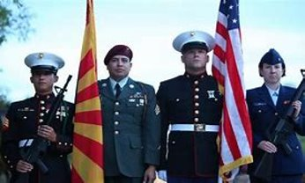
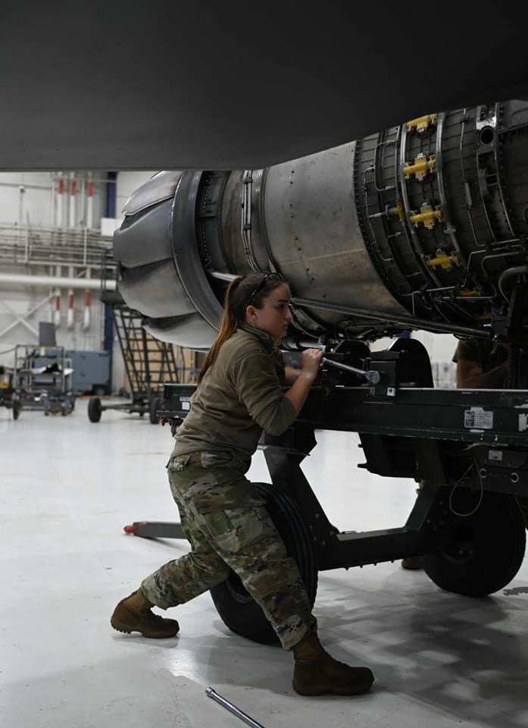
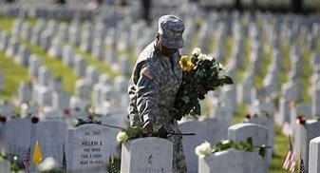
Notable Wars
World War I (Jully 28 1914 – Nov 11,1918)
World War II (Sept 1,1939 –Sept 2,1945)
Korean War (July 25, 1950 – July 27,1953)
Vietnam War (Nov 1,1955 – April 30,1975)
Gulf War (Aug 2,1990 – Feb 28,1991)
Afghanistan War (Oct 7, 2001– Aug 30, 2021)
Iraq War (Mar 20, 2003 – Dec 15, 2011)
Notes:
Jay -
World War I
World War II
The Korean War
The Vietnam War
The Gulf War
The Afghanistan War
The Iraq War
The Afghanistan War is the longest war in U.S. history.
The Iraq war was one of the longest and most divisive conflicts in U.S. History. More than 4,400 American military members have been killed and over 1 million troops were injured since the U.S. and its allies invaded Iraq in March 2003.
The Vietnam War was one of the most controversial wars in American History. It lasted 103 months, and more than 50,000 soldiers lost their lives. The Vietnam and Afghanistan wars have this much in common: they are both distant, profoundly complex, and ill-understood campaigns. Not surprisingly, they defied easy resolutions.
Photo credit:
Bottom left: U.S. Air National Guard photo by Airman 1st Class Tylin Rust
Bottom middle right: U.S. Navy Photo by Hendrick L. Dickson/Released
Top right: Photo provided by Jennifer Gaines.

Slide 25
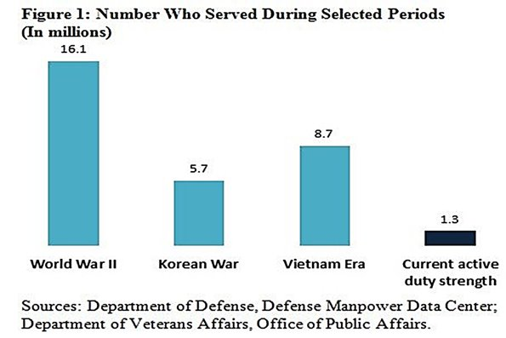
Draft vs. volunteer forces
Notes:
Jay
According to the U.S. Census Bureau, the U.S. veteran population totals nearly 20 million men and women living in the United States and Puerto Rico who have served on active duty in the U.S. Army, Navy, Air Force, Marine Corps or Coast Guard. These veterans served for different lengths of time and during different wartime and peacetime periods. They entered the military at different ages and came from different backgrounds. Some were drafted, while others volunteered.
Their differences make each veteran unique and influence the size and overall characteristics of veterans as a group. We can think of veterans as two main cohorts — “draft era” and “All Volunteer Force” (AVF). Draft-era veterans are mainly those veterans who served in the military during the Vietnam era, Korean War or World War II. Forty-eight years ago, in 1973, the draft ended and the AVF began. The draft-era military was substantially larger than today’s AVF.
To put this into perspective, 16 million people served in World War II, 6 million served in the Korean War and 9 million served during the Vietnam era, according to this Department of Defense chart. In contrast, AVF active-duty military strength has remained under 2 million each year since the 1990s. In 2015, there were just under 1 million living World War II veterans, 70 years after the end of the war, while the active duty military size was about 1.3 million service members.

Slide 26
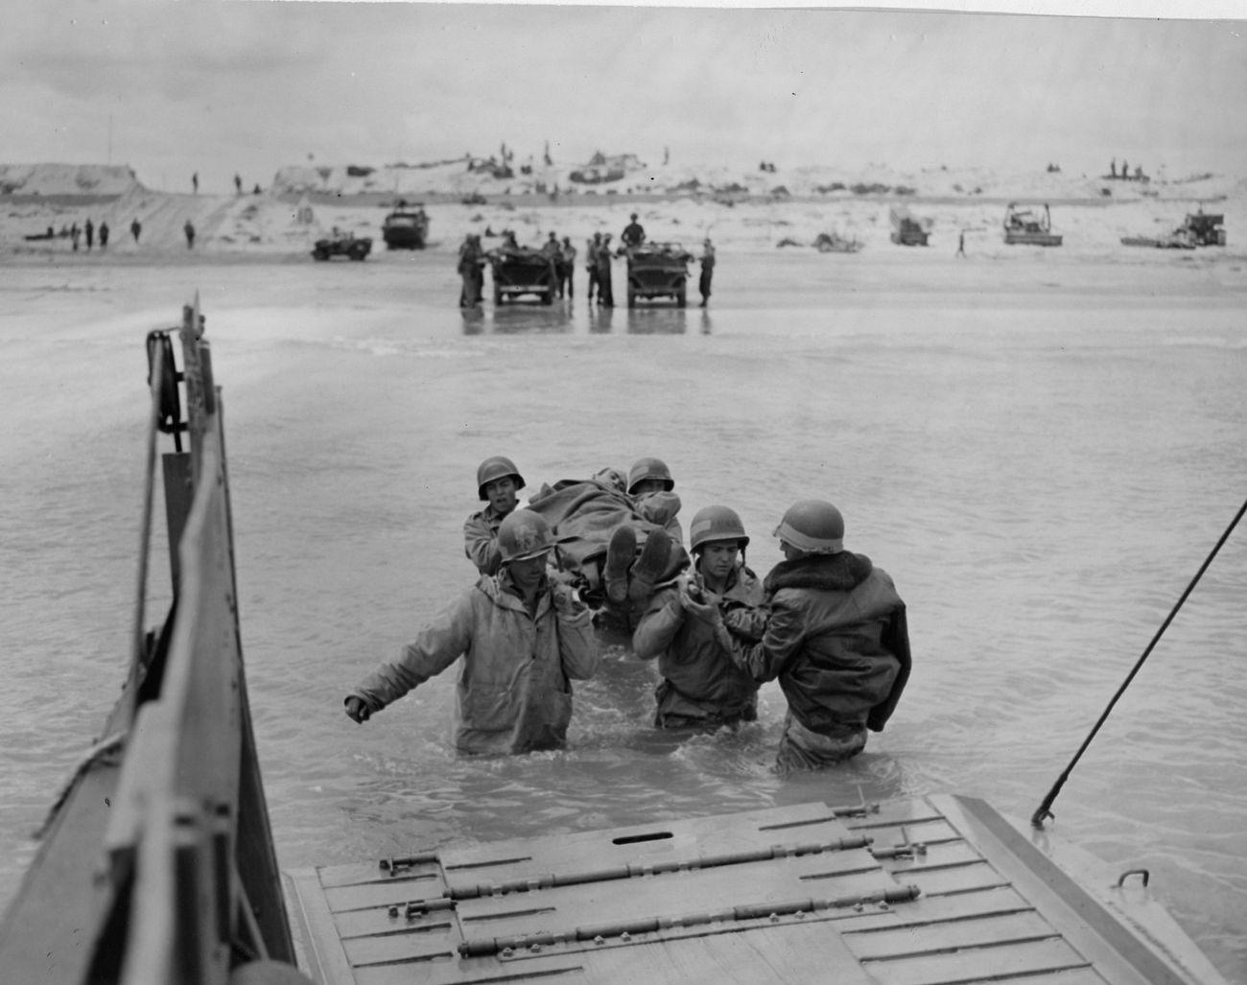
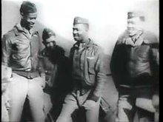
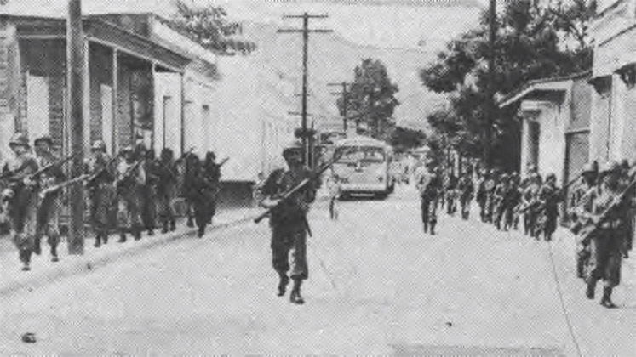
Minority Participation in the Military during WW II
Notes:
John -
African American 901,896
Puerto Rican 51,438*
Japanese American 33,000
American Indian 20,000
Chinese American 13,311
Filipino American 11,506
Hawaiian 1,320
*Full Latino numbers are not known because Latinos, other than Puerto Ricans, did not serve in segregated units, like African Americans.
https://www.nationalww2museum.org/students-teachers/student-resources/research-starters/research-starters-us-military-numbers
https://www.nationalww2museum.org/students-teachers/student-resources/research-starters/research-starters-us-military-numbers

Slide 27
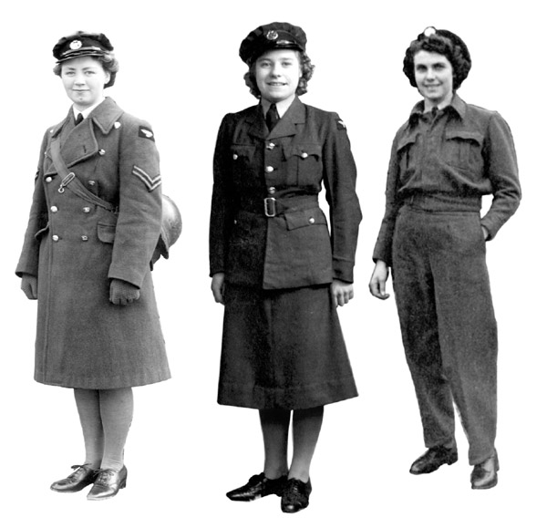
Women in the U.S. Military – WW II
Notes:
John
Women's Army Corps (WAC) 150,000
Navy’s Women Accepted for Voluntary Emergency Service (WAVES) 100,000
Coast Guard Women’s Reserves (SPARS) 10,000
Marine Corps Women’s Reserve 23,000
Army Nurse Corps 60,000
Navy Nurse Corps 14,000
Women’s Air Force Service Pilots (WASP) 1,074

Slide 28
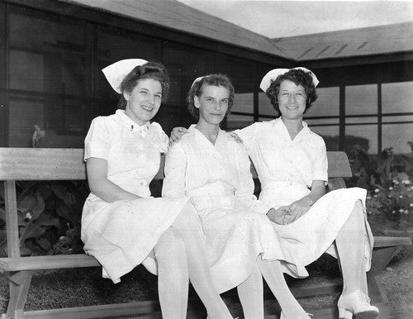
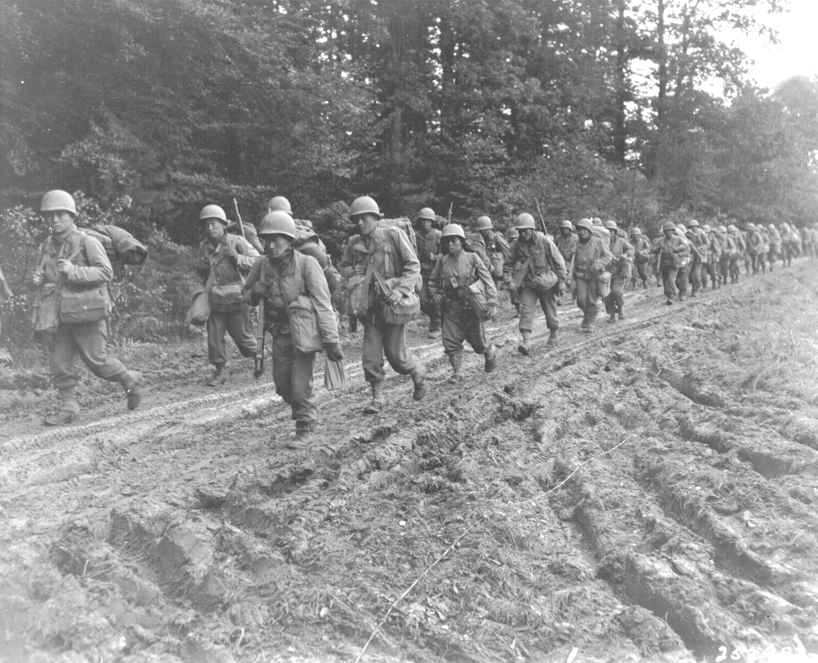
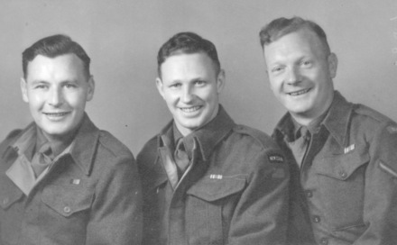
Profile of U.S. Servicemen WW II (1941-1945)
Notes:
John
38.8% (6,332,000) of U.S. servicemen and all servicewomen were volunteers
61.2% (11,535,000) were draftees
Average duration of service: 33 months
Overseas service: 73% served overseas, with an average of 16 months abroad
Combat survivability (out of 1,000): 8.6 were killed in action, 3 died from other causes, and 17.7 received non-fatal combat wounds
Non-combat jobs: 38.8% of enlisted personnel had rear echelon assignments—administrative, support, or manual labor.
Average base pay: enlisted—$71.33 per month; officer—$203.50 per month

Slide 29
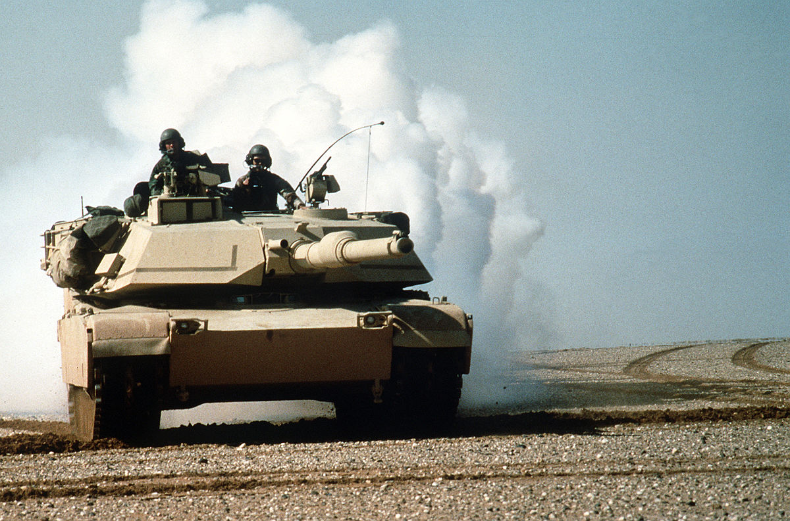
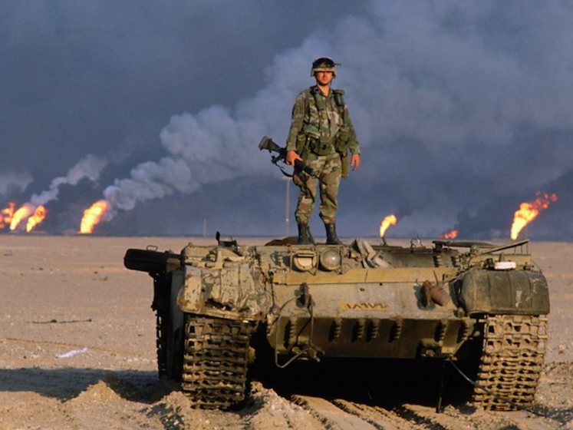
The changing face of America’s veteran population
Gulf War era Veterans now account for the largest share of all US Veterans
The share of the U.S. Population with military experience is declining
Veterans Affairs Projects suggest the number of living veterans will continue to decline over the next 25 years.
Notes:
John
There are around 19 million U.S. veterans as of this year, according to data from the Department of Veterans Affairs, representing less than 10% of the total U.S. adult population.
Gulf War-era veterans now account for the largest share of all U.S. veterans,
The share of the U.S. population with military experience is declining.
VA projections suggest the number of living veterans will continue to decline over the next 25 years.
The demographic profile of veterans is expected to change in the next quarter century.
Fewer members of Congress have prior military experience than in the past.
The Department of Veterans Affairs receives a relatively low favorability rating compared with other government agencies.
Americans continue to see veterans’ services as an important priority.
https://www.pewresearch.org/fact-tank/2021/04/05/the-changing-face-of-americas-veteran-population/
Gulf War-era veterans now account for the largest share of all U.S. veterans, having surpassed Vietnam-era veterans in 2016, according to the VA’s 2018 population model estimates. VA estimates for 2021 indicate there are 5.9 million American veterans who served during the Vietnam era and 7.8 million who served in the Gulf War era, which spans from August 1990 through the present. There are also around 240,000 World War II veterans and about 933,000 who served during the Korean conflict, the VA estimates. Some veterans served through multiple eras but are counted only in their earliest era. Roughly three-quarters (78%) of veterans in 2021 served during wartime, and 22% served during peacetime. (Veterans with wartime and peacetime service are only counted in wartime.)
The share of the U.S. population with military experience is declining. In 2018, about 7% of U.S. adults were veterans, down from 18% in 1980, according to the Census Bureau. This drop coincides with decreases in active-duty personnel. Over the past half-century, the number of people on active duty has dropped significantly, from 3.5 million in 1968, during the military draft era, to about 1.4 million (or less than 1% of all U.S. adults) in today’s all-volunteer force. The draft ended in 1973.
VA projections suggest the number of living veterans will continue to decline over the next 25 years. By 2046, the department estimates there will be around 12.5 million veterans, a decrease of about 35% from current numbers. By that time, Gulf War-era veterans are projected to make up a majority of those who served, and most veterans who served in the Vietnam era or earlier will have died.
The demographic profile of veterans is expected to change in the next quarter century. Currently, about nine-in-ten veterans (89%) are men, while about one-in-ten (11%) are women, according to the VA’s 2021 population model estimates. By 2046, the share of female veterans is expected to increase to about 18%. The number of female veterans is also projected to increase slightly, from around 2 million in 2021 to approximately 2.2 million in 2046. The number of male veterans, on the other hand, is projected to drop from about 17 million in 2021 to around 10.3 million in 2046.
As with trends in the U.S. population overall, the veteran population is expected to become more racially and ethnically diverse. Between 2021 and 2046, the share of veterans who are non-Hispanic White is expected to drop from 74% to 62%. The share of veterans who are Hispanic is expected to double from 8% to 16%, while the share who are Black is expected to increase slightly from 13% to 15%.
Projections also indicate that the veteran population will become slightly younger, with 33% of veterans being younger than 50 in 2046 compared with 27% in 2021, even as the overall U.S. population continues to age. The share of veterans ages 50 to 69 is expected to shrink from 36% to 33%, while the share of those 70 and older is predicted to be around a third of the total (34%) by 2046, slightly lower than the current share (37%).
Fewer members of Congress have prior military experience than in the past. As the share of Americans who are veterans has declined, so has the share of legislators who have previously served in the military. In the current Congress, 17% of lawmakers in both houses had prior military service, down drastically from just a few decades ago.
The share of senators who are veterans reached a post-Korean War peak of 81% in 1975, while the share among House members peaked in 1967 at 75%. However, in recent elections, both Democrats and Republicans have made special efforts to recruit veterans for congressional contests, and the newly elected freshman class includes 15 such lawmakers.
The Department of Veterans Affairs receives a relatively low favorability rating compared with other government agencies. The VA received the third-lowest rating among 10 agencies and departments in a Pew Research Center survey last spring. Roughly two-thirds of U.S. adults (65%) had a favorable view of the VA, and 22% expressed an unfavorable view. As with many of the agencies and departments in the survey, there were partisan differences in approval. Republicans and Republican-leaning independents expressed higher favorability for the VA (72%) than Democrats and Democratic leaners (61%).
A 2019 survey found veterans themselves had mixed feelings about the agency: 9% of veterans said the department was doing an excellent job meeting the needs of military veterans; 37% said the VA was doing a good job. About half said it was doing only a fair (37%) or poor (15%) job.
Americans continue to see veterans’ services as an important priority. In a March 2019 survey, a 72% majority of U.S. adults (and identical 72% shares of Republicans and Democrats) said that if they were making the federal budget, they would increase spending for veterans’ benefits and services – the highest share of all 13 program areas included in the survey, except for education (also 72%), and the second-highest level of support for increased spending on veterans services since the Center first asked the question in 2001.

Slide 30
Veteran Population Declines
Notes:
Jay -
Veteran Population Declines JUNE 02, 2020 https://www.census.gov/library/visualizations/2020/comm/veteran-population-declines.html

Slide 31
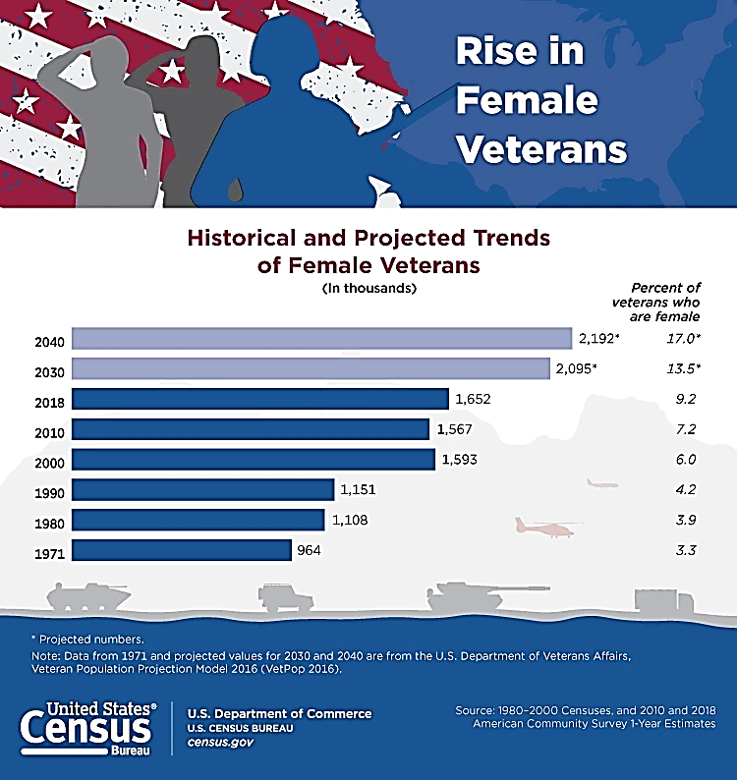
Rise in Female Veterans
Notes:
Jay June 02, 2020 https://www.census.gov/library/visualizations/2020/comm/veteran-population-declines1.html
Another fallacy is that all veterans are men. During the last two years of World War I, in 1917-1918, women were allowed to join the U.S. military and have served ever since, according to History.org. In December 2015, Defense Secretary Ash Carter stated that starting in 2016 all combat jobs would be open to women. Today, the U.S. Census reports that 1 in 12 veterans are women.

Slide 32
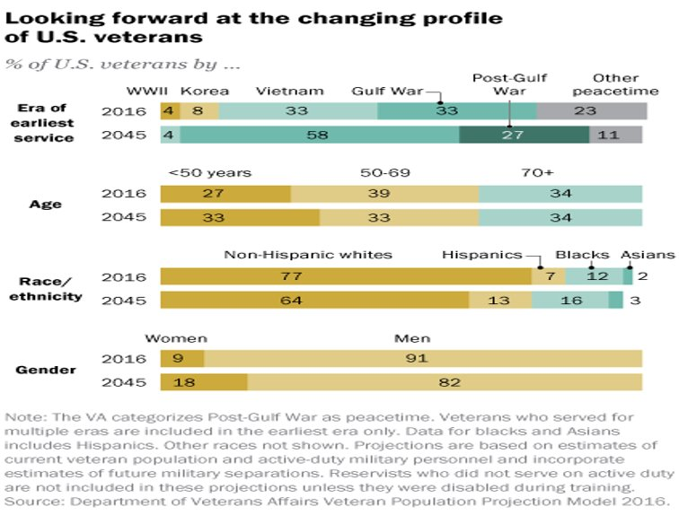
Looking forward at the changing profile of U.S. veterans
Notes:
jay

Slide 33
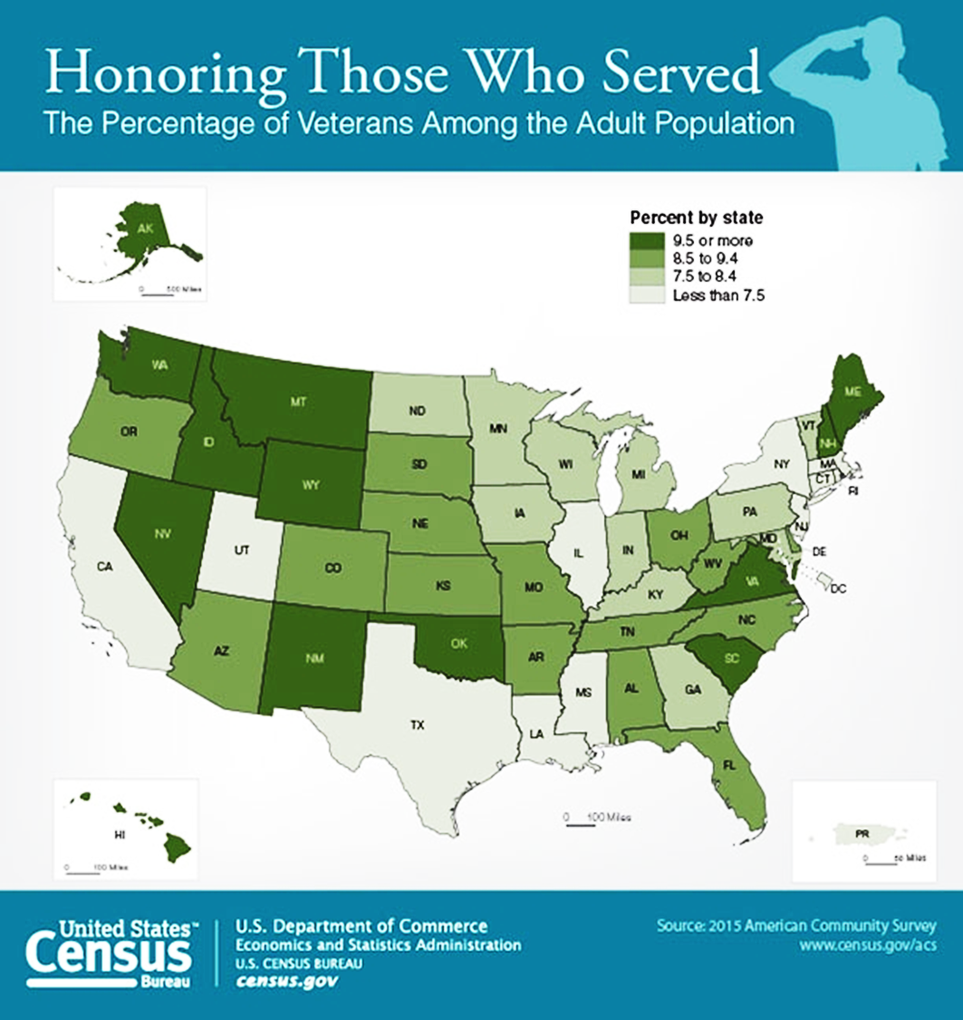
Honoring Those Who Served
Notes:
jay

Slide 34
Veteran Population in WA State
State | All Veterans | White, alone | Black or African American, alone | American Indian and Alaska Native, alone
WA | 569,339 | 488,320 | 29,561 | 4,623
Asian, alone | Native Hawaiian and Other Pacific Islander, alone | Some other race, alone | Two or more races | Hispanic or Latino (of any race) | White alone, Not Hispanic or Latino
15,942 | 4,398 | 6,416 | 20,079 | 28,440 | 469,543
Notes:
Jay 09/30/2018) https://www.va.gov/vetdata/veteran_population.asp

Slide 35
Homeless Veterans in WA State Veterans Affairs Point in Time (PI) Count
State | Number of CoCs | Homeless Veterans, 2018 | Sheltered ES Homeless Veterans, 2018
WA | 6 | 1,636 | 479
Point-in-Time (PIT) Count
Continuums of Care (CoCs), which are local planning bodies responsible for coordinating all homelessness services in a geographic area.
Sheltered TH Homeless Veterans, 2018 | Sheltered SH Homeless Veterans, 2018 | Sheltered Total Homeless Veterans, 2018 | Unsheltered Homeless Veterans, 2018
290 | 1 | 770 | 866
Notes:
Jay What the PIT Count Measures
The PIT Count is among the ways VA estimates the homeless population nationwide to help direct resources based on need. Here’s who performs the PIT Count and what it measures:
The PIT Count is administered by HUD’s more than 400 Continuums of Care (CoCs), which are local planning bodies responsible for coordinating all homelessness services in a geographic area.
During even-numbered years, CoCs are only required to count sheltered persons (those living in emergency shelters and transitional housing), although many CoCs voluntarily collect data about unsheltered persons during those years.
During odd-numbered years, CoCs are required to count sheltered and unsheltered persons—those living on the street or in another place not meant for human habitation.
The January 2019 PIT Count results reflect national snapshots of homelessness through the end of 2018.
A Goal Within Reach
The goal of ending homelessness among Veterans is within reach—and in fact is already happening community by community.
Here’s what we must do to further this progress and sustain these gains:
Maintain government investments that are supporting effective interventions to prevent homelessness among Veterans and rapidly re-house those who become homeless, much like those communities and states that have already announced an end to Veteran homelessness
Keep up our relentless outreach to Veterans in need
Collaborate with governments, employers and community-based entities to house, employ and serve Veterans exiting homelessness
Learn more about VA’s homeless programs and get involved. If you know a Veteran who is homeless or at imminent risk of becoming homeless, refer him or her to a local VA Medical Center, where homeless coordinators are ready to help. Veterans and their families can also call 1-877-4AID-VET to be connected to VA services.

Slide 36
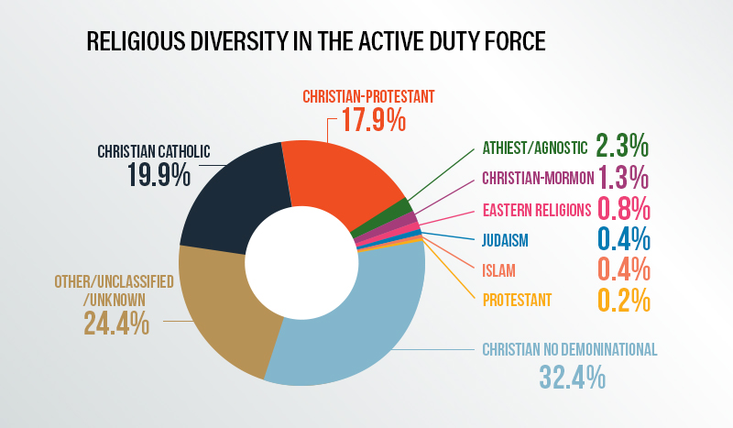
Religious Diversity in the Active Duty Force January 2019
Religious Diversity in the Active Duty Force January 2019
https://crsreports.congress.gov/product/pdf/R/R44321
Notes:
Jay https://crsreports.congress.gov/product/pdf/R/R44321 Pg 47

Slide 37
Legislation for Veterans
Uniformed Services Employment & Reemployments Rights Act (USERRA)
Prohibits Discrimination Against Members of the Armed Forces
Applies to All Employers
Reasonable Efforts to Accommodate Disabilities
The Provision of Training
The Escalator Principle
Amended with the Service Members Access to Justice Act (SAJA)
Notes:
Jay The U.S. also has an extensive assortment of legislation for veterans.
USERRA provides protection for disabled veterans, requiring employers to make reasonable efforts to accommodate the disability. Service members convalescing from injuries received during service or training may have up to two years from the date of completion of service to return to their jobs or apply for reemployment.
USERRA provides that returning service-members are reemployed in the job that they would have attained had they not been absent for military service (the long-standing "escalator" principle), with the same seniority, status and pay, as well as other rights and benefits determined by seniority. USERRA also requires that reasonable efforts (such as training or retraining) be made to enable returning service members to refresh or upgrade their skills to help them qualify for reemployment. The law clearly provides for alternative reemployment positions if the service member cannot qualify for the "escalator" position. USERRA also provides that while an individual is performing military service, he or she is deemed to be on a furlough or leave of absence and is entitled to the non-seniority rights accorded other individuals on non-military leaves of absence.
Health and pension plan coverage for service members is provided for by USERRA. Individuals performing military duty of more than 30 days may elect to continue employer sponsored health care for up to 24 months; however, they may be required to pay up to 102 percent of the full premium. For military service of less than 31 days, health care coverage is provided as if the service member had remained employed. USERRA clarifies pension plan coverage by making explicit that all pension plans are protected.
The period an individual has to make application for reemployment or report back to work after military service is based on time spent on military duty. For service of less than 31 days, the service member must return at the beginning of the next regularly scheduled work period on the first full day after release from service, taking into account safe travel home plus an eight-hour rest period. For service of more than 30 days but less than 181 days, the service member must submit an application for reemployment within 14 days of release from service. For service of more than 180 days, an application for reemployment must be submitted within 90 days of release from service.
USERRA also requires that service members provide advance written or verbal notice to their employers for all military duty unless giving notice is impossible, unreasonable, or precluded by military necessity. An employee should provide notice as far in advance as is reasonable under the circumstances. Additionally, service members are able (but are not required) to use accrued vacation or annual leave while performing military duty.

Slide 38
More Legislation
Wounded Veteran Job Security Act
Prohibits discrimination and acts of reprisal against persons who receive treatment for illnesses, injuries, and disabilities incurred in, or aggravated by, service in the armed forces
Veterans Employment Preference
Preference over non veterans both in hiring from competitive lists of eligible’s and in retention during reductions in force
Twenty-First Century Communications and Video Accessibility Act of 2010
Veterans disabled by a hearing or visual impairment can take advantage of the evolving technology at work
Notes:
Jay

Slide 39
OFCCP Compliance (DOL Regs)
Connected to Vietnam Era Veterans Readjustment Assistance Act (VEVRAA) and Section 503 of the Rehabilitation Act of 1973
Guidelines for Veterans and/or Disabled Workers
Highlights Include:
Hiring Benchmarks
Data Collection
Invitation to Self-Identify
Incorporation of EO Clause
Job Listings
Records Access
Notes:
Jay The Office of Federal Contract Compliance Programs (OFCCP) is a division of the US Department of Labor that has been charged with implementing the laws that require equal employment opportunity for anyone working within the government contract system. As stated in the OFCCP mission statement, this would mean enforcing laws "that ban discrimination and require Federal contractors and subcontractors to take affirmative action to ensure that all individuals have an equal opportunity for employment, without regard to race, color, religion, sex, national origin, disability or status as a Vietnam era or special disabled veteran."
The first thing to keep in mind with OFCCP compliance is that it applies directly to any contractors or their subcontractors who have work with the federal government exceeding ten thousand dollars. In other words, OFCCP compliances pertains to virtually everyone.
From a recruiting perspective, the new regulations require contractors to document the following computations or comparisons pertaining to applicants and hires on an annual basis and maintain them for a period of three (3) years:
- The number of applicants who self-identified as, or are otherwise known to be, individuals with disabilities;
- The total number of job openings and total number of jobs filled;
- The total number of applicants for all jobs;
- The number of applicants with disabilities hired; and
- The total number of applicants hired.
In order to comply with this, the contractor must have EVERY applicant fill out a disclosure form similar to the EEOC form most companies use.

Slide 40
Why Hire Transitioning Veterans?
Military Service:
Illustrates proven abilities
Demonstrates resourcefulness and drive
Ensures discipline and dedication
Provides security clearances
Adds value to the corporate mission
Notes:
Jay

Slide 41
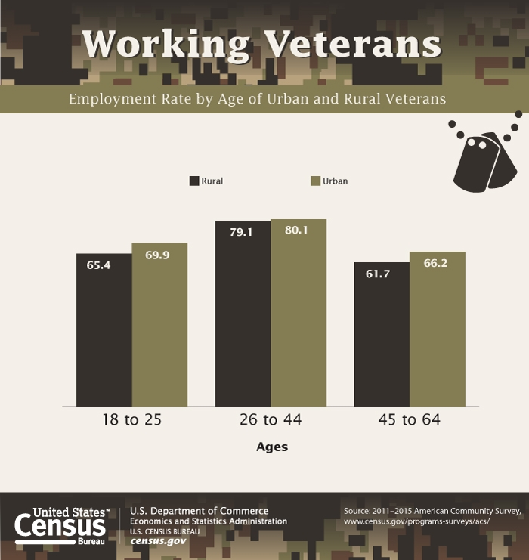
diversity at work by age
Notes:
Jay According to the American Community Survey, there were 7.0 million veterans 18 to 64 years old in the labor force in 2016. Of those veterans, 6.7 million were employed. As you can see by this chart, the rate of employment increases when a veteran lives in an urban area, although the employment rate in rural areas is still pretty high.

Slide 42
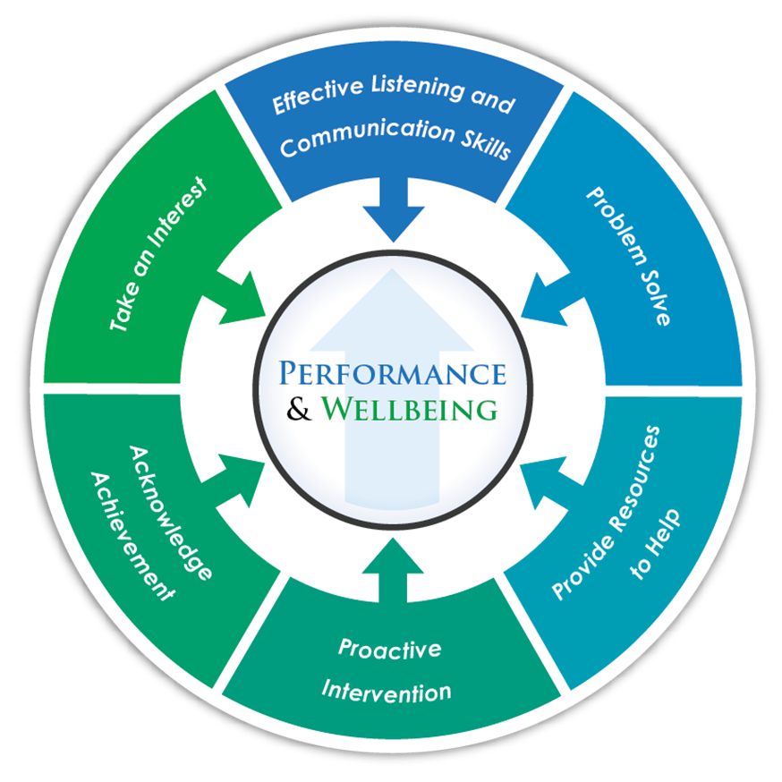
How to Optimize Veterans Programs
Mentoring Programs
Strategic Matching
Internal or External Mentors
Proactive Intervention Programs
Nutrition, exercise and rest
Flexibility towards productivity
Suicide prevention
Support Programs
EAP programs
Careerpathing
Retention programs
Focus groups
Business resource groups
Veteran’s Support Organizations
Workplace Accommodations
Impact on performance
Notes:
Jay Veterans may face challenges upon re-adjusting into the workplace and society. However, this is where employers can play a key role through workplace inclusion efforts.
The emphasis for Veterans programs should be on optimizing comprehensive interventions for high performance and wellbeing. Again, we want to transition away from developing simplistic initiatives such as recruiting veterans only, and ensure that the organization takes a multi-faceted approach to inclusion, support and accommodations.

Slide 43
Veterans In-State Service Shared Leave Program
Notes:
Angela –
Leave for veterans and their spouses
The Veterans In-State Service Shared Leave Program (VISSLP) was created to allow Washington State general government and higher education employees to voluntarily donate their leave to be used for:
A veteran to attend medical appointments or treatments for a service connected injury or disability, including U.S. Department of Veterans Affairs compensation and pension exams; or
The employee is a spouse of a veteran who requires assistance while attending medical appointments or treatments for a service connected injury or disability, including U.S. Department of Veterans Affairs compensation and pension exams.
Eligibility to Donate Leave to the VISSLP An employee may donate vacation leave, sick leave, or all or part of a personal holiday to the VISSLP if the donating employee’s employer approves the employee’s request to donate leave and:
Vacation leave: The full-time employee’s request to donate will not cause their vacation leave balance to fall below 80 hours after the transfer.
For part-time employees, requirements for vacation leave balances are prorated.
Sick leave: The employee’s request to donate leave not cause their sick leave balance to fall below 176 hours after the transfer.
Personal Holiday: The donating employee’s employer approves the employee’s request to donate all or part of their personal holiday to the VISSLP.
Eligibility to Receive Leave from VISSLP An employee may be eligible to receive shared leave from the VISSLP if:
The employee is a veteran and is attending medical appointments or treatments for a service connected injury or disability, including U.S. Department of Veterans Affairs compensation and pension exams; or
The employee is a spouse of a veteran who requires assistance while attending medical appointments or treatments for a service connected injury or disability, including U.S. Department of Veterans Affairs compensation and pension exams.
The employee has less than 40 hours of accrued vacation leave and accrued sick leave.
https://www.dva.wa.gov/veterans-service-members-and-their-families/veterans-benefits/veterans-state-service-shared-leave-program#:~:text=Eligibility%20to%20Receive%20Leave%20from,compensation%20and%20pension%20exams%3B%20or

Slide 44
Veterans Hiring Resources
Feds Hire Vets
http://www.fedshirevets.gov/
Office of Personnel Managment - Vet Guide for HR professionals
http://www.opm.gov/staffingPortal/Vetguide.asp
U.S. Office of Human Resource Management - Veterans FAQ
https://www.commerce.gov/hr/careers/veterans/faqs
U.S. Federal Register - Executive Order 13518 of November 9, 2009
https://www.gpo.gov/fdsys/pkg/FR-2009-11-13/pdf/E9-27441.pdf
Notes:
Angela

Slide 45
Readjustment Factors
The length of time the veteran was away
The veteran’s proximity to active warfare
The number of times the veteran engaged in warfare
The age of the veteran
The veteran’s marital status
Notes:
John

Slide 46
Post-traumatic Stress
Combat or military exposure
Child sexual or physical abuse
Terrorist attacks
Sexual or physical assault
Serious accidents, such as a car wreck
Natural disasters, such as a fire, tornado, hurricane, flood, or earthquake
Notes:
John-Posttraumatic stress disorder (PTSD) is an anxiety disorder that can occur after you have been through a traumatic event. More recently, we have seen a shift towards dropping the “D”, and simply calling it PTS in order to remove the stigma of having a “disorder” noted in one’s personnel file.
It is a stereotype to assume that all veterans have PTS because all veterans have not served in combat. Nevertheless, even if one did serve during a period of conflict, the individual could have worked in a variety of capacities such as logistics, transportation, food services, etc.
Post-traumatic stress is caused by an event is that is horrible or scary. During this type of event, you think that your life or others' lives are in danger. You may feel afraid or feel that you have no control over what is happening. Anyone who has gone through a life-threatening event can develop PTSD. These events can include (read the list above).
After the event, you may feel scared, confused, or angry. If these feelings don't go away or they get worse, you may have PTSD. These symptoms may disrupt your life, making it hard to continue with your daily activities.
All people with PTSD have lived through a traumatic event that caused them to fear for their lives, see horrible things, and feel helpless. Strong emotions caused by the event create changes in the brain that may result in PTSD.
Most people who go through a traumatic event have some symptoms at the beginning. Yet only some will develop PTSD. It isn't clear why some people develop PTSD and others don't. How likely you are to get PTSD depends on many things:
How intense the trauma was or how long it lasted
If you lost someone you were close to or were hurt
How close you were to the event
How strong your reaction was
How much you felt in control of events
How much help and support you got after the event
There are four types of PTSD symptoms:
Reliving the event (also called re-experiencing symptoms)
Bad memories of the traumatic event can come back at any time. You may feel the same fear and horror you did when the event took place. You may have nightmares. You even may feel like you're going through the event again. This is called a flashback. Sometimes there is a trigger -- a sound or sight that causes you to relive the event. Triggers might include:
Hearing a car backfire, which can bring back memories of gunfire and war for a combat Veteran.
Seeing a car accident, which can remind a crash survivor of his or her own accident.
Seeing a news report of a sexual assault, which may bring back memories of assault for a woman who was raped.
Avoiding situations that remind you of the event
You may try to avoid situations or people that trigger memories of the traumatic event. You may even avoid talking or thinking about the event. For example:
A person who was in an earthquake may avoid watching television shows or movies in which there are earthquakes.
A person who was robbed at gunpoint while ordering at a hamburger drive-in may avoid fast-food restaurants.
Some people may keep very busy or avoid seeking help. This keeps them from having to think or talk about the event.
Feeling numb
You may find it hard to express your feelings. This is another way to avoid memories.
You may not have positive or loving feelings toward other people and may stay away from relationships.
You may not be interested in activities you used to enjoy.
You may not be able to remember parts of the traumatic event or not be able to talk about them.
Feeling keyed up (also called hyperarousal)
You may be jittery, or always alert and on the lookout for danger. This is known as hyperarousal. It can cause you to:
Suddenly become angry or irritable
Have a hard time sleeping
Have trouble concentrating
Fear for your safety and always feel on guard
Be very startled when something surprises you

Slide 47
Wounded in Combat
The 2016 American Community Survey reports that 4.0 million veterans have a service-connected disability
Variety of Different Disabilities
Readjustments to Life, Home and the Workplace
Notes:
John The 2016 American Community Survey reports that 4.0 million veterans reported having a service-connected disability. Veterans with a service-connected disability are assigned a disability rating by the U.S. Department of Veterans Affairs or the U.S. Department of Defense. Ratings range from 0 to 100 percent, in increments of 10 percentage points, depending
on the severity of the condition.

Slide 48
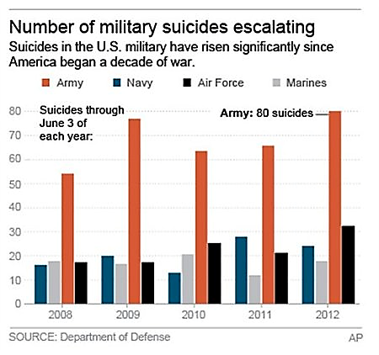
The Effects of PTSD
Veterans who are Dealing with the Residual Effects of Military Rape & Sexual Assault
Veterans Who Contemplate and/or Completed Suicide
Homelessness
Notes:
John Veterans Affairs’ National Health Study for a New Generation of U.S. Veterans is an ongoing study of Iraq and Afghanistan Veterans by researchers with VA's Office of Public Health. More than 20,500 Veterans participated in the study, half of whom were deployed to Iraq and Afghanistan.
The study aims to provide insight on the overall health of recent Veterans, to improve VA's understanding of the health services Veterans need, and to maximize the quality of care VA offers to these Veterans. Among the study's findings so far have been:
41.5 percent of women and 4 percent of men in the study experienced military sexual trauma while in the military;
15.7 percent of Veterans deployed to Iraq and Afghanistan screened positive for PTSD, compared to 10.9 percent of non-deployed Veterans. Overall, 13.5 percent of Iraq and Afghanistan era Veterans screened positive;
NBC News reported that the U.S. military received a record number of sexual assault reports in 2016. Service members reported 6,172 cases of sexual assault in 2016 compared to 6,082 last year, an annual military report showed. This was a sharp jump from 2012 when 3,604 cases were reported.
Service members who report being sexually assaulted by a commanding officer or military colleague do so at their own peril. They face ridicule, demotion, an investigation that includes a review of their sexual history, and even involuntary discharge. Right now, it is far too easy for a sexual predator in the military to rape or sexually assault a fellow service member and get away with it. Until these crimes are taken seriously and assailants are punished as the felons they are, the epidemic will continue. In 2011, U.S. Rep. Jackie Speier introduced bipartisan legislation that would create a path to justice for service men and women who are victims of rape or sexual assault. H.R. 3435, the Sexual Assault Training Oversight and Prevention Act (STOP Act) would take these cases out of the normal chain of command and place the jurisdiction, still within the military, in the hands of an impartial office staffed by experts -- both military and civilian.
Female veterans are also at a much greater risk for suicide, with their suicide rate 2.5 times higher than that for female civilians. Among men, the risk was 19 percent higher among veterans compared to civilians. As a whole, older veterans make up most military suicides -- roughly 65 percent of suicides were committed by those age 50 or older. These findings were a part of the largest study undertaken of veterans' records by the VA, which is designed to uncover fresh information about where to direct resources and identify veterans most at-risk.
While the report acknowledges that it is hard to pinpoint specific causes behind veteran suicide but the risks likely involved factors more prevalent in rural areas, such as social isolation, limited health care access, gun ownership and opioid addiction. Nationally, 70 percent of the veterans who take their lives had not previously been connected to VA care. Previous studies have also connected military installations and branch of service, as the chart here indicates.
As of January 2014, the U.S. Department of Housing and Urban Development reports that about 39,471 homeless adults are veterans, and they are concentrated in California, Texas, Florida and New York.
The number of homeless veterans in the U.S. has dropped over the last decade, according to data released by the federal government. According to an annual survey called the Point-in-Time Count, the number of homeless veterans fell to just under 50,000 in 2014 from nearly 75,000 in 2010, a drop of 33%. Clearly progress is being made with a total homeless population of 39,461 today. The announcement from the federal agencies, including the Department of Housing and Urban Development and the Department of Veterans Affairs, attributed the drop to several strategies, including reducing prerequisite "barriers" to get veterans in permanent housing more quickly and focusing housing efforts on chronically homeless and "vulnerable" veterans.

Slide 49
The End
Notes:
Start on next slide

