Slide 1

Equity and Belonging –
Why am I so emotional?
June 2024
Notes:
Lenora

Slide 2
“Belonging means more than just being present; it means being a valued member of a community.”
john a. powell
Notes:
Lenora

Slide 3
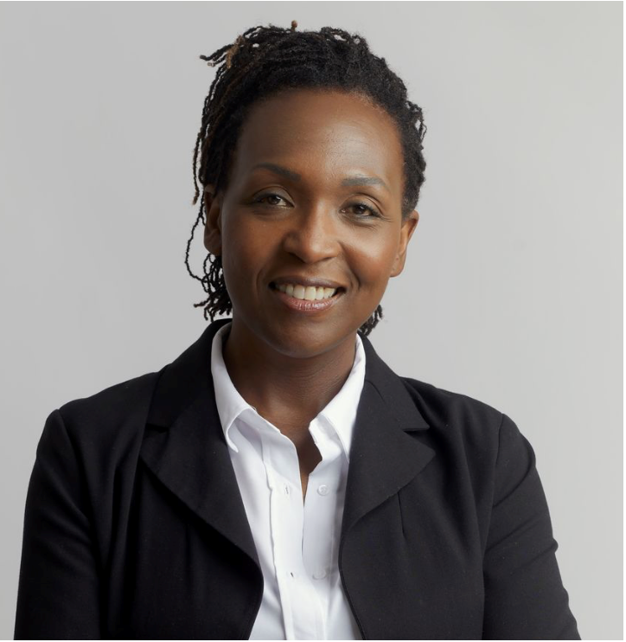
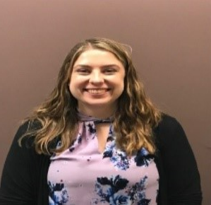
Who we are
Lenora Sneva
Director
Aunna Moss
Lead Consultant
20+ years of public service experience. Certifications: lean, organization change management, DEI (Diversity, Equity, and Inclusion), behavioral assessments, personal and leadership development. Human-centered consulting – leading with empathy, respect and flexibility.
Notes:
Lenora

Slide 4

Icebreaker
How would you feel if….
  Your boss announced….
  Your partner listed your house for sale….
  Your best friend announced they were getting married….
Notes:
Lenora

Slide 5
Agenda
Welcome and overview
Overview of organization change management frameworks
Case study – The Forum
Reflections and closing
Q&A
Notes:
Lenora

Slide 6
Learning objectives
Understand the normal and natural emotional responses to change.
Understand why it is important to apply organization change management frameworks to help embed diversity, equity, inclusion and belonging into agency culture.
Learn about a real-world example of how OFM is embedding equity and belonging into agency culture.
Learn how to apply scalable organization change management frameworks to equity and belonging work.
Notes:
Lenora

Slide 7

What is change?
Change is external - something that happens to people, even if they don’t agree with it
Source: Bridges' Transition Model - Guiding People Through Change by Managing Endings (mindtools.com)
Notes:
Aunna

Slide 8

What is transition?
Transition is internal – It is what happens in people’s minds as they experience change
Source: Bridges' Transition Model - Guiding People Through Change by Managing Endings (mindtools.com)
Notes:
Aunna

Slide 9
The Kubler-Ross Change Curve and William Bridges Transition Model
Ending, Losing, Letting Go
The Neutral Zone
The New Beginning
Integration – changes integrated a renewed individual
Shock – surprise or shock at the event
Decision – learning how to work in the new situation; feeling more positive
Denial – disbelief; looking for evidence that isn’t true
Experiment – initial engagement with the new situation
Frustration – recognition that things are different; Sometimes angry
Depression – low mood; lacking in energy
Sources: Kübler-Ross Change Curve® - EKR Foundation and Bridges' Transition Model - Guiding People Through Change by Managing Endings (mindtools.com)
Notes:
Aunna

Slide 10
Strategies to navigate emotional responses to change - Individual learners
Decision/integration
Shock/ Denial
Individual learner role: ACCEPT AND EMBRACE
Individual learner role:
GRIEVE, PAUSE and REFLECT
Experiment
Accept and embrace the change. Lead by example.
Frustration/ Depression
Individual learner role:
EXPLORE and ADAPT
Grieve what you’re losing with the change. Pause and reflect on past changes to help you prepare for the new change.
Explore what the change means for you and learn from others.
Individual learner role:
SHIFT YOUR PERSPECTIVE
Consider change as a challenge rather than a threat.
Sources: Adapted from Riding the Waves of Change – Approaches and tools to help you move through the new “NORMA.” Employment Security Department Product, Planning, and Performance Team and
Why Change Is so Hard — and How to Deal with It (neuroleadership.com)
Notes:
Aunna
As leaders and colleagues, the role that we play during times of change varies based on where an individual falls on the change curve. You can use this tool to identify the role that you need to play based on where a colleague or employee falls on the change curve.
Review roles individually
Awareness/Denial= Catalyst
Anxiety/Resistance= Counselor
Analysis/Exploration= Coach
Acceptance/Commitment= Cheerleader
We are going to look at each of these roles a bit more closely.
Leader/colleague role: Catalyst
See
Indifference
Disbelief
Going through the motions
Avoidance/withdrawal
Apathy
Hear
Silence
“It’s fine.”
“This can’t be happening.”
“It won’t actually happen.”
Give information so people understand the change that is being introduced.
Provide information in small doses
Create a safe environment for people to share their initial reactions
Use active listening and reflect back people’s experiences to understand their initial reactions
Provide frequent, consistent information about the change; explain what to expect and actions to adjust
Don’t push the new vision
Check in-regularly
Regularly ask for and answer questions
Accept where they are with the change without judgement
Leader/colleague role: Counselor
See
Anger
Frustration
Sadness
Lack of concentration
Glorifying the past
Disengagement
Negativity
Hear
“It’s unfair”
“It doesn’t make sense”
“I’m leaving”
Help people process emotions.
Identify, name and acknowledge the emotion
Be empathetic and understand their reality
Listen
Accept where they are with the change without judgement
Make connections with people if they are avoiding the change
Ask: “What barriers might be in the way of moving through this change?”; “What concerns do you have with this change?”
Leader/colleague role: Coach
See
Exploring options
Risk-taking
Tentativeness
Processing
Self-doubt
Openness
Hear
“I Enthusiasm
Optimism
“I’ve got an idea”
“Let’s try…”
“What if…”
Help people begin to see possibilities – for themselves and the organization.
Co-create new solutions
Agree on exploratory actions
Explore specifically… roles, timeframes, skills, etc.
Spark creativity in conversation
Express confidence
Ask: “What do you need to be successful?” … “How can I help?”
Leader/colleague role: Cheerleader
See
Acceptance of the change
Future orientation
Initiative
Self-efficacy
Confidence
Hear
“How can I contribute?”
“Let’s get on with it”
“We can do it even better”
“I’m prepared whatever comes up”
Acknowledge progress and reward positive action – all along the way.
Solve problems, remove barriers, get into action.
Invite into implementation
Acknowledge how people are learning and growing
Provide guidance, support and recognition
Recognize individual and team accomplishments
Stay available – keep fine tuning the plan (i.e. follow the plan, do check, act cycle)
Share successes with others

Slide 11
Strategies to navigate emotional responses to change - Leaders
Decision/integration
Shock/ Denial
Leader role: SUPPORTER
Leader role:
CATALYST
Experiment
Acknowledge progress and reward positive action – all along the way
Frustration/ Depression
Leader role: COACH
Give information so people understand the change that is being introduced.
Help people begin to see possibilities – for themselves and for the organization
Leader role: COUNSELOR
Help people process emotions.
Source: Riding the Waves of Change – Approaches and tools to help you move through the new “NORMA.” Employment Security Department Product, Planning, and Performance Team
Notes:
Aunna
As leaders and colleagues, the role that we play during times of change varies based on where an individual falls on the change curve. You can use this tool to identify the role that you need to play based on where a colleague or employee falls on the change curve.
Review roles individually
Awareness/Denial= Catalyst
Anxiety/Resistance= Counselor
Analysis/Exploration= Coach
Acceptance/Commitment= Cheerleader
We are going to look at each of these roles a bit more closely.
Leader/colleague role: Catalyst
See
Indifference
Disbelief
Going through the motions
Avoidance/withdrawal
Apathy
Hear
Silence
“It’s fine.”
“This can’t be happening.”
“It won’t actually happen.”
Give information so people understand the change that is being introduced.
Provide information in small doses
Create a safe environment for people to share their initial reactions
Use active listening and reflect back people’s experiences to understand their initial reactions
Provide frequent, consistent information about the change; explain what to expect and actions to adjust
Don’t push the new vision
Check in-regularly
Regularly ask for and answer questions
Accept where they are with the change without judgement
Leader/colleague role: Counselor
See
Anger
Frustration
Sadness
Lack of concentration
Glorifying the past
Disengagement
Negativity
Hear
“It’s unfair”
“It doesn’t make sense”
“I’m leaving”
Help people process emotions.
Identify, name and acknowledge the emotion
Be empathetic and understand their reality
Listen
Accept where they are with the change without judgement
Make connections with people if they are avoiding the change
Ask: “What barriers might be in the way of moving through this change?”; “What concerns do you have with this change?”
Leader/colleague role: Coach
See
Exploring options
Risk-taking
Tentativeness
Processing
Self-doubt
Openness
Hear
“I Enthusiasm
Optimism
“I’ve got an idea”
“Let’s try…”
“What if…”
Help people begin to see possibilities – for themselves and the organization.
Co-create new solutions
Agree on exploratory actions
Explore specifically… roles, timeframes, skills, etc.
Spark creativity in conversation
Express confidence
Ask: “What do you need to be successful?” … “How can I help?”
Leader/colleague role: Cheerleader
See
Acceptance of the change
Future orientation
Initiative
Self-efficacy
Confidence
Hear
“How can I contribute?”
“Let’s get on with it”
“We can do it even better”
“I’m prepared whatever comes up”
Acknowledge progress and reward positive action – all along the way.
Solve problems, remove barriers, get into action.
Invite into implementation
Acknowledge how people are learning and growing
Provide guidance, support and recognition
Recognize individual and team accomplishments
Stay available – keep fine tuning the plan (i.e. follow the plan, do check, act cycle)
Share successes with others

Slide 12

Our vision for equity and belonging at OFM – Know
OFM Employees
Know
  Equity and belonging are leadership priorities
  How to apply an equity perspective to business priorities
  Our path forward to building leadership at every level and a culture of equity and belonging at OFM
Notes:
Lenora

Slide 13
Our vision for equity and belonging at OFM – Feel
OFM Employees
Feel
  A sense of belonging within OFM
  Supported,
  Encouraged
  Willingness to fall forward and show vulnerability
Notes:
Lenora

Slide 14
Our vision for equity and belonging at OFM – Do
OFM Employees
Do
  Apply an equity perspective
  Routinely recognize opportunities to enhance equity and redistribute power
  Participate in the Forum
  Take responsibility for their individual learning journey
Notes:
Lenora

Slide 15
Equity and Belonging at OFM in 2024
Connected
    Valued
          Engaged
Notes:
Lenora

Slide 16

Overview
Gathered employee feedback
OFM DEI Foundations Training
2023 Employee Engagement Survey
2023 Respect and Inclusion Survey
Diversity, Equity and Belonging Retreat
Theme
Gaps in our equity and belonging efforts
Notes:
Lenora

Slide 17

Our “why”
All OFM employees understand how equity lives within our 2023-2025 strategic plan priorities
Equity work is a shared responsibility
Notes:
Lenora

Slide 18
Equity and belonging principles
Share power – who defines value and guides decision-making
Continually seek and apply feedback – iterative design and centering shared decision-making
Address questions and concerns as they arise – progress over perfection and psychological safety
Provide meeting materials at least 3 business days in advance – accessible and inclusive design
Notes:
Lenora

Slide 19

Equity and belonging principles continued
Provide meeting materials no more than 2 business days after each session – transparency and increased accessibility
Execute effective project management and organizational change management skills – human centeredness, fighting a sense of urgency
Ensure all attendees have the resources and support they need to fully participate –accessible language/communication, universal design
Notes:
Lenora

Slide 20
Organization change management roadmap
Leadership involvement
Communications Plan
Resistance Management
Training/
coaching
Sustainment
Notes:
Lenora

Slide 21
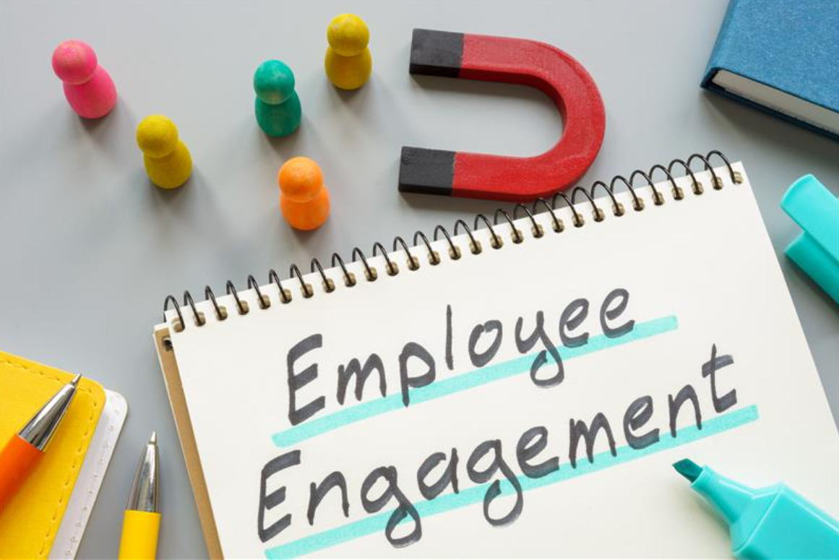
Organization change management strategies and activities
Strategies
Neutral facilitators
In person retreat to start co-creating future state vision
Activities
1:1’s with impacted customers
Small group sessions
All staff coffee chats
Emails
Padlet
Microsoft Teams site for shared documents and collaboration
Notes:
Lenora

Slide 22

Here at OFM, Equity work is a shared responsibility
We have retired the DEI Council, and the work has evolved into shared responsibility frameworks.
The Forum – Provide opportunities to strengthen knowledge and skill in discussing equity and belonging
Equity and Belonging Advisory Team – Focus on HR policies, communications and data
Notes:
Lenora

Slide 23

The Forum – General information
Logistics
Virtual one-hour meetings once per month between April – November 2024
Purpose
Create opportunities for divisions to share how they are applying an equity perspective to their strategic priorities and how they are actioning employee engagement survey data
Create space for employees to share personal stories to enhance belonging
Participants
Led by an OFM division. All OFM employees and GOV Affiliates are invited to participate.
Notes:
Lenora

Slide 24
Lessons Learned
- What worked well?
- What could be improved?
Notes:
Lenora

Slide 25
2024 Equity and Belonging Roadmap
Feb – May 2024
Cultural humility and leadership training
Apr – Nov 2024
The Forum
Ongoing
PEAR – budget, hiring, and supplier diversity
Mar – Apr 2024
Supervisor coaching and discussions
Apr, Jul, and Nov 2024
Equity and Belonging Advisory Team
Every month
Business Resource Groups
Notes:
Lenora

Slide 26
Resources
Charter
PowerPoint
Survey
Checklist
Notes:
Lenora

Slide 27
Reflections and closing
Summary
Questions?
Feedback
Notes:
Aunna

Slide 28
Sources
Employment Security Department Lean Engagement & Development Team/Organizational Change Management Team. “Riding the Waves of Change.”
“The Change Curve: Accelerated Change, and Increasing Its Likelihood of Success.” MindTools, The Change Curve - Change Management Training from MindTools.com.
“Kubler-Ross change Curve.” Elisabeth Kubler-Ross Foundation, Kübler-Ross Change Curve® - EKR Foundation.
“Bridges Transition Model.” Mindtools, Bridges' Transition Model - Guiding People Through Change by Managing Endings (mindtools.com)
Belhy, Anastasia. “Understanding the Kubler-Ross Change curve.” Cleverism, Understanding the Kubler-Ross Change Curve | Cleverism
“How Leaders can Emotionally Support Employees During Change | Use the Change Curve as a Conversation Canvas. Farwell, Emotionally Support Employees During Change | Use the Change Curve as a Conversation Canvas (gofarwell.com)
“Why Change Is so Hard – and How to Deal with It.” NeuroLeadership Institute, Why Change Is so Hard — and How to Deal with It (neuroleadership.com)

