Slide 1
Immigration as a Barrier to Employment- Raise Every Voice

Slide 2
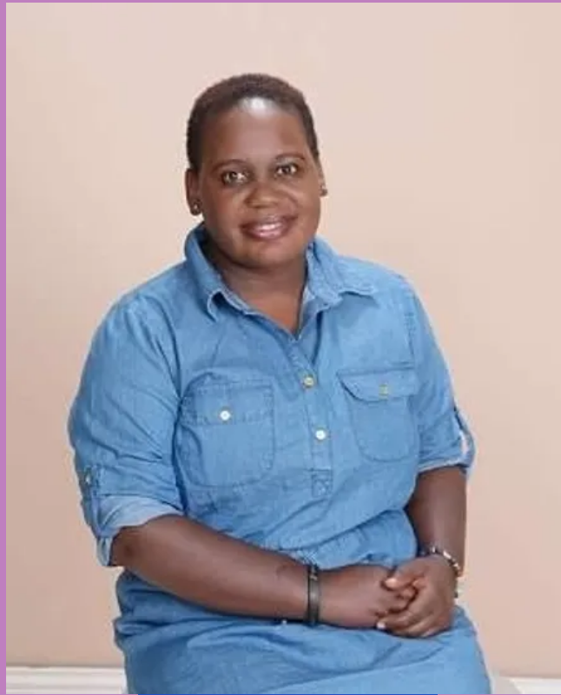
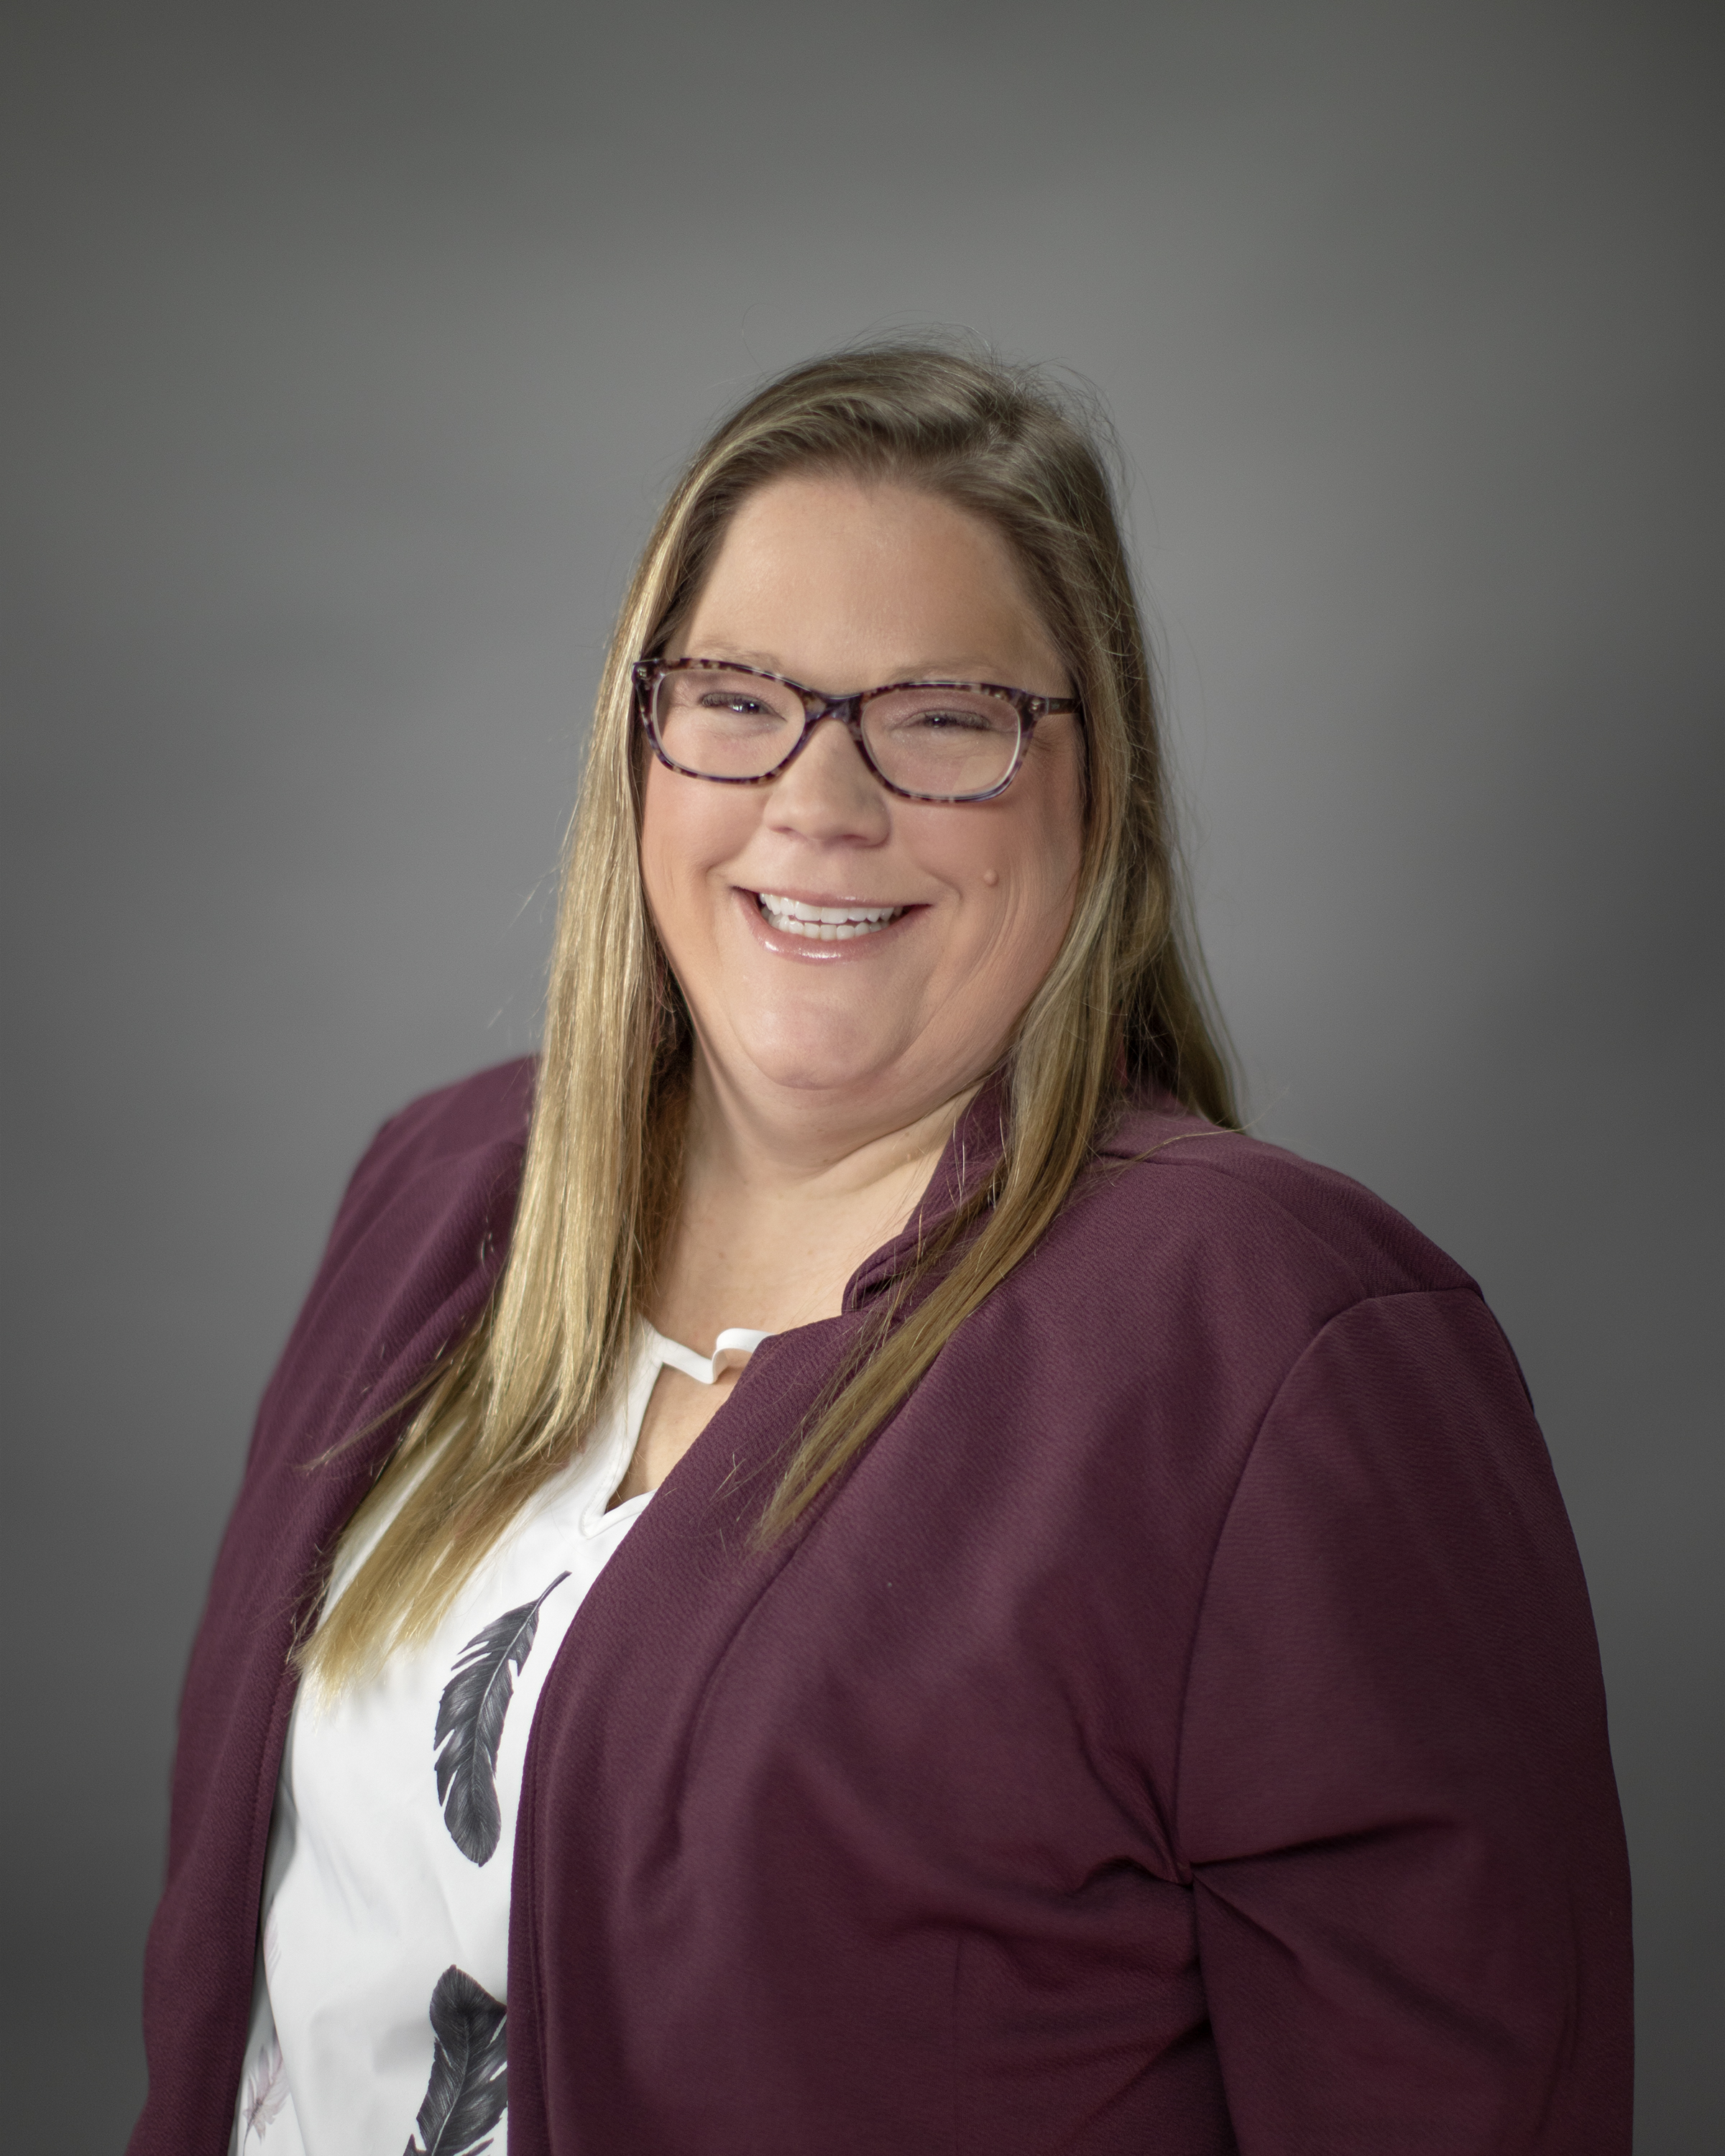

Presenters
Teddy Kemirembe (She/her)
Sarah MacLeod (She/her)
Seth Pilkey (He/him)
Notes:
1 Teddy
2 Sarah
3 Seth

Slide 3

Background:
Raise Every Voice Tour.
Challenges and Intersectionality.
Immigrant Workforce & Policies.
Notes:
Teddy
•The Covid-19 pandemic has taught us many lessons, key among which is the importance of a dependable workforce particularly direct support professionals who are at the frontline of supporting individuals with developmental disabilities. Though acerbated by Covid-19, the shortage of direct support professionals and other staff in DDA is ongoing and concerning. This shortage remains a hinderance to the attainment of “the mission of DDA to transform lives by providing support and fostering partnerships that empower people to live the lives they want”. Within, our administration, immigrants are a vital resource in the department’s efforts to provide services to our participants. Specifically, a big majority of direct support professionals are individuals from immigrant communities. These During COVID –19 21 million quit.
•The process of applying entails financial and emotional costs. The initial application and renewal fee for 2023 is $410.00. Though applicants can submit applications 180 days prior to expiration, the length of wait times has continued to increase over the years from between 60 and 90 days in previous years, to almost 15 months with an average wait time of seven and a half months
Parlatore Law Group (2023): What Is Employment Sponsorship? | Parlatore Law GroupUS Citizenship and Immigration Services (2013): E2en.pdf (uscis.gov)
During COVID –19 21 million quit

Slide 4

Raise Every Voice Tour
DDA continued the Raise Every Voice campaign into the Raise Every Voice Tour! As a continuation of this campaign give an opportunity to all DDA employees (especially those who did not get a chance to participate in the raise every voice campaign).
This campaign was started by our DSHS Secretary Jilma Meneses and continues to this day!
Notes:
Teddy

Slide 5
Who is DDA>
People with developmental disabilities and their families are valued residents of the state of Washington. The Developmental Disabilities Administration strives to develop and implement public policies that will promote individual worth, self-respect and dignity such that each individual is valued as a contributing member of the community.
We employ:
  Case Managers (Social Workers).
  Direct Support Professionals (NAC and CNA).
  Behavioral Health Professionals.
  Medical Care Staff.
Notes:
Seth

Slide 6

Why do people immigrate?
Employment opportunities.
Educational purposes.
Escaping violent conflicts.
Reuniting family.
Environmental factors.
This Photo by Unknown author is licensed under CC BY-SA.
Notes:
Sarah
Many individuals who come to the U.S. do so to reunite their families. This could be siblings, spouses, parents, children, or other relatives who moved previously. The wait time for relatives to immigrate is often longer because they must wait until the primary visa holder earns citizenship.
About 13.6% of people in the US are foreign-born. Foreign-born people are more likely to be in the labor force and in a married-couple family than people born in the US. Government spending on immigration and border security dropped in 2022 after hitting a record high in 2020 and staying elevated in 2021.
Teddy share story: I immigrated to the US in 2006 to join my then husband on a G1 visa which is a diplomatic visa .

Slide 7

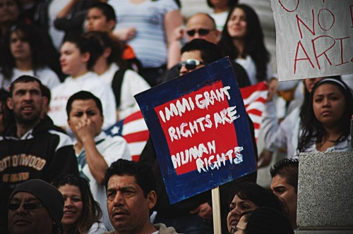
Challenges and intersectionality
Cultural misunderstandings.
Financial access and equity.
Race, gender and ethnicity related challenges.
LGBTQA+.
Religious practices.
Mental health.
Language barrier or access.
Access to services like education, housing and health care.
This Photo by Unknown author is licensed under CC BY.
This Photo by Unknown author is licensed under CC BY.
Notes:
Sarah- Intersectionality is an important concept to understand and have awareness of because, we as individuals, are not one dimensional. We can't be put into a neat box and checked off. We have many layers to our identities, and those layers can present various barriers.

Slide 8

Types of visas
H1B: Non-immigrant work visa with specialist.
H2B: Non-immigrant work visa temporary work non-agricultural labor.
EB-1: Priority workers.
EB-2: Advanced exceptional skills.
What about everyone else?
This Photo by Unknown author is licensed under CC BY-SA.
Notes:
Teddy.
Saada, Sabrina. “H-1B Fees: How Much Does It Cost in 2023?” VisaNation, 24 Apr. 2023, www.immi-usa.com/h1b-visa-processing-fees-2016.
Wigert, By Shane McFeely and Ben. “This Fixable Problem Costs U.S. Businesses $1 Trillion.” Gallup.com, 30 May 2023, www.gallup.com/workplace/247391/fixable-problem-costs-businesses-trillion.aspx.
Kumar. “USCIS Guidance for H1B, L1 Fee Increase ($4000) Until 2025.” RedBus2US, May 2019, redbus2us.com/uscis-guidance-for-h1b-l1-fee-increase-4000-until-2025.

Slide 9

Transforming Lives
Governor’s message.
One DSHS.
Strategic plan.
Employer of Choice.
Notes:
Seth -
•Connecting it to the Governor's Message: Governor Inslee’s executive order highlighted the contribution of immigrants to Washington state’s economy and committed to policies geared towards serving and supporting immigrants. According to Yen, Washington’s total population increased by 15% in the period 2010 to 2021 and the immigrant population increased by 29%. We should find ways to improve the current infrastructure to attract more immigrants and retain those that we currently have. Medium.com (2017) Governor Inslee signs executive order protecting rights, services for Washingtonian Immigrants. Retrieved from: https://medium.com/wagovernor/inslee-signs-executive-order-protecting-rights-services-for-washingtonian-immigrants-2055f2a5465e Yen, W. (2023) Washington State’s Immigrant population:2010-21. OFM Health Care Research Center. Retrieved from: https://ofm.wa.gov/sites/default/files/public/dataresearch/researchbriefs/brief110.pdf
•One DSHS-
•Strategic plan 2023-2025- Strategic Objective #7: Continue to support and promote equity, diversity, access and inclusion in the workplace and public outreach through recruitment, hiring, training, retention as well as staff and stakeholder communications.
•Employer of Choice- At DSHS, we strive every day to get even better at what we do, no matter how each of us contributes to our agency mission. If we are to continue transforming lives, an important piece of that is transforming ourselves. Our most important resource is our professional, caring, compassionate staff. We need to continue our efforts to be an employer of choice – recruiting and retaining individuals committed to a career in public service. We will keep a laser focus on equity, diversity and inclusion. https://www.dshs.wa.gov/node/29389

Slide 10
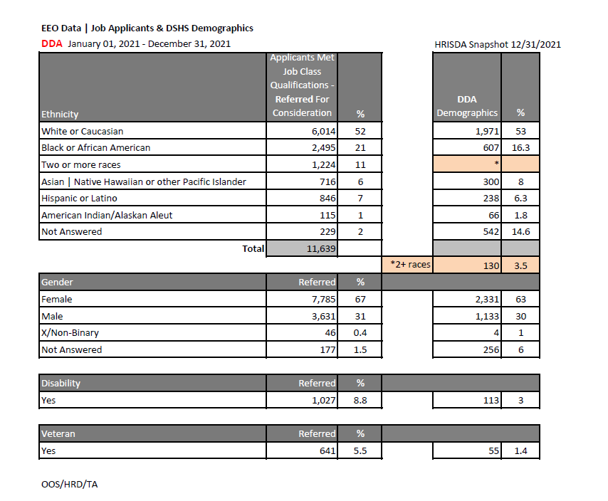
Person-centered metrics
Using 2021 data, PHI noted that 33% of the state’s direct care givers were immigrants. In the period of 2010 to 2021 we also noted the immigrant population increased by 29%.
At DDA we estimate 323 of our team members hold work permits. The Employment Authorization Document expires one to two years from the date of issuance.
Though Washington led the the nation for supporting direct care workers, we continue to face a direct care crisis in 2024.
Notes:
Sarah -
Based on data provided by PHI, Washington state was considered the leading state in the nation for supporting direct care workers. Using the 2021 data, PHI noted that 33% of the state’s direct care givers were immigrants. Though the category on supporting immigrant workers was not discussed in the PHI report, the state and particularly DDA should take the lead in attracting more immigrants. While responding to the PHI report, Jessica Nelson noted that more work awaits especially because “Washington state continues to face an ongoing direct caregiver crisis. "Direct Work Force Index (2023) Washington. https://www.phinational.org/state/washington/Washington.
Washington vs federal scope- how we how to disrupt it all!

Slide 11

Lived experiences
“When I moved to Washington state in 2014, my work permit was still valid for a year my country. Uganda was responsible for renewing the work permit as a diplomat’s wife. So, when I applied at Catholic Health Initiative (CHI) during the interview I was asked if I will need assistance with immigration. This was a miracle for me. CHI as an employer sponsored me.”
Teddy –EDAI Administrator DDA-HQ
Notes:
Teddy

Slide 12
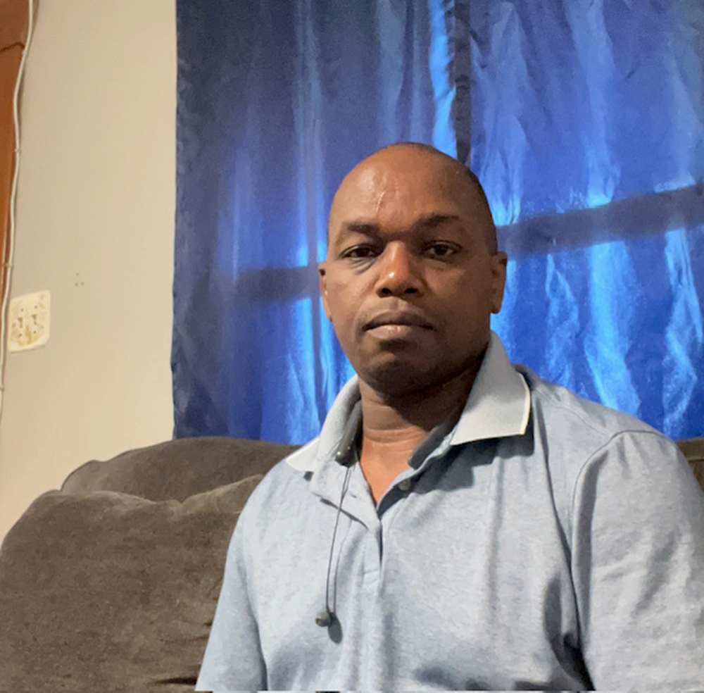
Lived experience- Martin
“I filed my asylum and got authorized to work here in USA, I have been working with DSHS here in Washington from 2019. I have tried to do legal procedures for my immigration status and for now am waiting for my appeal, I have gone so much, for all the process take long to fulfill, like mostly I go through mental distress thinking much about my family which I wish one day they will be here, I feel lonely, sometime…”
Martin-SOCR

Slide 13

Lived experience- Margaret
“I came in the USA in 2015 and since then I haven't gotten my green card and with that it has created a lot of problems mentally stressing. Getting work permits anxiety and afraid of been kicked out of workplace like last year February I was stopped from working due to delays.”
Margaret - SOLA

Slide 14

Lived experience shared on intersectionality
"I came to the United States in (02/07/2021), I have not been able to gain full freedom, this means though I can work I cannot visit my family and I cannot bring my family here since I don’t have a green card or citizenship. Although I can work and support my family, I still go through a lot of hardships that has caused mental and emotional stress to not only myself but to my family also. I constantly have to worry about being sent back to my country due to not obtaining a green card or being indefinitely kept out of work until I have my work permit is renewed which takes over six months at time. Most stressing of all is when I cannot see my ailing wife who for the past one year has been battling esophageal cancer, she cannot even access better healthcare, because she still cannot come here for treatment .“
- Lawrence
Notes:
Teddy
I work hard in this country and put all my time and efforts into building a strong foundation here for myself and my family. I also work hard in my workplace constantly to learn, and to continue to be a strong advocate for the vulnerable individuals that I serve as being an employee of the state. Since I began work at IHS I have obtained permanent employment with DDA and plan to continue to grow with this company. Being in constant fear of losing employment due to not having citizenship makes me feel my livelihood is at risk. I also work with individuals from my country that has the same stressors and fears as I. We are all very hard-working individuals who values our placement in the United States and would like to continue to work hard and build permanent status here.
My options are also different, and I get a different treatment when I try to access some services , at some point I and a friend tried to get some finances for some work we were doing, and I was so disappointed when we could not be approved, simply because of our status.
The organization asked if we were citizens or if we had permanent status and everything was trashed simply because we were not citizens yet we qualified in all other aspects, it feels so bad when you are treated different and yet you are giving your best to serve the nation.
A green card or citizenship would help in a big way, may be my wife can get better healthcare, and family can be reunited.

Slide 15

Solutions in development
An accessible resource list (easy to follow, multiple languages) available to current team members.
Clarify HR processes and rules regarding team members using visas and work permits.
Create unbiased onboarding and hiring practices.
DSHS workgroup.
This Photo by Unknown author is licensed under CC BY-SA.
Notes:
Sarah
Create an accessible resource list that is easy to follow and in multiple languages available to current team members.
Focus supports on those who already work for DSHS to help with continuing their employment.
Create a project team to continue momentum for this proposal.
Paid work time for working through the immigration and visa process.
Clarify existing HR processes and rules regarding team members utilizing visas and work permits.
Collect data on when someone applies will need assistance with immigration paperwork during the onboarding process.
Data collection for areas related to those current team members and the overall impact to their ongoing employment and interruption to services.
Working to create unbiased onboarding and hiring practices.
Monitor Federal policies for immigration related to employment visas.
Draft a DSHS/DDA Policy that focuses on the topic of immigration with relation to state employees.

Slide 16
Solutions implemented
Focus on those who already work with us to aid in continued employment.
Data collection focused on current immigrant team members and the overall impact to their ongoing employment and interruption to services.
This Photo by Unknown author is licensed under CC BY-SA.
Notes:
Sarah
Create an accessible resource list that is easy to follow and in multiple languages available to current team members.
Focus supports on those who already work for DSHS to help with continuing their employment.
Create a project team to continue momentum for this proposal.
Paid work time for working through the immigration and visa process.
Clarify existing HR processes and rules regarding team members utilizing visas and work permits.
Collect data on when someone applies will need assistance with immigration paperwork during the onboarding process.
Data collection for areas related to those current team members and the overall impact to their ongoing employment and interruption to services.
Working to create unbiased onboarding and hiring practices.
Monitor Federal policies for immigration related to employment visas.
Draft a DSHS/DDA Policy that focuses on the topic of immigration with relation to state employees.

Slide 17
Solutions proposed
This Photo by Unknown author is licensed under CC BY-SA.
Paid leave for immigration and visa process work.
Collect data on applicants who may need assistance with immigration.
A policy on immigration with relation to state employees.
Monitor federal policies for changes related to employment visas.
Notes:
Seth
Create an accessible resource list that is easy to follow and in multiple languages available to current team members.
Focus supports on those who already work for DSHS to help with continuing their employment.
Create a project team to continue momentum for this proposal.
Paid work time for working through the immigration and visa process.
Clarify existing HR processes and rules regarding team members utilizing visas and work permits.
Collect data on when someone applies will need assistance with immigration paperwork during the onboarding process.
Data collection for areas related to those current team members and the overall impact to their ongoing employment and interruption to services.
Working to create unbiased onboarding and hiring practices.
Monitor Federal policies for immigration related to employment visas.
Draft a DSHS/DDA Policy that focuses on the topic of immigration with relation to state employees.

Slide 18
References
Blueprint for a Just and Equitable Future (2020)
Kumar. “USCIS Guidance for H1B, L1 Fee Increase ($4000) Until 2025.” RedBus2US, May 2019.
Medium.com (2017) Governor Inslee signs executive order protecting rights, services for Washingtonian Immigrants.
Parlatore Law Group (2023): What Is Employment Sponsorship? | Parlatore Law Group.
Saada, Sabrina. “H-1B Fees: How Much Does It Cost in 2023?” VisaNation, 24 Apr. 2023,
US Citizenship and Immigration Services (2013): E2en.pdf (uscis.gov).
Wigert, By Shane McFeely and Ben. “This Fixable Problem Costs U.S. Businesses $1 Trillion.” Gallup.com, 30 May 2023.
Notes:
Saada, Sabrina. “H-1B Fees: How Much Does It Cost in 2023?” VisaNation, 24 Apr. 2023, www.immi-usa.com/h1b-visa-processing-fees-2016.
Wigert, By Shane McFeely and Ben. “This Fixable Problem Costs U.S. Businesses $1 Trillion.” Gallup.com, 30 May 2023, www.gallup.com/workplace/247391/fixable-problem-costs-businesses-trillion.aspx.
Kumar. “USCIS Guidance for H1B, L1 Fee Increase ($4000) Until 2025.” RedBus2US, May 2019, redbus2us.com/uscis-guidance-for-h1b-l1-fee-increase-4000-until-2025.
Parlatore Law Group (2023): What Is Employment Sponsorship? | Parlatore Law Group
US Citizenship and Immigration Services (2013): E2en.pdf (uscis.gov)

Slide 19

What questions do you have?

