Slide 1
Reading The Room:
Incorporating Anti-Racism and Social Equity at Work
Lisa Grund & Tangi Tash
v1. 2023

Slide 2
Disclaimer:
Please note that the views and opinions expressed during this presentation are our own and DO NOT represent those of the company we work for. Our presentation appearance does not constitute an endorsement from our employer.
Notes:
TANGI

Slide 3
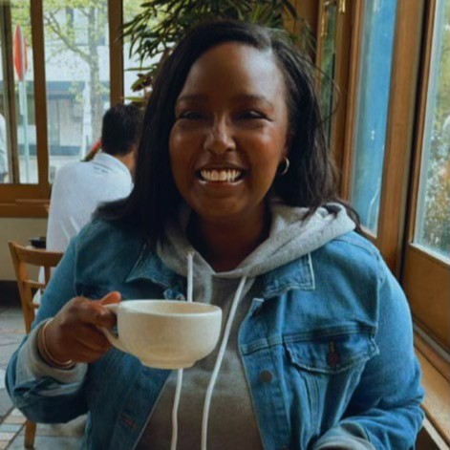
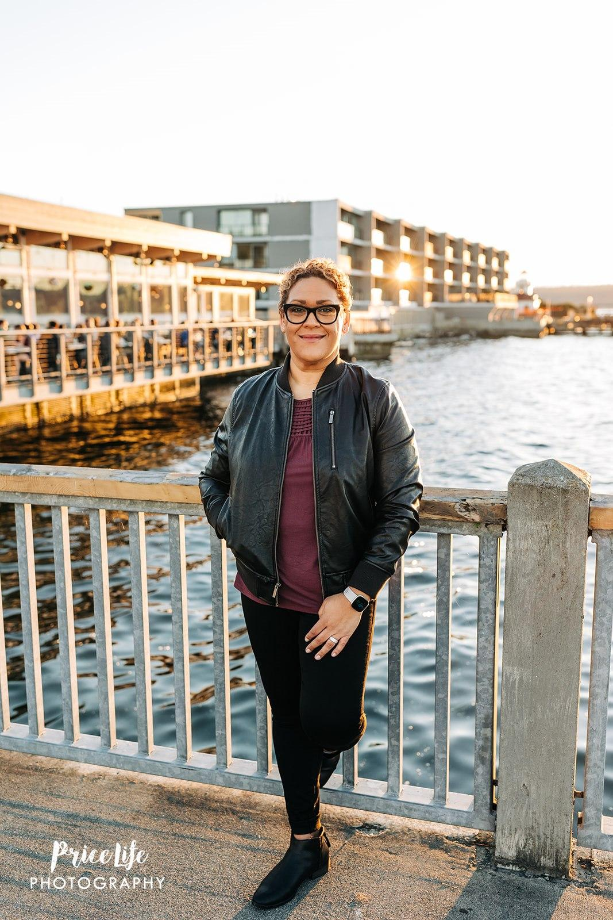
Speaker Introduction
Lisa Grund Mom, Leader, Wife, Speaker, Coach & BIPOC woman (short curly hair, wearing black & purple, standing against a bridge near water). Interesting facts:
Peloton Addict
Tangi Tash Wife, Mentor, Leader & Black woman (straight black hair sitting in Cafe with cup of tea in hand.)
Interesting Fact:
Lover of Frenchies
Notes:
LISA & TANGI

Slide 4
What Does it Mean to be Anti-Racist?
Anti-Racism:
A belief that recognizes and rejects the supremacy of one racial group to another and promotes racial equality across societal institutions.
Notes:
TANGI

Slide 5
Examples of Anti-Racism at Work:
Sponsorship
Advocacy
Networking Outside of Your Demographic
Mentoring
Volunteering
Active Listening
Representation & Inclusive Recruiting
Challenging the Status Quo
Notes:
TANGI

Slide 6
Sponsorship and Advocacy: Mentorship Matters
What is a Career Sponsor?
They are a leader (not necessarily by title)
They have influence with other leaders and decision makers
They have a successful track record
They want to help you advance in your career
What is the Mentor Role?
Encourages skill development
Mentors help guide others in goal achievement
Help expand mentees professional network
A role-model
Mentors provide critical feedback
Notes:
LISA

Slide 7
Circle of Influence
Sponsor
Employee
Influential Leader
Decision Maker
Door Opener
Advocating for yourself
Share Authentically
Intentional Conversations
Accountability
Circle of Influence
Mentor
Feedback
Regular Check-In’s
Introductions to their network
Sounding board
Notes:
LISA

Slide 8
Building Authentic Relationships
Psychological Safety
Intentional Networking
Open and honest dialogue
Be mindful of labels
Listen with your full attention
Notes:
LISA

Slide 9
Best Practices for Inclusive Recruiting
Augmented Writing Tools
Create Accessibility Features on Company Job Board
Conduct Unconscious Bias Training
Commit to Internal Equity & Promotion
Create Diverse Interview Panels
Develop a Standardized Interview Process
Build Measurable Organizational DEI goals
Notes:
TANGI

Slide 10
Q&A

Slide 11
References
Baboolall, David, and Alexandra Nee. “Tracking Diversity, Equity, and Inclusion Data in Private Markets.” McKinsey & Company, McKinsey & Company, 31 Oct. 2022.
KENDI, IBRAM X. How to Be an Antiracist. Penguin Random House LLC, 2019.

Slide 12
HELPFUL RESOURCE GUIDE CLICK PDF ICON BELOW
Notes:
TANGI/LISA

Slide 13
CONNECT WITH US
Tangi Tash | LinkedIn
Lisa Grund | LinkedIn
Notes:
LISA/TANGI

