Slide 1




NORMALIZING SHARED POWER AS A TOOL TO DISRUPT POLICIES, PRACTICES, AND PROCESSES
Normalizing
Shared Power
As a tool to disrupt Policies, Practices, and Processes
Follow us:

Slide 2





SHARED POWER CONSULTANTS
MEET YOUR
SHE/HER/THEY
SHE/HER/DIVA
SHE/HER/ELLA
HE/HIM/HIS
SABRINA D. NJOROGE
RAUNEISHA LARKINS
AMBER
ORTIZ-DIAZ
JEAN
PAUL
02

Slide 3






OVERVIEW
Community Agreements
04
Engagement Activity
06
What is Shared Power
07
Disrupting Policies
09
Equity in Processes
10
Shared Power in Practice
11
Zero-Sum Theory
12
Review
13
Call to Action
14
03

Slide 4











HOW TO SHOW UP AUTHENTICALLY
HOW TO SHOW UP
Authentically
Be Transparent
Assume Good Intentions & Own Your Impact
Transparency is a trust building mechanism. It creates a workplace culture that is more collaborative and trustworthy. It is the manifestation of understanding "we are not perfect."
Center the impact and take responsibility for the harm created.
Speak Your Truth
Expect & Accept Non-Closure
When you speak the truth, you open the door for self- liberation. Own your words, as the truth will set you free. View others lived experiences as an asset to conversations rather than a liability.
Sit in your "uncomfortability." Do not rush to quick solutions.
Remain Engaged
Seek to Understand
Lean into the discomforts of tough conversations, as these moments are opportunities for self-growth.
Show respect by valuing others' perspectives, lived experiences, thoughts and feelings.
Stay Curious
Check Your Privilege
Curiosity broadens knowledge, challenges assumptions, and strengthens engagement.
Take a moment to reflect on the privileges you have experienced in your life are influencing your thoughts and behaviors.
Take Time to Reflect
Show Up & Be Your Authentic Self
Taking time to pause and reflect on ourselves helps us to learn from mistakes. It involves intentional analysis of our beliefs and actions. It strengthens our empathy for others and boosts problem-solving.
Bring your authentic self to conversations. Be transparent about where you are on your journey so others can meet you where you are.
04

Slide 5








MENTAL HEALTH CHECK-IN
MENTAL HEALTH
Check-In
How has your experience with the conference been thus far?
Green
Everything has been fantastic!
Blue
So far, so good. Can’t complain.
Yellow
I may have room for a little more information.
Purple
I am processing.
Red
My brain is on overload!
05

Slide 6

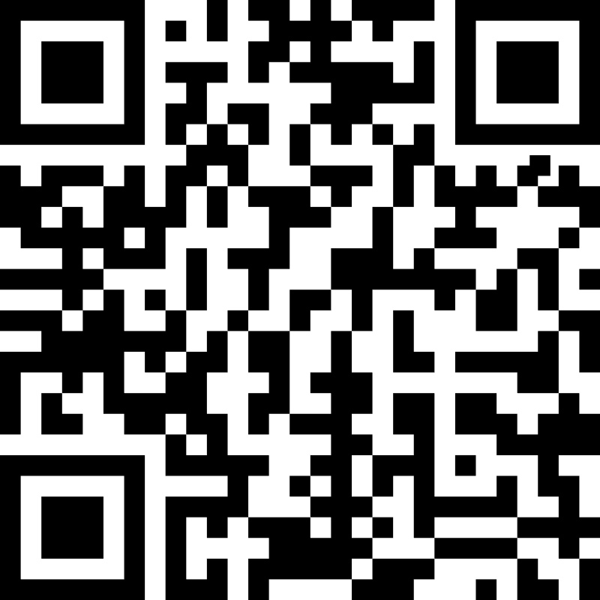
ENGAGEMENT ACTIVITY
PROMPT
Using the link below, tell us what comes to mind when you hear the term “Shared Power”.
ENGAGEMENT
Activity
06

Slide 7

WHAT IS SHARED POWER
WHAT IS...
Shared Power
DISRUPTING SYSTEMS
THE FOUR PRINCIPLES
DEFINITION
07

Slide 8


BRAIN BREAK!

Slide 9


DISRUPTING POLICIES
DISRUPTING
Policies
DEFINITION OF POLICY
NORMS IN GOVERNMENT
DECISION-MAKING MODEL
ACTIVELY DISRUPTING
09

Slide 10


EQUITY IN PROCESSES
EQUITY
in Processes
MINDFUL
SPACEFUL
Being mindful in spaces requires the three A’s:
Ways to understand the spaces you are in:
  Asking Questions
  Attention
  Attitude
  Decision making model
  Empowering
  Privilege
10

Slide 11


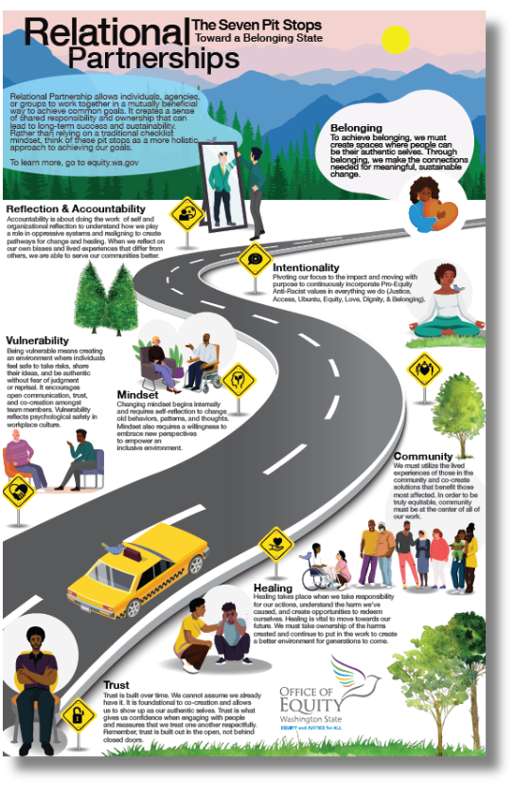

SHARED POWER IN PRACTICE
SHARED POWER
In Practice
11

Slide 12

ZERO-SUM THEORY
ZERO-SUM
1919
Fairground Park pool was the largest in the country and probably the world.
Theory
1950
Once desegregated, the pool went from 313,000 to only 10,000 swims.
1971
U.S Supreme Court elected to drain public swimming pools to avoid integration.
12

Slide 13

QUICK REVIEW
DEFINING SHARED POWER
DISRUPTING POLICIES
EQUITY IN PROCESSES
SHARED POWER IN PRACTICE
ZERO-SUM THEORY
13

Slide 14



CALL TO ACTION!
In one word, what are you willing to commit to disrupt the status quo in state government.
14

Slide 15



THANK YOU
Contact Us
www.equity.wa.gov
sharedpower@equity.wa.gov

