Slide 1
Supporting Leadership and Utilizing BRGs to Recruit and Retain Latine Employees
By the Washington State Latino Leadership Network
Photo by Leon Overweel on Unsplash

Slide 2
Introduction
Photo by Vladislav Klapin on Unsplash

Slide 3
Learning Objectives
Background on Business Resource Groups (BRGs)
Background of Hispanic/Latino Population in Washington
Benefits of BRGs for the Public
Benefits for State Employees
Benefits for State Agencies
How to Support BRGs and Leadership

Slide 4
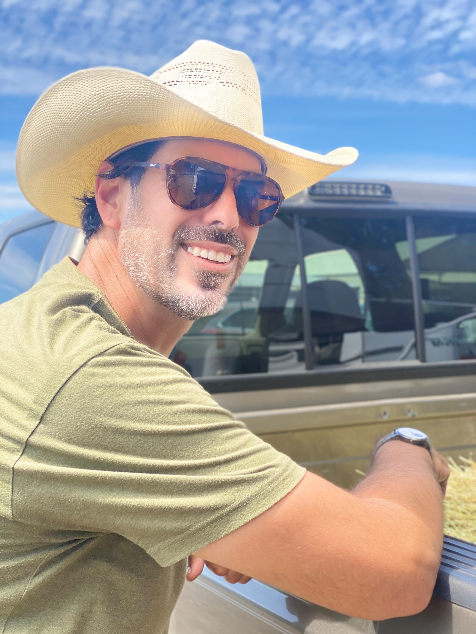
Who are your presenters?
Herminia Esqueda (She/Her/Ella)
Monica Andrade-Hupp (She/Her)
Tony Griego (He/Him)

Slide 5
What is the Latino Leadership Network?
Who We Are
LLN is a business resource group that strives to provide Latinos and their allies in state government a place where they feel a sense of community, learn new things that help them in their professions, and meet other fellow Latino state workers.
Vision
Connecting and inspiring Washington State’s Latino workforce and leaders of today and tomorrow.
Mission
Through the power of connection: invest, inspire and serve.
While LLN uses the term “Latino”, we use the term for anyone who identifies as Hispanic, Latino, Latina, Latine, Latinx, Latin@, Chicano, or other similar identifiers.

Slide 6
What is a Business Resource Group?
Statewide business resource groups (BRGs) bring together groups of employees and their allies who have a common interest or characteristic
All BRGs have a charter, mission, goals, and bylaws
BRGs bring unique knowledge and perspective to state business needs, such as recruitment and retention
Notes:
Poll – Have you participated in a Business Resource Group (BRG) event?

Slide 7
Background/Context
Photo by Nahas Akbar on Unsplash

Slide 8
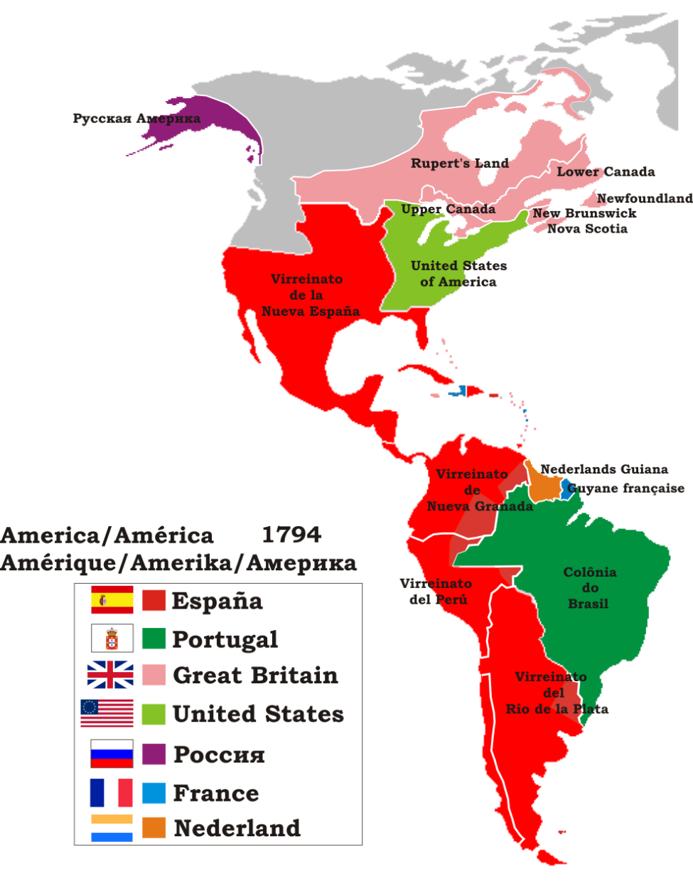
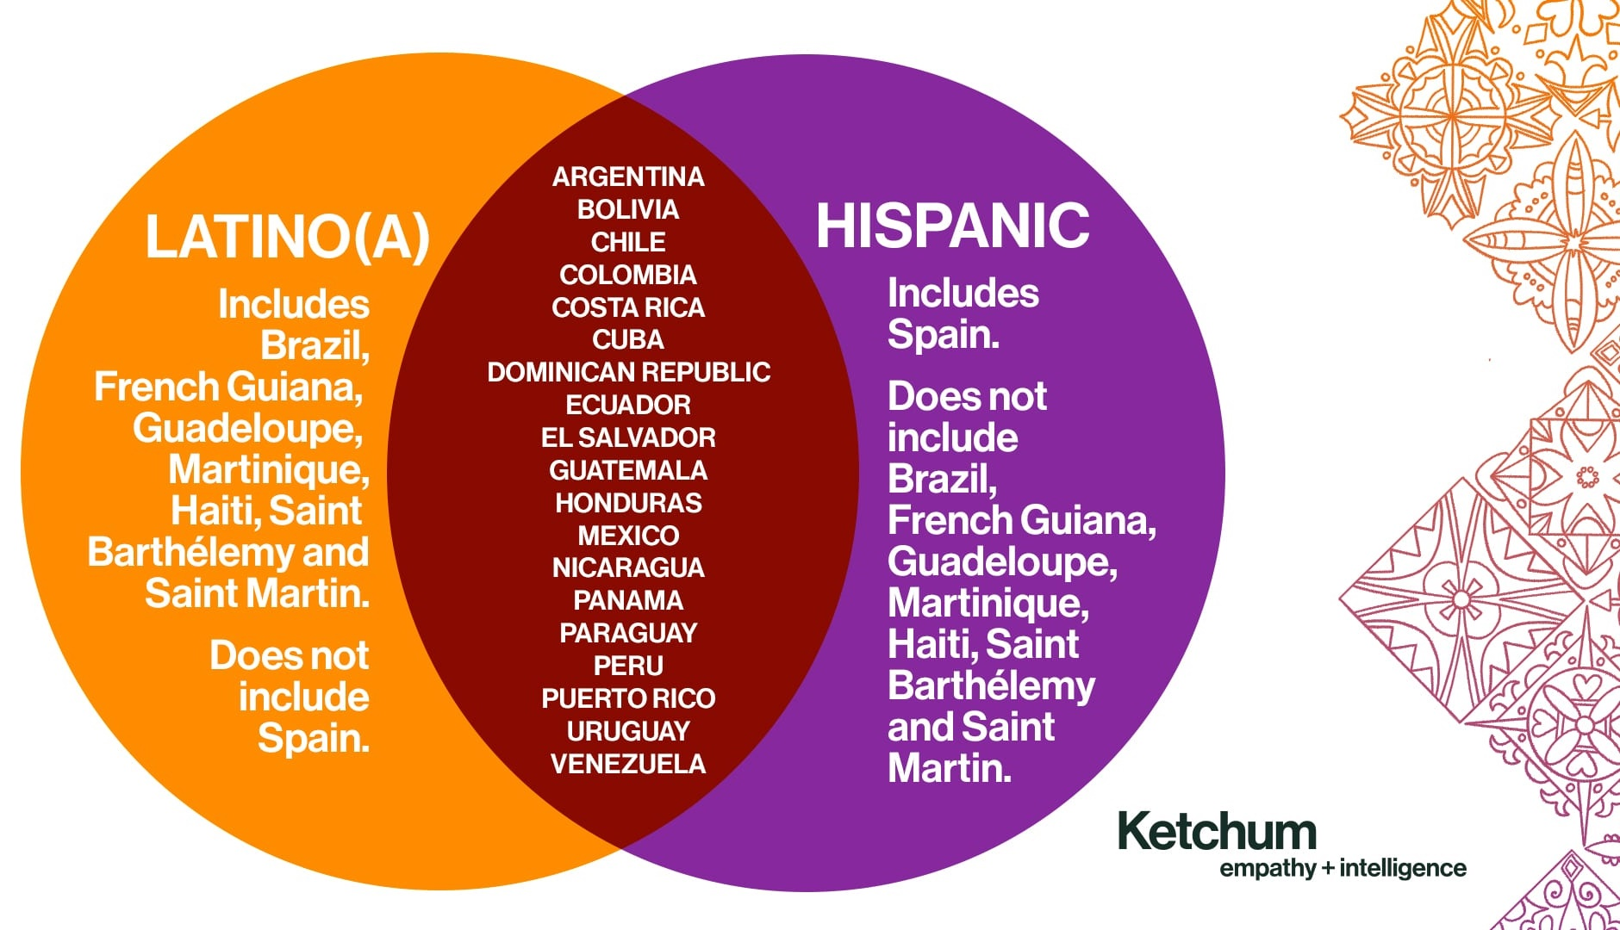
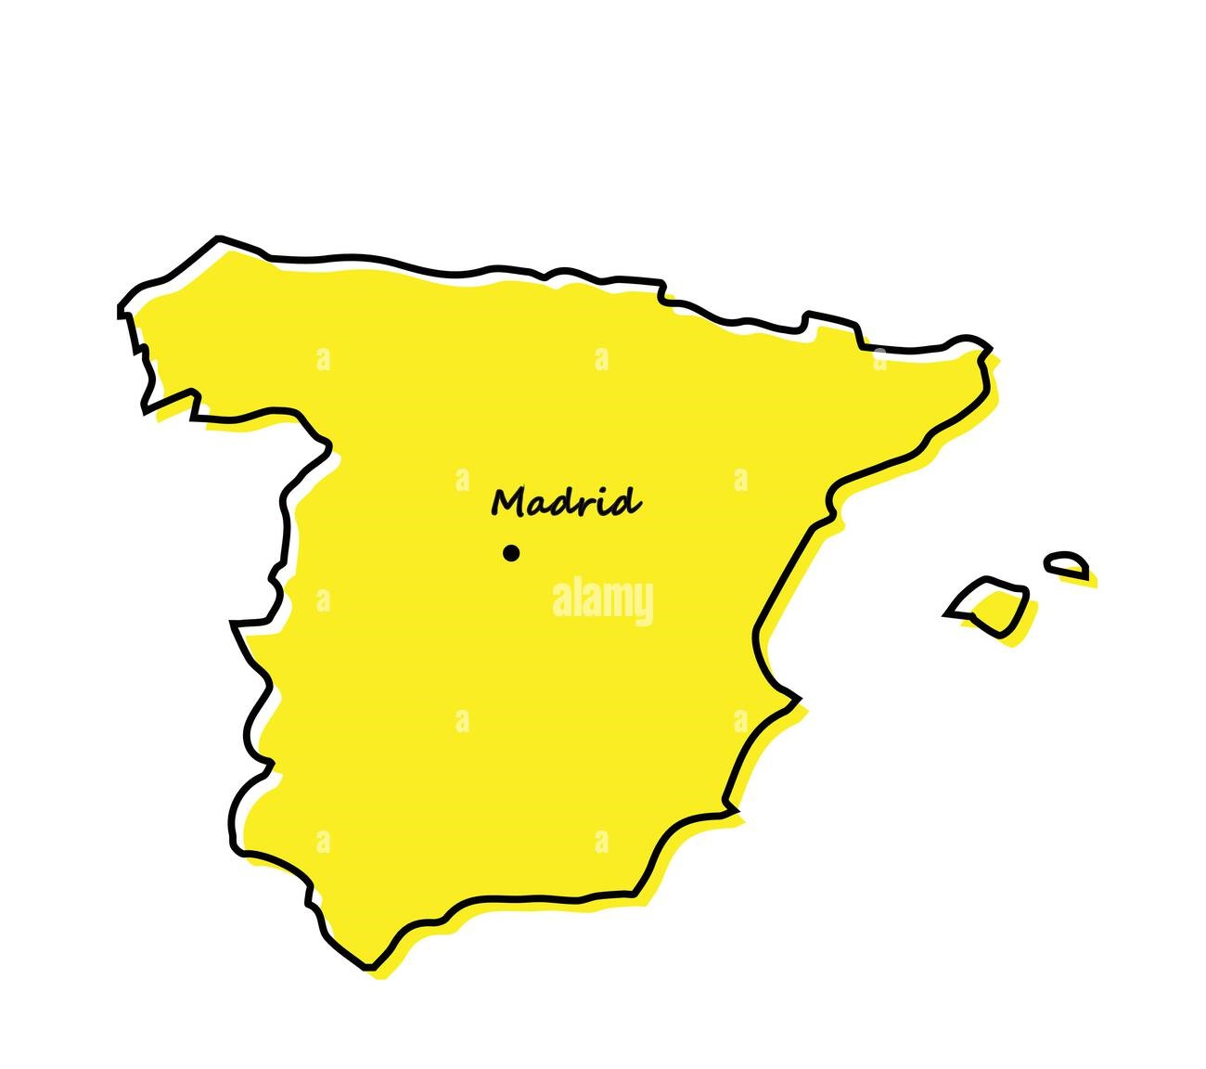
What is Hispanic and/or Latine?

Slide 9
Race vs. Ethnicity – What does it mean?
A Timeline of Hispanic/Latino on the US Census
1930 US Census – First and only appearance of “Mexican”
Race option
Mexican “Repatriation”
1940 to 1970 US Census – No option provided
1980 US Census – First appearance of “Spanish/Hispanic Origin”
Ethnicity option
2000 US Census – “Hispanic, Latino, or Spanish Origin”
Specificity options: Mexican/Mexican Am/Chicano, Puerto Rican, Cuban, Other
2024 US Office of Management & Budget publishes revision to Statistical Policy Directive
Race and Ethnicity become one combined question
Definitions
Race – divides people into social groups based on physical characteristics such as skin color
Ethnicity – divides people into social groups based around cultural characteristics such as language, values, heritage, history, and ancestral geography

Slide 10
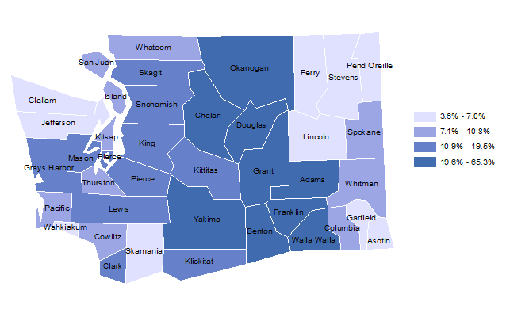
Population and demographics for Washington
2022 WA Office of Financial Management (OFM) estimate of Hispanic/Latino population: 1,139,944 people
OFM estimates almost a half million Spanish speakers with limited English proficiency
Hispanic Population as a Percentage of Total Population

Slide 11
Generational Experiences
2021 Pew Research of American Community Surveys found
81% of US Hispanics were US citizens
US Hispanic population age is younger than overall US population
US Hispanic population with a Bachelors degree is growing (1 in 5)
Median Age
Hispanic Total | Hispanic US-Born | Overall US
29.5 years | 21.0 years | 37.8 years
Notes:
11 facts about Hispanic origin groups in the U.S. | Pew Research Center
Latinos not only cover a vast geography, we have a range of varying generational experiences.
We are demographic group that is often assumed in media to be a monolith because of a shared language.
When in fact our experiences in our country and in Washington are shaped by our age and family heritages. As the Hispanic population has grown in Washington, it has also expanded throughout the state.

Slide 12
Hispanic State workforce demographics
Data Source: WA OFM
Data Source: WA OFM
Notes:
Diversity Overview | Office of Financial Management (wa.gov)

Slide 13
Challenges for Latine state employees
2020 LLN Professional Development & Inclusion Survey found:
1 in 5 Latinos felt they had been paid less or passed over for promotion because they were Latino
1 in 3 Latinos felt they experienced discrimination in the workplace
The Latina Pay Gap
Data Source: 2020 WA LLN Professional Development & Inclusion Survey
Data Source: www.equalpaytoday.org

Slide 14
Challenges in Advancement and Recruitment
LLN Survey found:
2 out of 5 Latinos felt that to advance in leadership requires adjusting their speech, appearance, or behavior
Only 40% of Latinos felt their unique experience as a Latino was valued as an asset within their agency
Data Source: WA OFM

Slide 15
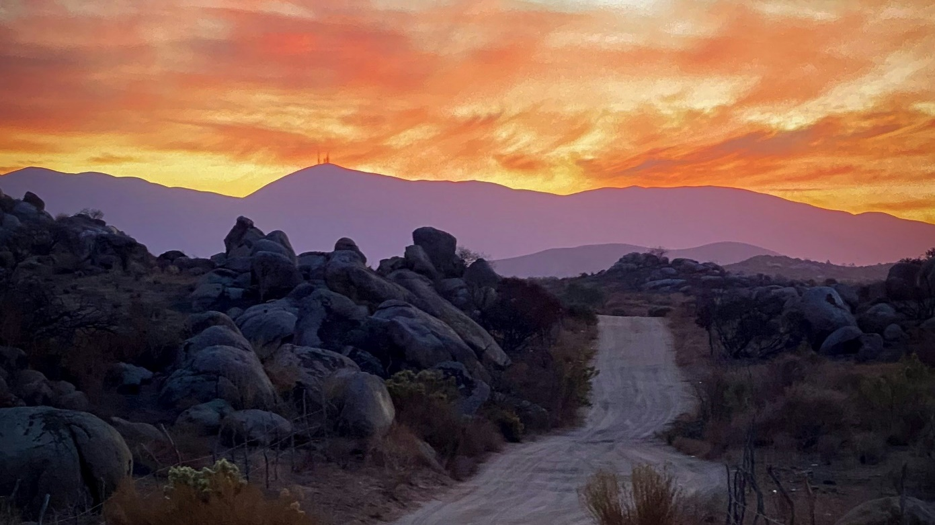
Benefits of BRGs for the Public
Photo by Luis Ramirez on Unsplash

Slide 16
SSB 5304 Workgroup
SSB 5304 – Testing individuals who provide language access to state services
The bill directed Dept. of Social and Health Services (DSHS) to convene the Language Access Workgroup to study and make recommendations to the Legislature regarding interpretive service certification policies and programs for Washingtonians with limited English proficiency.
The bill required inclusion of stakeholders, community groups, and partner agencies.
DSHS sought out and encouraged participation from BRGs
Provided draft recommendations
Final report recommendations informed by BRG cultural perspectives and state employee experience

Slide 17
OAH Writing Style Guide
Office of Administrative Hearings – Writing Style Committee
OAH Writing Style Manual – Gender Inclusive Writing Appendix
Gathered input from LGBTQ Commission, ICSEW, and RAIN
Held a speaker panel and training with RAIN
Results - community perspective with understanding of state service, systems, and experience as state employees

Slide 18
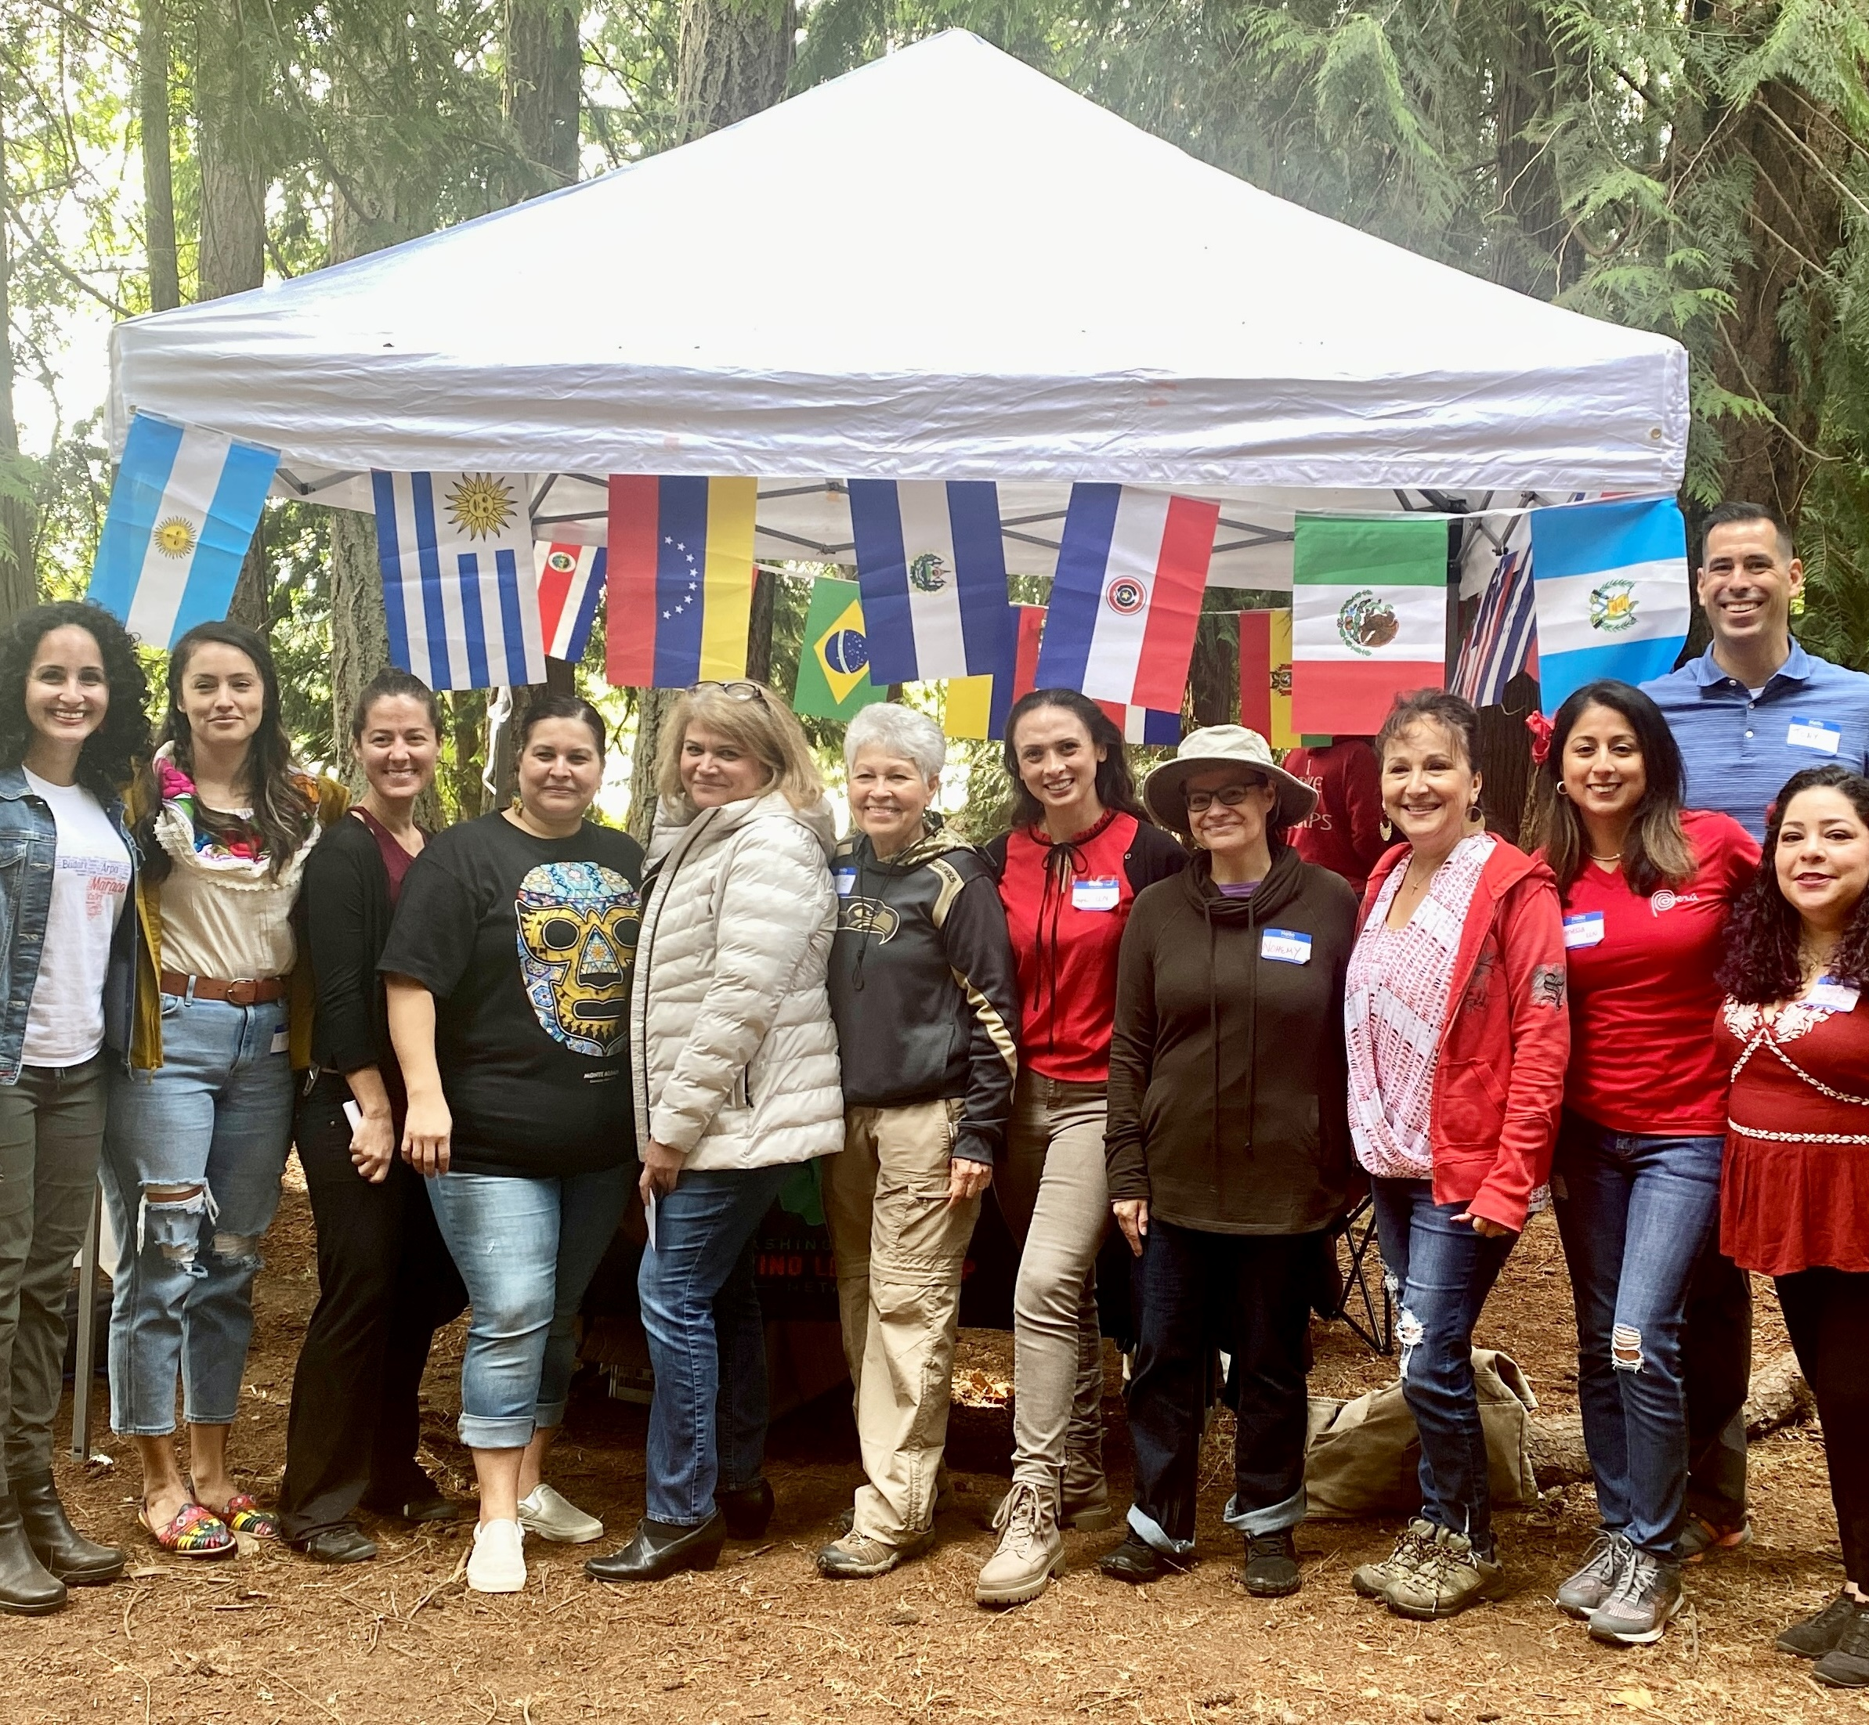
Representative public service
BRGs help state agencies provide culturally informed services
By supporting state employees from these groups BRGs agencies show they value our experiences
Feeling valued and serving our communities helps support recruitment and likelihood of recommending the state as an employer

Slide 19
Benefits for State Employees
Photo by Theo Bickel on Unsplash

Slide 20
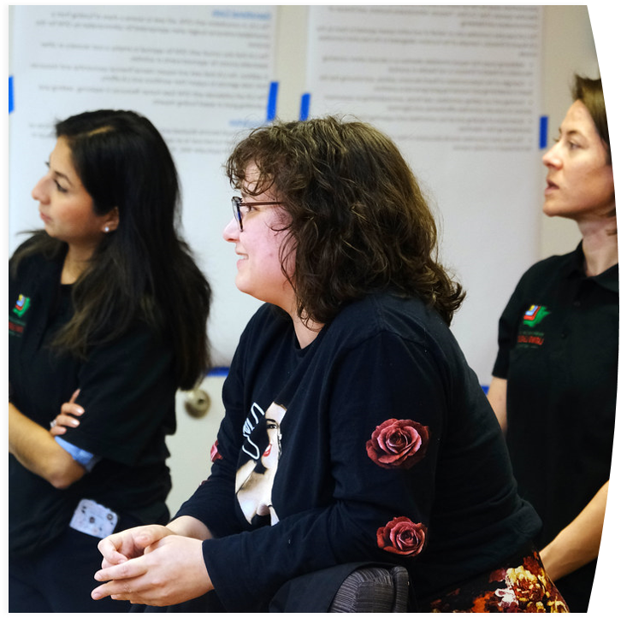
Community and Network Building
Bringing together state employees from across agencies to build their professional network.
Building Social Capital – Leveraging existing community resources and connection in building a network in support of your goals.
Latino Leadership Network hosts “Charla” sessions to provide space in General Membership Meetings
Charla – Chat or informal conversation

Slide 21
Professional Development
Training and education opportunities
Participation in projects
Giving presentations and skills sharing in meetings
Photo by Miquel Parera on Unsplash

Slide 22
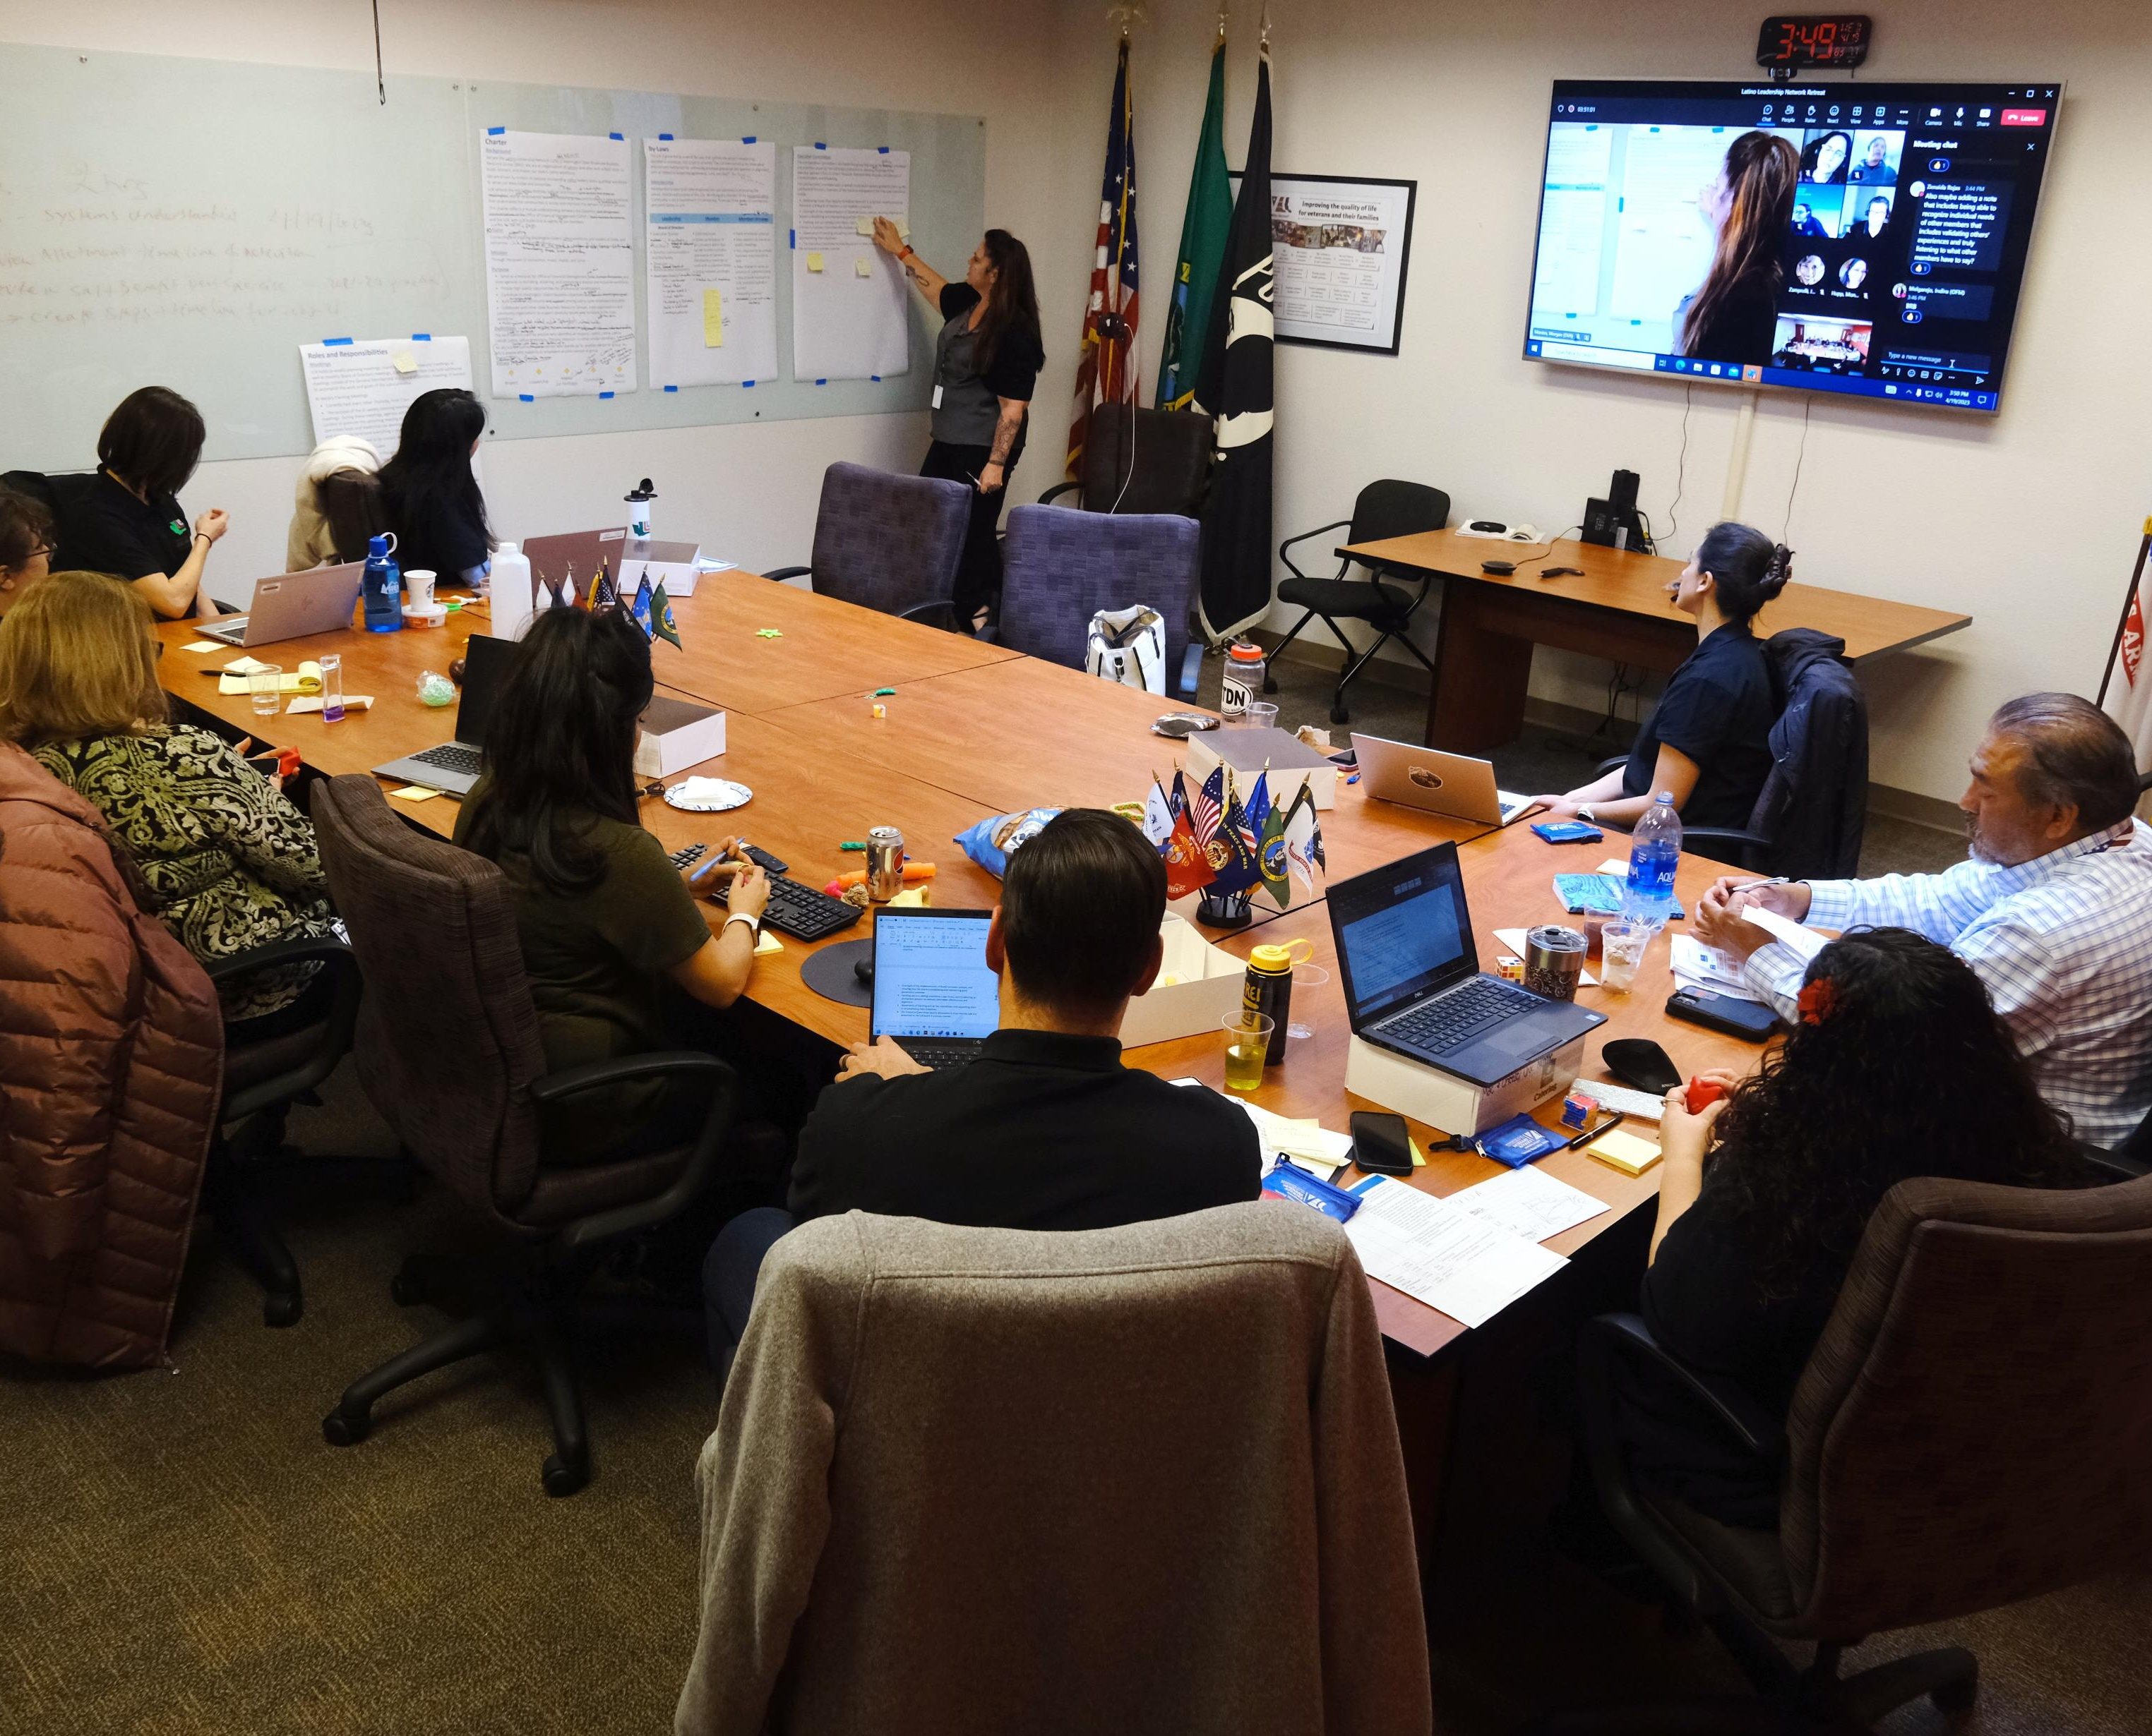
Leadership Experience
BRGs provide opportunities for leadership experience
Committees
Workgroups
Projects
Executive Leadership
Opportunity to be part of a leadership team composed of members of their identity or community group

Slide 23
Navigational Capital
The ability to maneuver through systems and institutions that historically were not designed for you.
Examples:
How to apply for a recruitment.
Negotiating salary.
Photo by Aliaksei Lepik on Unsplash

Slide 24
Benefits for Agencies
Photo by Meritt Thomas on Unsplash

Slide 25
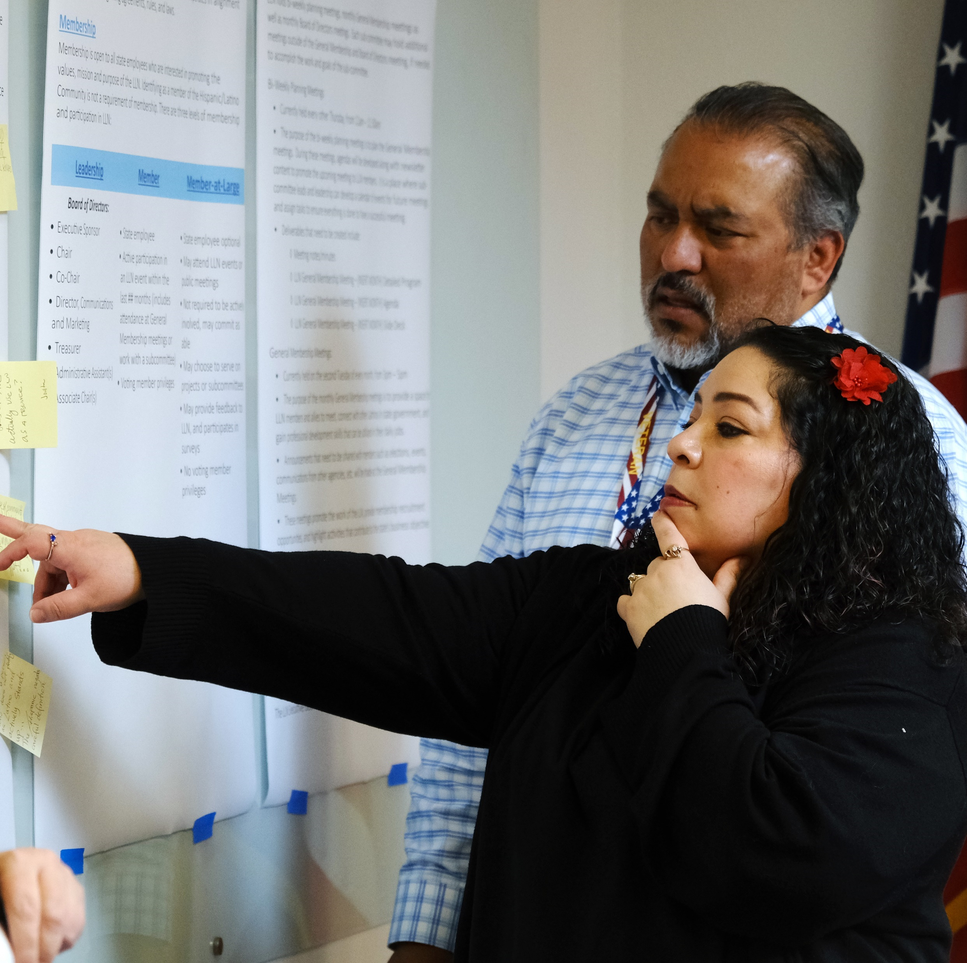
Informed Community Engagement
Community Engagement informed by public service
BRG members are not only state employees, they also are customers of state services

Slide 26
Recruitment Support
BRGs help advertise agency recruitments
Example: Assistant Attorney General – Spanish Speaking
Participation on interview panels
Example: OAH Language Access Coordinator
Job Listing Request Form

Slide 27
Leadership Development
BRGs are an incubator for future agency leaders. They allow for members to discover their leadership style and values in a community of peers.

Slide 28
Cross Agency Collaboration
Information sharing in General Membership meetings and Committee meetings
Sharing of resources and information in DEI Committee
LLN Best Practices Committee and projects
LLN Newsletter (widens outreach and access for those that cannot attend)
Presentation agency work in LLN General Membership meetings
Universal Basic Income presentation
OAH Spanish UI Hearings
DOL and WDFW PEAR team presentations

Slide 29
Supporting BRGs and Leadership
Photo by Neil Thomas on Unsplash

Slide 30
Encourage Participation
Actively encourage participation! (for allies too)
Make it safe to take time for meeting attendance.
EO 21-01 Affirms BRGs
“Wheareas, BRGs are integral partners of the state of Washington in its work to provide the best possible services to all Washingtonians.”
State HR Policy – Supporting Employee Business Resource Group Participation
Open to all current employees who identify as a member of the community or ally
Participation is considered work-related and a leadership priority
Participating employees shall experience no loss in pay, and shall not be asked to take leave time to attend BRG-related activities

Slide 31
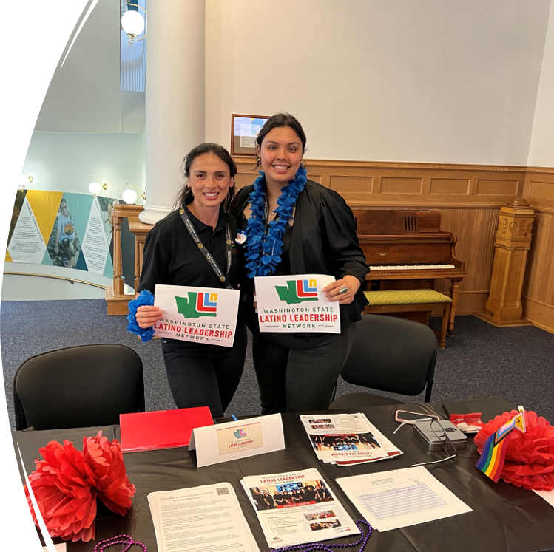
Encourage Leadership Level Participation
Support employees in seeking BRG leadership roles
Understand that this comes with a time commitment
Leadership includes more than elected positions and may include leading a committee or a project

Slide 32
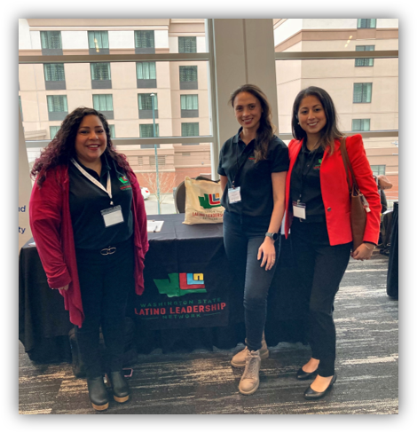
Attend BRG Events as Leaders
Visible attendance by agency leaders is a sign of support!
Leadership by example
An opportunity to engage in community discussions and state agency events that reinforce our member’s existing leadership abilities with new skills and perspectives to enhance our work.

Slide 33
Showcase your Agency/Work/Skills
Agencies can highlight their achievements and project work!
BRG members are interested to learn from their peers.
Interest in agency projects and achievements can help drive interest and recruitment.
Dept. of Licensing PEAR Team
Dept. of Fish and Wildlife PEAR Team
OAH Spanish Unemployment Hearings
Dept. of Children, Youth, and Families Language Access Survey

Slide 34
Lend a Helping Hand
Design agency projects or BRG requests with an understanding of the impact and workload.
Embrace culturally sensitive collaboration.
Invite BRG leadership and leaders to your professional development opportunities and conferences.

Slide 35
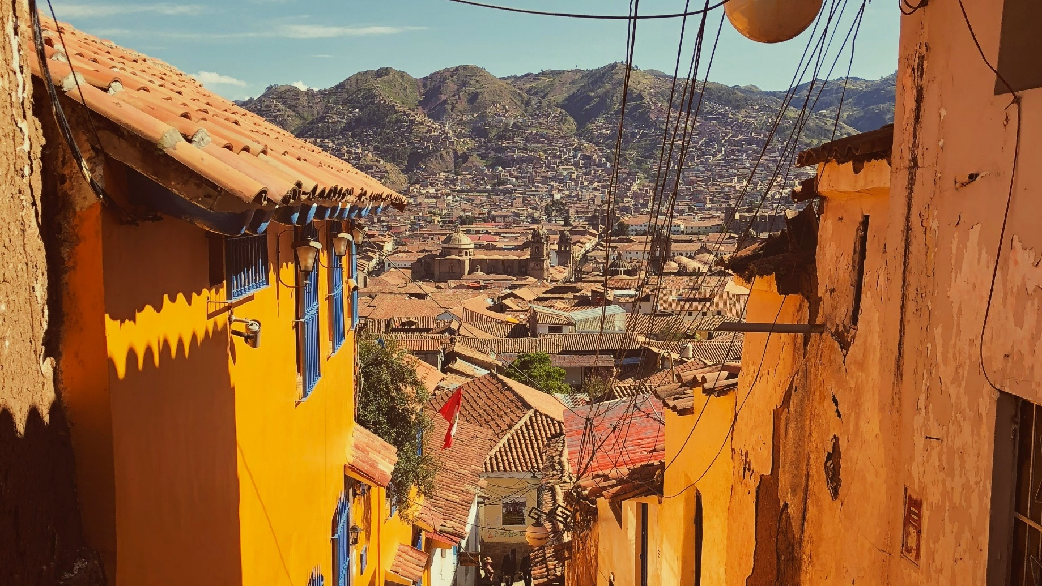
Closing
Photo by Joe Green on Unsplash

Slide 36
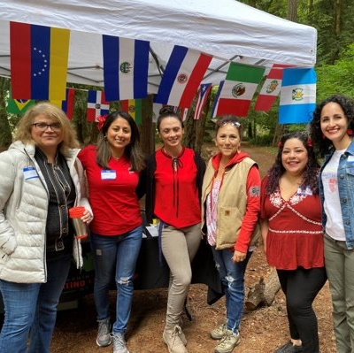
Recap
Today we covered:
Background on Business Resource Groups (BRGs)
Background of Hispanic/Latino Population in Washington
Benefits of BRGs for the Public
Benefits for State Employees
Benefits for State Agencies
How to Support BRGs and Leadership

Slide 37
Promote LLN (and BRGs)
Contact - LLN@ofm.wa.gov
LLN General Membership Meetings – 2nd Tuesday of the Month from 3-5pm
Save the Date: LLN Hispanic Heritage Month Celebration on Saturday September 28th

