Slide 1

The Americans with Disabilities Act (ADA)
A Model for Disrupting Policies and Practices to Foster Equity
Notes:
The ADA: A Model for Disrupting Policies and Practices to Foster Equity
Hello! Thank you everyone for being here! We’re excited to talk with you about the Americans with Disabilities Act and how this law requires us to disrupt policies and practices to include disabled people.
My name is Katie Warden, I’m the director of the Northwest ADA Center.
Today, I’ll also be presenting with… Linda Clemon-Karp. In a few slides, we’ll take a moment to introduce ourselves and our relationship to this work a litte more deeply.

Slide 2
Roadmap
Where are we going today?
01. Disability as Diversity
02. ADA Overview
03. Seemingly Neutral Policies
04. Planning for Inclusion
Notes:
What is our plan for today? First, we’re going to talk about how we at the Northwest ADA Center – and how many disabled scholars and activists think about disability – so we’ll explore disability from a diversity perspective. Next, we’re going to present a high-level overview of the ADA – who are people with disabilities, where does this law apply in our lives and work, and what are some of it’s basic requirements. Next, we’ll focus on the theme of this conference – disrupting policies and practices. We’ll talk about what we’re calling seemingly neutral policies or practices and how the ADA requires us to modify or change all sorts of policies that can exclude people with disability. Last, were going to learn about concrete steps we can take to plan for inclusion – how can we craft policies that are less exclusionary?
That’s the content we want to cover today. I also want to let you know that we are going to take a short break for reflection and dialogue halfway through the presentation. Of course, please do whatever you need to be present – take breaks, stim, lay down – whatever can support your access.
I also want you to know – please feel free to ask questions throughout - we want this presentation to be as useful and practical as possible.

Slide 3
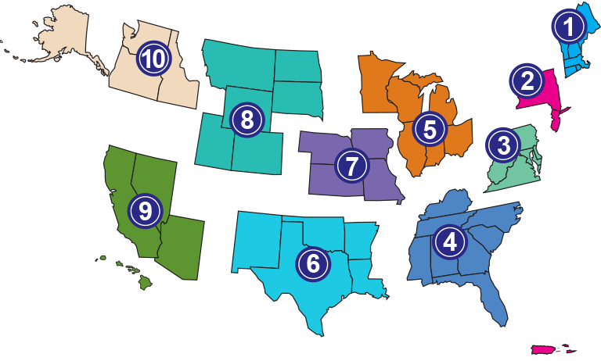
Northwest ADA Center
Questions about the ADA?
Call or email:
1-800-949-4232
nwadactr@uw.edu
Notes:
I’d like to also share a little information about where we work - the Northwest ADA Center. We are part of a national network of ADA centers - and we are funded to provide information about the ADA – to help people understand how this law applies to their lives. On the slide is a map of the different regional ADA centers – you can ask us questions about the ADA – it’s free and confidential – over the phone or email. Our contact information is on the slide.
I’d like to also share a little information about where we work - the Northwest ADA Center. We are part of a national network of ADA centers - and we are funded to provide information about the ADA – to help people understand how this law applies to their lives.
On the slide is a map of the different regional ADA centers. We're region 10 and we work in Idaho, Oregon, Washington an Alaska.
You can ask us questions about the ADA – it’s free and confidential – over the phone or email. Our contact information is on the slide.
I’m a lawyer and a sociologist. I also am a person with a disability – I have type 1 diabetes, a learning disability, and a mental health condition or a mental illness. I share that with you all because most of the time my disabilities are not visible, sometimes they become visible – and that’s true for many people with disabilities.
I also want to introduce myself, I'm the director of the Northwest ADA Center, I'm a lawyer and sociologist - and I identify as disabled. You might notice that I use both the terms disabled people and people with disabilities interchangeably; this reflects the dominant practice in disability studies (DS), that academic part of the disability rights movement. I also want to let you know that I have type 1 diabetes, ADHD, and an assortment of mental illnesses. So this disability rights work is very important to me both personally and professionally.
Part of what we're talking about today – reasonable modifications – this flexibility and openness to changing policies and expectations – has been key to ensuring access for people with these impairments - like me. I share that identity with you all because in disability activism, we’re encouraged to share our relationship to disability, because our relationship to disability, whether we identify as disabled, we love disabled people, or we’re going to become disabled – can shape how we understand disability rights and can shape what seems important or critical. It can also keep me from seeing issues that would be obvious or apparent to people who has a different relationship to disability.

Slide 4

Legal Disclaimer & Funding Acknowledgement
The Northwest ADA Center is funded under a grant from the Administration for Community Living (ACL), NIDILRR grant #90DP0095.
However, these contents do not necessarily represent the policy of the ACL, and you should not assume endorsement by the Federal Government.
The information provided by the Northwest ADA Center is intended as general information.
Notes:
Now, on the screen is our disclaimer slide. The NW ADA Center is federally funded to share information about the Americans with Disabilities Act – however, the information and opinions in our trainings are just that – our opinions – and don’t necessarily represent the views of the federal government. What we talk about is just information – and it’s not intended as legal advice.

Slide 5
Learning Objectives
01. Consider disability from a “misfits” perspective
02. Be familiar with the ADA’s key concepts
03. Understand accommodations as a way to create access
04. Be familiar with best practices for creating inclusive spaces
Notes:
Among the takeaways of this session, participants will be able to:
1. Define and recognize a reasonable modification request;
2. Recount three elements of the workplace accommodations process;
3. Learn to ensure accessibility when planning a meeting;
4. Apply these concepts and practices to any exclusionary policy.
At the end of the webinar, I'm hoping you'll be able to think about disability from a diversity perspective – to think about how policies or practices in your work might lead to exclusion for disabled people. I want us to understand the ADA requirements as a way to create access…

Slide 6
Disability as Diversity
1
Notes:
Let's jump into our content. There are many different models or frameworks for understanding disability. There are many ways to think about or define disability. In general, we categorize different perspectives on disability into groups or frameworks – deficit frameworks or diversity frameworks.

Slide 7
Deficit Framework of Disability
Variation from the typical is “bad”
Society should seek to minimize (bad) variation within its members
Disability is a trait or attribute of the individual
Solution is to “fix”, “treat” “rehabilitate” or “cure” the impairment
Notes:
In the United States, we are all socialized into a Deficit Framework or perspective of disability. This is still a dominant way of thinking about disability, and some key aspects of thinking about disability from a deficit perspective is that
Variation from the typical is “bad” (a value judgment)
Society should seek to minimize (bad) variation within its members
Disability is a trait or attribute of the individual and is therefore is not contextual
Solution is to “fix”, “treat” “rehabilitate” or “cure” the impairment
When we think about disability from this framework - If we see disability as bad, something that should be fixed – if we think that disability is about the individual, something inside our bodies or minds – it can lead to an assumption or belief that people with disabilities are

Slide 8
Rosemarie Garland-Thomson:
…people for whom something has gone terribly wrong…
Notes:
https://dsq-sds.org/index.php/dsq/article/view/4254/3594
But for the ways of being in the world that we consider disabilities, the majority world apparently understands us as people to whom something has happened, for whom something has gone terribly wrong. Indeed, this is the distinctive aspect of disability identity. This inquisitional targeting of people with perceptible disabilities is neither disability prejudice nor discrimination itself. It is what people in the world craft from this interrogational moment that makes disability discrimination and exclusion. This is my specific narrative response to "What's wrong with you?"—the primal interrogation that makes disability identity.
people for whom something has gone terribly wrong –On this slide is a quote from one of the founders of disability studies, Rosemarie Garland-Thomson. For me, this quote really captures the heart of the deficit framework – it’s a view that disability really is a tragedy, something that should be fixed, and something that’s located – something that’s in the person for whom something has gone terribly wrong.

Slide 9
Diversity Framework of Disability
Variation from the typical is natural and valuable
Society should seek to enable all its members to participate to their maximum capacity
Disability is NOT a trait or attribute of the individual
Solution: remove barriers of exclusion, which may or may not include medical or technological intervention
Notes:
But, a different framework of disability underlies the disability rights movement – and the ADA. Instead, we understand disability as part of the diversity of human experience. Arguing that, difference – differences in the way a person communicates, moves, thinks, senses visual or auditory input – is well, just different. Not better and not worse than the way anyone else communicates, moves, thinks, senses visual or auditory input. Just a form of diversity.
From a diversity perspective, • Variation from the typical is natural; diversity is valuable • Society should seek to enable all its me
Solution: remove barriers of exclusion, which may or may not include medical or technological augmentationmbers to participate to their maximum capacity • Disability is NOT a trait or attribute of the individual; but rather disability is a socially constructed status
In this framework, disability isn’t just about the individual – it isn’t about our bodies or minds, instead, from this perspective…

Slide 10
Defining Disability from a Diversity Framework
Disability: An interaction between one’s way of functioning and the social and built environment in which they find themselves
  Individuals may have nontypical or impaired functioning, but societal barriers disable individuals

Slide 11
Disability is Contextual
Body Mind
Environment
Notes:
Let’s talk some more about this view of disability – that disability is about the interaction between the way we exist in the world and the environment.
On the slide right now, there are two arrows pointing towards each other – and on one arrow we have the words Body Mind and that’s to represent our embodiment, the ways our bodies and minds function, and on the other arrow we have the words social environment – and social environment that refers to all of our expectations, assumptions, policies and practices – even the social norms about how we behave in public - and disability, in this perspective, happens when the body, when we meet or encounter the environment - disability is about the experience of having these nontypical – different – ways of being in an environment that doesn't fit or support or accept those differences. ​
– what are we saying when we say that people with disabilities have nontypical or even impaired functioning – we're recognizing the diversity of ways that people exist in the world – the diversity of ways that bodies and minds function. Right, so some bodies might move through space on two legs walking – some bodies might move through space using mobility devices – some body minds might communicate with speech and some might communicate with behavior or written words or with communication devices. Some body minds might process information faster or slower than is typical. ​
​
​
Today, because our focus is on policies and practices, we're mostly talking about the social environment – so when we have expectations about how people are supposed to move or act or communicate – these expectations influences our policies and practices – maybe we assume all people can get into dental chairs indepdenently or maybe we assume that all people can and do sit quietly in a waiting room - these expectations or assumptions can exclude people with disabilities when we move or act or communicate differently or in non-typical ways.​
​
Again these assumptions – that we are uniform – that we act the same – get built into our policies and practices – and those can lead to a misfit for someone with a disability – we don't fit expectations, we don't fit into standard policies or practices – there's a misfit between the way that wemove and think and exist and the social environment – those policies. That means we can be excluded or not get the health care we need – or have a right to. ​
​
​
And so, as we're talking to today – you might keep in mind - What are some policies, practices – the typical way we might do things – that can exclude people with disabilities? Where in your practice or your work, might you be assuming that everybody acts and thinks and communicates and moves in the same way?​
​
​
​
​
That’s our focus today.​
​

Slide 12
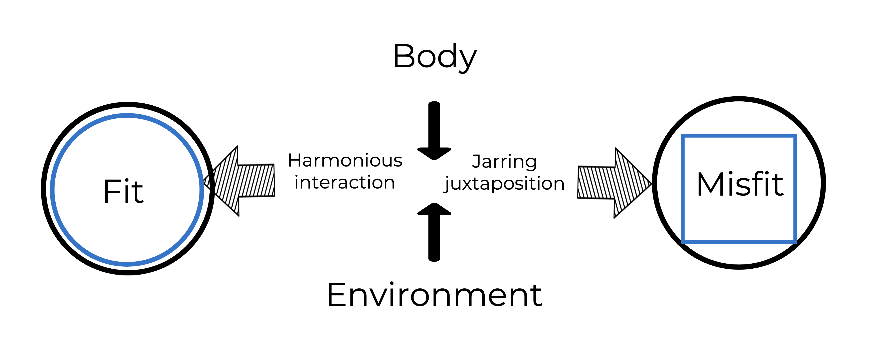
A “Misfits” Framework
Garland-Thomson 2011
Notes:
The misfits perspective is a newer take or update to the social model. It’s particularly useful because it removes judgment and blame from the equation. In this model, most people, people who don’t have disabilities, experience a “fit” when they live their lives, most of the time. When you go to the movie theater, you can drive there in your car, and the car is made to fit your needs to steer with your hands and control the pedals with your feet. The steps up to the movie theater are easily negotiable on two walking legs. You can understand the language used by the clerk and they understand your language and your desire to buy a movie ticket. There aren’t subtitles in the movie and you can hear the dialogue just fine. That’s a fit. Disability happens when you need to steer and pedal with your hands – but the car isn’t built that way. Disability happens when you need a ramp to enter the theater, and there’s only steps. Disability happens when you can’t see the movie listings and times – you need to hear that information – and there isn’t anyone there to read the movie times. Do you see what I’m saying? There’s no wrong or right here. There’s just a mismatch between an individual’s needs for access and the way the movie theater is built.
We’ll get to this soon, but one way to think about disability rights laws is that they attempt to create a fit for people with disabilities – to make spaces include ramps, to require interpreters in certain public settings, to accommodate the individual needs of people with disabilities.

Slide 13
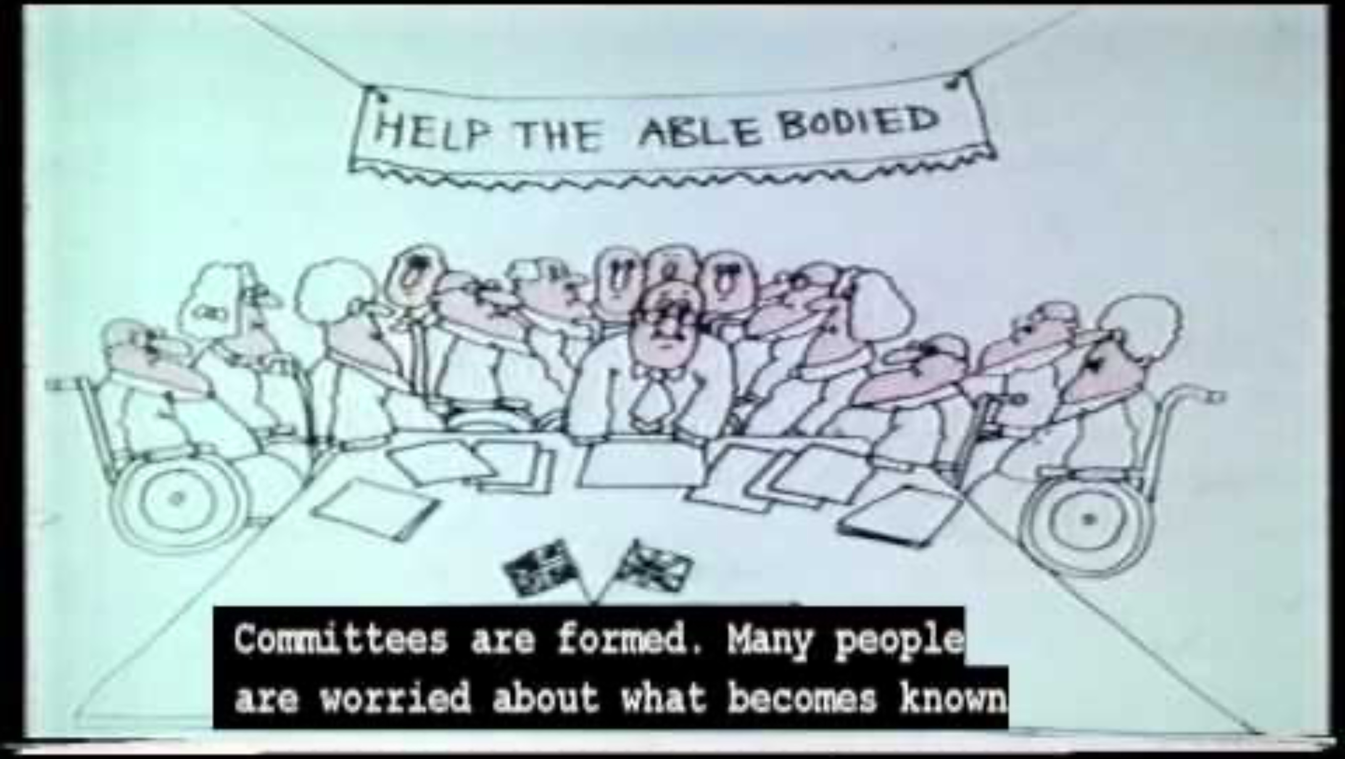
Social Model of Disability
https://www.youtube.com/watch?v=9s3NZaLhcc4
Notes:
Adams-Spink, Geoff. “Social Model of Disability Animation.” (Nov. 7 2011). You Tube. Available at: https://www.youtube.com/watch?v=9s3NZaLhcc4

Slide 14
ADA Overview
2

Slide 15
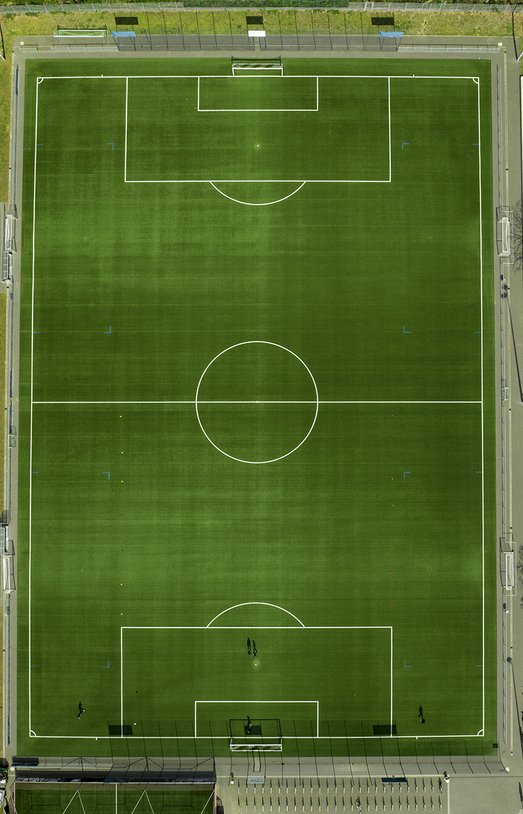
The ADA is a civil rights law.
              May not discriminate against or exclude people with disabilities.
              Must give people with disabilities equal opportunities and benefits as those given to people who do not have disabilities.
Notes:
The Americans with Disabilities Act is a civil rights law.
And as a civil rights law, the ADA has two broad, overarching requirements:
We may not discriminate against or exclude people with disabilities.
We must give people with disabilities equal opportunities and benefits as those given to people who do not have disabilities.
On the screen now, is an image of a soccer field – a playing field. When we say that the ADA is civil rights law – that means this is a law that’s about leveling the playing field – it’s about access and opportunity.
It’s not about benefits or special privileges. I want to note that because sometimes when we think about disability, we do think about benefits – we have laws that provide people with disabilities special benefits, like social security benefits or special education benefits – maybe people with disabilities qualify for reduced payments on utilities or public transportation – there are laws or policies that do something extra for people with disabilities. But that’s not the ADA – the ADA is just about getting us on the playing field – getting us access – but it’s not about giving anyone a free ride or special privilege or benefit. I think it’s important to keep that in mind as we talk through the ADA requirements – these requirements are necessary, the baseline to get disabled people access to your services, your programs, your facilities – the access that non-disabled people have already, just naturally, because of the way we’ve built our world.

Slide 16
ADA applies to all state and local agencies and their work!
The ADA affects virtually everything that state and local agencies do.

Slide 17
The ADA’s non-discrimination requirement applies:
Education
Transportation
Recreation
Health care
Social services
Courts
Voting
Emergency services
Offices where people go to:
Renew licenses
Apply for food stamps
Pay their taxes
Attend town meetings
Serve on boards and commissions

Slide 18
Who is a person with a disability?
Notes:
Now, let’s talk about who this law protects. Who is a person with a disability?

Slide 19
A person with a disability is someone who:
ADA’s Disability Definition
Has physical or mental impairment that substantially limits a major life activity.
Has a record of such an impairment.
Is perceived by others as having such an impairment.
Notes:
Because this is a law that’s about civil rights – a level playing field – access – and not about benefits or extra privileges – we have a really, really broad definition of disability.
Under the ADA a person with a disability is anyone who has a physical or mental impairment that substantially limits a major life activity.
Let’s break down this definition a bit. We’re really asking – Does someone have a disease or a condition that limits their ability to do things like concentrate or eat or read or walk or communicate? Does someone have a condition that limits their ability to see, hear, speak, breath, or learn?
I want to point out that definition just says “limits” – it doesn’t say unable. So, for example, someone might be able to walk, but not for long distances or not everyday and they would be protected. The law doesn’t just protect people who can’t do something, completely – that’s in part, because disability often isn’t an all or nothing type of experience. Many Deaf people have some hearing and many people who are legally blind, have some vision. People who use wheelchairs – sometimes can walk a little – or maybe their condition fluctuates and changes – they might need to use a wheelchair one day, but not the next.
I also just want to note that this law also protects people who have a record of a disability, like someone who has recovered from cancer, and people who are perceived by others as having a disability. That last part – protecting people who are perceived to be disabled – that can cover people who might have scarring or protect people who are rumored to have a disability, even if they don’t.
One more note on this disability definition: temporary conditions can also be covered! Someone might be temporarily disabled – might be limited in activity - and if it’s a substantial limitation – they could be protected as well.

Slide 20
Stigma creates disability:
ADA’s Disability Definition
A person with a disability is someone who is perceived by others as having an impairment that substantially limits a major life activity.
Notes:
Because this is a law that’s about civil rights – a level playing field – access – and not about benefits or extra privileges – we have a really, really broad definition of disability.
Under the ADA a person with a disability is anyone who has a physical or mental impairment that substantially limits a major life activity.
Let’s break down this definition a bit. We’re really asking – Does someone have a disease or a condition that limits their ability to do things like concentrate or eat or read or walk or communicate? Does someone have a condition that limits their ability to see, hear, speak, breath, or learn?
I want to point out that definition just says “limits” – it doesn’t say unable. So, for example, someone might be able to walk, but not for long distances or not everyday and they would be protected. The law doesn’t just protect people who can’t do something, completely – that’s in part, because disability often isn’t an all or nothing type of experience. Many Deaf people have some hearing and many people who are legally blind, have some vision. People who use wheelchairs – sometimes can walk a little – or maybe their condition fluctuates and changes – they might need to use a wheelchair one day, but not the next.
I also just want to note that this law also protects people who have a record of a disability, like someone who has recovered from cancer, and people who are perceived by others as having a disability. That last part – protecting people who are perceived to be disabled – that can cover people who might have scarring or protect people who are rumored to have a disability, even if they don’t.
One more note on this disability definition: temporary conditions can also be covered! Someone might be temporarily disabled – might be limited in activity - and if it’s a substantial limitation – they could be protected as well.

Slide 21
State and local government agencies:
Recap!
May not discriminate against or exclude people with disabilities.
Must give people with disabilities equal opportunities and benefits

Slide 22
What does the ADA ask us to do?
…Make changes to our usual ways of doing things.
Notes:
So, what does the ADA ask us to do? We make changes to our usual way of doing things when necessary so people with disabilities can participate.
Let’s talk about look at some examples of neutral policies and practices – our usual ways of doing things – that might be exclusionary – and let’s talk about how to make accommodation – make changes to be more inclusive.

Slide 23
Seemingly Neutral Policies & Practices
3

Slide 24
Disability discrimination includes:
Congressional Findings
Outright intentional exclusion
Discriminatory effects of:
  Architectural, transportation, and communication barriers
  Overprotective rules and policies
  Failure to make modifications to existing facilities and practices
  Exclusionary qualification standards and criteria

Slide 25
Seemingly Neutral Policies and Practices
Discriminatory Barriers
No pets allowed.
Everyone works 9 to 5.
Everyone works in the office together.
All client appointments are 30 minutes long.
No food allowed.
People must independently fill out program applications.
Providing information in only one modality.
Notes:
This paragraph prohibits both blatantly exclusionary policies or practices and nonessential policies and practices that are neutral on their face, but deny individuals with disabilities an effective opportunity to participate. This standard is consistent with the interpretation of section 504 by the U.S. Supreme Court in ‘Alexander v. Choate, 469 U.S. 287 (1985). The Court in Choate explained that members of Congress made numerous statements during passage of section 504 regarding eliminating architectural barriers, providing access to transportation, and eliminating discriminatory effects of job qualification procedures. The Court then noted: "These statements would ring hollow if the resulting legislation could not rectify the harms resulting from action that discriminated by effect as well as by design." ‘Id. at 297 (footnote omitted).

Slide 26
Change the environment to the fit the person!
ADA Tools
Workplace Accommodations
Reasonable Modifications
Effective Communication
Notes:
When we think about these concepts, we’re thinking about ways to disrupt policies and practices that can be exclude people with disabilities. But, before we jump into these methods of disruption – let’s talk about who people with disabilities are
Key concepts that require us to build flexibility into our policies and practices, to disrupt policies and practices that exclude people with disabilities.
Workplace accommodations
Reasonable modifications
Effective communication
Program access
Similar logic underlies / guides all these changes – these requirements to do things differently to fit people with disabilities.

Slide 27
Reasonable Accommodations
Legal Definition
Any change in the work environment or in the way things are customarily done that enables an individual with a disability to enjoy equal employment opportunities

Slide 28
Example Accommodations
Seemingly Neutral Workplace Policies and Practices
Everyone works 9 to 5.
Provide flexible start times, breaks, alternate work schedules.
Everyone works in the office together.
Allow remote work.

Slide 29
Example Accommodations (2)
Seemingly Neutral Workplace Policies and Practices
Everyone fills out the same form.
Provide accessible documents.
No pets are allowed at work.
Allow service and emotional support animals.

Slide 30
Prompt!
10 Minute Break
Reflect on any seemingly neutral policies in your workplace that you suspect might create barriers for disabled people or others?​
How might the policy be modified to better "fit” someone with a nontypical embodiment?​
What mechanisms are provided for people to communicate that they need this modification?​

Slide 31
Reasonable Modifications
Legal Definition
Changes to policies, procedures, or the physical environment so that people with disabilities can participate.

Slide 32
Example Modifications
Seemingly Neutral Policies for Providing Services
All appointments are 30 minutes long.
Schedule longer appointments!​
Only the client may attend the event or appointment.
Allow support people to attend and participate! ​

Slide 33
Example Modifications (2)
Seemingly Neutral Policies for Providing Services
No food allowed.
Allow people to bring snacks!
People must independently fill out program applications.
Provide assistance completing applications!

Slide 34
Effective Communication
Legal Definition
Communications with people with disabilities must be as effective as communications with others.​
Provide communication aids and tools when necessary!​
  Interpreters​
  Notetakers​
  Large print materials​
  Captioning​

Slide 35
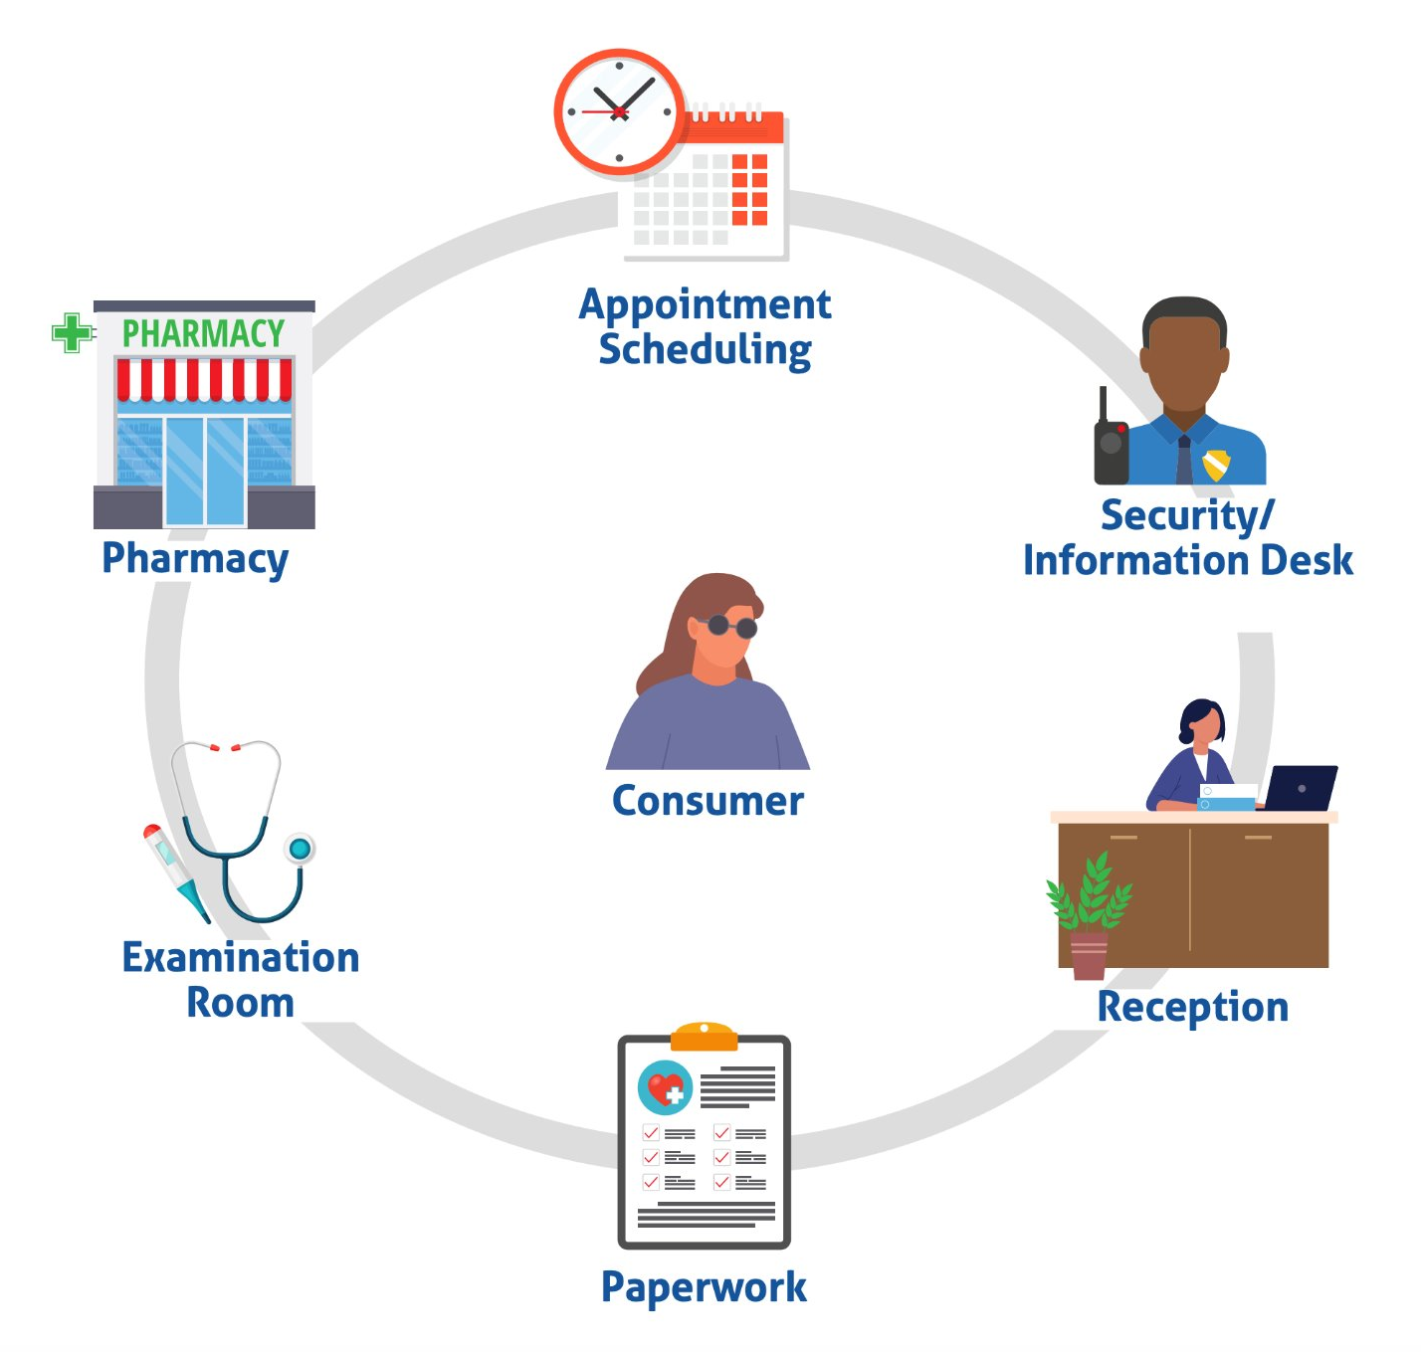
Points of Contact
Seemingly Neutral Communication Practices
When do you share and receive information with the clients or the public?

Slide 36
Effective Communication Examples
Seemingly Neutral Communication Practices
Providing information in one format.
Provide information in writing and orally. Use audio descriptions. Make sure electronic information is accessible to screen readers.
Assuming interpretation is not required.
Provide qualified interpreters! ​

Slide 37
Planning for Inclusion
4

Slide 38
Self-Evaluation & Transition Plans
ADA Tools
ADA Title II Action Guide for State and Local Governments
All public entities, regardless of size, must evaluate all of their services, policies, and practices and modify any that do not meet ADA requirements.

Slide 39
Example of a Self-Evaluation Form

Slide 40
Example of a Self-Evaluation Form 2

Slide 41
ADA Tools for Identifying Barriers
Self-Evaluation & Transition Plans
ADA Title II Action Guide for State and Local Governments
UW Transition Plans
NWADA Center Accessibility Checklists
ADA Best Practices Tool Kit for State and Local Governments

Slide 42
Tips for Implementing Accommodations
Planning for Inclusion
Establish a policy for requesting and receiving accommodations. ​​
Ensure that all staff understand the accommodation process.​​
Evaluate each situation on a case-by-case basis.​

Slide 43
Model Policies & Resources
Model Communication Assessment Form ​
Example of a Policy and Procedure for Providing Auxiliary Aids for Persons with Disabilities
Ask JAN Example Accommodation Policies
A Planning Guide for Making Temporary Events Accessible to People With Disabilities

Slide 44
Conclusion
Follow the ADA.
Value and prepare for difference:
Make accommodations.
Choose accessible spaces.
Communicate effectively.
Remember, we can change the environment to “fit” people!

Slide 45
Conclusion
Questions about the ADA?
1-800-949-4232
nwadactr@uw.edu

