Slide 1
Enterprise Reporting Introduction to Web Intelligence
Enterprise Reporting Services
Notes:
Pick a logo for the main page of your presentation. Delete the other logo.

Slide 2
Introductions
Your name?
Your agency?
Any experience with Enterprise Reporting (ER) Financial Reports?
How do you expect to use ER Web Intelligence?

Slide 3
Chapter 1
Overview

Slide 4
Course Objectives
At the conclusion of class participants should have an understanding of the tool’s basic features:
Logon | Navigate
View Reports | Edit existing Documents
Create New Documents | Set Sections and Breaks
Insert totals / subtotals | Print / Export Reports
Schedule Reports

Slide 5
Training Materials
Class Handouts
ER Intro to Web Intelligence (AFRS Financial Queries) training exercises
Course evaluation: please use this to note any issues or suggestions; this provides helpful feedback for improving future classes.
Additional Resources
Toolbar Crosswalk
SAP Business Objects Web Intelligence Product Tutorials
http://scn.sap.com/docs/DOC-7819

Slide 6
Web Intelligence vs. Standard Reports
Standard Reports |  | Web Intelligence
Pre-defined reports Report scheduling and viewing application |  | Self service reporting For querying, organizing, and analyzing data

Slide 7
Hours of Operation
ER Hours of Operation
24/7 for viewing reports
Daily AFRS Data updates are from 8 pm through Midnight – New and existing AFRS queries cannot be generated during this time
System Maintenance – Between 12:00 am and 7:30 am on the Last Monday of every month
Getting Support
8:00 a.m. to 5:00 p.m. Monday through Friday
360-407-9100
solutionscenter@des.wa.gov

Slide 8
Chapter 2
Web Intelligence Access

Slide 9
Web Intelligence access
Web Intelligence customers must have online access either through the State Governmental Network (SGN) or through Secure Access WA (SAW) for use from outside of the state firewall.
This guide only includes information for access within the SGN.

Slide 10
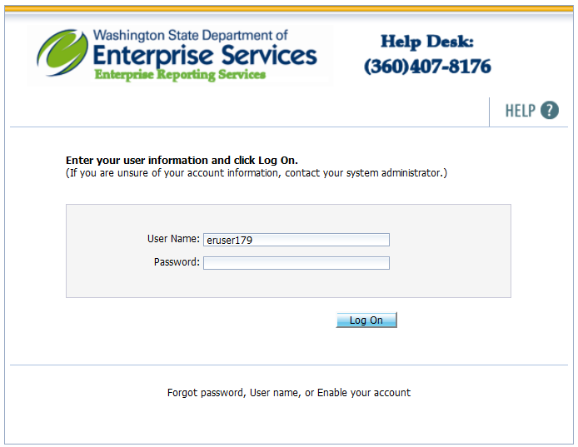
Access through SGN
Type https://reporting.des.wa.gov into the address bar of your internet browser and click Go, or press [Enter].
Enter your assigned User Name in the User Name field
Enter your Password in the Password field.
This application is using hardened password. Refer to the password guidelines on the next page.
Click the Log On button or press [Enter] to initiate a connection to the Web Intelligence.

Slide 11
Password Requirements
The hardened password criteria are as follows:
Password must be at least eight characters long.
Password must contain at least two of the following character classes: upper case letters, lower case letters, numerals, and special characters. It cannot contain your logon ID.
Password must be changed every 120 days.
After five incorrect logon attempts, your user account will be locked.

Slide 12
Chapter 3
BI Launch Pad Navigation

Slide 13
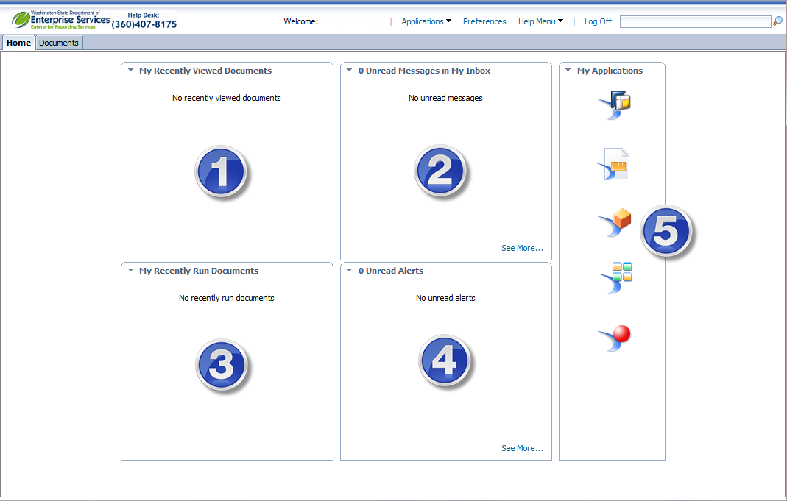
BI Launch Pad Navigation
The “Home” tab allows for quick access to:
Recently Viewed Reports
Unread Business Objects Inbox Items
Recently Run Reports
Unread Alerts (Currently not in use)
Applications

Slide 14
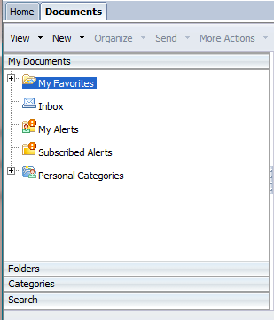
Folder Structure
The “Documents” tab allows access to
My Documents – Access to personal documents. Other users will not have access to these documents.
Folders – Access to Agency and other public folders.
Personal Categories – Allows users to group reports that are used frequently together regardless of their folder.
Search – Allow users to search for documents and objects stored in Web Intelligence.

Slide 15
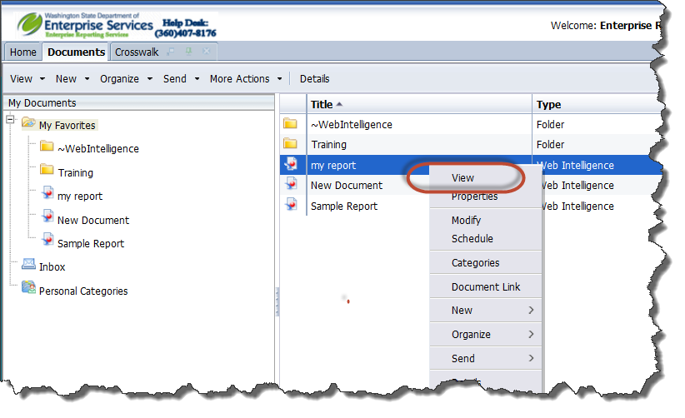
Viewing Existing Documents
The BI Launch Pad allows for the viewing of existing Web Intelligence Reports. To view an existing Web Intelligence Report:
Click on the report in the Recently Viewed or Recently Run lists on the “Home” tab or select the “Documents” tab.
Select the correct folder where you need to view your report(s). In the example below we are looking in “My Documents” and “My Favorites”.
Right Click on the report you wish to view and from the menu select “View”.

Slide 16
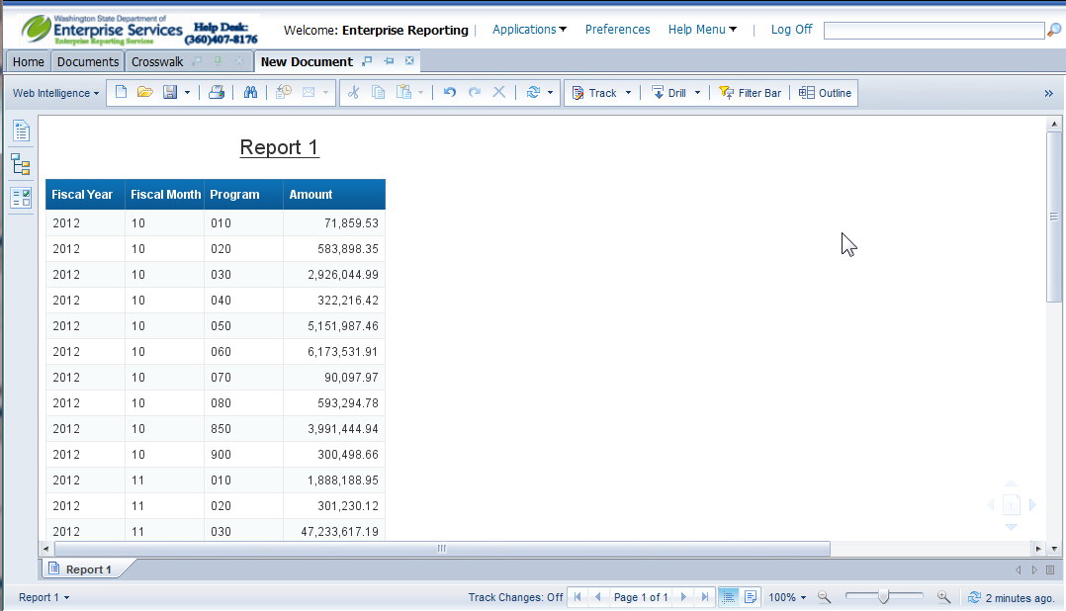
Viewing Existing Documents
The report will open in view mode.
To navigate you can scroll up and down or left and right, and advance pages using the page navigation controls located on the bottom of the page.

Slide 17
Chapter 4
Creating New Web Intelligence Documents

Slide 18
Creating New Web Intelligence Documents
A Web Intelligence document consists of a query, a report and any formulas or variables created.
The document can be very simple or very complex, depending on the user's business need at the time.
The data is represented in Web Intelligence as a universe. A Universe provides an easy to use and understand data structure for non technical Web Intelligence users to run queries against a database to create reports and perform data analysis.
You build queries using the universe objects. When the query is ran, the request is sent to the database, and the result is returned to the tool in a report, in the form of a table, consisting of columns and rows.

Slide 19
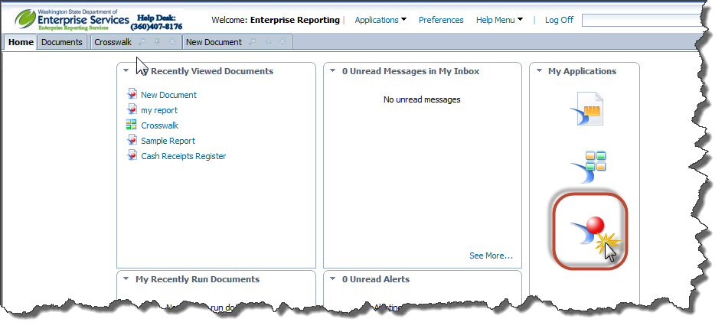
Creating New Web Intelligence Document
To create a new Web Intelligence document , click on the Web Intelligence Icon in the “My Applications” panel.

Slide 20
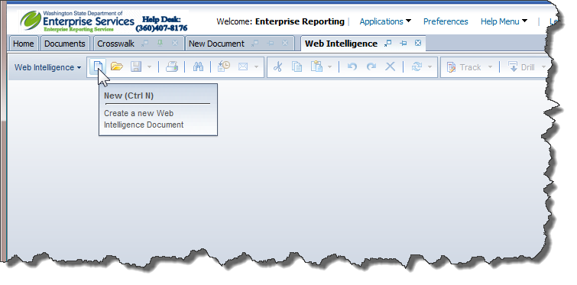
Creating New Web Intelligence Document
Click on "New" in the Web Intelligence Toolbar

Slide 21
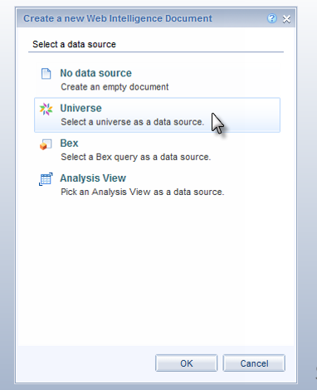
Creating New Web Intelligence Document
Select Universe, and click OK.

Slide 22
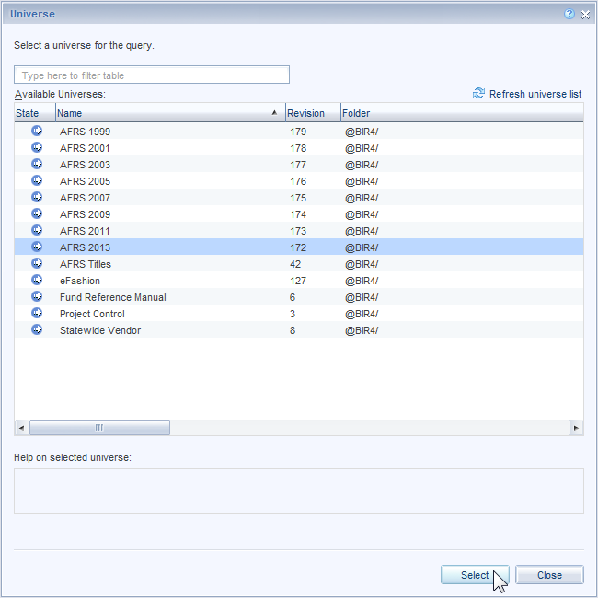
Creating New Web Intelligence Document
Select a universe. If a default universe is proposed, you can use this universe or select a different universe.
Click Select

Slide 23
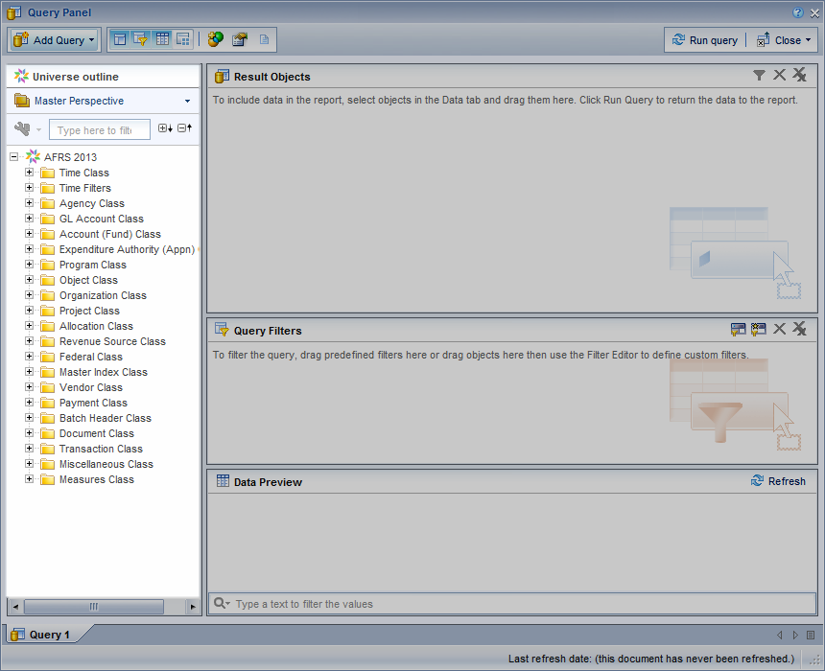
Creating New Web Intelligence Document
Data Outline Panel – Shows the universe and its classes and objects that are available for reporting.

Slide 24
Creating New Web Intelligence Document
A universe contains the following structures:
Classes
A class is a logical grouping of objects within a universe. It represents a category of objects. A class can be divided hierarchically into subclasses.
Objects
An object is a named component that maps to data or a derivation of data in the database.
Types of objects
Dimension - Parameters for analysis. Dimensions typically relate to a hierarchy such as geography, product, or time. For example: Agency Code
Detail Provide a description of a dimension, but are not the focus for analysis. For example: Agency Title
Measure - Convey numeric information which is used to quantify a dimension object. For example: Amount

Slide 25
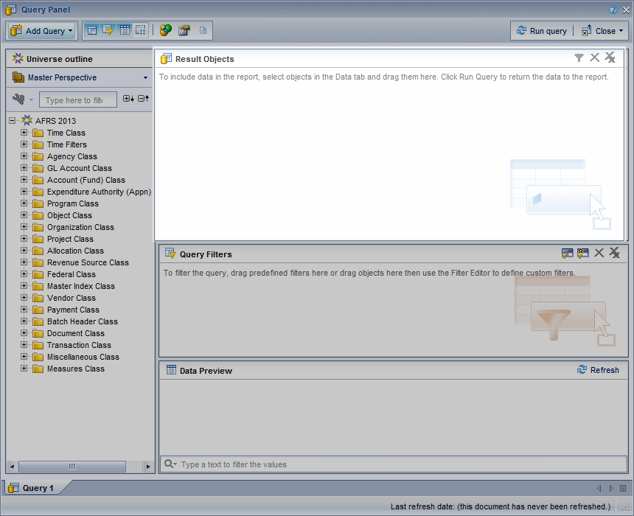
Creating New Web Intelligence Document
Results Object Panel – Objects selected and placed here will be displayed in the report.

Slide 26
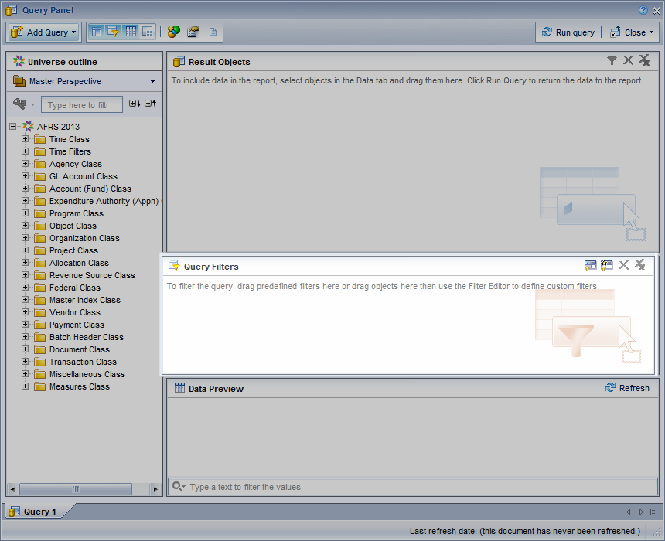
Creating New Web Intelligence Document
Query Filter Panel – Where objects are added to define how to limit the data returned in a query.

Slide 27
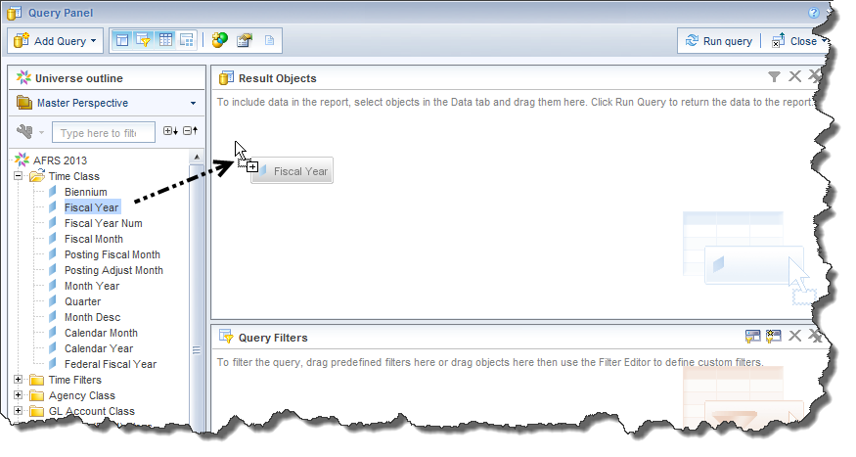
Creating New Web Intelligence Document
Select the objects you want to include in the query and drag them to the Result Objects pane. To add all the objects in the class, drag the class to the Result Objects pane.

Slide 28
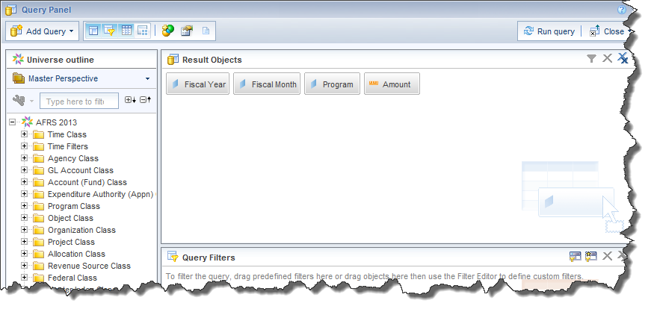
Creating New Web Intelligence Document
Repeat the previous step until the query contains all the objects you want to include.

Slide 29
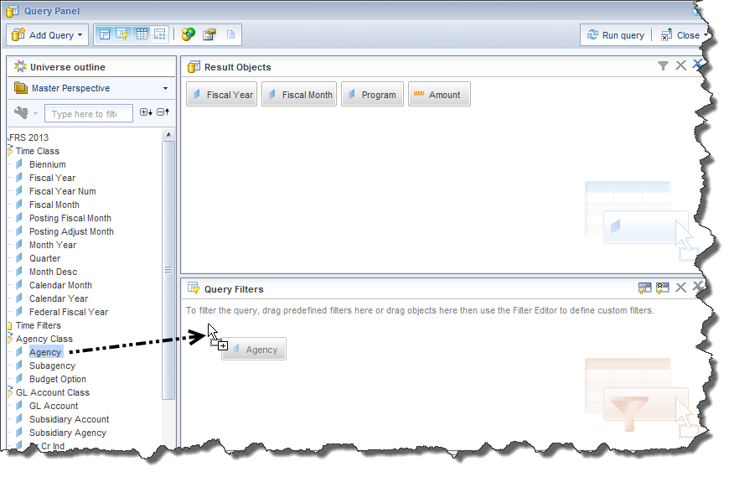
Creating New Web Intelligence Document
Select the objects on which you want to define query filters and drag them to the Query Filters pane.

Slide 30
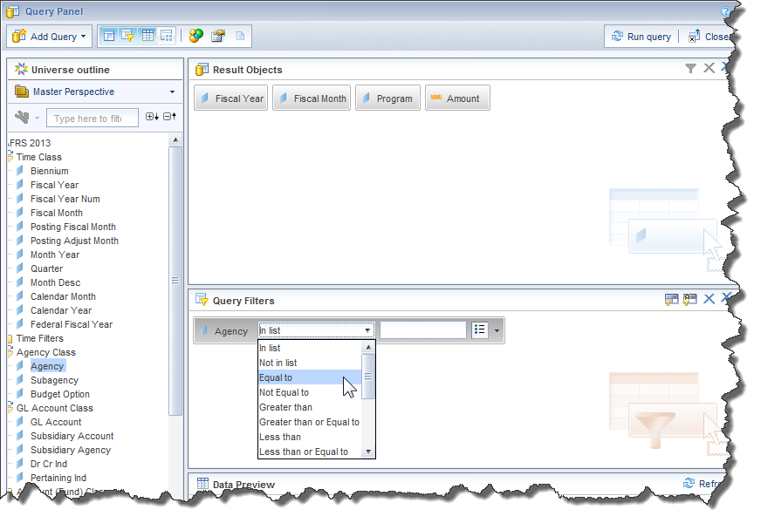
Creating New Web Intelligence Document
After a data element is selected, a filter editor box will display as illustrated below. The default operator is "In list". Click on the arrow by In list to view the complete list of operators. Choose Equal to from the list of operators. Type the value in the text box on the filter editor box.

Slide 31
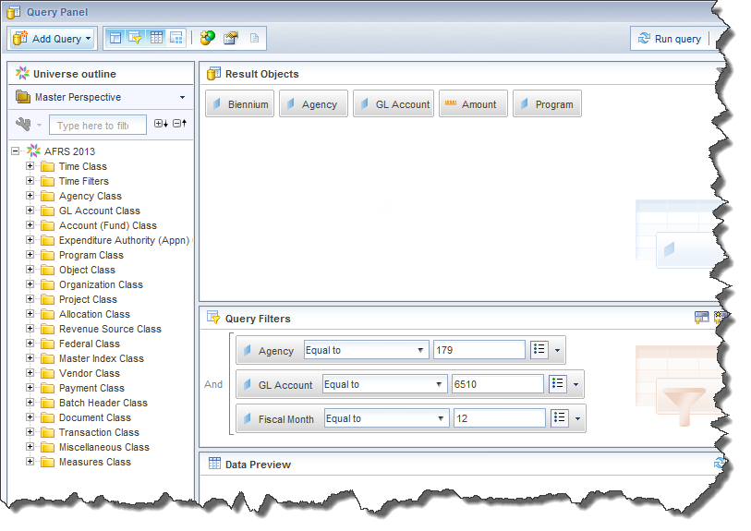
Creating New Web Intelligence Document
Repeat the previous step until the query contains all the filters you want to include.

Slide 32
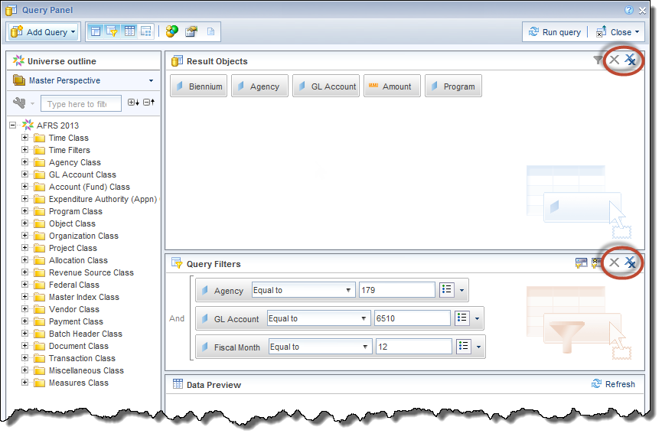
Creating New Web Intelligence Document
To remove an object from the Result Objects or Query Filters panes, click Remove at the top right corner of the pane.
To remove all objects from the Result Objects or Query Filters panes, click Remove All at the top right corner of the pane.

Slide 33
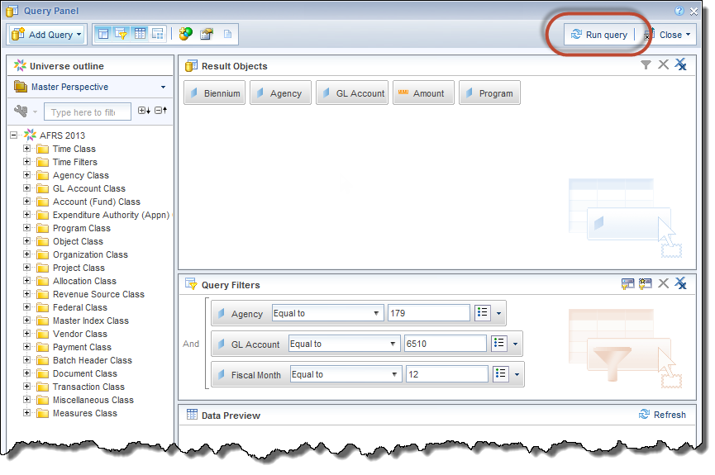
Creating New Web Intelligence Document
Click Run Query to run the query.

Slide 34
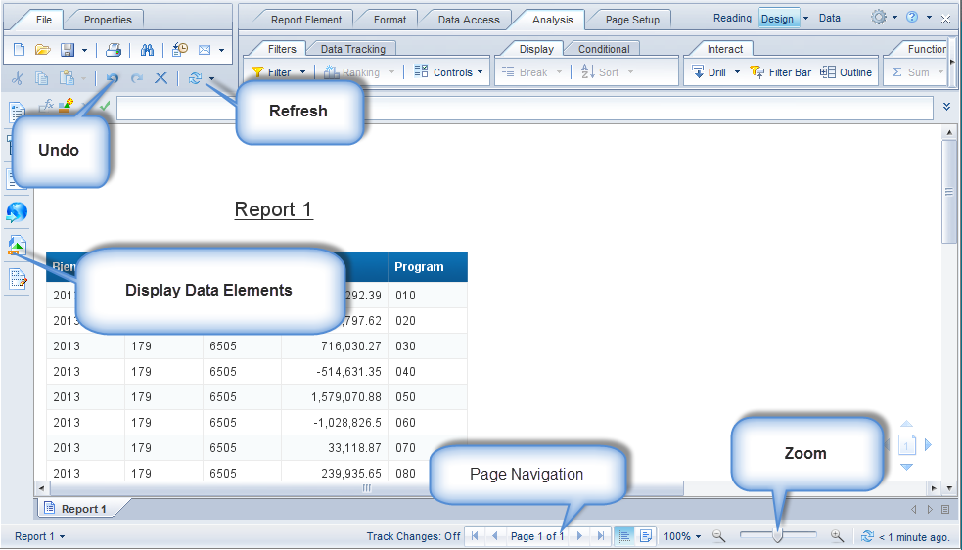
Navigating the Report Panel
After a query is run, the results will be displayed in the Report View window.

Slide 35
Save a Web Intelligence Document
After a query is run, the results will be displayed in the Report View window.
Depending on your security profile, you can save a document to either a personal or a public folder within the tool.
If you are a regular user, you can save a file to a folder under My Folders.
If you are a power user, you can save to either a folder in My Folders or to certain Public Folders.

Slide 36
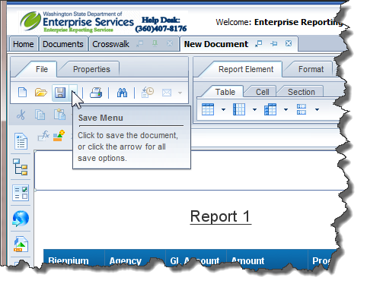
Save a Web Intelligence Document
To save a Web Intelligence Document click the Save button on the upper left corner.

Slide 37
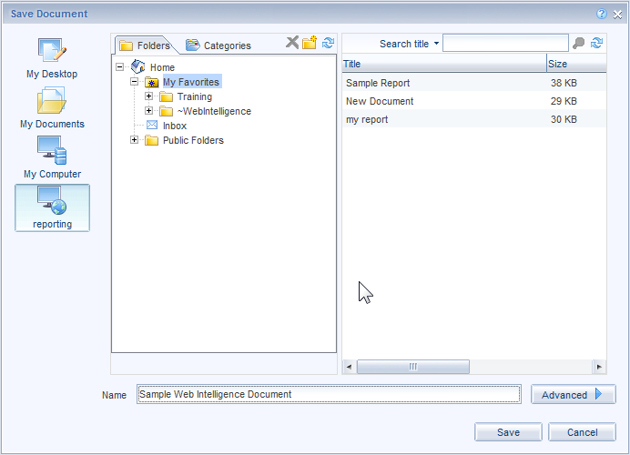
Save a Web Intelligence Document
The following Save Document dialog box will appear.
Enter the Title for the Document and click Save on the bottom. Document title can only contain numbers and letters; it cannot contain special characters.
Note: The My Favorites folder is highlighted so that is the default location where the document or query will be saved. You can choose another folder to which you have access, if you wish.

Slide 38
Chapter 5
Query Filter Options

Slide 39
Operators
Operator | Retrieves Data | Example
Equal To | Equal to the specified value | {Fiscal Month} Equal To 10 retrieves data for fiscal month 10
Not Equal To | Not equal to the specified value | {Fiscal Month} Not Equal To 10 retrieves data for all fiscal months other than 10
Greater Than | Greater than the specified value | {Fiscal Month} Greater Than 10 retrieves data for fiscal months 11 and higher
Greater Than or Equal To | Greater than or equal to the specified value | {Fiscal Month} Greater Than or Equal To 10 retrieves data for fiscal months 10 and higher
Less Than | Lower than the specified value | {Fiscal Month} Less Than 10 retrieves data for fiscal months 01 through 09
Less Than or Equal To | Lower than or equal to the specified value | {Fiscal Month} Less Than or Equal To 10 retrieves data for fiscal months 01 through 10
Between | Between two values; including these values | {GL Account} Between 6500 and 6600 retrieves data for GL Accounts 6500 through 6600
Not Between | Outside the range of two specified values | {GL Account} Between 6500 and 6600 retrieves data for all GL Accounts not between 6500 and 6600

Slide 40
Operators
Operator | Retrieves Data | Example
In List | Same as values specified | {Agency} In List ‘225;310;477’ retrieves data only for Agencies 225, 310, and 477
Not In List | Everything other than values specified | {Agency} Not In List ‘225;310;477’ retrieves data for all excluding Agencies 225, 310, and 477
Is Null | Which there is no value entered in the database | Is Null does not apply to the AFRS Universes
Is Not Null | For which there is a value | Is Not Null does not apply to the AFRS Universes
Matches Pattern | Includes a specific string that is like a value | {Program Index} Matches Pattern ‘15%’ retrieves data for any Program Index that begins with 15
Different From Pattern | Excludes a specific string that is like a value | {Program Index} Different From Pattern ‘15%’ retrieves data for any Program Index that does not begin with 15
Both | Corresponds to two specific values | {Budget Option} Both “1” and “2” retrieves data for budget options one and two
Except | Corresponds to one specified value and does not correspond to another specified value | {Budget Option} Except Option “1” retrieves data for budget options other than one

Slide 41
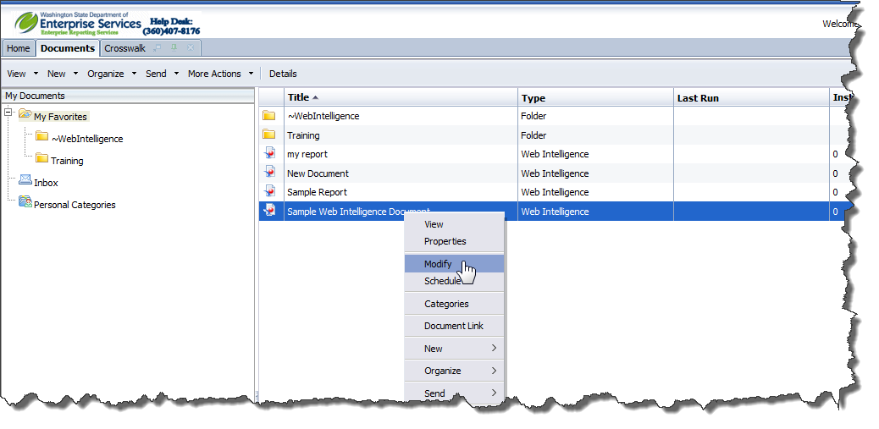
Modify a Document
Locate your query in your [My Favorites] folder
Right click
Select “Modify”

Slide 42
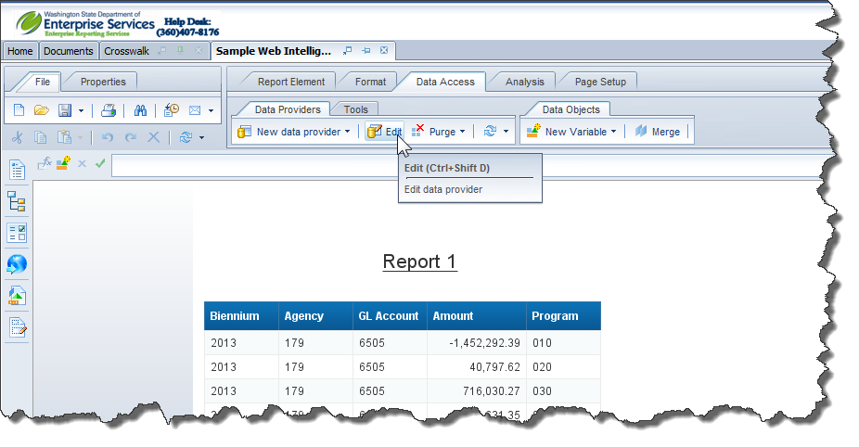
Modify a Document
Select the Data Access tab and click the Edit icon located on the Data Providers sub tab.

Slide 43
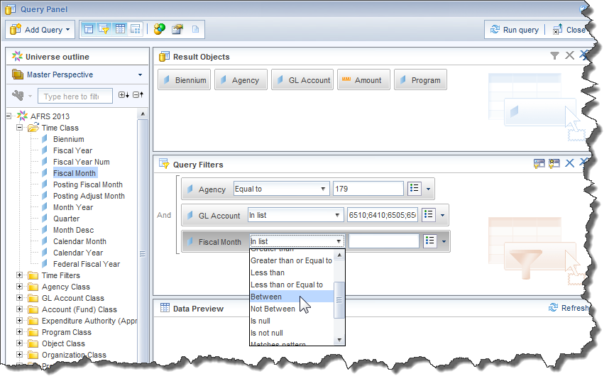
Between
To set a filter using a range of values use the "Between" operator. Since you have placed Fiscal Month in the Result Objects you can drag down to the Query Filter Box. Change the operator to Between from the drop down list of operators.

Slide 44
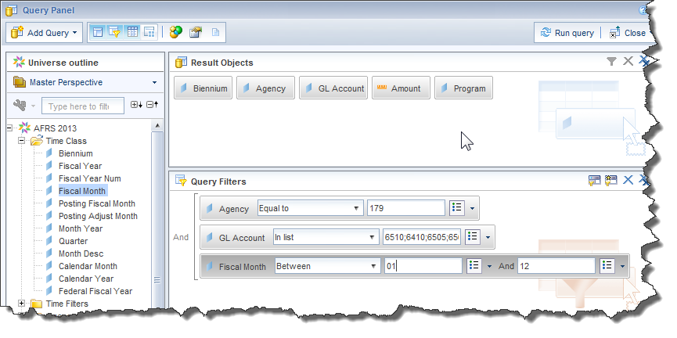
Between
The filter editor box now displays two fields for entering values. Enter a value in each box. The ‘Between’ operator is inclusive and will include the values entered.

Slide 45
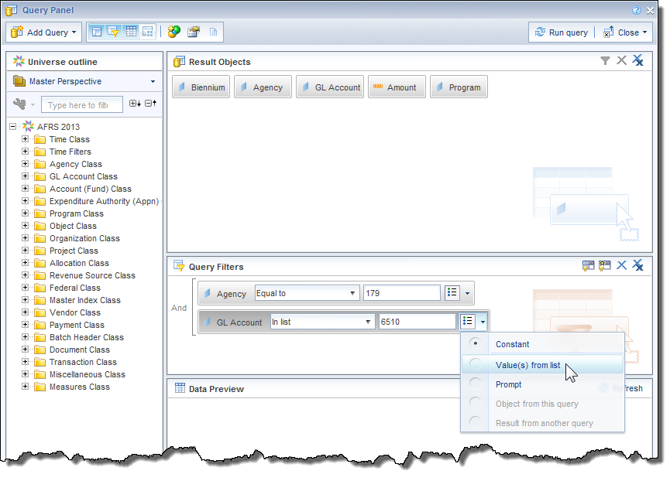
Values from list
To set a filter using a list of values use the default operator "In list". Click on the arrow on the end of the filter editor box. Select Values from List.

Slide 46
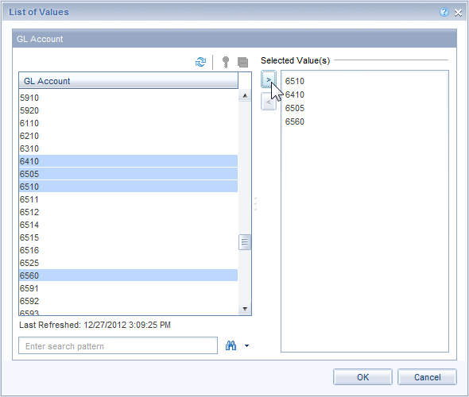
Values from list
Select the values from the list. Multiple items can be selected by holding the ‘CTRL’ or ‘Shift’ keys and selecting your values. Once the values are selected, use the top arrow to move the values into the ‘Selected Value(s)’ box. Then click OK.

Slide 47
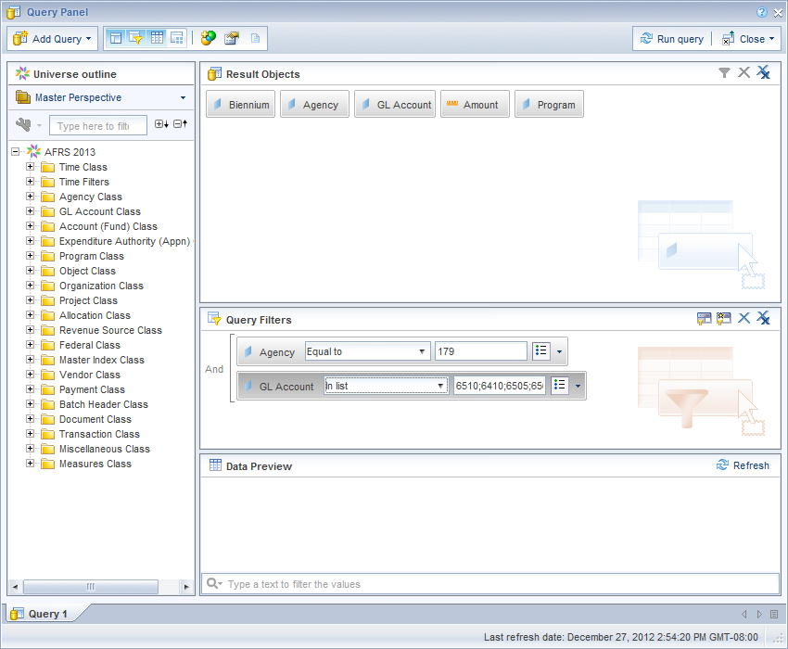
Values from list
When free forming a list of values each value should be separated with a semicolon and no spaces. Examples: 6510;6410;6505;6560

Slide 48
Matches Pattern
To include wildcard characters in a value to further define a filter use Matches Pattern. This is very useful when you are trying to find data that begins with, ends with, or contains a specified value. For example, you may create a filter to find all vendors that start with a certain word.
Please note that using text in filters is not case sensitive.

Slide 49
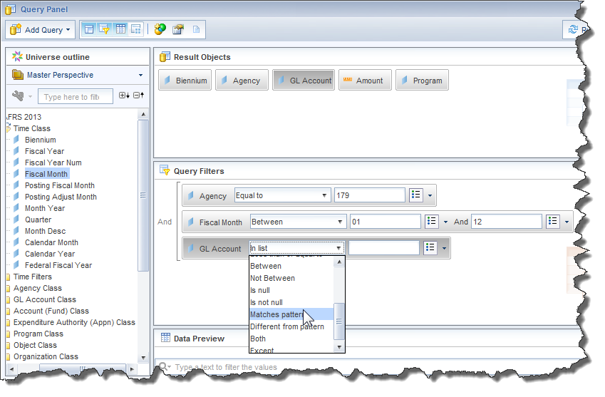
Matches Pattern
Drag a dimension into the Query Filters area.
Change the operator to Matches pattern by selecting it from the drop-down list of operator values.

Slide 50
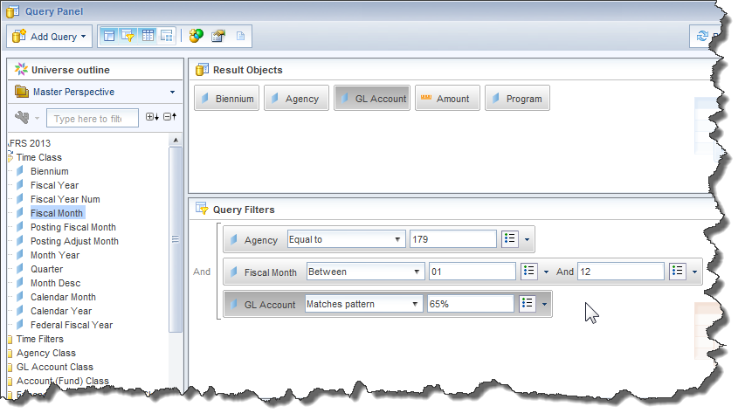
Matches Pattern
Type your value into the Value entry field followed by a ‘%’. This will select values that begin with the value entered followed by any other characters.

Slide 51
Chapter 6
Working with Web Intelligence Reports

Slide 52
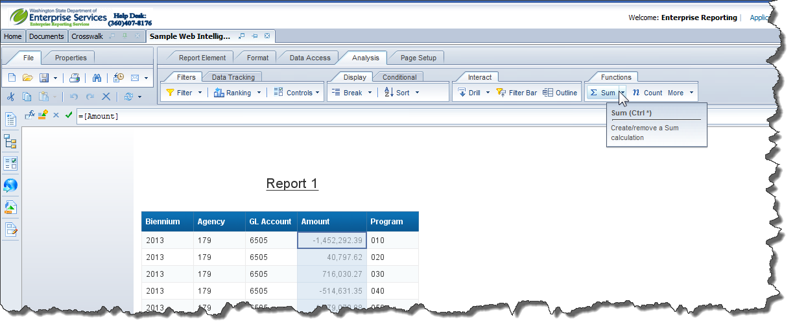
Simple Calculations – Sum
Highlight the data in the Amount column
Select the Analysis tab and click the Sum icon located on the Functions sub tab.
Navigate to the end of the report to see your total

Slide 53
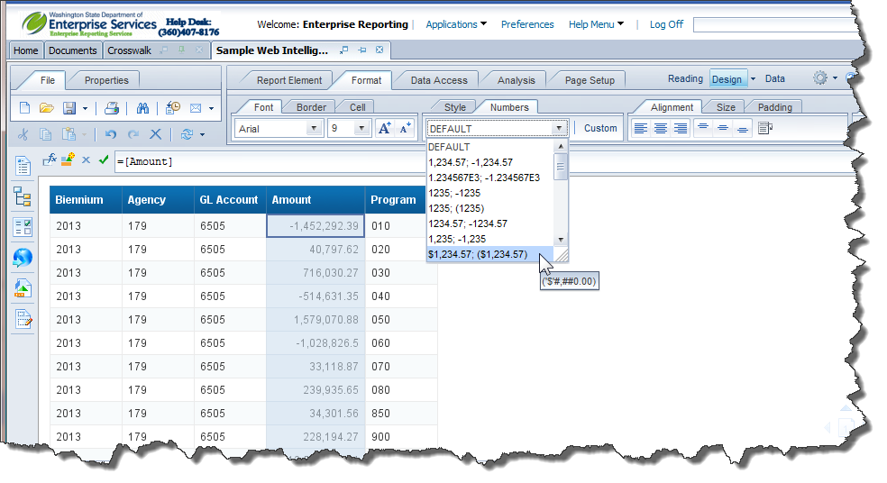
Format Numbers
To reformat the numbers in a measure column select the Format tab and choose the format from the dropdown list located on the Numbers sub tab.

Slide 54
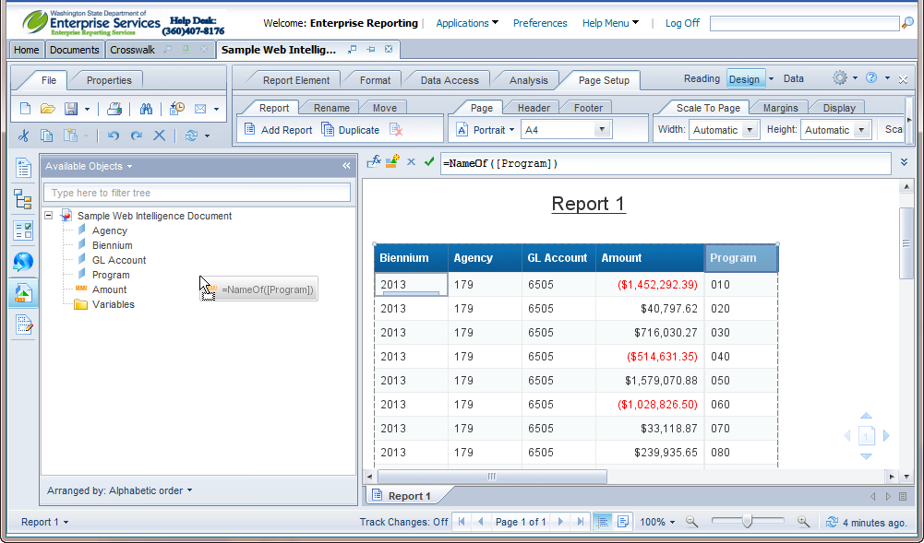
Remove Columns
To Remove a column –
Click and drag the object into the Available Objects Window.

Slide 55
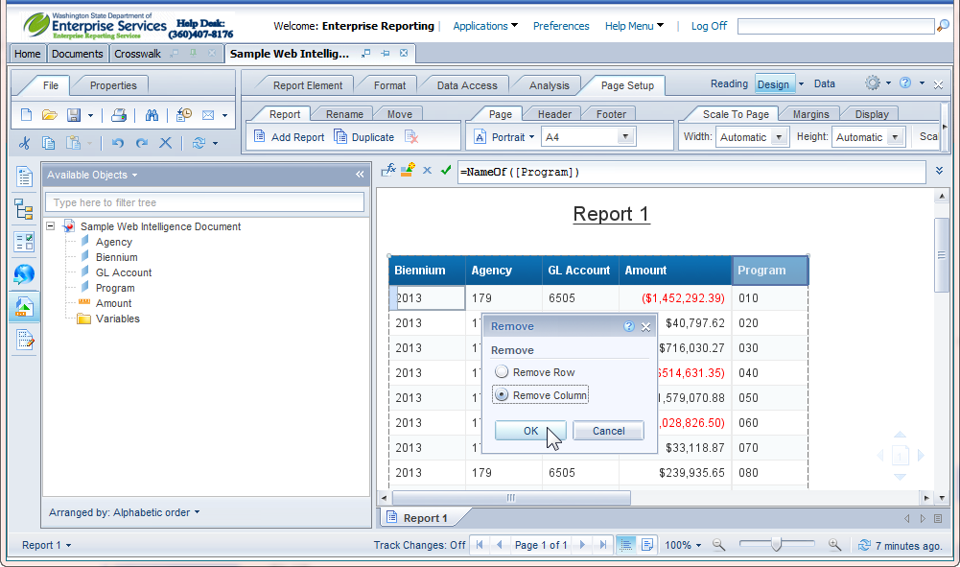
Remove Columns
Select Remove Column in the Remove dialogue box and click OK.

Slide 56
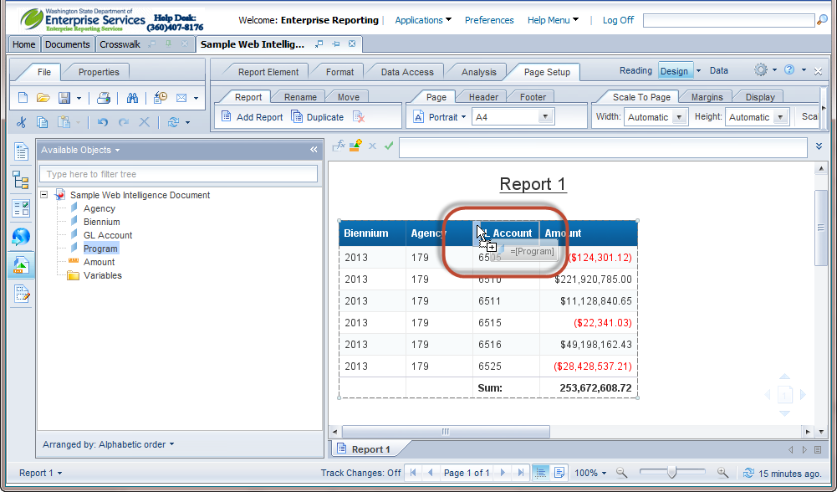
Add Columns
To add Column – Click and drag the object to the report table where it needs to be added. Overlap it with the edge of the cell next to it. Drop the object in the desired spot.

Slide 57
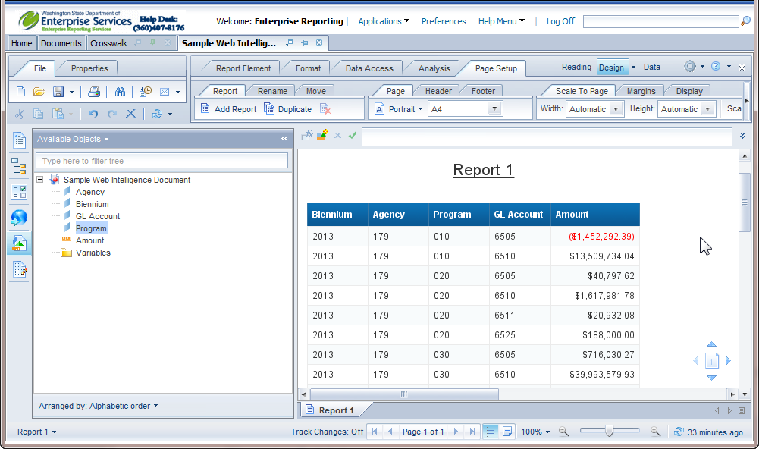
Add / Remove Columns
When adding and removing columns the data will aggregate based on the columns displayed in the report.

Slide 58
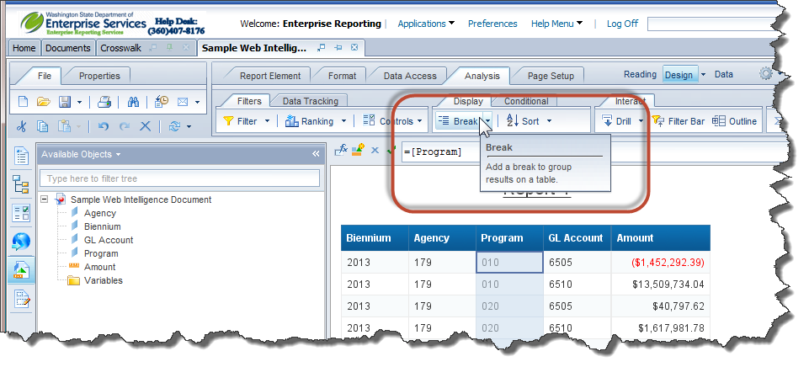
Breaks
A break divides a large table into smaller sub-tables based on a selected dimension value. Using a break, you can display subtotals by the specified value, as well as a grand total for all values. The data is automatically sorted in ascending order by the dimension values when a break is inserted.
To add a break, click in the data to highlight the column. Click on the Insert/Remove Break button on the Reporting toolbar.

Slide 59
Chapter 7
Printing and Exporting Reports

Slide 60
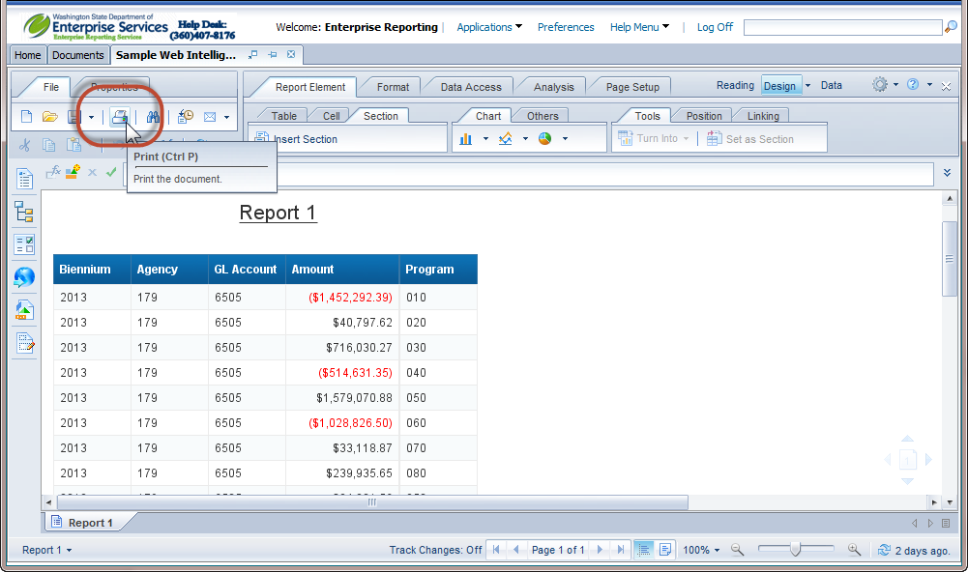
Printing Reports
Reports can be printed by clicking on the Print icon located on the File tab.

Slide 61
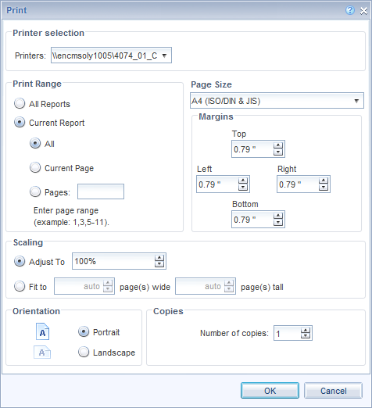
Printing Reports
When the Print icon clicked the Print dialogue box displays. Set the print options and click OK.

Slide 62
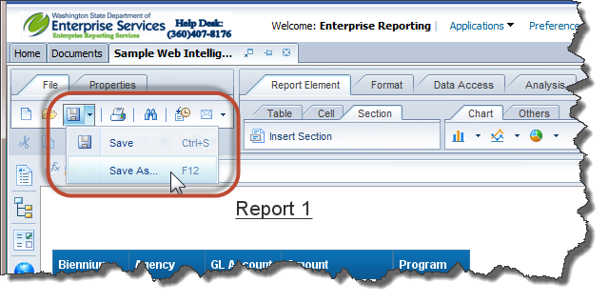
Exporting Reports
To export a report click on the dropdown arrow next to the Save icon and select Save as.

Slide 63
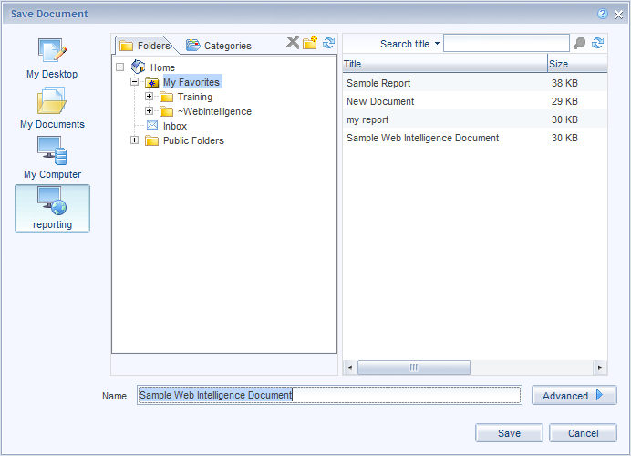
Exporting Reports
When Save as is clicked the Save dialogue box displays. Select My Desktop, My Documents, or My Computer as the location.

Slide 64
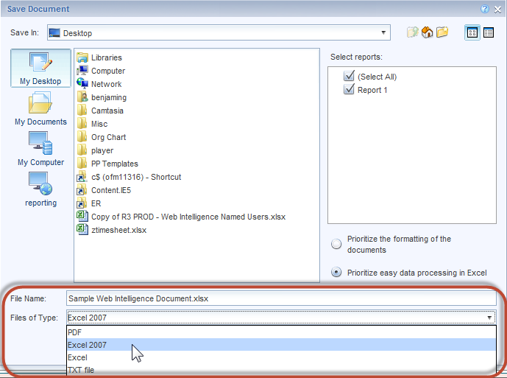
Exporting Reports
Verify the file name and update if needed.
Select the file type.

Slide 65
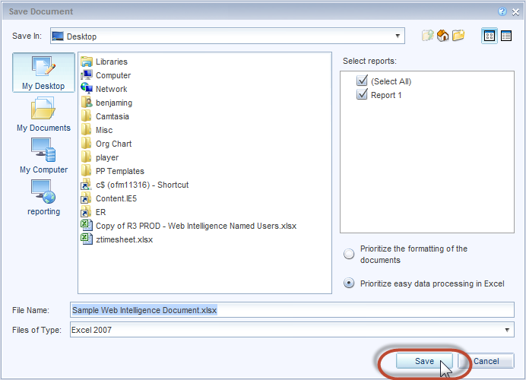
Exporting Reports
Click Save.

Slide 66
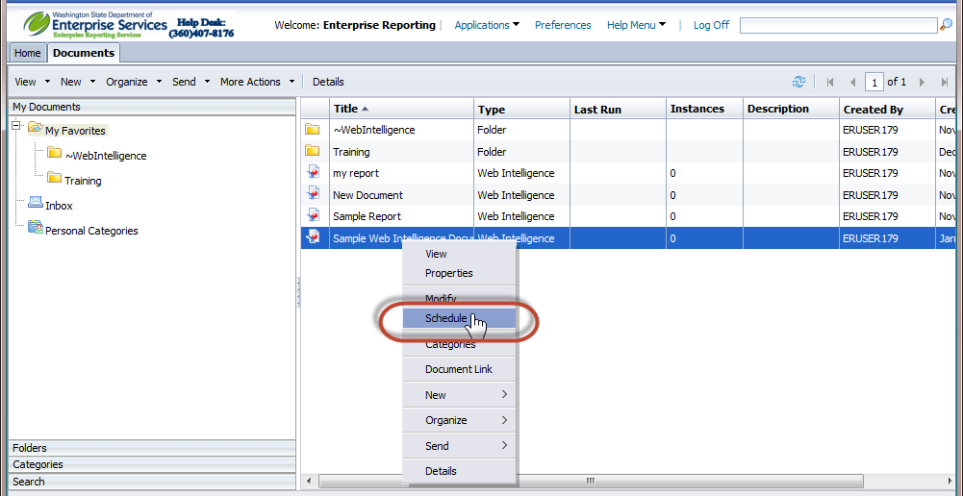
Scheduling Reports
Web Intelligence reports can be scheduled to run on a recurring schedule.
On the Documents tab, locate and select the object that you want to schedule.
Right click
Select “Schedule”

Slide 67
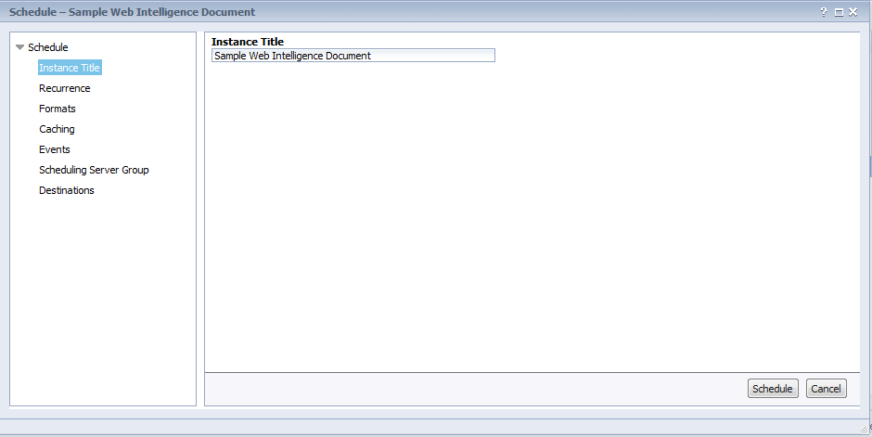
Scheduling Reports
The schedule Dialogue will open.

Slide 68
Scheduling Reports
In the Instance Title box, type a name for the instance.
In the "Schedule" dialog box, click Recurrence
Choose one of the recurrence options from the Run object list and set the required options. When you click Schedule, the default is “immediately.”
The following additional options are available:
• Once
This option requires a start and end time parameter. The object runs once at the time that you
specify. If you schedule the object with events, the object will run once if the event is triggered
between the start and end times.
• Hourly
This option requires information in hours and/or minutes for how frequently the object is run.
Instances are created regularly to match the parameters that you enter. The first instance is
created at the start time that you specify, and the object will cease to run on its hourly schedule
at the end time that you specify.
• Daily
This option requires a start and end time parameter. The object runs once every N days at the
time that you specify. It will not be run after the end time that you specify.

Slide 69
Scheduling Reports
• Weekly
This option requires a start and end time parameter. Each week, the object runs on the selected
days at the time that you specify. It will not be run after the end time that you specify.
• Monthly
This option requires a start date and time, along with a recurrence interval in months. The object
runs on the specified date and time every N months. It will not be run after the end time that you
specify.
• Nth Day of Month
This option requires a day of the month on which the object is run. Instances are created regularly
each month on the day that you enter at the start time that you specify. The object will not be run
after the end time that you specify.
• 1st Monday of Month
This option requires a start and end time parameter. An instance is created on the first Monday
of each month at the time that you specify. The object will not be run after the end time that you
specify.
• Last Day of Month
This option requires a start and end time parameter. An instance is created on the last day of
each month at the time that you specify. The object will not be run after the end time that you
specify.
• X Day of Nth Week of the Month
This option requires a start and end time parameter. An instance is created monthly on a day of
a week that you specify. The object will not be run after the end time that you specify.
• Calendar
This option allows you to select a calendar of dates. (Calendars are customized lists of schedule
dates that are created by the Bi platform administrator.) An instance is created on each day that
is indicated in the calendar, beginning at the start time that you specify and continuing until the
end time that you specify.

Slide 70
Scheduling Reports
Click Formats
Select the format you want to schedule to from the Output Format list.
Click Destinations
Select a destination option
Select the Keep an instance in the history check box if you want to save a copy of the instance.
Select the Use default settings check box if you want to the report to be sent to the logged in user.
You can schedule to the following destination locations:
• Default Enterprise Location
If you select this option, the instance is saved within Business Objects.
• BI Inbox
This option saves the instance to BI Inboxes specified.
• Email
This option sends the instance to the specified email recipients.
•FTP Server
This option saves the instance to the specified FTP server.
• File System
This option saves the instance to the specified file location.
Click Schedule

Slide 71
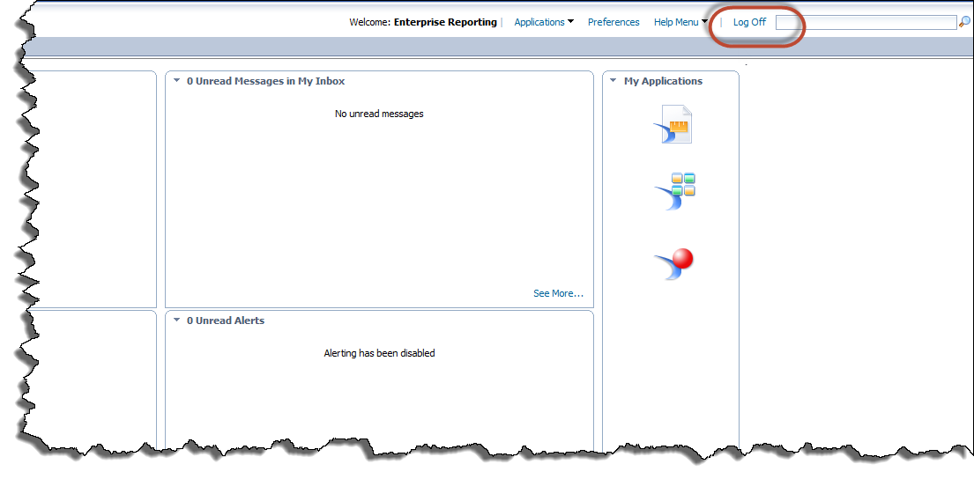
Log Off
To log off click the Log Off button.

Slide 72
Questions
Questions

