Slide 1
Recruiting through the Great Resignation: Best Practices from Private Sector Recruiting

Slide 2
Recruiting through the Great Resignation: Best Practices from Private Sector Recruiting
Health Care Industry Mindset
Building Candidate Pipelines
Recruitment Tools for Sourcing
High Touch Candidate Experience
Getting Hires

Slide 3
What I’ve Learned About Recruiting…
Nobody knows everything about anything
You can learn something from anyone
One size does not fit all
The grass is greener but sometimes requires dealing with the stuff that makes it greener
Pobody’s Nerfect or Nobody’s Perfect
“Recruitment Emergencies” are an open door for errors or worse
Hiring is a two-way street
Kindness goes a long way
LEEF

Slide 4
Great Resignation: Employee Behavior
According to the U.S. Bureau of Labor Statistics:
4 million Americans quit their jobs in July 2021.
Resignations peaked in April and have remained abnormally high for the last several months, with a record-breaking 10.9 million open jobs at the end of July.

Slide 5
Great Resignation: Employee Behavior
Anthony Klotz (Associate Professor, Mays Business School, coined the term "Great Resignation" and believes the rise of hybrid and remote work helped cause the phenomenon.
"How we spent our time before the pandemic may not be how we want to spend our time after," says Klotz.
– LinkedIn News

Slide 6
Great Resignation: Employee Behavior
“Some good reasons for leaving a job include company downturn, acquisition, merger or restructuring as well as the desire for change — be it advancement, industry, environment, leadership or compensation. Family circumstances may also be a factor. Deciding to leave a job is a tough decision.”
SNHU – Southern New Hampshire University.

Slide 7
Job Seeker’s Market
Job seekers have options:
There are about 1 million more job openings than people looking for work- CNBC
Looking for workers: In 42 states, there are more jobs than unemployed people – The Virginia Pilot
The US economy has more open jobs than people looking for work – Business Insider

Slide 8
Job Seeker’s Market
Research company ratings – Google, Glassdoor, Indeed, LinkedIn
Research salary – payscale.com, salary.com, glassdoor, Indeed.com
“Best candidates are off the market within 10 days.” Officevibe.com
Candidate experience – high touch

Slide 9
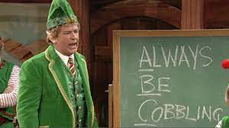
Health Care Industry Mindset
RECRUITING
Sense of Urgency and Bias for Action
Team Effort/ Competitive/Shared Learning
Partnership with HMs, Business Partners and Community

Slide 10
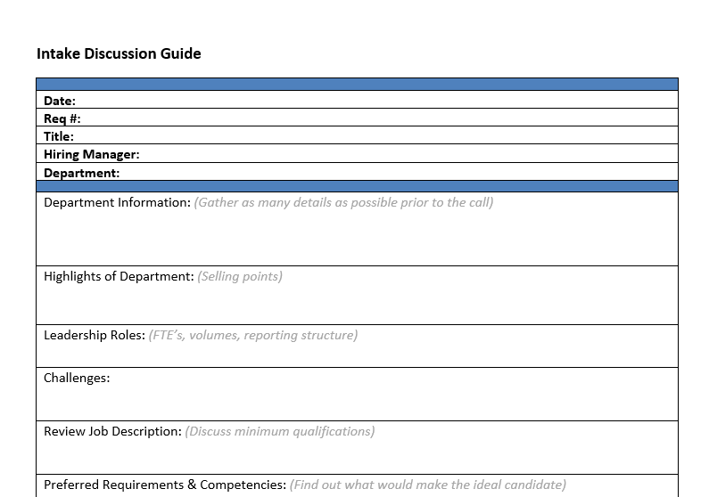
Intake Discussion Guide

Slide 11
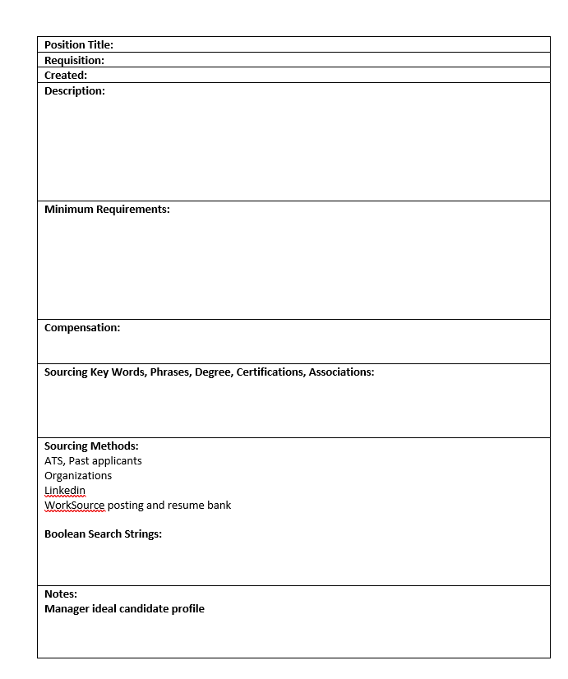
Sourcing Document

Slide 12
Candidate Sourcing
ATS (NeoGov) – Search past qualified (Silver Medalists)
Referrals – Set up a referral program or strategy.
References - Ask references if they are interested in hearing about opportunities with your agency (Skillsurvey).
Applicants/Prospective Candidates – When phone screening.
Boomerang Employees – Employees who left in good standing.
WorkSource – Post jobs, search resumes, message job seekers
CareerOnetop Business Center – Recruit and Hire Resources
Colleges – Comprehensive list of colleges in WA (Wikipedia).
WARN – Worker Adjustment and Retraining Notification.
Linkedin – Biggest professional network. Connect, comment, share.
Military Facilities in WA – Transition Centers, Family Service Center.
Veteran Service Organization – WA DVA List of Federal, State, County and VSOs.

Slide 13
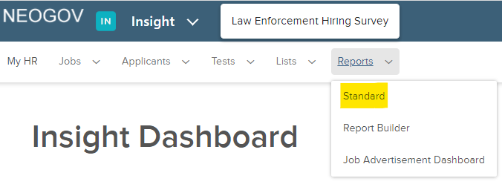
Building Candidate Pipelines – ATS NeoGov

Slide 14
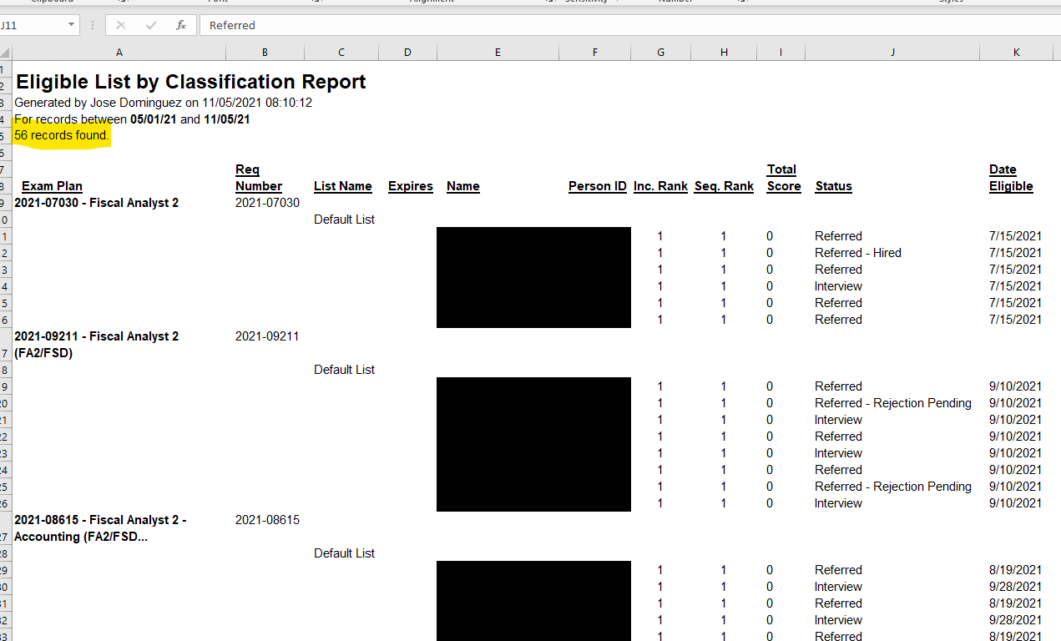
Building Candidate Pipelines – ATS NeoGov

Slide 15
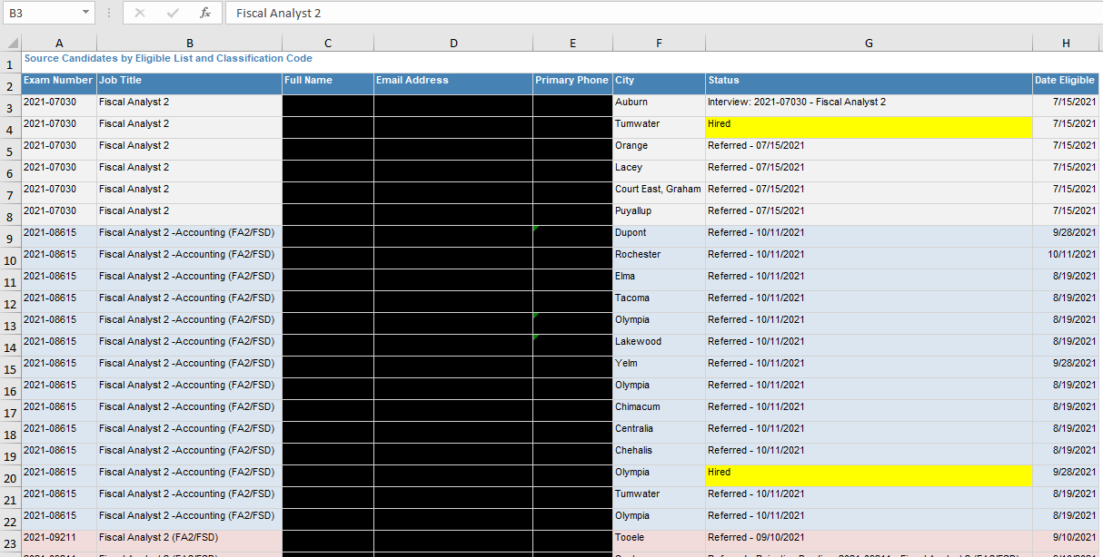
NeoGov Report Builder

Slide 16
Research - Competitor Job Postings

Slide 17
Candidate Research – Indeed.com

Slide 18
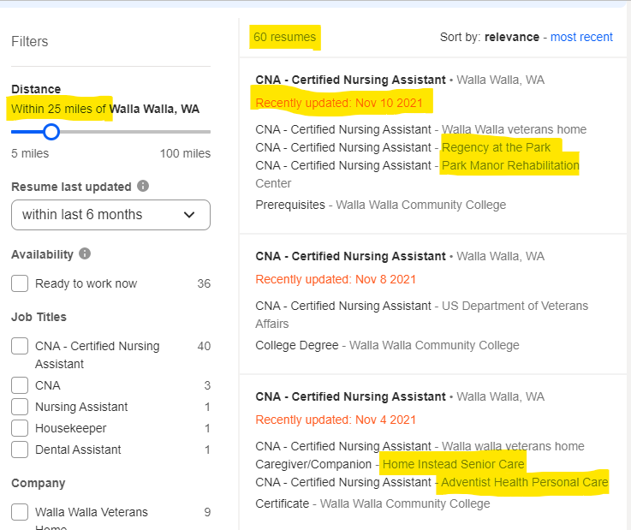
Candidate Research – Indeed.com

Slide 19
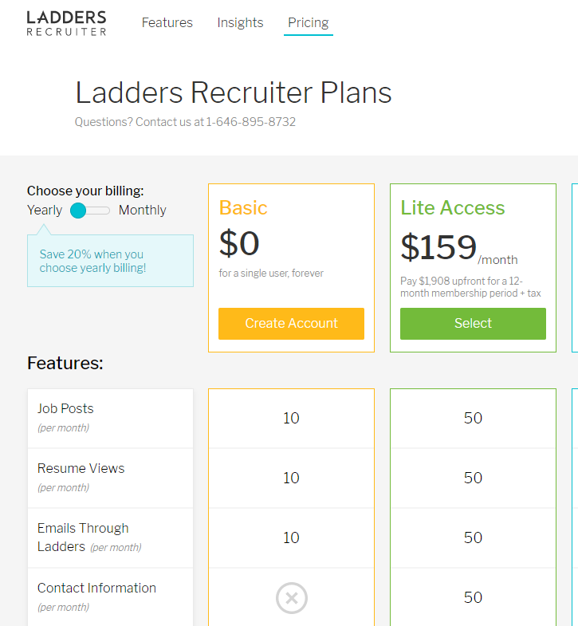
Candidate Sourcing – TheLadders.com

Slide 20
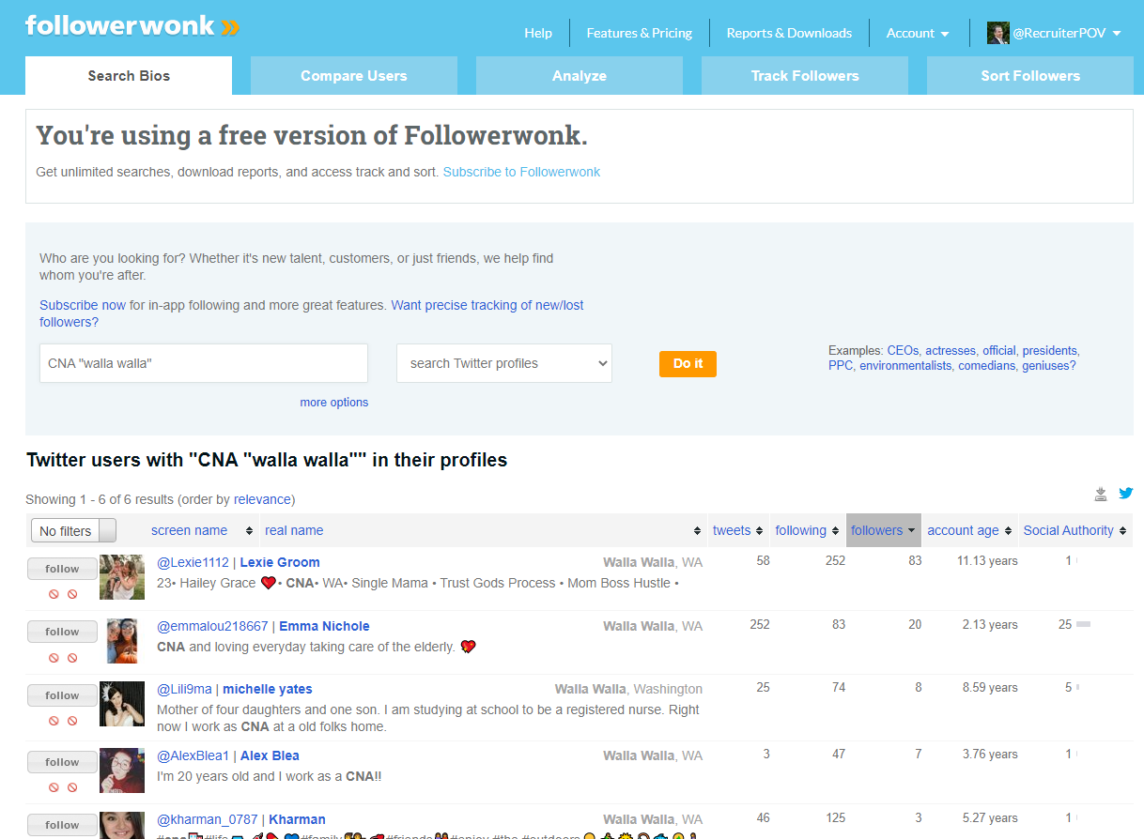
Candidate Sourcing – followerwonk.com

Slide 21
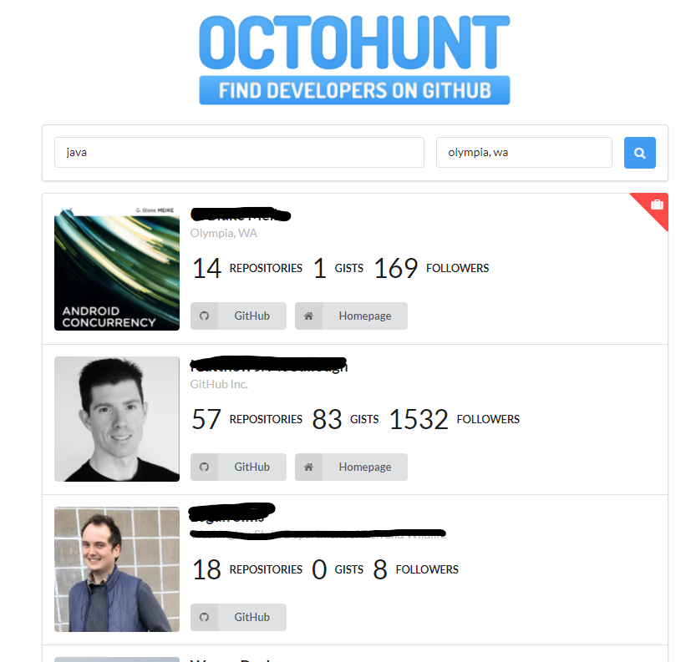
Candidate Sourcing – Octohunt
Available for hire!

Slide 22
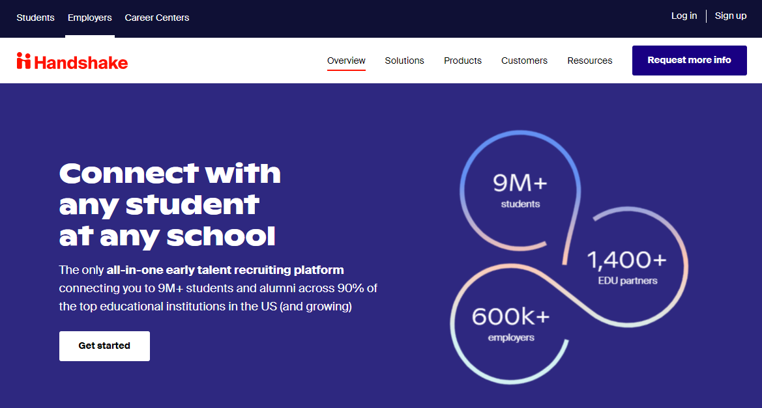
Candidate Sourcing – Handshake

Slide 23
Hacking LinkedIn for Candidates

Slide 24
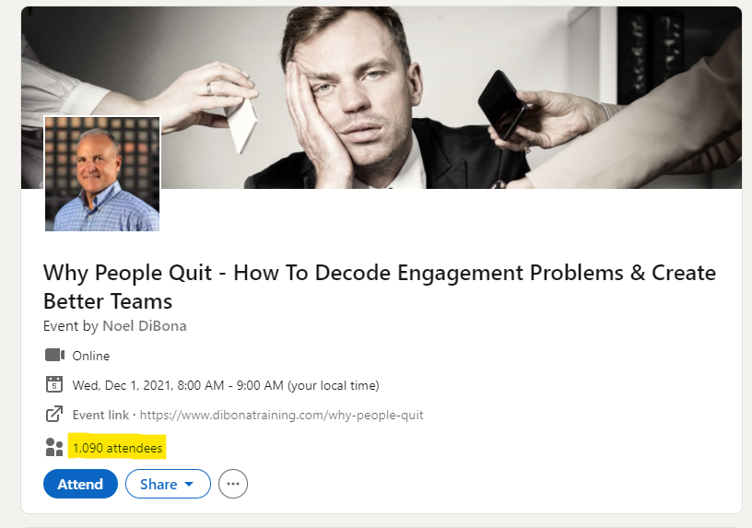
Hacking LinkedIn for Candidates

Slide 25
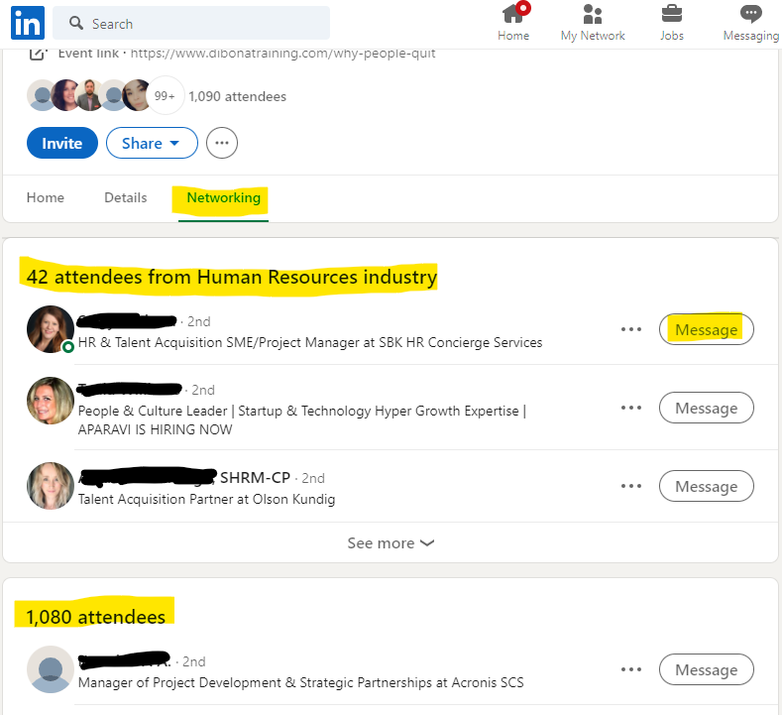
Hacking LinkedIn for Candidates

Slide 26
You’ve got names…now what? Make Contact!
Hello First Name,
This is Jose Dominguez with WA State Dept of Widgets. I’m calling because you had previously applied to a Fiscal Analyst position with us, and I wanted to check in with you. I know you are busy, so I’d like to schedule some time to speak with you briefly about opportunities that have recently become available. My calendar is free next week on Tuesday at 10:00am for about 15 minutes. Does that work for you? Or is there another time that works best?
I don’t know if you remember, but our agency is setting the standard in government accounting…
Intent of contact
Script for person to person
Script for voicemail

Slide 27
Move the Candidate to the Next Step
Heath Powell – Intention is Key for Selling Over the Phone (video)

Slide 28
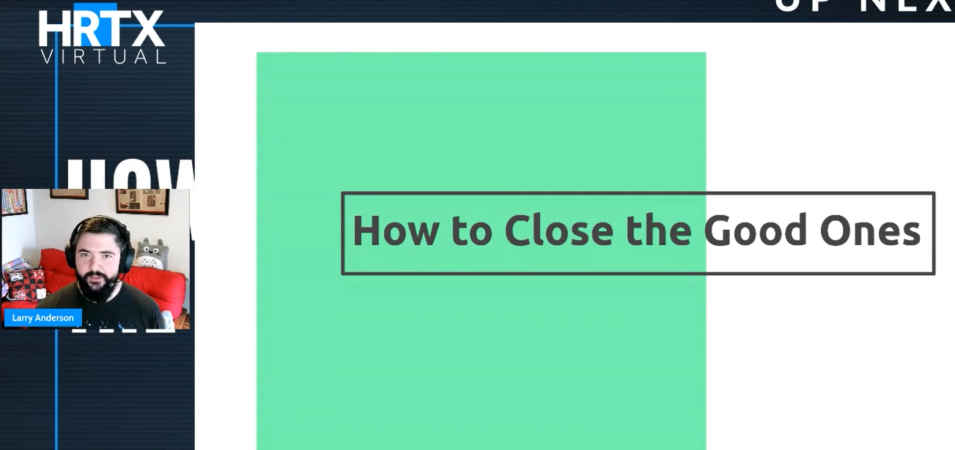
Closing the Candidate
Larry Anderson – How to Close the Good Ones
(video)

Slide 29
More Candidate Sources
Conferences – Links to venues and conferences in WA 2022
Google – A recruiter’s best friend
Google Alerts – Get up to date news on hospital or other industry closures, layoffs, and other employment news
Indeed – Find competitors and what people say about your agency
Glassdoor- Find competitors and what people say about your agency
Mini Virtual Hiring Events – Free Zoom account (host up to 100 people, 40 minutes, unlimited one-to-one, private and group chat)
Twitter – Followerwonk.com
Instagram – Search profiles
Facebook – Search accounts, -posts
ZoomInfo - B2B, industry, company and people search
Dice – User license
Competition – Similarsites.com – free chrome extension
Associations – Search Washington Associations And Organizations by Subject

Slide 30
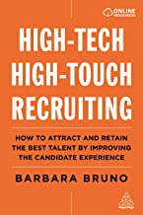
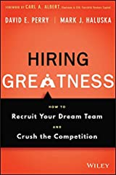
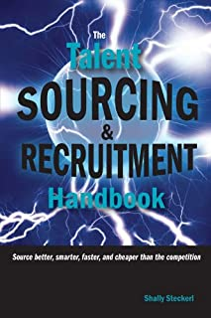
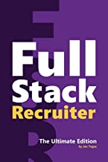
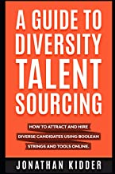
Other Resources
Government Recruiter Game Plan - Article
Recruiting Trailblazers - Podcast
Recruiting Brainfood - Podcast
Sourcing Challenge Show - Podcast

Slide 31
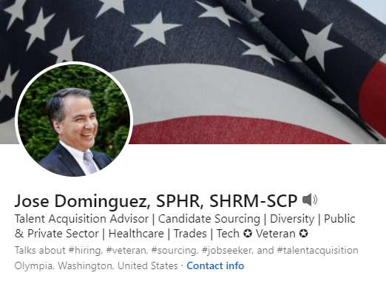
Thank You! – Questions?
linkedin.com/in/joseadominguez

