Slide 1
March 7, 2018
State Disability Employment Parity Act
Ann Reiter

Slide 2
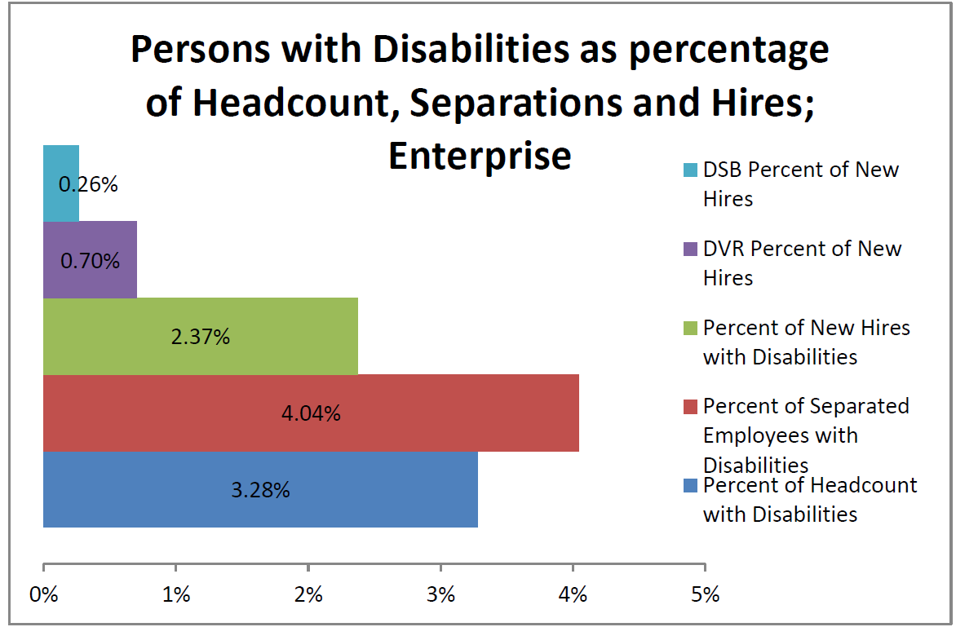
RCW 43.41.275
Effective July 24, 2015
Bill cites that:
Persons with disabilities suffer significantly higher rates of unemployment and underemployment than in the general population.
Previously, there was no policy similar to Schedule 15A in the federal civil service system for priority hiring of persons with disabilities.
Intent: To increase the hiring of persons with disabilities in the state workforce.
Calendar year 2017

Slide 3
Year to Year Comparison
 | 2015 (Total/PWD) | 2016 (Total/PWD) | 2017 (Total/PWD)
Average monthly # of employees | 53,893 1,954 (3.6%) | 54,897 1,924 (3.5%) | 56,282 1,864 (3.3%)
New Hires | 4,578 109 (2.4%) | 5,371 98 (1.8%) | 5,695 135 (2.4%)
DSB Client Hires | 6 | 16 | 15
DVR Client Hires | 28 | 54 | 40
Separations | 5,551 220 (4%) | 5,589 247 (4.4%) | 5,742 232 (4%)
Planned Internships | 19 | 16 | 10

Slide 4
Strategies
Enterprise (SHR):
Collaboration between SHR, DVR and DSB
Create a business resource group (estimated launch June 2018)
Conduct enterprise level data analysis
Agencies:
Collaborate with DVR and DSB to assist agencies in recruiting and retaining employees in supported employment positions.
Participate in the state’s Supported Employment Program.
Participate in the Disability Equity Index

Slide 5
FY 2017 Agency successes:
The Military Department increased the percentage of people with disabilities within their agency from 4.6 percent to 5.1 percent by attending job fairs and posting announcements on websites that specifically target individuals with disabilities.
The Department of Corrections partnered with DVR to promote job opportunities. They updated their website and job postings, making them compliant with the Americans with Disabilities Act increasing access to the opportunities available.
The Department of Labor and Industries attended disability job fairs. They posted positions with WorkSource and met with the Wounded Warriors organization which resulted in increased affirmative action utilization in several job groups.

Slide 6
FOR MORE INFORMATION:
Ann Reiter for reporting reqs. and process information
(360) 810-0563
ann.reiter@ofm.wa.gov
Or
Cassie Bordelon for statewide or agency data
(360) 480-1799
cassie.bordelon@ofm.wa.gov
Or
Tammy Pitre for statewide or agency strategies
(360) 407-4127
tammy.pitre@ofm.wa.gov

