Slide 1
Contact Theory
Theory and Application for lowering prejudicial attitudes

Slide 2
Exercise
Think of a time you worked with someone who was of a different background or culture for the first time
Think about how you felt about that person’s group before you met
Did you hold any stereotypes or beliefs about that person’s group?
Did you have expectations of how that person would act based on their group affiliation?
Remember how you felt after working together
Did anything change?
Did you feel more positive towards that person’s group?

Slide 3
What is Contact Theory
The theory that intergroup contact under appropriate conditions can effectively reduce prejudice between majority and minority group members.
Originally developed from ideas 1930s and 1940s where writers had begun to speculate about the outcomes of interracial contact
Social scientists began extensive research into contact theory following Brown v. Board of Education
The social scientist Gordon Allport was a major influence in how contact theory is currently defined

Slide 4


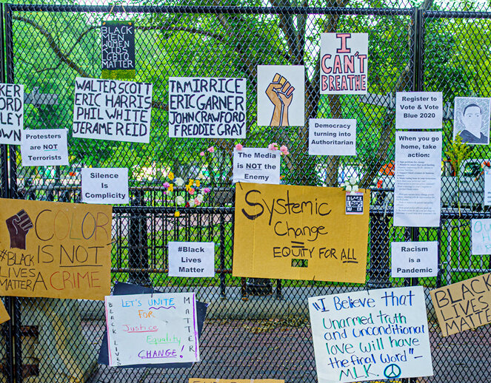
Law and Contact Theory
In Grutter v. Bollinger (2003), the U.S. Supreme Court held that the Constitution "does not prohibit the law school's narrowly tailored use of race in admissions decisions to further a compelling interest in obtaining the educational benefits that flow from a diverse student body.“
Contact theory was submitted as evidence for a nexus between the use of race in admissions decisions and the Government’s compelling interest of decreasing prejudice.

Slide 5
Allport’s definition of contact theory
"[Prejudice] may be reduced by equal status contact between majority and minority groups in the pursuit of common goals. The effect is greatly enhanced if this contact is sanctioned by institutional supports (i.e., by law, custom, or local atmosphere), and provided it is of a sort that leads to the perception of common interests and common humanity between members of the two groups."
— Gordon W. Allport, The Nature of Prejudice (1954)

Slide 6
Allport’s four conditions for decreasing prejudice
Decreased Prejudice
Equal status
Common goals
Intergroup cooperation
Support of authorities, law or customs

Slide 7
How does contact theory work?
Empathy
Perspective-taking
Outgroup
Contact
Positive attitude to outgroup
Intergroup
Anxiety & Threat
Associations
Blue = positive relationship/ increases
Red = negative relationship/ decreases

Slide 8


Trekkies

Slide 9
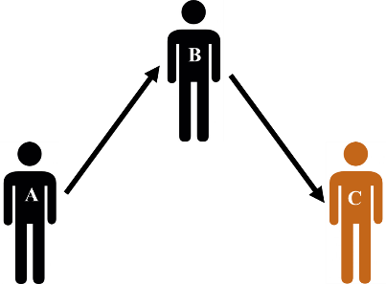
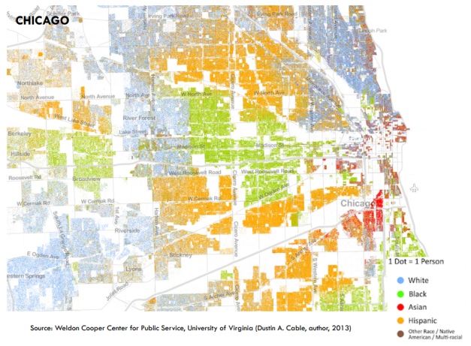
The multiplier effect of contact
‘Extended Contact’
  Knowing your friends have outgroup friends reduces prejudice towards that outgroup, even if you don’t have outgroup friends yourself
‘Secondary Transfer Effect’
  Contact with one outgroup not only reduces prejudice towards that outgroup but also towards other outgroups
‘Contextual Effect’
  Positive effect of living in an area where others have positive contact – over and above own contact; norms matter.

Slide 10
Empirical Research: Race
In one study, researchers investigated the amount of contact white athletes had with black teammates and whether the athletes played an individual or team sport. Team sports (e.g., football or basketball), as opposed to individual sports (e.g., track or swimming), require teamwork and cooperative interactions to win. Results showed that White athletes who played team sports reported less prejudice than athletes who played individual sports

Slide 11
Empirical Research: LGBTQ+
In a national study of interpersonal contact and heterosexuals' attitudes toward gay men, researchers found that increased contact "predicted attitudes toward gay men better than did any other demographic or social psychological variable“; such variables included gender, race, age, education, geographic residence, marital status, number of children, religion and political ideology. Further research found that contact experiences with two or three LGBTQ+ persons are associated with more favorable attitudes than are contact experiences with only one individual.

Slide 12
Empirical research: Religion
Researchers in the Netherlands found people living in regions with high numbers of Muslims (i.e. those more exposed to unavoidable intergroup contacts) get used to and are more experienced with their integration and express lesser perceived threats. In addition, they also found that higher contacts with Muslim colleagues directly reduce anti-Muslim attitudes. Similarly, in another study, researchers surveyed Czech and Slovak university students and found that personal contacts with Muslims and experience with visiting an Islamic country had more positive attitudes towards Muslims.

Slide 13
Indirect contact theory
There is growing evidence for a number of indirect, non-face-to-face intergroup contact strategies as a means to improve relations between social groups.
While the benefits of direct intergroup contact have been empirically established, its implementation is often not practical.
In many countries, racial and religious groups are often residentially, educationally or occupationally segregated, which limits the opportunity for direct contact.

Slide 14
Examples of Indirect Contact
Extended contact hypothesis: posits that knowing that a member of one's own group has a close relationship with a member of an outgroup can lead to more positive attitudes towards that outgroup.
Imagined contact: Simply imagining a positive encounter with a member or members of an outgroup category can promote more positive intergroup attitudes.
Electronic- or E-contact: E-contact involves an in group member interacting with an outgroup member over the Internet and includes text-based, video-based or a mixture of both text- and video-based online interactions. Electronic contact has been empirically shown to reduce inter-religious prejudice between Christian and Muslim students in Australia

Slide 15
Meta-analytic Evidence for Contact Theory
Meta analysis studies are the summarized findings of multiple samples from multiple studies
A meta-analysis of 713 independent samples from 515 studies found that intergroup contact typically reduces intergroup prejudice.
The study also supported Allport’s four elements for increasing the effectiveness of contact theory

Slide 16
Can increased contact lead to increased negative feelings?
Recent evidence suggests that although negative intergroup contact is more influential than positive intergroup contact, it is also less common than positive contact in real world intergroup encounters
People who have had positive experiences with out-group members in the past show a smaller discrepancy between the effects of positive and negative contact.

Slide 17
Conclusions
To understand the effects of diversity you have to look at frequency & quality of contact
Direct contact has reliable effects
But contact also works indirectly (extended contact) and at a neighbourhood level
Contact should form the basis of social interventions to promote integration
Contact is overwhelmingly positive vs negative

Slide 18
Turning Theory into Application
A diverse, equitable, and inclusive workforce would foster positive contact thereby decreasing prejudice in how we serve the public
Promoting collaboration among BRGs and ERGs
Access to a wide selection of diverse mentors
Inviting employees to participate in activities such as hiring panels, safety committees, or job shadowing
Asking state employees for ideas.

Slide 19

Case Study: RAIN Gender Identity Panels
RAIN has been conducting panels comprised of state employees who identify as transgender
The panels share their lived experiences as state employees who happen to be transgender
Over 12 different agencies and over 300 employees have attended the panels (pre-covid numbers)

Slide 20

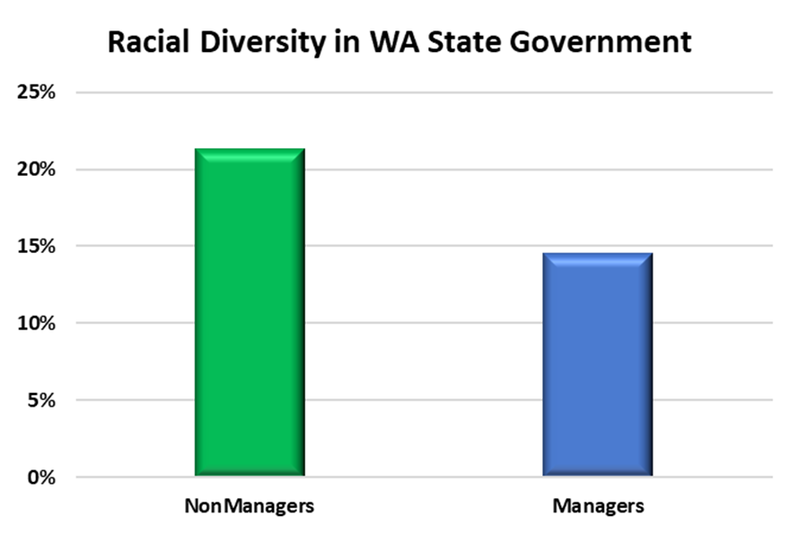
Case Study: BRG Leadership development
Last year the Department of Enterprise Services began offering BRG leaders the opportunity to attend either the Leading Others or Leading Teams training courses.
Each BRG is allocated two slots for members to attend one of the courses for free.
This initiative is great way to increase diversity in state leadership

