Slide 1
Employee Recognition: An investment in workforce retention
March 12, 2025
Robin Vazquez – Employee Resources Director
Washington State Health Care Authority
Notes:
Numerous studies have shown that employees perform better, have higher morale and lower turnover, when they are engaged at work. Recognition is a key piece of employee engagement – if we want our employees to perform their best, we have to create conditions that support their success. Robin will talk about options available to state agencies for formal and informal recognition, as well as about fostering a culture of high performance with psychological safety.

Slide 2
Quick Intro:
Hi, I’m Robin
Notes:
I’m currently the Employee Resources Director at the Washington State Health Care Authority. I’ve been with the state for nine years and my background is mainly labor relations and HR policy.

Slide 3
Today’s Objectives
Review what employee recognition is
Learn about why recognition matters in the workplace
Learn how recognition influences people’s brains
Talk about different tactics for providing employee recognition in the state government environment
Learn how recognition influences organizational culture
Provide a quick primer on ethics
Wrap up

Slide 4
The landscape: Maximum volatility
Spending freeze
New Governor
New agency directors
Challenging state budget climate
Uncertain federal level funding and policy direction
Notes:
I don’t want to provide this presentation as if I’m divorced from reality. This is a tough time to be in state government, and we face challenges and stress as managers and leaders.
This is why thoughtful recognition efforts are even more important: “Simply put, when employees leave, it costs a lot.
The actual financial cost of turnover varies by role and industry. Still, the general rule of thumb is that replacing workers requires one-half to two times the employee's annual salary. This includes the cost of time, money, and resources it takes to offboard, recruit, and onboard.” - https://www.kudos.com/blog/how-employee-recognition-can-fight-the-great-resignation
In terms of retention, Robert Half found that 66% of employees would quit if they didn’t feel recognized – for millennials, that number jumps to 76%. ibid

Slide 5
What is employee recognition?
A recognition program should recognize verifiable accomplishments that further the agency’s mission, strategic goals or objectives. (WAC 357-37-070)
Employee recognition is the act of showing appreciation and acknowledgement for employees for contributions to the organization that links to the company’s purpose, mission and values.
Notes:
Effective Employee Engagement in the Workplace (2017), from the International Journal of Applied Management and Technology: https://scholarworks.waldenu.edu/cgi/viewcontent.cgi?article=1239&context=ijamt
What is Employee Reward and Recognition? from Reward Gateway: https://www.rewardgateway.com/pillar/definition-of-employee-recognition#:~:text=Employee%20recognition%20is%20the%20act,recognition%20and%20leadership%2Dled%20recognition.
https://scholarworks.waldenu.edu/cgi/viewcontent.cgi?article=1239&context=ijamt:
WAC 357-37-070
What factors should employers consider in developing employee recognition programs?
Employee recognition programs must be designed to recognize verifiable accomplishments. Programs may be linked to individual or group accomplishments as described in RCW 41.60.150 or to accomplishments that further the employer's mission, strategic goals or objectives.

Slide 6
Why Recognition?
Only one in three workers in the U.S. strongly agree that they received recognition or praise for doing good work in the past seven days.1
On the 2024 Statewide Employee Engagement Survey, the statewide score for “feeling valued as an employee at my agency” went down from 63% to 62%. The “appropriate recognition question” was static at 64%. 2
For leaders, the significant role of recognition in enhancing employee engagement cannot be overstated. Agencies should prioritize implementing recognition programs that acknowledge employees’ efforts and achievements.3
Notes:
1. Gallup Workplace Article: https://www.gallup.com/workplace/236441/employee-recognition-low-cost-high-impact.aspx
2. 2024 Statewide Engagement Survey: https://ofm.wa.gov/state-human-resources/workforce-data/state-employee-engagement-survey
3. NIH.gov study: https://pmc.ncbi.nlm.nih.gov/articles/PMC11717283/#sec024
HBR – Recognizing Employees is the Simplest Way to Improve Morale. https://hbr.org/2016/05/recognizing-employees-is-the-simplest-way-to-improve-morale?zd_source=hrt&zd_campaign=5503&zd_term=chiradeepbasumallick
“

Slide 7
Why Recognition Works
Human beings feel the need to accomplish things and be appreciated and recognized for those accomplishments. In addition to feeling accomplished, we need to know that our contributions to the world are valued. Without this recognition, we begin to feel our hard work has no purpose.
HBR found that more than 40% of employed Americans feel that they would put more energy into their work if they were recognized more often.*
*If you’re hoping to boost engagement and morale through recognition, ask employees HOW they like to be recognized. Some folks like a parade, while others would rather get a root canal than be the center of attention.
Notes:
HBR found that more than 40% of employed Americans feel that they would put more energy into their work if they were recognized more often.
https://hbr.org/2016/05/recognizing-employees-is-the-simplest-way-to-improve-morale?zd_source=hrt&zd_campaign=5503&zd_term=chiradeepbasumallick: “Make it personal. Another interesting point from the OGO research: 76% of people save handwritten thank you notes. A customized, thoughtful gift will have a bigger impact than something mass-produced, regardless of the price tag.”
Employee Recognition – Low Cost, High Impact (Gallup): “Gallup's data reveal that the most effective recognition is honest, authentic and individualized to how each employee wants to be recognized. Acknowledging employees' best work can be a low-cost endeavor -- it can be as small as a personal note or a thank-you card. But the key is to know what makes it meaningful and memorable for the employee, and who is doing the recognizing. Keep these employee recognition ideas in mind the next time you praise a colleague. https://www.gallup.com/workplace/236441/employee-recognition-low-cost-high-impact.aspx

Slide 8
A lack of recognition doesn’t feel good
“The fear induced by the risk of social rejection can be traced back to our evolutionary heritage when rejection could literally mean the difference between staying alive and dying of starvation or exposure. Our modern brains fail to distinguish between the fear of rejection that is irrational in most settings and more rational fears, such as that of an oncoming bus barreling toward you on a city street...many of the brain circuits for social pain and physical pain overlap.”
-Amy Edmondson, author of The Right Kind of Wrong: The Science of Failing Well
Notes:
Human beings are wired to crave connection, belonging, and acceptance.
Make it personal. Another interesting point from the OGO research: 76% of people save handwritten thank you notes. A customized, thoughtful gift will have a bigger impact than something mass-produced, regardless of the price tag.

Slide 9
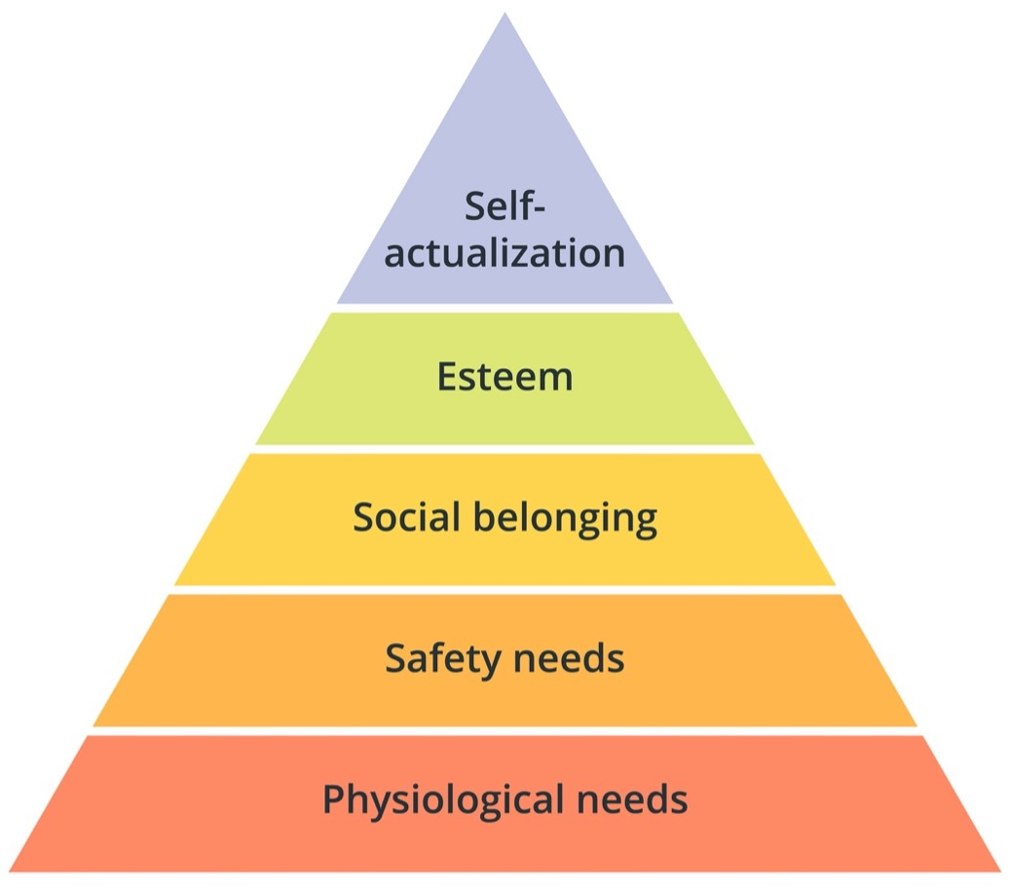
Our brains on recognition: let’s get scientific
Notes:
https://www.kudos.com/blog/the-science-behind-employee-recognition#anchor_1:
Employee recognition promotes positive psychological functioning (PPF) and its absence worsens it. Positive psychological functioning is comprised of the positive feelings that lead to self-acceptance, personal growth, and social contribution. The absence of recognition can deteriorate an employee’s psychological health, and ultimately their performance. Feeling unappreciated affects not only your emotions, but also how you think and act. It’s no surprise that a lack of appreciation can influence your mental health and lead to mental illness. If others ignore what you do for them, it can feel devastating. You might start to wonder why you bother putting effort into a task, or worse, you’ll lose sight of how your work contributes value to your organization.
“PPF: This is a scale of 33 items which measure 11 psychological key resources: autonomy, resilience, self-esteem, purpose in life, enjoyment, optimism, curiosity, creativity, humor, environmental mastery and vitality.”
Psychological Safety: If you feel seen, useful and appreciated for your work, speaking up to raise concerns, point out mistakes, ask questions or disagree gets easier. It’s about feeling secure in your place within a community, which evolutionarily is critical for survival.

Slide 10
Types of Employee Recognition
Public Recognition
Team building activities
Kudos
Peer recognition
Special accomplishment documentation
PDP evaluations
Formal recognition programs
Stay interviews
Financial:
Recognition awards*
Exchange time*
Growth and development increases*
Notes:
This is not an exhausted list.
Examples of formal recognition programs include the Excellence in Washington State Government Leadership Awards and the Extra Mile Awards, as well has PSRW
Photo source: https://lightroom.adobe.com/shares/e73f5479491c4156bf1a27dd1f2a19e3; the May 2024 Public Service Recognition Awards Ceremony.
Gallup.com – Employee Recognition: Low Cost, High Impact. “When asked what types of recognition were the most memorable, respondents emphasized six methods in particular -- and money isn't the only (or the top) form of recognition:
public recognition or acknowledgment via an award, certificate or commendation
private recognition from a boss, peer or customer
receiving or obtaining a high level of achievement through evaluations or reviews
promotion or increase in scope of work or responsibility to show trust
monetary award such as a trip, prize or pay increase
personal satisfaction or pride in work”
https://www.gallup.com/workplace/236441/employee-recognition-low-cost-high-impact.aspx

Slide 11
Financial Recognition Award
Other than suggestion awards and incentive pay unit awards, agencies shall have the authority to recognize employees, either individually or as a class, for accomplishments including outstanding achievements, safety performance, longevity, outstanding public service, or service as employee suggestion evaluators and implementors.
Limited to $200 for a team or individual
Cash or small gifts, pins, certificates, etc.
This may look like “Per RCW 41.60.150, your extraordinary work qualifies for employee recognition. These awards are taxable so it will show on an upcoming earnings statement.”
Notes:
Use HCA’s recognition handbook here.
Recognition Awards (RCW 41.60.150):

Slide 12
Exchange time and G&D Increases
Exchange time
Only applies to OT exempt employees
May be awarded in recognition of often working excessive hours in order to carry out their job responsibilities.
No more than 120 hours can be granted
Has no cash value – cannot be donated or cashed out
Growth and development increases
Only applies to WMS employees
Can be awarded under certain circumstances (if you use this tool, you should have guidelines or a policy)
May not exceed a total of 25 percent during an employee's appointment to a position, as long as the position's duties are unchanged or do not result in a higher evaluation if new duties were assigned.
Notes:
G&D - May agencies provide salary increases for WMS employees? Employers may provide salary increases to WMS employees in recognition of the employee's demonstrated growth and development in accordance with WAC 357-58-100.
WAC 357-58-095: https://app.leg.wa.gov/WAC/default.aspx?cite=357-58-095.
Exchange time: https://ofm.wa.gov/state-human-resources/compensation-job-classes/compensation-administration/compensation-plan-components/exchange-time

Slide 13
Impact on Culture: Recognition feels like Belonging
It does not need to be financial or even tangible.
It can be things like intentional goal setting and conversations about roadblocks or victories at work.
It can also be acknowledgement that someone is struggling.
It can be mentorship, helping someone network or even providing a reference during a job search.
Fairness and authenticity matter.
Meaningful recognition practices reinforce DEI in the workplace: https://www.workhuman.com/resources/reports-guides/from-appreciation-to-equity-gallup-report/
Notes:
“…Practicing recognition in the workplace improves employees' mental well-being, and increases their motivation to contribute value to their organization.” - https://www.kudos.com/blog/the-science-behind-employee-recognition#anchor_1
From Appreciation to Equity: HOW RECOGNITION REINFORCES DEI IN THE WORKPLACE, from Gallup – Workhuman, 2023. “Authentic recognition requires getting to know employees on a personal level, understanding their individual interests and passions and then carefully considering what motivates them (or doesn’t). The point is to understand who employees are as people — and recognize them as such. That’s where the authenticity shines. Doling out haphazard, inauthentic thanks won’t yield the culture boost leaders are looking for — especially if they’re after an improvement in wellbeing along with stronger DEI. Authentic recognition is a key predictor of employee wellbeing, and, in particular, Black and Hispanic employees are highly attuned to authenticity. Black employees are 79% more likely to be thriving, and Hispanic employees are 69% more likely, when they also strongly agree the recognition they receive is authentic.”
“…(R)ecognition is critical to the culture and operation within the workplace, which impacts workforce engagement. Also, employee rewards and recognition directly affect employee performance and are a form of powerful feedback. The strategies I1 identified were in alignment with Haines and St-Onge’s (2012) findings that rewards and recognition directly affect employee engagement and performance. I3 indicated that employees wish to feel appreciated and valued when performing daily tasks. The need for autonomy, intrinsic rewards, and influence are required to achieve employee engagement (Bolman & Deal, 2014). Competency and recognition are fostered when leaders provide employees with the opportunity to communicate issues they may experience, or provide input about operations within the workplace (Yuan, Lin, Shieh, & Li, 2012).”

Slide 14
A word on ethics
The state supports and encourages appropriate use of state resources for both employee recognition and team building activities.
These kinds of activities encourage employee retention, satisfaction, and positive team morale. When using state resources for such activities, we also need to ensure that we are abiding by ethics rules.
Consider whether your planned activities for recognition may be allowable (not prohibited) by agency policy and the Ethics in Public Service Act (RCW 42.52)
Notes:
“State agencies may allow employees to participate in activities that are not official state duties but promote organizational effectiveness by supporting a collegial work environment. Often these activities involve an accumulated use of state time or resources that is more than de minimis. So long as the employees who participate in the activity limit their use of state resources, then these activities would not undermine public confidence in state government.” -Executive Ethics Board FAQ 2017

Slide 15
Questions?

