Slide 1
Considerations for Mental Health and Well-Being in the Workplace: a Systems Perspective
HR Lunch and Learn Series
February 1, 2023
K. Darrow Brown, LICSW
Program Director, Washington State EAP
Interim Assistant Director, Workforce Support & Development
Department of Enterprise Services

Slide 2
Today’s Plan
Objectives:
Learn about the framework described in US Surgeon General’s Framework for Workplace Mental Health & Well-Being
Learn about the “Five Essentials for Workplace Mental Health & Well-Being”
Connect the Five Essentials to our workplaces and the work we do
Generate ideas and approaches to promote and foster well-being in the context of the Five Essentials

Slide 3
The Workplace Landscape in the US
76%
84%
81%
Mental health symptoms
Workplace conditions
Looking for workplaces
The percentage of workers reporting at least one symptom of a mental health condition.
Mindshare 2021 Report
The percentage who said their workplaces contributed to at least one mental health challenge.
Mindshare 2021 Report
Workers who reported they will be looking for workplaces supporting mental health.
APA Work and Well-Being

Slide 4
EAP Counseling Cases
20%
Bullying/Mistreatment
Burnout
Conflict at Work
Discrimination
Job Transition
Layoff
Performance Issues
Retaliation
Sexual Harassment
Stress at Work
Termination
Workplace Concerns as Presenting Problem

Slide 5
“The Surgeon General’s Framework for Workplace Mental Health & Well-Being is intended to spark organizational dialogue and change in the workplace.”
“Organizations can use this Framework to support their workplaces as engines of mental health and well-being.”

Slide 6
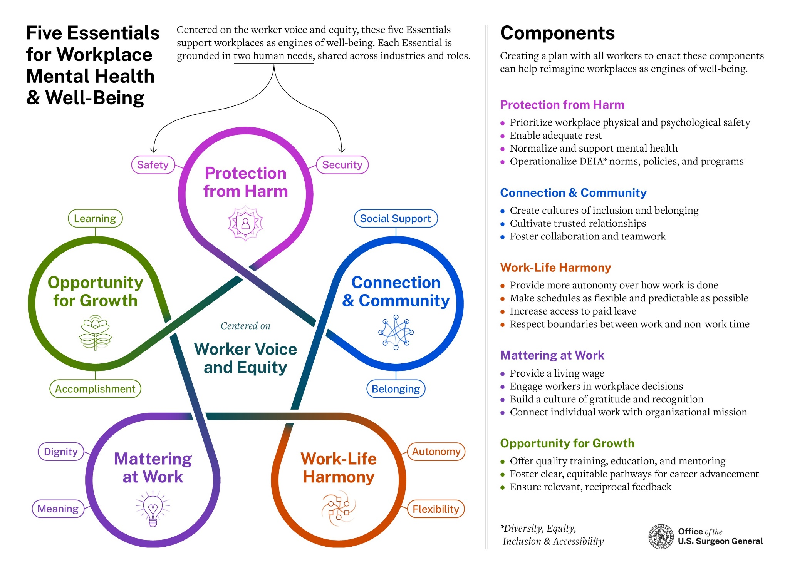

Slide 7
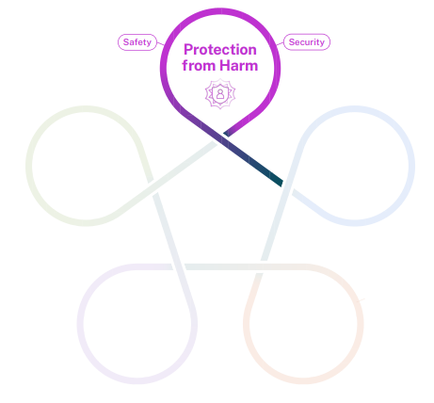
Prioritize workplace physical and psychological safety
Enable adequate rest
Normalize and support mental health
Operationalize Diversity, Equity, Inclusion, and Accessibility (DEIA) norms, policies, and programs

Slide 8
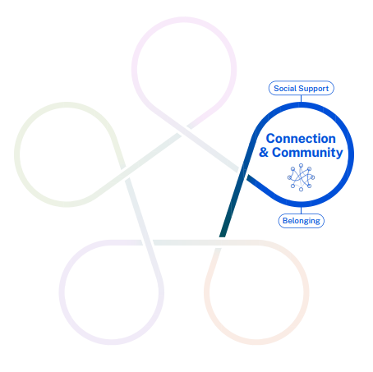
Create cultures of inclusion and belonging
Cultivate trusted relationships
Foster collaboration and teamwork

Slide 9
Provide more autonomy over how work is done
Make schedules as flexible and predictable as possible
Increase access to paid leave
Respect boundaries between work and non-work time

Slide 10
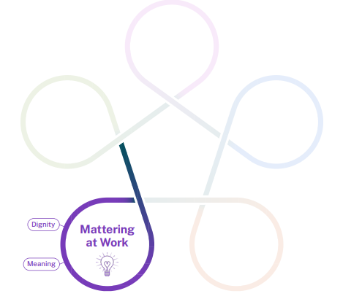
Provide a living wage
Engage workers in workplace decisions
Build a culture of gratitude and recognition
Connect individual work with organizational mission

Slide 11
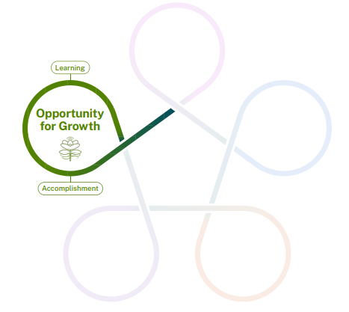
Offer quality training, education, and mentoring
Foster clear, equitable pathways for career advancement
Ensure relevant, reciprocal feedback

Slide 12
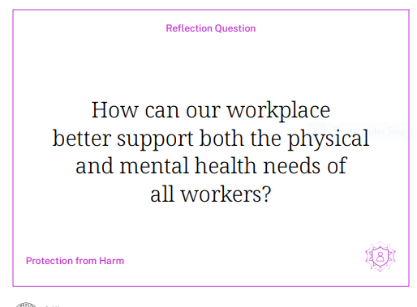
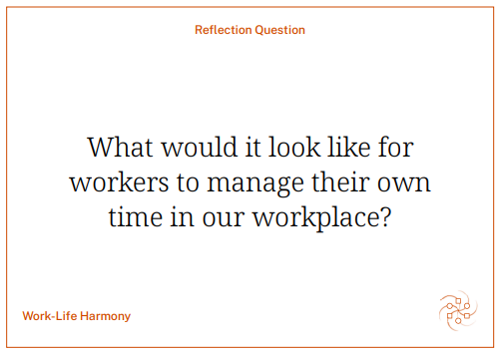
Reflection

Slide 13
Breakout
What connection do you see between the Five Essentials, your workplace and the work you do?
What idea do you have that would promote workpalce mental health and well-being in the context of the Five Essentials

Slide 14
Links
U.S. Surgeon General - Current Priorities
U.S. Surgeon General - Framework for Workplace Mental Health and Well-Being
U.S. Surgeon General – Reflection Questions
Washington State EAP – Home Page

Slide 15
Thank You
darrow.brown@des.wa.gov
(877) 313- 4455
eap.wa.gov

