Slide 1
Behavioral health impacts of COVID-19
Trends, Workforce Impacts, & Resources
Kira Mauseth, Ph.D.
Behavioral Health Strike Team

Slide 2
Agenda
What to expect from a behavioral health standpoint over the next few months
Developing healthy teams and resilience in the workplace
Understanding impacts to you and your teams
Defining key terms

Slide 3
Definitions
Burnout: Exhaustion of body, mind, and motivation due to exposure to prolonged and unresolved work stress or frustration. Burnout is often a consequence of perceived disparity between the demands of the job and the resources that an employee has available to them.
Compassion fatigue: Emotional and physical exhaustion leading to a diminished ability to empathize or feel compassion for others, also described as secondary traumatic stress.
Resilience: The process – involving behaviors, thoughts, and actions – of adapting well in the face of adversity, trauma, tragedy, threats, or significant sources of stress. Can be developed by focusing on connection, purpose, and flexibility /adaptability.
Resilience factors: Conditions that help a person survive during and recover from a crisis or trauma- usually internal strengths and external resources.

Slide 4
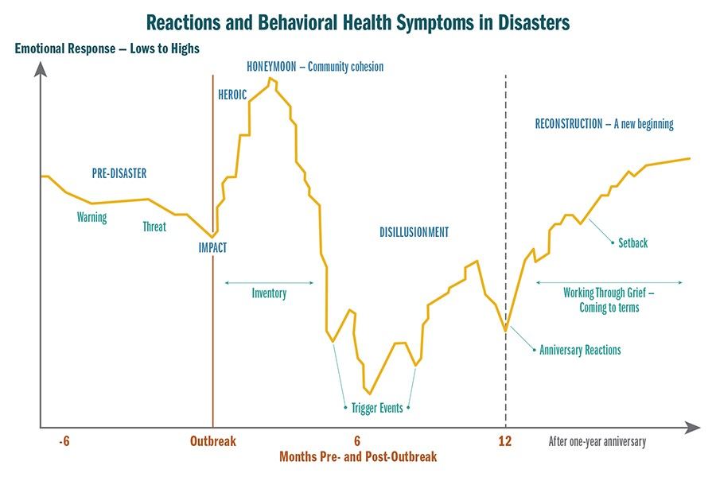

Slide 5
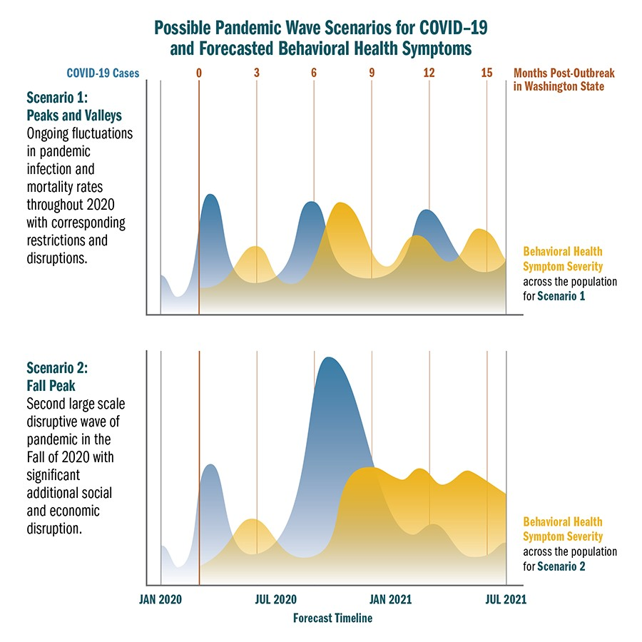

Slide 6
Key Things to Know
Upwards of three million Washingtonians will likely experience clinically significant behavioral health symptoms within the next 2-5 months.
Depression, anxiety, and acute stress will likely be the most common
PTSD less common, but concern among some populations (post-vent critical care, exposure to traumatic events)
Significant decrease in depression and anxiety from July, trend likely short-term
Substance use related challenges are expected to significantly increase:
Roughly 50% of individuals who experience behavioral health diagnoses develop a substance-related disorder, and vice versa
Most, but not all, are an exacerbation of pre-existing problematic behavior
34% increase in abuse cases in first 6 months of 2020, youth aged 13-17 (poison control)

Slide 7
Disillusionment Phase
Can be uncomfortable and challenging for individuals and communities:
Confronted with limitations of disaster assistance and support
As gap between needs and resources widens, people may feel abandoned
Also a gap between expectations and reality (eg: schooling, working from home)
Symptoms are like to trend more towards:
Depression, sadness, grief, or loss as the most common experiences
Emotional burnout likely to be socially disruptive due to length and scope of the pandemic
Increased by economic pressures and divisions among people and groups
Exception: Severe disease activity, trauma cascade would likely shift behavioral health symptoms

Slide 8
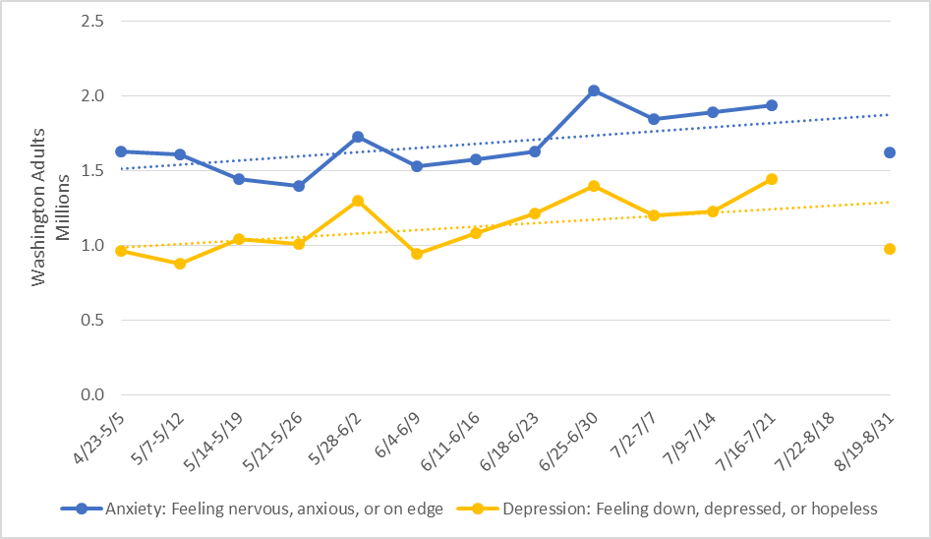
Anxiety, Depression (Census Bureau)

Slide 9
The Trauma Cascade
“… a situation in which parts of the disaster recovery cycle can be repeated or prolonged, during which people may have reduced ability to emotionally recover…”
Including: Wildfires, community outbreaks, social/civil unrest, individual’s life events, and more
What is the potential impact?
Restarting the disaster cycle, but at a lower baseline
Prolonged Disillusionment Phase
Reduced emotional capacity, ability to recover
Behavioral health symptoms: moderate to severe symptoms of acute stress which has the potential to result in PTSD and/or major depressive disorder

Slide 10
Recovery vs Return to Baseline
An eventual return to baseline levels of functioning for many people should occur around 14 months after the initial outbreak
Assuming rates of infection do not significantly increase, and
A sense of a “new normal” is underway
-OR-
If COVID-19 cases dramatically increase in the fall months, one of the major outcomes will likely be a trauma cascade
Disaster recovery cycle can either be repeated or prolonged
Reduced ability to emotionally recover due to additional/ongoing impacts
Other impacts (economic, social) will also play a role

Slide 11
The Good News
Typical long-term response to disasters is resilience, rather than disorder. Resilience is something that can be intentionally taught, practiced, and developed for people across all age groups.
Resilience can be increased by:
Focusing on developing social connections, big or small
Reorienting and developing a sense of purpose
Becoming adaptive and psychologically flexible
Focusing on hope

Slide 12
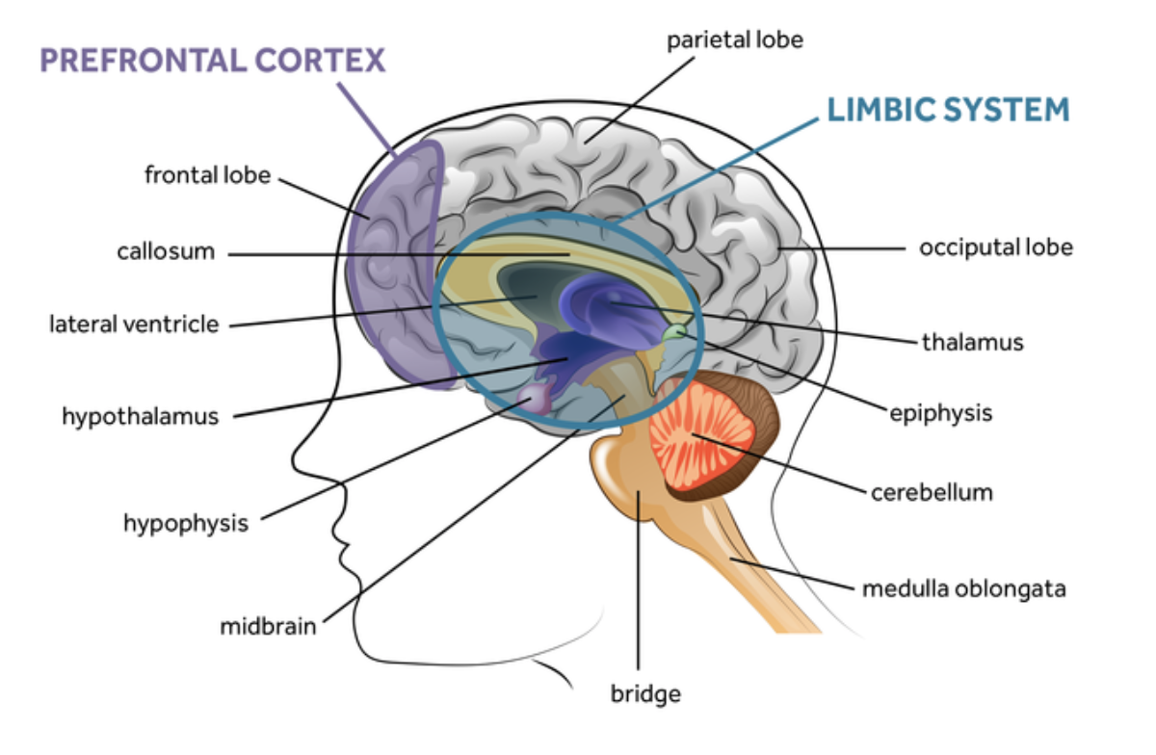

Slide 13
Common Experiences in the Disillusionment Phase:
Easily distracted
Trouble remembering things
Quick to anger or easily frustrated
Frequent headaches or stomachaches
Trouble falling or staying asleep
Carbs!
Sadness or loneliness (even with all the meetings!)
Information that normalizes the shared experience helps people develop resilience.

Slide 14
Stressed Brains in the Workplace
Potential for increased emotional responses:
Anger
Fear
Frustration
Less higher-level thinking capacity

Slide 15
Compassion Fatigue and Job Burnout
Burnout can lead to many harmful consequences, including changes in the way people view themselves, their world, their meaning or purpose, and the future.
Even the most resilient and well-balanced people can suffer emotionally and physically when they fail to take care of their own needs.

Slide 16
Compassion Fatigue And Job Burnout
Burnout can lead to many harmful consequences, including changes in the way people view:
Themselves
Their environment
Their world
Their meaning or purpose and
The future
Other workplace factors that contribute to burnout include:
When people don’t (or aren’t able to) process the emotional rewards from their work.
Work where there may be few compassion rewards (The work regularly feels more challenging or draining than rewarding).
Too few resources and too much personal demand to meet perceived needs or asks.

Slide 17
Opportunities for Supervisors & Managers
Walk the Walk: What is DONE is what matters, not what people are told to do.
Be honest and open in the communication process.
If you don’t know, tell your team you don’t know.
Active Listening is something that all team members can benefit from learning and practicing.
Listen with the intention of understanding and caring, NOT to problem solve.

Slide 18
Active Listening
You have noticed that a colleague seems “off”- coming late to meetings, looking distraught or more tired that normal, not engaging with the team in the same way. How might you approach them about any concerns you may have? What would you say or do if you were worried about how they were doing?
Clarify
Ask open ended questions
Reflect
Summarize what you think you heard
Express Empathy
Listen with the intent to Care, not problem solve

Slide 19
What can we do to reduce burnout generally?
Develop Resilience: Connection, Purpose, Flexibility / Adaptability and Hope.
Reminding yourself of things that motivate you to increase your sense of purpose and redefine that as you need to when things change, as well as the successes you are having.
Maintaining and enhancing interpersonal boundaries: Know your limits. Say no to tasks that will take away from your work-life balance. Ask others to help when reaching limits.
Connect with people outside of work or socially within work.

Slide 20
Resilience
Internal Strengths
External Resources
Cooperation and communication
Problem solving
Self-awareness
Empathy
Self-efficacy
Goals and aspirations
What has worked well for you in the past?
Why did that work well?
What resources are still needed?

Slide 21
Resilience Development
Flexibility and Adaptability
Purpose
Connection
How can you be creative in physical distancing while leveraging connection?
How can you adjust your physical space?
How can you adapt your schedule to give yourself discreet and clear breaks and boundaries?
What motivates you?
What contributes to compassion rewards?
What can you remind yourself of to help on a day-to-day basis (don’t think too long term or big picture).
How can you maintain existing connections with others?
How can you develop new connections?
Connection can be anything.

Slide 22
Practice the REST Model
Reward: Reward yourself for a job well done. Build reinforcements into your work. Help pay attention to this aspect for maintaining resilience.
Establish: Establish healthy boundaries. When you are off duty, stick to that boundary.
Share: Share your feelings, concerns, and stories. Participate in support and consultation groups. Make time for connections and activities in your life.
Trust: Trust your support network and reach out as needed. Refer people elsewhere if you are too tired or compromised emotionally to be able to offer support.

Slide 23
Take time off as you can and do things that are entirely NOT work related.
Taking care of yourself takes care of the team and the organization.
Finding ways to reduce burnout NOW is essential. Get outside as much as you can (when safe to do so and the weather is good).
Getting processes in place from the top down (and modeling good self-care) dramatically reduces burnout for team members.

Slide 24
Resources
Training:
Health Support Team (including train-the-trainer)
PsySTART-Responder (frontline healthcare only)
Specific Resources:
Behavioral Health Group Impact Reference Guide
Healthcare, behavioral health, outreach teams, post-vent
Unique challenges/considerations
Support strategies (organizational, supervisory, personal)
Family toolbox:
Supporting Children and Teens During the COVID-19 Pandemic
Emergency and healthcare workers:
Coping During COVID-19 for Emergency and Healthcare Professionals
Businesses and workers:
COVID-19 Guidance for building resilience in the workplace

Slide 25
Resources:
DOH - Forecast and situation reports, guidance, and resources:
https://www.doh.wa.gov/Emergencies/NovelCoronavirusOutbreak2020COVID19/HealthcareProviders/BehavioralHealthResources
State – General mental health resources: https://coronavirus.wa.gov/information-for/you-and-your-family/mental-and-emotional-well-being

Slide 26
DES Workforce Support & Development Resources
Live and asynchronous learning opportunities to support and develop the state workforce through COVID.
Virtual Learning Paths include:
Workforce Support During Extraordinary Times
Human Resources Training
Leadership
Working Remotely
Workplace Culture and Diversity, Equity, and Inclusion
https://des.wa.gov/services/training-and-development/online-learning-resources-workforce-development
New Leadership Series with 2-hour online workshops include:
Building a Psychologically Safe Team Culture
Coaching Your Remote Team
Managing Stress, Time, and Energy for Leaders
Managing Emotions for Success as a Leader
Self-Awareness & Values-Driven Leadership

Slide 27
Ongoing Webinars:
Self-Care
How to Build Resilience When Your Job Involves Helping Others in Crisis
For Supervisors and Managers: Leading Teams and Supporting Employees through COVID
Working from Home during COVID-19: Coping with the Challenges, Setting Yourself Up for Success
Parenting and Family Challenges: Helping Yourself and Your Family through COVID
Couples: Managing Your Way through COVID-19
Leading the Human Side of Change
Navigating Change in Challenging Times
Free & Confidential Counseling, Coaching, and Consultation
Resources: https://des.wa.gov/services/hr-finance/washington-state-employee-assistance-program-eap/covid-19-resources

