Slide 1
Paving the way: Dynamic Succession Planning
Bobby Humes (he, him)
Director of Human Resources
State Investment Board
Notes:
(1 min)
Intro:
Name, Pronouns
Place of Employment
Thank You for the Invite
Experience with Succession Planning

Slide 2
Overview
Why Succession Planning
Spotlight: OFM Succession Planning Toolkit
Equity: Identifying High Performers and High Potential Staff
Org Strategy and Performance Management
Communication, Evaluating, Celebrating and Moving On
Notes:
(2 minutes)
Here’s our Overview
I’m here to provide just one hour of content for a complex, highly visible and highly rewarding function that is not HR’s only to own.
We over the next hour 45 minutes we’ll discuss:
The Why behind succession plan
OFM Succession Planning Toolkit
Equity in identifying High Performing/High Potential Staff
The importance of org strategy and performance management
Communicating, evaluating

Slide 3
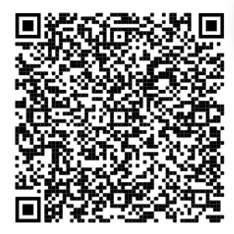
Project Spotlight: OFM Succession Planning Documents
Thank YOU!
SPToolkit_EB1.pdf (wa.gov)
Notes:
(1 minute)
I want to give a huge thank you to the team at OFM HR and any associated, partners, supporters and adopters who were part in creating the OFM Succession Planning Toolkit. I don’t know all the names and stories, but your effort and professionalism is evident in this product – thank you.
I’ll be using the product developed by the OFM/HR team to frame the rest of our discussion here today. To access the Toolkit, use the link in the chat, the QR code or simply be present and enjoy your lunch as I walk us through the construction of the toolkit and how to some ways of thinking through how best to use the toolkit to develop your agency’s succession plan.
SPToolkit_EB1.pdf (wa.gov)

Slide 4
Why Succession Planning
Staff Retention
Continuity
Equity
Notes:
(2 minutes)
Succession planning, like any staff retention strategy should be thought of as long-term in nature. We must think of our people as long-term partners in accomplishing the missions of our agencies.
To do this effectively we have to do what I call – hold it lightly – we must both put our aims towards attracting a diverse mix of people and minds to accomplish our goals, while acknowledging that people and their circumstances change, much like our business, policy, legislative planning.
Think hiring an emerging leader, creating a new team structure under new leadership, promoting a first-time manager, or losing an employee due to turnover or other unforeseen and uncontrollable circumstances. We might move to develop someone who could ultimately move on before we realize their full potential. And I asset that’s okay.
You must be ready for the long game here. Short term activity like quick fixes and performance-driven culture creates operational HR and strategic outcome risks in my mind.
Key Succession Planning Elements:
Strong Growth Culture
Strong Learning and Development Culture
Learning and Development Resources
Strong Employee Engagement Culture
The business environment creates the frame for your plan. Whatever risks are inherent in conducting your organization’s business should be evaluated by your leaders with the input for your AAG.

Slide 5
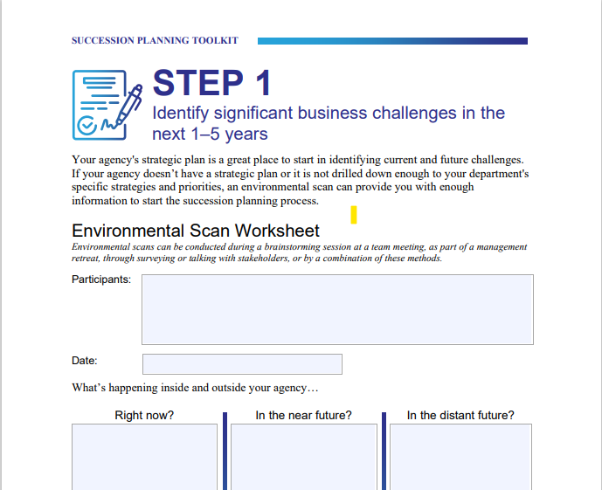
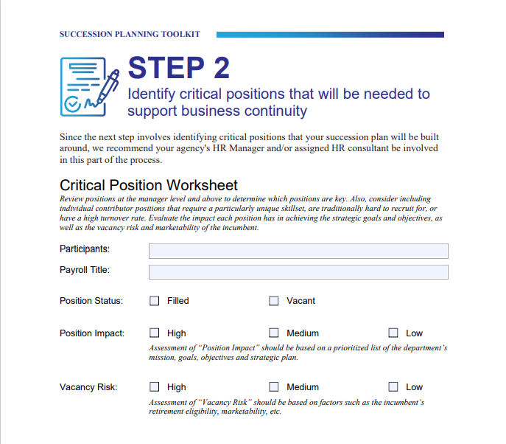
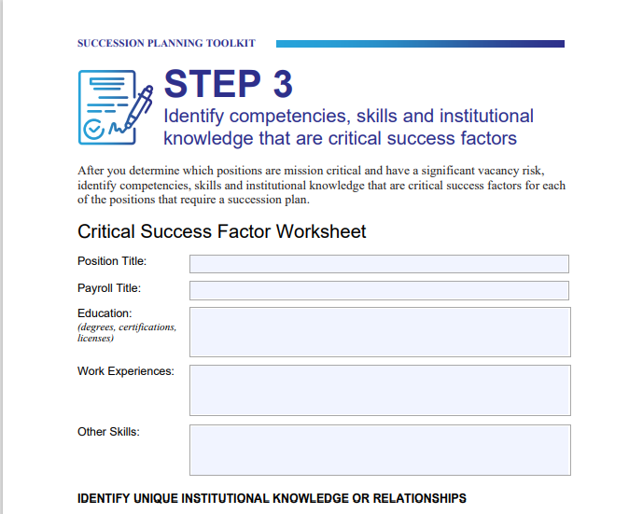
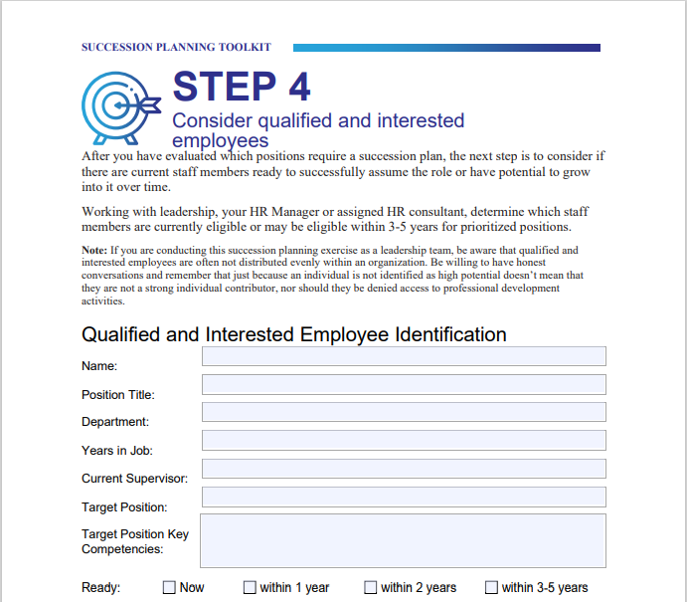
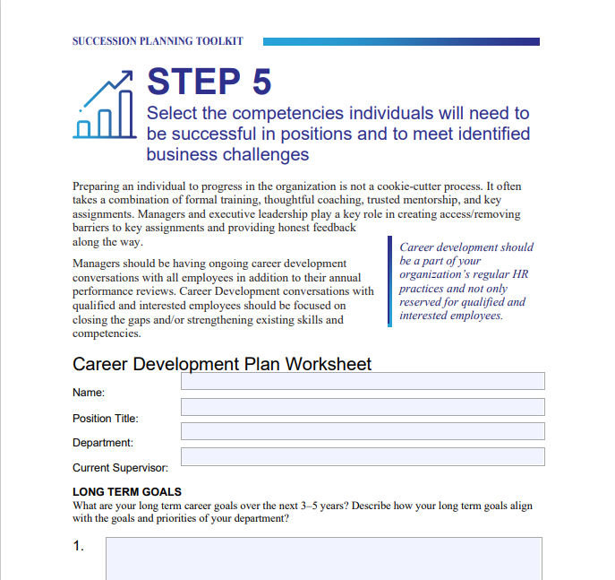
Project Spotlight: OFM Succession Planning Documents
Notes:
(2 minutes)
The toolkit involves 5 steps:
Step 1: Identify significant business challenges in the next 1-5 years
Step 2: Identify critical positions that will be needed to support business continuity
Step 3: Identify competencies, skills, and institutional knowledge that are critical success factors
Step 4: Consider qualified and interested employees
Step 5: Select competencies individuals will need to be successful in positions and to meet identified business challenges
Let’s take a deeper look at step 1…

Slide 6
Step 1: Identify significant business challenges in the next 1-5 years
What’s happening inside and outside your agency:
Right now?
In the near future?
In the distant future?
Notes:
(2 minutes)
Our first step is to look at the big picture and identify current and future challenges.
The toolkit recommends using the Environmental Scan Worksheet found on page 4 if your agency doesn’t have a strategic plan, but I want to recommend using it if you have a strategic plan as well. Often, we fail to update our strategic plan mid-cycle and the environmental scan can serve to support updating any strategic focuses as well.
An exercise like this should be done at the level of the organization responsible for making such decisions and should involve staff input as executive may not understand the nuances of skill/partner alignment/involvement.
However, succession planning is typically not a bottom-up method of organizational planning, but we will discuss ways to create more inclusion in the process which is truly vital to making the plan a success.

Slide 7
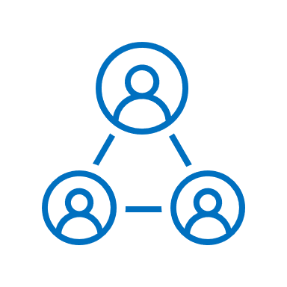
Step 2: Identify critical positions that will be needed to support business continuity
HR Involvement
Position/Roll Status
Impact/Risk Assessment
Notes:
(3 minutes)
Step 2: Identifying critical positions that will be needed to support business continuity.
HR involvement is critical to this work and HR should have an excellent grasp on the business, the talent needs of the business as well as keen awareness on the learning and development resources and capabilities at the organization’s disposal.
Position role and status is about understand if the position is filled or vacant – simple enough
The impact of the position (high, medium, low) and the vacancy risks (high, medium, low). Position impact should be based on mission, goals and agency objectives.
I’ll highlight that its not easy to get a read on vacancy risks if the organization hasn’t equipped people leaders to have retention discussions with staff as a standard part of leading humans in the workplace.
Succession Planning Questions (page 12 of the Succession Planning Toolkit)
The questions below are designed to assist in identifying contacts, processes and procedures, institutional knowledge, and competencies needed for your position. The knowledge, experience, and competencies should reflect the actual needs of the position, which are not necessarily the knowledge, experience, and competencies you bring to the position. This questionnaire should be updated as needed or a minimum of once a year.
Over the next five years, what are/will be the key responsibilities of this position?
What key competencies are needed for this position?
What are the interim key responsibilities to be reassigned until this position is filled?
We ask each of these questions with the organization’s mission, goals and objectives in mind.

Slide 8
Step 3: Identify competencies, skills, and institutional knowledge that are critical success factors
Education
Work Experiences
Other Skills
Notes:
(2 minutes)
Step 3: Identify competencies, skills and institutional knowledge that are critical success factors.
Education refers to relevant degrees, certifications and licenses. These elements should have alignment with organization mission, goals and objectives and should be updated as necessary to reflect the changing business environment.
While education can be gained by providing opportunities for learning new concepts and ideas, a person’s lived experiences creates a dynamic range of skills and attributes which can only come from experience. The best way to understand how an incumbent's work experience has impacted their work is for HR conduct an interview.
In that interview, it is important to look for other skills which have an impact on the success of the incumbent in light of the organization's mission goal and objectives.

Slide 9
Step 3: Identify competencies, skills, and institutional knowledge that are critical success factors
Institutional Knowledge
& Relationships
Plan for Knowledge Sharing
Notes:
(5 minutes)
We’re still on step three…..
In that same interview that HR will conduct, we want to get really clear on the degree of institutional knowledge as well as the necessary and effective working relationships the incumbent leverages (or should leverage) in carrying out the job.
We’ll use all of this information to build a plan for knowledge sharing which is a stop gap should the incumbent or successor move on before we can implement our planning. Bottom line item I want you to take away from this slide – building a plan for knowledge sharing is vital to your plan’s success.
Let look at some questions that can be used in this interview. I’ll place them in the chat as well.
Interview your incumbents and teams: (These questions are taken from page 13 of the Succession Planning Toolkit)
What information would have been useful for you to know when you first came into this position?
What information have you learned since that would be helpful for others in this position to know?
What do you consider to be the most valuable and/or unique knowledge that you hold in your current role? Do you have knowledge that is hard to replace or that no one else has?
Who are the people you interact with most frequently (internally and externally)? Is there anyone for whom you are the main or only point of contact?
Is there any key documentation that you find particularly useful to your role? Are these readily available to others? Procedures, manuals, software, reference materials, websites, newsletters?
In your position, what is generally likely to go wrong, and how do you usually respond to or resolve problems? How have you identified and managed potential risks or problems in the past?
What mistakes do you think have been made in the past that you think could be avoided in the future?
Are there other roles that you perform (officially or unofficially) in the organization?

Slide 10
Step 4: Consider qualified and interested employees
Growth Mindset
Timeframe
Action Plan
Notes:
(5 minutes)
Step 4: Consider Qualified AND interested employees:
At this step leadership and HR work together to determine which staff are eligible or may be eligible within 3-5 years for prioritized positions.
The “may be eligible” is work for leadership and HR to handle and implies a commitment to distinguish what development is needed to best prepare staff towards eligibility. This exercise is not only looking at what you have on hand, it mostly about looking at what could be.
Thinking about what could be stems from a growth mindset. A growth mindset is about embracing the learning that comes from failure in a setting where we are allowed to take risk in a supportive environment.
Article: What Having a “Growth Mindset” Actually Means (hbr.org)
Applying the growth mindset to the work of considering interested employees is about framing what it might take for them to get to where we need them get imperfectly for a degree of time while we support that staff member in taking on new ways of being and new work outcomes. It’s messy.
The timeframe you associate with the effort is key as well. This is a level set for the staff member and leadership - understanding the timeframe gives us the awareness we need to know what it will take to get the staff member from point A to point B. This timeframe does not float out in arbitrary space – this timeframe should be aligned to the strategy or business environment.
Your action plan is just that- a plan of action. It should be as detailed, accessible and clear as possible. If this qualified/interested staff member has a skill deficiency in data management, your action plan should detail the specific learning and development opportunity/pathway and the timeframe for participation in said learning engagement.

Slide 11
Step 5: Select competencies individuals will need to be successful in positions and to meet identified business challenges
Leader/Staff
Communication
Long Term/Short Term Goals
Skill and Competency
Requirements
Notes:
(5 minutes)
Step 5: Select competencies individuals will need to be successful in position and to meet identified business goals.
All that thinking and identification of what is required for the staff member to get from where they are now skill-wise to where the succession plan has identified is not fodder for a discussion with key staff. This is a career development conversation. Here are some pointers:
These types of conversation should already be a norm – a discussion like this can sometimes create more stress than glee because of the content of the discussion in the context of culture
Be clear how you got here and why this person has been identified – we’re not doing anyone any favors; we’ve put a lot of thought into this; we didn’t make any mistakes.
Tell the staff member the reason for the meeting beforehand – make your excitement clear (if that’s a normal part of your behavior wheel)
Listen for the no and be okay with that
We want to make sure we are in alignment with where this staff members life and career is headed, and we shouldn’t make assumptions. Getting clear on long and short-term goals creates an opportunity to explore where that alignment might be. This alignment is key to this step.
We also want to ask what skills or competencies they believe is necessary for them to reach those goals.

Slide 12
Equity Spotlight: Identifying High Performers and High Potential Staff
Key Succession Planning :
Strong Growth Culture
Strong Learning and Development Culture
Learning and Development Resources
Strong Employee Engagement Culture
Notes:
(3 minutes)
I wanted to make space for this equity spotlight on identifying high performers and high potential staff. The keys to succession planning are here:
Strong Growth Culture
Strong Learning and Development Culture
Learning and Development Resources
Strong Employee Engagement Culture
This work can be the key to long term success and support of the communities we serve, however, done poorly – this work can continue to exacerbate the harm many feel of being overlooked due to racial, gender and other forms of oppression, bias and hate. Knowing this, we must bring intentionality to this work by:
Ensuring decision makers involved in this process have participated in anti-bias training
Ensuring that HR is part of the decision-making process
Succession planning is done with the backdrop of strong strategy and planning

Slide 13
Equity Spotlight: Identifying High Performers and High Potential Staff
4 Box
9 Box
Notes:
As you think through identifying your high performers there are two simple tools the 4 box and 9 box succession planning exercises.

Slide 14
4 Box Approach
“At Potential”
Demonstrates high potential
Definitely “at” potential; high performer with unique skills and contributions
High Potential
Has potential but emerging or being determined
Rated as good performers or meets expectations; likely not making any moves from current role

Slide 15
9 Box Approach
Potential
1.
High performance, high potential
3.
High performance, medium potential
6.
High performance, “at” potential (niche role)
2.
Medium performance, high potential
5.
Medium performance, medium potential
8.
Medium performance, “at” or low potential
4.
Low performance, high potential (New in Position)
7.
Low performance, medium potential (Mismatch to Job)
9.
Low performance, or low potential
Performance

Slide 16
Wrap Up: Communicating, Evaluating, Celebrating and Moving On
Notes:
(3 Minutes)
Communication is key, it should be no surprise to anyone that succession planning is part of the sustainable path of organizational success. A high-level communications plan on this looks like:
Agency-wide messaging on what succession planning is, the organization’s equitable approach the learning and development and its importance to sustainable organizational strategy outcomes
People leader messaging on their role in leading a growth oriented (or growth minded) organization which starts with feedback, accountability and investment in the skills and talents of staff
Identified staff direct and clear discussion on their long and short-term goals, how it related to the organization’s goals and objectives and that they are begin consider for a strategic opportunity that will take development, focus and isn’t necessarily promised – on either end.
Evaluating our staff, our strategic focus and what it continues to be necessary to ensure the outcomes we desire is a key element to the success of your plan. Performance evaluations take on a new light when we recognize we’re not just providing feedback on the quarter, the year – we’re establishing what is necessary now and ongoing for the performance to sustain or improve. This evaluation allows us to have the feedback discussion and ensure our high potential staff continue their development towards our shared long-term goals.
Celebrating isn’t done enough in our workplace. Leveraging an organizations current talent for any length of time, seeing that talent grow and mature and then leveraging that talent at a higher degree of ultility is an amazing accomplishment which should not go without:
Agency-wide messaging on the good news!
Some pause in the thing to reflect on what’s been achieved and how
Promotions, courses, new skills
Moving on is what keeps many organizations from truly leaning in and developing high potential staff. Its that popular fictional discussion:
Leader A: What happens if we train them, and they leave?
Leader B: What happens if we don’t train them, and they stay?
Type in the chat – what happens if we don’t train them and they stat?
Moving on is a normal part of the talent lifecycle – with a healthy succession plan – moves aren’t surprises, they are partnerships. With a healthy succession plan – we’re already aware of the risk of losing the person identified as our high potential and we’ve expanded our long term approach to include a few more names.

Slide 17
Questions, Thoughts, Comments

Slide 18
Thank You!
Notes:
(1 min)
Outro:
Thank you
I don’t know everything if I’ve said anything here that was in error, please call me in so I can be better
Feel free to find me on global if you want to share ideas on this or any other HR topic
Be great out there!

