Slide 1
Human resources managers meeting
11 01 2023
Cindy Cotter and Devonee Davis
DES

Slide 2
Online recruiting system (OLRS)

Slide 3
OLRS statistics
Monthly Averages | FY17 | FY18 | FY19 | FY20 | FY21 | FY22 | FY23 | FY24 Qtr1
Postings | 973 | 1,000 | 1,032 | 925 | 857 | 1,436 | 1,452 | 1,438
Applications | 31,556 | 30,959 | 30,080 | 27,774 | 22,297 | 25,864 | 27,931 | 37,874
Hits | 904,106 | 887,597 | 830,452 | 1,284,131 | 1,756,731 | 2,551,986 | 2,522,988 | 2,853,456
Offers/Hires | 1,030 | 948 | 1,024 | 1003 | 922 | 1,483 | 1,459 | 1,196
Note: Hiring Freeze started May 18, 2020. Lifted April 28, 2021.
Data for internal use.
Notes:
Applications have increased this last quarter.
July 35,223
August 40,423
September 37,977
The previous quarter:
June 29,594
May 31,121
April 28,198
June 1 and June 27th – news articles re: state jobs for remote employment with pay over 80K published. News Tribune, Tacoma News Tribune, Tri-Cities Harold.
The Hits report is based on job posting Advertise From date. This date can be edited (new date entered), which impacts the Hits report.

Slide 4
Coming soon
Referred List Personally Identifying Information (PII) Blinding in Online Hiring Center (OHC)
  DES Workforce Product Support is contracting with NEOGOV for a customization to blind candidate PII on referred lists and redact PII on attachments within OHC.
  Functionality anticipated early 2024.
Single Sign On (SSO)
  DES is in the contracting phase with NEOGOV for the use of SSO when accessing the OLRS.
Notes:
Working towards a contract with NEOGOV for the PII blinding functionality.

Slide 5
WPS HelpDesk Stats

Slide 6
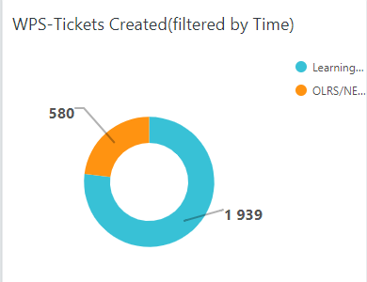
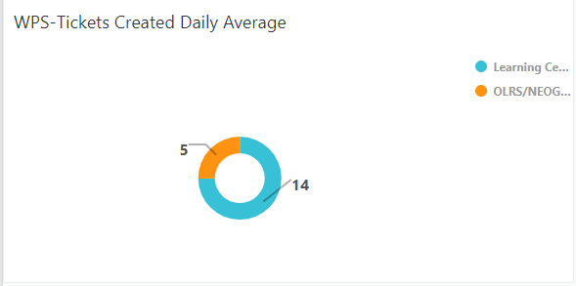
WPS Tickets Created – 05/01/2023 through 10/30/2023
Notes:
The night of the user’s HRMS start date, the data feed will provide DES with:
HRMS data
Active Directory data
Using the full eight digit employee ID, the data is combined to create a complete user account

Slide 7
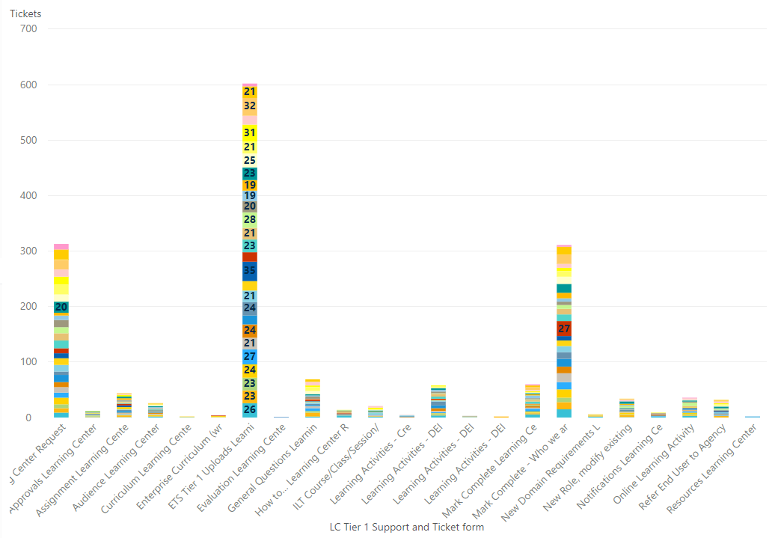
Learning Center Helpdesk tickets by Category
Notes:
The night of the user’s HRMS start date, the data feed will provide DES with:
HRMS data
Active Directory data
Using the full eight digit employee ID, the data is combined to create a complete user account

Slide 8
OLRS Helpdesk tickets by Category
Notes:
The night of the user’s HRMS start date, the data feed will provide DES with:
HRMS data
Active Directory data
Using the full eight digit employee ID, the data is combined to create a complete user account

Slide 9
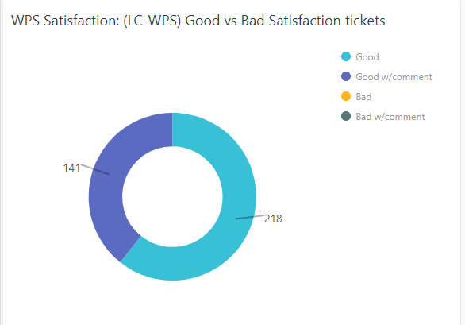
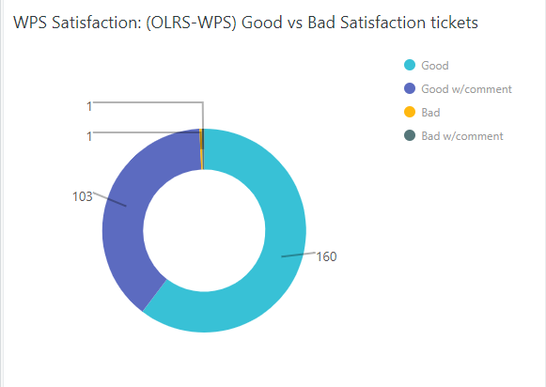
WPS Satisfaction from 05/1/2023 through 10/30/2023
Notes:
The night of the user’s HRMS start date, the data feed will provide DES with:
HRMS data
Active Directory data
Using the full eight digit employee ID, the data is combined to create a complete user account

Slide 10
Learning center

Slide 11
Ongoing Priority Tasks
Description | Priority Order | Status | % Complete
Role Changes | High | In Progress | 50%
Accessibility Assessment | High | Complete | 100%
I.T. Security Replacement | High | Not Started
Remove Home Page | High | Not Started
Redesign Learner Dashboard | High | In Progress | 75%
OneWA Training Effort | High | Not Started
IAAs for Extended Enterprise | Medium | In Progress | 95%

Slide 12
Ongoing Priority Tasks
Description | Priority Order | Status | % Complete
Optimization | Important | Awaiting report and prioritization of projects | 75%
Cloud First Project | Nice | Restarted
Join Reports Club Create custom datasets | Important | Approved | 100%
Begin Reports Project | Important | Awaiting prioritization for ETS Resources
LinkedInLearning Integration | Nice | Restarted | 20%

Slide 13
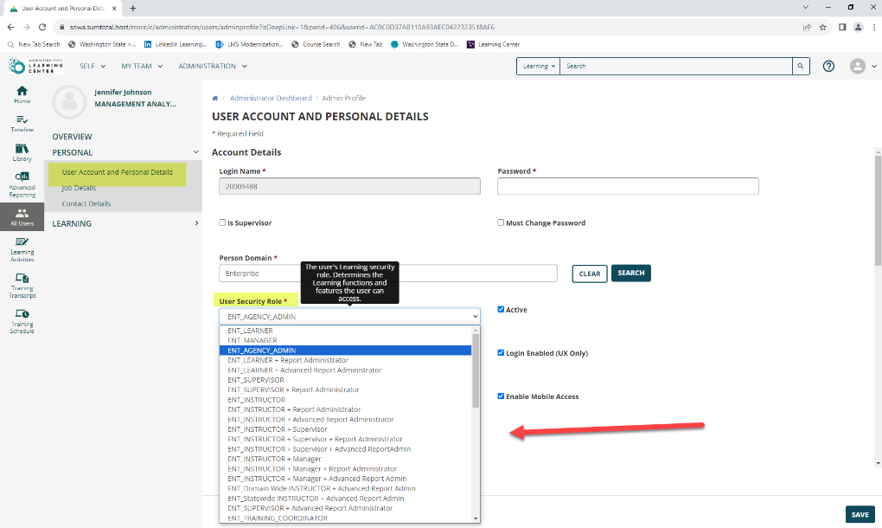
Role Changes
To reduce the number of roles:
  Give all base roles Advanced Reporting Permission and eliminate all roles that say +Report Administrator and +Advanced Report Administrator
  All roles will see Advanced Reporting in their left navigation
    We have the option to move it from there and people could use menu structure to access
  Beginning the week of November 6th Learning
  Center Administrators who are doing testing in
  the Sandbox environment will start to see some
  changes with roles.
  End-users who have an existing role
  that is being updated, will get moved to the new role.
  You can expect to see roles in the drop downs titles
  being updated

Slide 14
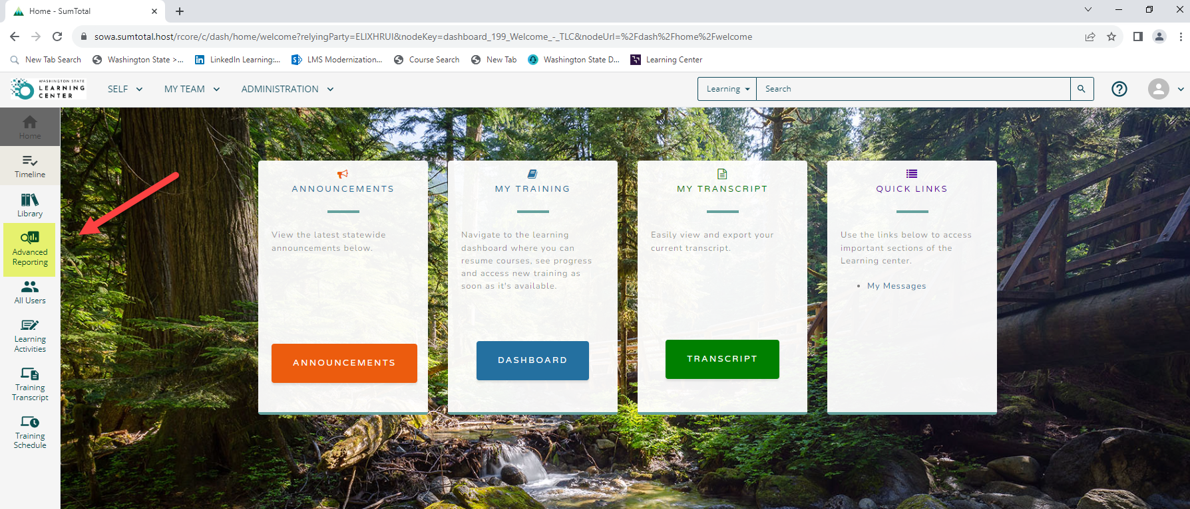
Role Changes
End-users who didn’t see the Advanced Reporting quick link on the left-hand quick navigation pane will now see it there.

Slide 15
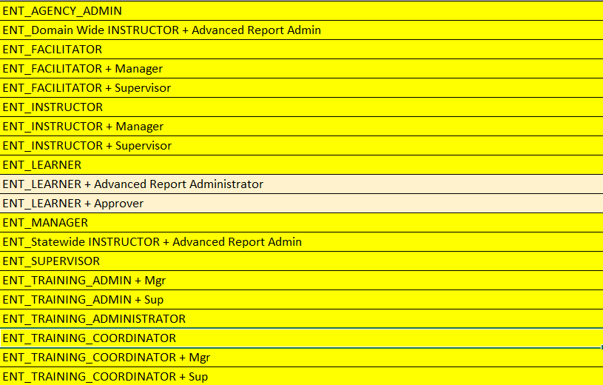
Roles Kept

Slide 16
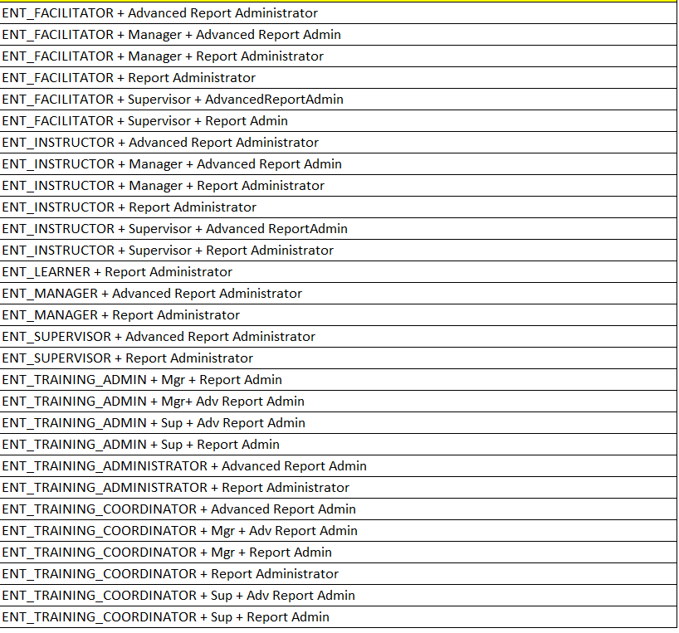
Roles Eliminated

Slide 17
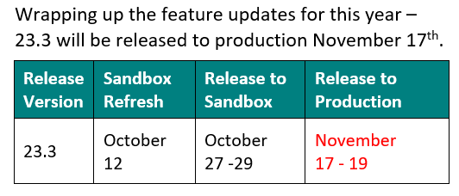
23.3 Update Schedule

Slide 18
Statewide DEI Training Update

Slide 19
DEI Dashboard 2023

Slide 20

Questions
Any questions, thoughts, concerns, enthusiasms?

Slide 21
Template
Header
Content
Header
Content
Notes:
The night of the user’s HRMS start date, the data feed will provide DES with:
HRMS data
Active Directory data
Using the full eight digit employee ID, the data is combined to create a complete user account

