Slide 1
Data Lifecycle & The Employee Experience

Slide 2
Reorganizing How We Collect and Think About Data
2
Recruitment & Onboarding
Workforce Representation
Sourcing and selection
Evaluating hiring processes
Composition
Diversity
Business Resource Groups
1
3
Movement
& Turnover
Why are employees leaving?
Where are they going?
Employee
Development
& Performance
Evaluation practices
Training
Experience
& Retention
5
Engagement
Modern Work Environment
Complaints & Investigations
4

Slide 3
Washington State Employee Exit Survey

Slide 4
What is the point of an exit survey?
Gives employees an opportunity to reflect on time with organization
Identify patterns or red flags
Improve recruitment and retention strategies
Retain institutional knowledge

Slide 5
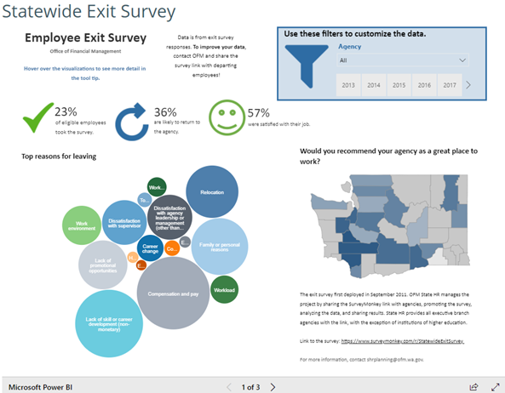
State Employee Exit Survey
Who is eligible?
All executive branch employees that leave voluntarily
Terminations are not included
Employees are not required to take the survey
Who collects data?
OFM-State HR creates the survey and collects the data
How will I see the results?
Raw and summary data available if more than 10 responses (demographics excluded) collected
Some exceptions may be made
Is agency participation required?
Currently, agencies are not required but strongly encouraged
Simply send survey link to employee that is exiting prior to them leaving

Slide 6
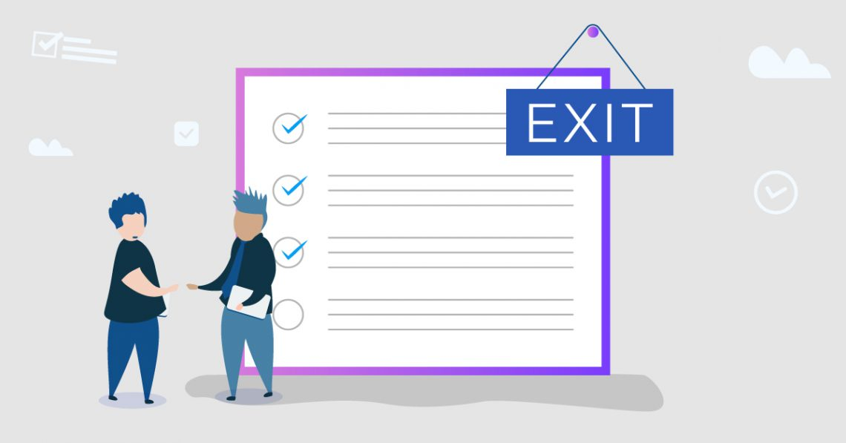
What’s on the survey?
Satisfaction with benefits, pay, supervisor, flexibility
Top reasons for leaving
Where are you going
How likely to return and recommend organization
Feedback on work environment
Demographics
Job class
Time with state & organization
Personal characteristics
Agency added questions
*Most questions are voluntary

Slide 7
What is on the horizon?
Starting July 1, 2021, all executive branch agencies (no matter the size) must offer the exit survey to exiting employees
Revamp of survey questions and data visualizations
Retirement specific questions
Small agency report

Slide 8
Washington State Employee Exit Survey
For more information on the exit survey, visit https://ofm.wa.gov/state-human-resources/workforce-data-planning/statewide-exit-survey
For any questions, please contact me at josh.calvert@ofm.wa.gov or 360-810-1497
Washington State Employee Exit Survey Link:
https://www.surveymonkey.com/r/StatewideExitSurvey

