Slide 1
Recruiting through the Great Resignation: Best Practices from Private Sector Recruiting Part 2

Slide 2
Great Resignation: Recap
According to the U.S. Bureau of Labor Statistics:
4 million Americans quit their jobs in July 2021.
Resignations peaked in April and have remained abnormally high for the last several months, with a record-breaking 10.9 million open jobs at the end of July.

Slide 3
Finding Candidates
Keywords
Linkedin Basics for Sourcing
Social media
Google – Alerts, Boolean, CSE
Research and Cross Referencing

Slide 4
Keywords
Job titles
Skills
Certifications
Licenses
Degrees
Companies
DEI terms
Trades
Industries
Phrases or natural language
Icons
Colleges
Associations
Awards
City
State
County
Country
Languages
Social media
Zip code
Area code
Accomplishments
Hobbies
Military branch
Veteran status
Conferences
Events
Nonprofits
Volunteerism
Clubs
Hashtags
LinkedIn groups
Resume
CV
Boards/Committees
Employment status

Slide 5
LinkedIn Search Basics
Free Account = A sample of the full potential
Limited search available each month
Commercial Use = Your attempt to exceed free account limits
What counts toward your limit:
Searching for LinkedIn profiles on LinkedIn.com and mobile.
Viewing profiles of people who you aren’t connect to
Searching outside of your network
Browsing LinkedIn profiles using the People Also Viewed section located on the right side of a profile.

Slide 6
LinkedIn Search Tips
Upgrade to a premium account
Recruiter Lite $120 per month
Career $40 per month
Sales Navigator $80 per month
Business $56 per month

Slide 7
Free LinkedIn Search
Search 1st degree connections
Searching profiles by name using the search box located at the top of every page on LinkedIn.com
Post jobs on your personal account - examples
Commenting on other posts – great way to start a conversation
Share content about jobs, company, industry, roles…
Searching for jobs on the jobs page – jobs that you hire
Search companies – competition or those that hire similarly
Search posts – degrees, licenses, certs, topics, industry
Search events – professions or industries
Join relevant groups – industries and professions that you hire

Slide 8
LinkedIn Sharing Tips
If your agency posts jobs or
content, like it, share it, send it
and comment…

Slide 9
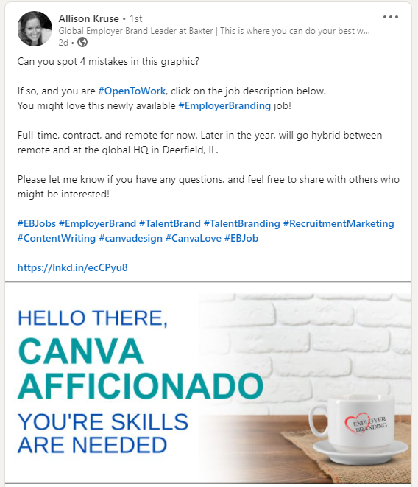
LinkedIn Posting Tips
Share jobs or content
What works about this post?

Slide 10
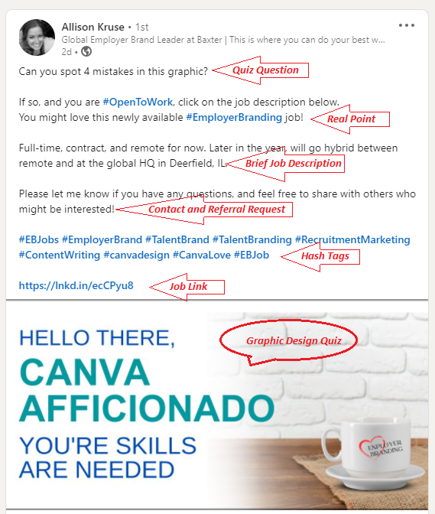
LinkedIn Posting Tips
Six points of reader engagement. Seven if you count the actual quiz…

Slide 11
LinkedIn Searching Posts
Degrees
License
Certification
#Hashtags
#opentowork
Industry
Diversity
Phrases
“Passed my NCLEX, CDL, CPA…”

Slide 12
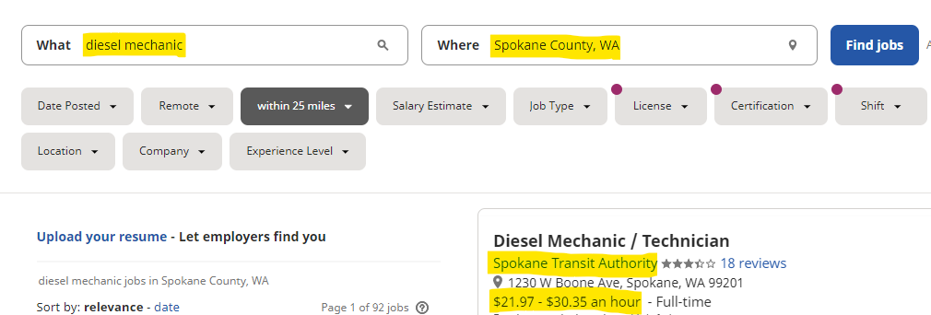
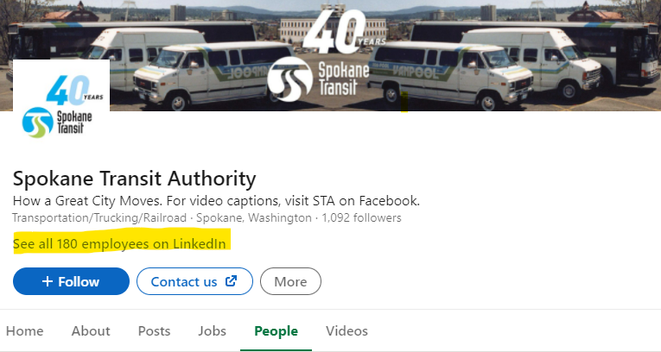
Cross
Reference

Slide 13
LinkedIn Posting Resources
Bitly.com – Free URL shortener
Hootesuite.com – Manage social media posting, scheduling, and more over several platforms and URL shortener
Buffer.com – Similar to Hootesuite
Canva.com – Drag and drop graphic design web site
Competition research and cross reference
Search schools for students and alumni

Slide 14
Boolean Basics
Keywords Words relevant to job Skills Certifications Job Titles
AND Nurse AND ER HR AND SPHR Mechanic AND Diesel
OR | Resume OR CV CPA OR Accountant BSW | MSW
NOT -job –apply –sample –submit –example
“ “ exact keywords or phrase “human resources”
( ) group parts of complex expressions
(RN OR Nurse OR Registered Nurse) AND (Hospital OR Clinic OR ER)
Filetype Type of document you are seeking .pdf .doc .xlsx
Site Website you are x-raying www.website.com

Slide 15
Boolean String Example
resume OR CV filetype:pdf CPA OR "certified public accountant" -sample -job –submit
Use Chrome
The string starts with resume OR CV because I'm looking for one or the other document.
The filetype:pdf is an operator that tells Google to find an Adobe version of that document; a common resume format.
I'm looking for a CPA but I added OR "certified public accountant" because it could show up on the resume either way.
The quotes capture the phrase exactly how I want it in the results.
Finally, I added -sample -job -submit because I want to remove all results that could be for job announcements, sample resumes or jobs that have "submit your application" wording. This will narrow my search down to almost only resumes or CVs; it's not a perfect science.

Slide 16
Boolean Shortcuts
LinkedinCSE – Custom search engine for LinkedIn only
Hiretual.com – Boolean builder (Keywords or JD)
Recruitin.net – Boolean builder
(Keywords and use OR between locations)
Save your search strings!

Slide 17
Boolean Strings:
Save them!
Licensed Practical Nurse:
site:linkedin.com/in OR site:linkedin.com/pub -pub.dir intitle:("LPN" OR "licensed practical nurse" OR "practical nurse") (renton WA)
Social Worker:
site:linkedin.com/in OR site:linkedin.com/pub -pub.dir intitle:("msw" OR "licsw" OR "lswaic") (renton WA)
HVAC Tech:
site:linkedin.com/in OR site:linkedin.com/pub -pub.dir intitle:(“HVAC Tech" OR “HVAC" OR “HVAC technician") (Tacoma WA)
CPA or Accountant:
site:facebook.com inurl:people (CPA OR accountant OR Payroll OR "certified public accountant") WA “olympia" –post
HVAC Technician:
site:instagram.com HVAC seattle –post (you can also add a #hvac instead and get different results)
Electrician:
site:twitter.com electrician seattle –tweet
Chef:
site:twitter.com tweets “olympia, wa” “chef” -intitle:jobs -inurl:(status|statuses)
Paralegal:
site:twitter.com tweets “tacoma” “paralegal” -intitle:jobs -inurl:(status|statuses)

Slide 18
Messaging Contacts
Don’t spam
Always send a note when connecting on linkedin
Intent is to move the prospect to the next step
Give prospects the information they need to take the next step
Don’t mislead, don’t promise or guarantee
Be honest about the open competitive process
Make it easy for them to apply

Slide 19
Thank You! – Questions?
linkedin.com/in/joseadominguez

