Slide 1

Capital Budget System (CBS)
Agency Training

Slide 2


Introductions…
Name
Agency
Capital Budget System Role
Goals for the class
Notes:
Instructor:
Introduction: Name, Restrooms, Participant Lounge, Back Door, Computers & Cell Phones, emergency exit, classroom number. Visitors from OFM
Participant intro’s – Name, Agency & Color - what color represents you? Red, Orange, Yellow, Green, Blue, or Purple.
Capital Budget System (CBS)
Raise your hands
How many of you are familiar with the Capital Budget process ?
How many of you have done any work in the CBS system?
Purpose: The purpose of this course, is to help you become familiar with using the CBS application.

Slide 3

Partnership between Office of Financial Management (OFM) and Department of Enterprise Services (DES)
OFM Budget division is the Business Owner of the Capital Budget System (CBS) and maintains Policy & Instructions.
DES Enterprise Technology Solutions(ETS)is the Technology Owner of the CBS System and provides system training, maintenance, and updates.
OFM Budget & ETS staff work together to make sure that the appropriate tools are available for agencies to complete their Capital Budget.

Slide 4
Budget Types & Systems
Capital – Capital Budgeting System (CBS)
Operation – Budget Development System (BDS)
Transportation – Transportation Executive Information System (TEIS)
Notes:
There are multiple budget types these are a few of them
Today we will focus on the Capital Budgeting System

Slide 5

Objectives
Gain a broad understanding of the CBS Application.
Knowledge of the various Security Roles within the application
Understand the different Budget Types
View the Process flows
Hands on activities
Available Resources
OFM Site
CBS Tutorial Site
WaTech Support Center

Slide 6
Web Browser Requirements
The Budget Portfolio Systems has adopted Microsoft Internet Explorer version 6.0 or 7.0 as the standard web browsers for system access. All system features and functions have been fully tested in and are supported by this standard. No other web browsers or release levels have been tested or are supported. You will need to use this standard to successfully access all Budget Portfolio System components. To determine your web browser release level, Select Help from your browser toolbar
Select About Internet Explorer
If you have Microsoft Internet Explorer 6.0 or 7.0 installed your about internet explorer window should clearly state this.
If you have questions or need assistance please contact
the DES Solution Center at (360) 407-9100 or solutionscenter@des.wa.gov
Notes:
Ensure you are using the correct web browser or use compatibility mode if using a higher version.

Slide 7
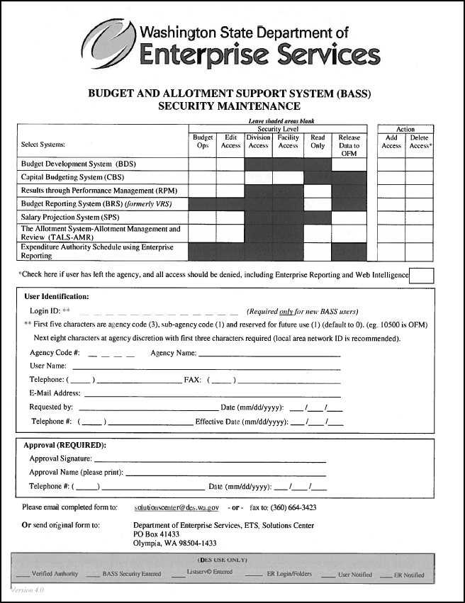
Bass Security Form
Notes:
Authorization – must be from requestors Chief financial officer or Budget manager
E-mail account must be established for the new user before security can be established because the temporary password and logon id are sent to the user.
The preferred method of communication is e-mail to the Solutions Center. Use of the fax feature on the form is limited

Slide 8
Security Roles
There are four different roles within the CBS system
Agency Facility User
Users can create projects with associated cost estimates
Users can submit to a Agency Division User, or BUDGET GROUP (Agency Edit Access User, or Agency Budget Operations User)
Users in this group only see their personal entries
Users do not have version capability
Notes:
We will review each of the four security roles individually at a high level

Slide 9
Security Roles Continued
Agency Division User
Users can create projects with associated cost estimates
Users collect projects from Agency Facility Users for submission to the Agency Budget Office
Users work with versions created by Budget Group
Users can submit projects to the Budget Group
Division User is the only person who can see individual data in a version

Slide 10
Security Roles Continued
Agency Edit Access User
Users can create projects with associated cost estimates
Users can collect projects from Agency Facility Users and Agency Division User to create a Budget Group Version
Versions assigned to Budget Group can be viewed or modified by the Budget Group
Locked versions or projects data can only viewed

Slide 11
Security Roles Continued
Agency Budget Operations User
Users can create projects with associated cost estimates
Users can collect projects from Agency Facility Users and Agency Division User to create a Budget Group Version
User can Lock Versions and projects
User can create versions for Agency Division User and the Budget Group
Users can submit Capital Budget request data to OFM

Slide 12
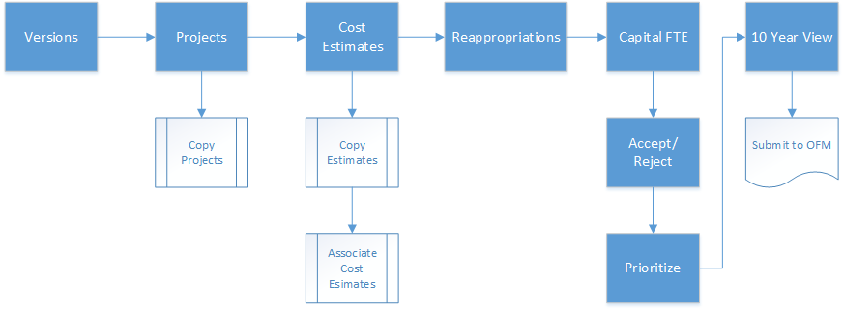
High Level Flow of CBS
Notes:
There are multiple components to the Capital Budget effort.

Slide 13
What is the CBS System?
CBS is a:
Estimating tool
Automatic Calculation for inflation
Multiple Version of Budgets
Electronic submittal to OFM
Secure
Access within the SGN or through Fortress

Slide 14

What types of Budget Requests can be entered into CBS?
Biennial Budget (requested every two years in the even year)
A financial plan that shows:
proposed expenditures
Timeline
Source of funding

Slide 15
What types of Budget Requests can be entered into CBS? Continued
Supplemental 1 (requested in the Odd year)
Any legislative change to the original budget appropriations
Supplemental 2 (requested in the Even year with your regular Budget request)
Any legislative change to the original budget appropriations

Slide 16
What types of Budget Requests can be entered into CBS? Continued
Re-appropriations
Authorization to use funds that were not spent as originally planned, with appropriate approval authority to ensure project completion

Slide 17
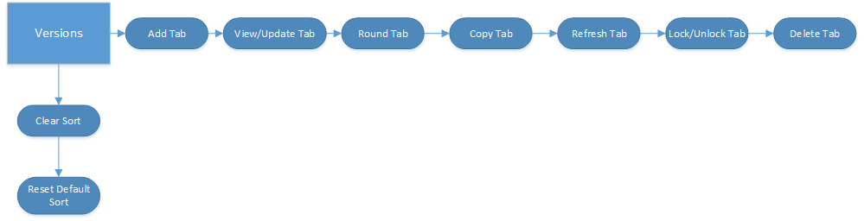
Version Flow

Slide 18
Establish a Version
Create a Version
Budget Group (Budget Operations & Edit Access User) creates Versions
Division User uses the versions created by the Budget Group.
Facility Users do not see versions when creating their projects & cost estimates

Slide 19
Exercise and Review
CREATING
A
VERSION
Notes:
Demo exercise
http://bass.ofm.wa.gov/basslogon_tr/default.aspx
Questions for after:
What role can create a version? – budget operations & Edit Access user
What role uses the version? – Division user

Slide 20
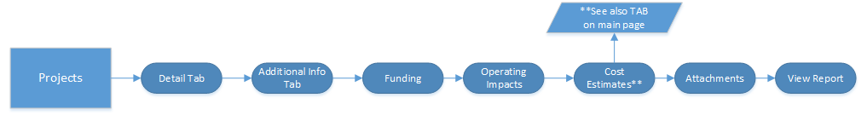
Projects Flow

Slide 21
Establish your Projects
DETAIL TAB has general information
Agency Summary needs to tell the whole story as this is what will determine funding
Direction for actual entries
Notes:
Establishing the project
http://bass.ofm.wa.gov/basslogon_tr/default.aspx
You may copy a project within a version and also copy a project from one version to another – lesson 3 of tutorial

Slide 22
Exercise and Review
CREATING
A
PROJECT
Notes:
Demo exercise
Questions for after:
Q - What do you need to verify when selecting the Biennium, Budget Type and Version?
A - Working Versions is selected
Q – What can you do to help with the funding of your project?
A - Tell the whole story as clearly as possible for people to understand your request

Slide 23
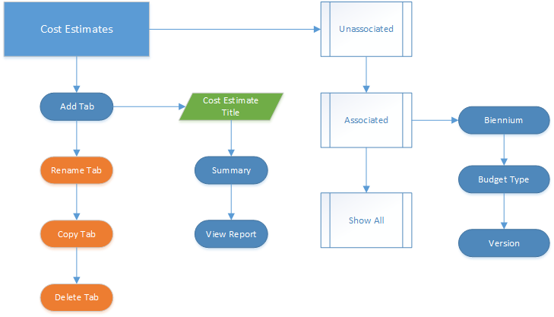
Cost Estimates Flow

Slide 24
Cost Estimates
All users can enter Cost Estimates into CBS
Two types of Cost Estimates
Associated Cost Estimates
Unassociated Cost Estimates
The cost estimates gives a breakdown of costs that will be associated with a project request.
Notes:
Everyone who has security in CBS can create an Unassociated Cost Estimate.
If you can create or enter data into a project you can create the Associated Cost Estimates or attach an Unassociated Cost Estimates. (Facility Users cannot do this process.)

Slide 25
Exercise and Review
Cost Estimates
Main Tab & Project Tab
Notes:
To show how to do an Unassociated and the Associated.
If more information is needed use the Tutorial instructions for each.

Slide 26
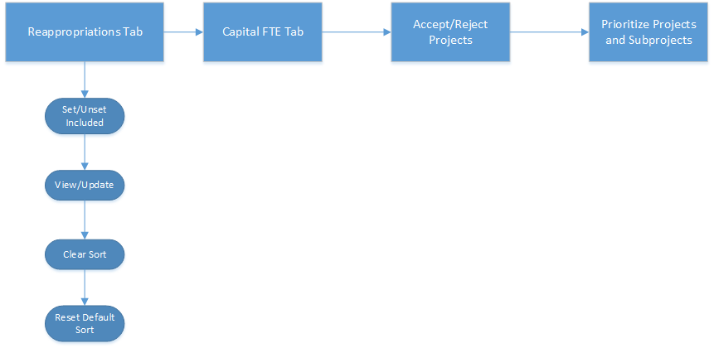
Reappropriation & Others

Slide 27
Reappropriations
You will need to do a search for the reappropriation data. You will have the following selections:
Biennium
Budget Types
Version
Below these selection fields you will see the following titles:
Preprior: provides the calculated expenditures of a given project available to reappropriation
Current EAS: provides the “Latest” dollar amount from TALS-EA
Actuals Current as of: displays date of last actual dollar amount extraction from TALS and Enterprise Reporting
Once you have selected the biennium & version you will then need to click on the LOAD DATA button. (Only do this once as it can mess up your data if repeated)
Notes:
Reappropriations come from your budget schedule.

Slide 28
Reappropriations
You will see new functions available for viewing your Reappropriation information and they are:
Set/Unset Included
View/Update
Clear Sort
Reset Default Sort
User will need to select the projects for Reappropriation so that it will become part of your Budget Request

Slide 29
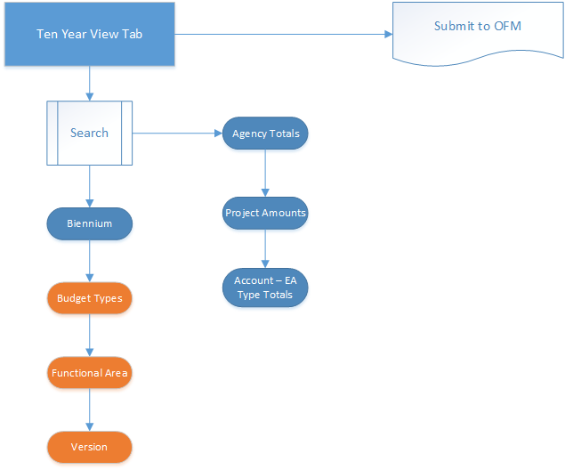
Ten Year View Flow
Notes:
The 10 year section has a Rounding Feature that can be done manually or automatically each time that you enter a change.
If you choose the Automatic Rounding you CANNOT UNDO it.

Slide 30
10-year View
Data loads from information entered in a particular version
You can update the 10-year information from this tab
The CBS001 report is ran from this screen
Rounding is available
Manually when you are ready
Automatically applied to changes as they occur (cannot be turned off once applied)

Slide 31
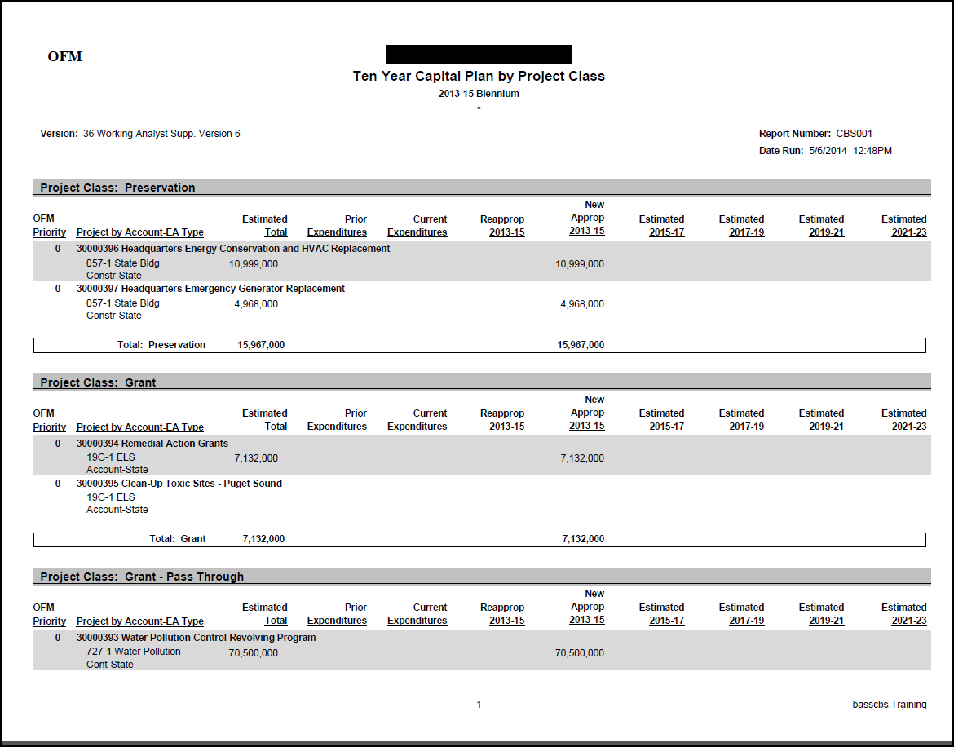
CBS001 Report
Notes:
Actual report sample

Slide 32
Additional Information
Some documentation is required per the OFM Budget Instructions such as:
DAHP – Historical Preservation
Cost Estimates – two tabs are available to create cost estimates. One outside the project and one within the project.
Locator is available within CBS however, if your location is not found other locator sites may also be used.

Slide 33
Tips for CBS
Remember to “Load” to see your Data
Project stays the same throughout all phases and for the life of the project.
Save often to avoid time outs
If you use the Save & Continue button you will be able to go directly to the next tab
If you just Save you will stay on the Tab that you are working in.

Slide 34
Resources
BASS main application page provides access to the login page, security form, tutorials, password changes & listserv announcements.
Within the SGN: http://bass.ofm.wa.gov/BASSLogon_pr/logon.aspx
Outside the SGN:
http://fortress.wa.gov/BassLogon_pr/logon.aspx
OFM Policy Budget information
http://ofm.wa.gov/budget/instructions/capital.asp
OFM Budget contact information
http://www.ofm.wa.gov/budget/contacts/default.asp
For system assistance please contact the WaTech Support Center at (360) 407-9100 or support@watech.wa.gov

Slide 35
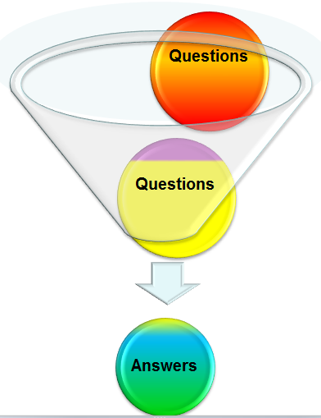
Questions?

Slide 36

Thank you
Thank you for attending this class.
All materials will be posted on the WaTech website in the next few days.
You are free to leave if desired or you may stay for some additional hands on work.
For those who are staying you will be using the on-line CBS tutorial instructions from the BASS application page.

Slide 37
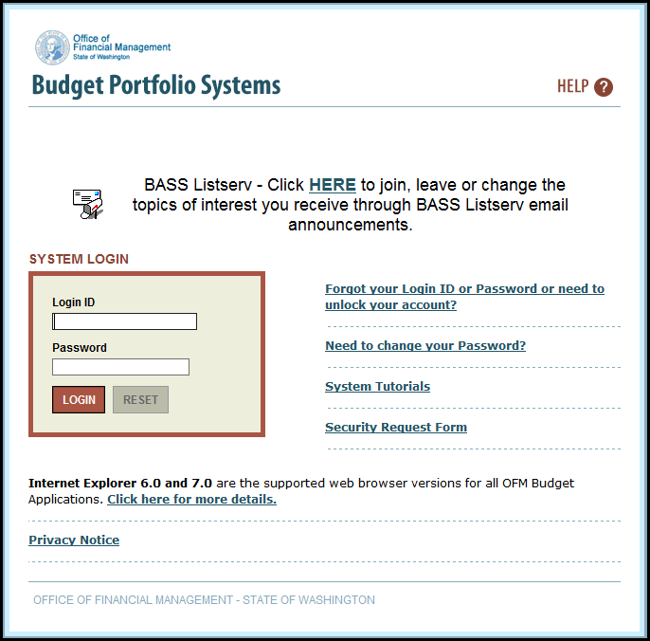
Tutorials
Step by step instructions

