Slide 1
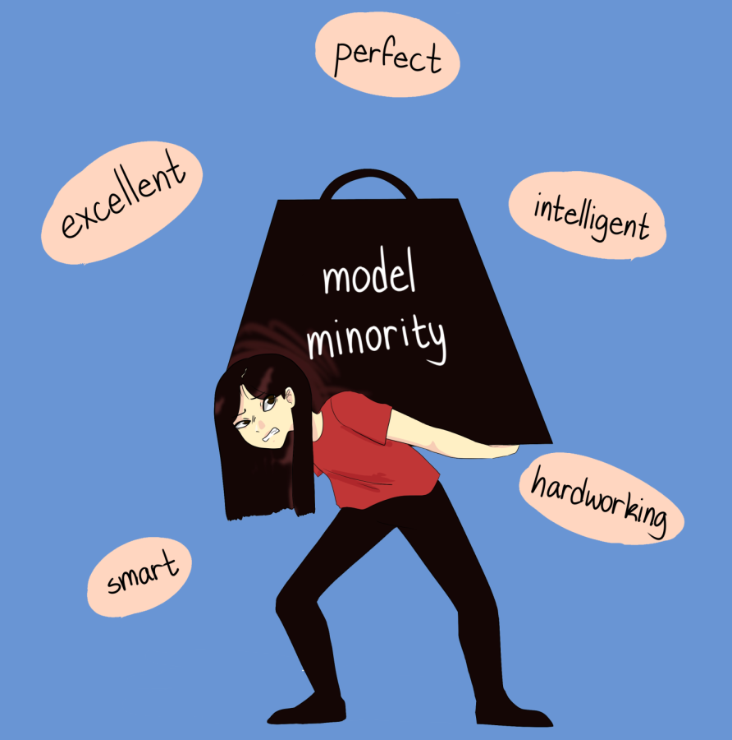
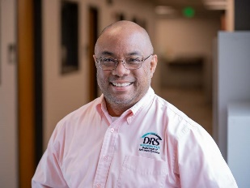

Model Minority Myth
Presenter: Jim Mendoza – CEBS, CRPC -
Co-Chair, HAPPEN BRG

Slide 2
Today’s Goals
Define the model minority stereotype
Illustrate racial microaggressions commonly experienced by ANHPI
Offer suggestions

Slide 3
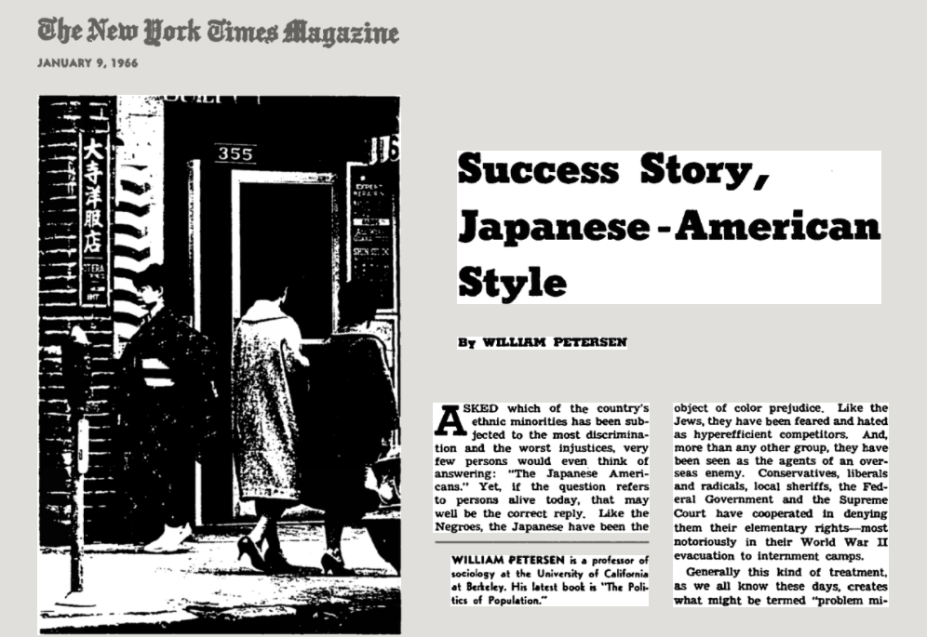
Model Minority – Origin
Notes:
The concept of the “model minority” was first established by sociologist William Petersen in an article, “Success Story, Japanese American Style,” published in the 1966 New York Times Magazine. In the article, Petersen attributed the apparent success of Japanese Americans only 20 years after their World War II incarceration in internment camps to cultural values, strong work ethic, family structure, and genetics.
Petersen's article follows the 1965 Moynihan Report, which blamed African-American culture and family structure for African Americans' socio-economic problems. The "model minority" analysis also pitted Japanese Americans — and, later, all Asian Americans — against so-called "problem minorities," which many say has distracted from charges of institutional racism.
Continued use of the term, it's been noted, has overlooked how the Immigration Act of 1965 preferentially allowed highly educated Asian scientists, engineers, and doctors to immigrate. It also masked the wide disparities of Asian Americans in income, employment, education, health, and experience.

Slide 4
Model Minority – Defined
A demographic whose members are perceived to achieve a higher degree of socioeconomic success than the population average, thus serving as a reference group to other groups.
Notes:
Put another way, Asian Americans serve as a model or reference on how to be successful.

Slide 5
Characteristics of the
Model Minority Myth
This myth characterizes (caricatures) Asian Americans as a polite, law-abiding group who have achieved a higher level of success than the general population through some combination of innate talent and pull-yourselves-up-by-your-bootstraps immigrant striving.
Notes:
This myth characterizes Asian Americans as a polite, law-abiding group who have achieved a higher level of success than the general population through some combination of innate talent and pull-yourselves-up-by-your-bootstraps immigrant striving.

Slide 6

Jo Koy
“Today is a good day to get injured at a show, ‘cause there will be a nurse in here.”

Slide 7
Characteristics of the
Model Minority Myth (cont)
The myth of the model minority is based in stereotypes.
It perpetuates a narrative in which Asian American children are whiz kids or musical geniuses. Within the myth of the model minority, Tiger Moms force children to work harder and be better than everyone else, while nerdy, effeminate dads hold prestigious—but not leadership—positions in STEM industries like medicine and accounting.
Notes:
The myth of the model minority is based in stereotypes. It perpetuates a narrative in which Asian American children are whiz kids or musical geniuses. Within the myth of the model minority, Tiger Moms force children to work harder and be better than everyone else, while nerdy, effeminate dads hold prestigious—but not leadership—positions in STEM industries like medicine and accounting.

Slide 8
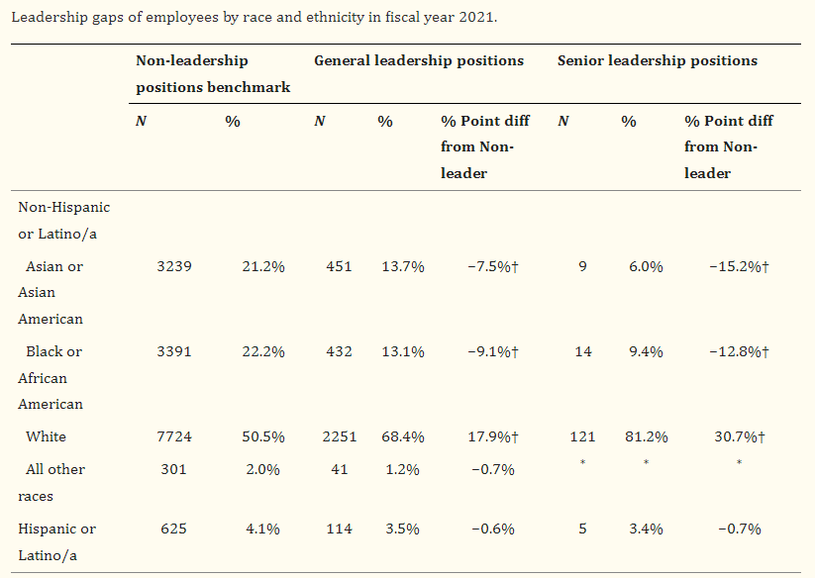
Leadership gaps of employees by race & ethnicity
Notes:
It may be true that treated as a whole group, Asian-Americans appear to be doing well. Relative to other racial and ethnic minorities, they live in wealthier neighborhoods, have high marriage rates, high levels of educational achievement, and are successful in the labor market.
The most striking success of Asian-Americans, and the one most commonly highlighted in the media, is in educational attainment. 54 percent of Asians have bachelor’s degrees, and 21 percent have attained advanced degrees.
All that said, a study done by the National Institutes of Health showed that Asians/Asian Americans made up only about 6% of the senior leadership positions while representing 21.2% of those in non-leadership positions in fiscal year 2021
This is what is known as the bamboo ceiling

Slide 9
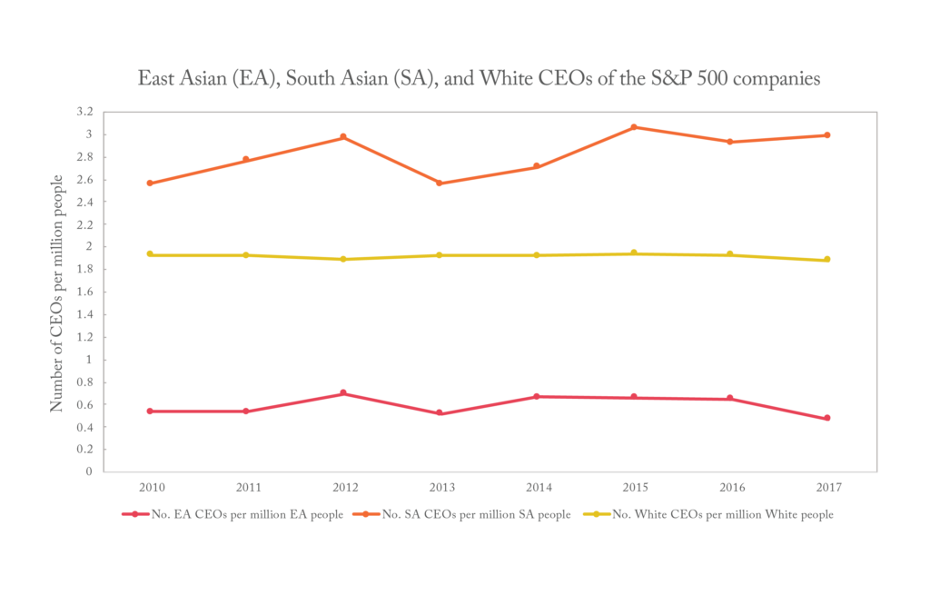
Bamboo Ceiling
Notes:
The term “bamboo ceiling,” was coined by Jane Hyun in her 2005 book, Breaking the Bamboo Ceiling: Career Strategies for Asians. Like the metaphorical glass ceiling, which refers to the invisible barriers preventing women from attaining leadership positions in their fields, the bamboo ceiling describes the barriers keeping qualified Asians from attaining leadership positions in the U.S.
In a groundbreaking 2020 article published in Proceedings of the National Academy of Sciences, Lu and APS William James Fellow Richard E. Nisbett of the University of Michigan, Ann Arbor, and Michael W. Morris of Columbia University conducted a series of 9 studies of Asian Americans and other Asians in the United States. In one study, they analyzed data from companies on the S&P 500—a stock market index that reflects the value of the largest U.S. companies—and found just 16 Asian CEOs in 2017, compared to 440 White CEOs. Viewed another way, although Asians made up roughly 6% of the country’s population at that time, they represented only 3% of the CEOs of S&P 500 firms. A 2015 study by the Ascend Foundation, a nonprofit organization for Asian professionals, analyzed the number of employees in the management pipeline of five large technology companies (Google, LinkedIn, Yahoo, Hewlett-Packard, and Intel). Asians were found to be well represented in the companies’ nonmanagerial workforces but underrepresented at the executive level.

Slide 10

Brave Space by Beth Strano

Slide 11

Discussion Time 1

Slide 12
Goal No. 2
Define the model minority stereotype
Illustrate racial microaggressions commonly experienced by ANHPI
Offer suggestions
Notes:
So let’s talk microaggressions

Slide 13
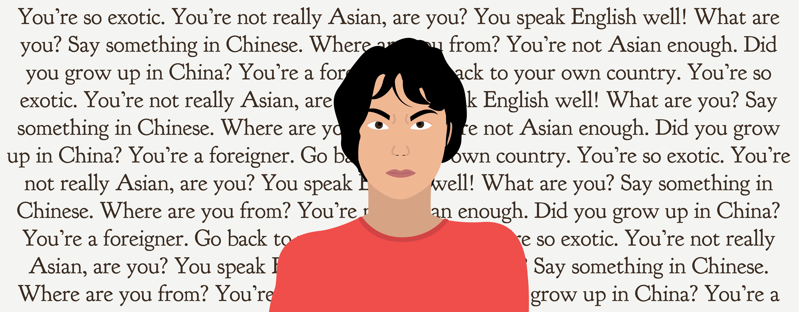
Microaggressions
Microaggressions are common, everyday slights and comments that relate to various aspects of one's appearance or identity such as class, gender, sex, sexual orientation, race, ethnicity, mother tongue, age, body shape, disability, or religion, among others.
Notes:
{Read definition}
I remember when my family moved from inner city Seattle to suburban Federal Way. I walked into my first class and heard these words: “Well, there goes the curve.” My internal response: ‘I must get an A because I am an Asian—not a Bsian.” As I look back upon that time, I have to ask, what sort of internal pressure was I putting on myself?
You speak so well. Of course I do.
Where are you from? I was born in Seattle. But where are you from?
You’re so exotic.
Beyond these, in my view point, the biggest microaggression Asians face is how we’re viewed as one homogenous whole…

Slide 14
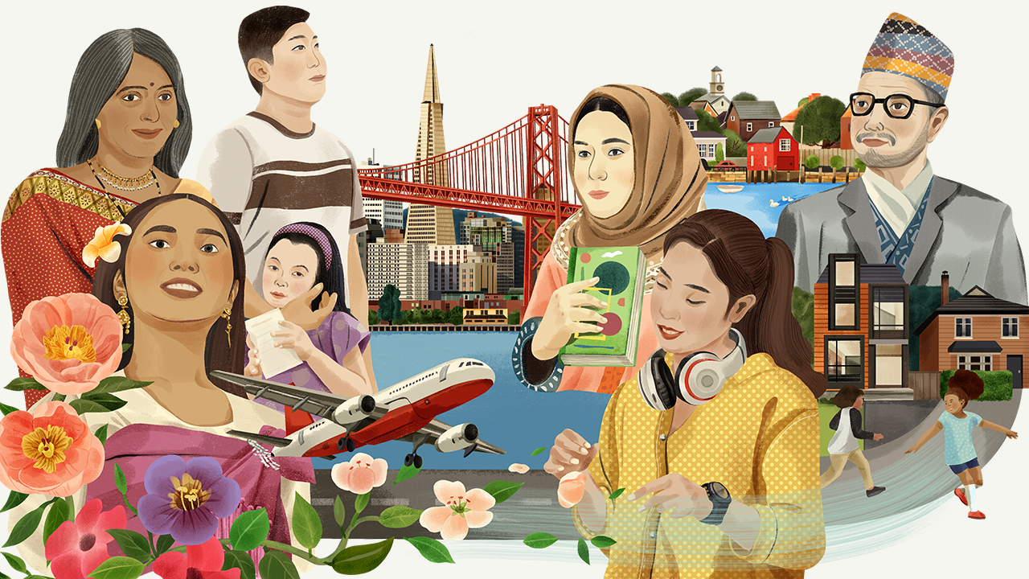
We aren’t just ONE group
Notes:
…but rather a melting pot of diverse cultures, countries, and languages.
AANHPI diaspora celebrates the rich, diverse culture that spans from countries such as China, Japan, Korea, Indonesia, Laos, the Philippines, Singapore, Samoa, Thailand, Taiwan, Vietnam, India, Pakistan, Bangladesh, Sri Lanka, and Nepal, just to name a few.

Slide 15
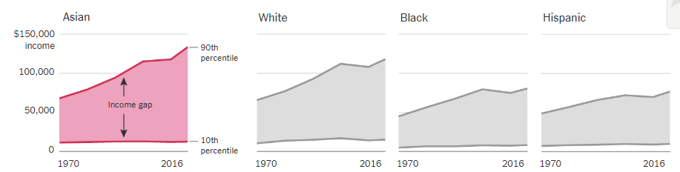
Crazy Rich Asians We aren’t just ONE group
Notes:
As an example, while Asians rank overall as the highest earning racial group ins the US, it’s not a status shared by all Asians.

Slide 16
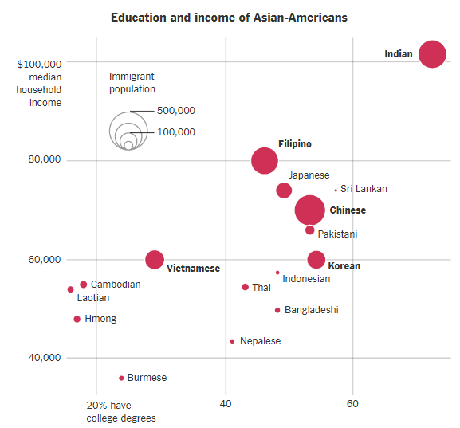
Education & income of Asian-Americans
Notes:
In fact, Asian Americans are the most economically divided racial group in the country. Disparities between these groups are largely driven by education, skills, and English language proficiency. Looking at this chart, you might think that certain are inherently smarter than other, but you would be wrong.

Slide 17
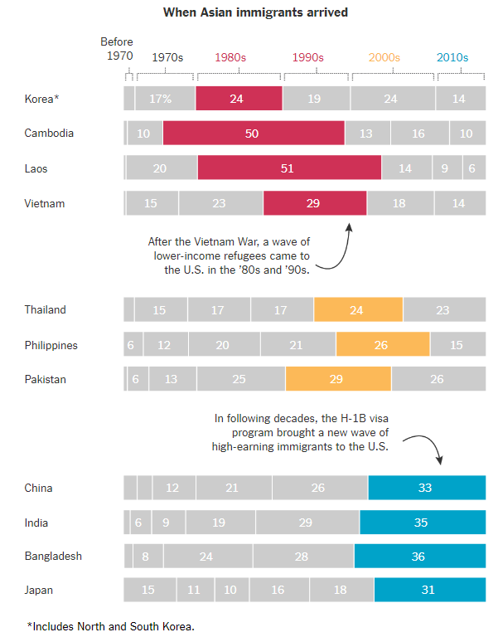
Impact of immigration laws
Notes:
The inequality can largely be tied back to US immigration laws.
The H1B visa essentially allowed employers to hire people with specialty skills – doctors, engineers, computers scientists from other countries. No surprise, these folks were more educated than post war refugees.

Slide 18
Discussion Time 2

Slide 19
Goal No. 3
Define the model minority stereotype
Illustrate racial microaggressions commonly experienced by ANHPI
Offer suggestions
Notes:
As a deceptively positive label, the AAPI population is assumed to be smart, obedient, complicit, affluent, and academically inclined. It is important to understand that, although these assumptions apply to some AANHPI who might benefit from or exemplify this stereotype, the “model minority” is still a form of racial prejudice. It ignores the multiethnic diversity of the Asian American Native Hawaiian Pacific Islander population and disregards their individual struggles. In order to respect the diversity and struggles of the AAPI population, we must first understand that the “model minority” is not necessarily true, and that it should not be an all-encompassing term for all “Asians.”

Slide 20
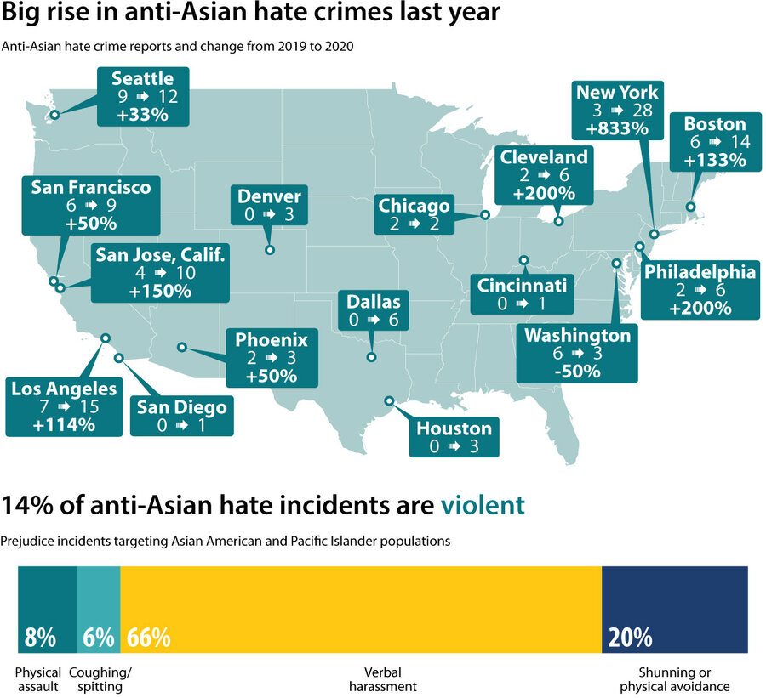
Rise in anti-Asian hate crimes
Notes:
It should also be noted that the “model minority” myth does not protect us from incidents of anti-Asian hate.
Hate crimes against Asians spiked 164% in the first quarter of 2021 compared with the same period in 2020, according to a report from California State University’s Center for the Study of Hate and Extremism.

Slide 21
What can I/we do?
Reach out to AAPI students, colleagues, friends, and neighbors.
Present data that contradict the model minority stereotype (disaggregate!)
Tell (and listen to) stories of individuals who do not fit the stereotype.
Monitor your own biases and assumptions about Asian Americans.
Notes:
So here’s some suggestions…

Slide 22
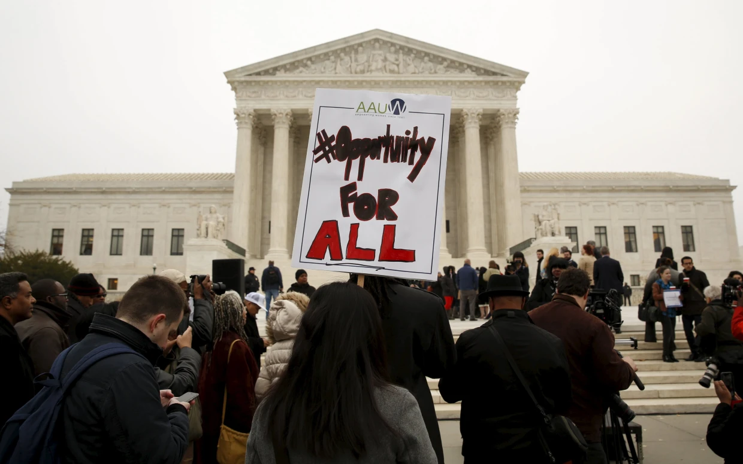
Stop using Asians as a “wedge”
Notes:
Stop using Asians as a wedge. According to Janelle Wong, the director of Asian American Studies at the University of Maryland, College Park, this strategy, she said, involves
Ignoring the role that selective recruitment of highly educated Asian immigrants has played in Asian American success followed by
Making a flawed comparison between Asian Americans and other groups, particularly Black Americans, to argue that racism, including more than two centuries of black enslavement, can be overcome by hard work and strong family values.“
Put another way, they’re doing it right, why can’t you? Funny thing, Asians aren’t the ones asking that question. As an example according to a 2016 national poll conducted by Advancing Justice, APIAVote and AAPIData.com, 64 percent of Asian-American voters favor programs designed to help blacks, women and other minorities access higher education.

Slide 23
Discussion Time 3

Slide 24
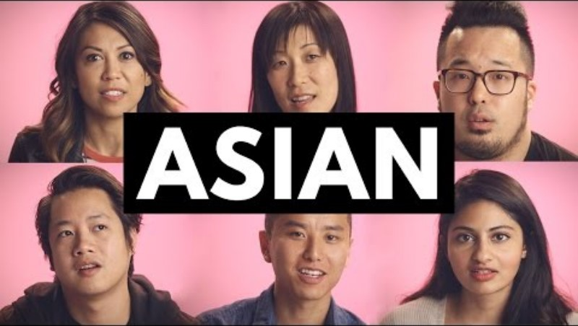
Be proud of who you are
Notes:
Don’t forget to enable CC

Slide 25
Thank you for listening
Presenter: Jim Mendoza – CEBS, CRPC -
Co-Chair, HAPPEN BRG

