Slide 1
DES Apprenticeship - Research
Bailey Adams (she/her), Employee Experience Consultant
Human resources
June 2024

Slide 2
What we’ll cover
How we decided which position to explore for an apprenticeship
What research/support partners did we utilize
Why we paused

Slide 3



What position/trade and why
Turnover Report
Recruitment Report
Unique Factors
Identified number of people leaving trades positions at DES in last five years – split out by position.
Identified number of applications per open recruitment of each trades position in last five years.
Identified, alongside workers, what unique factors we experience (i.e. we still use boilers).
Notes:
We had the most turnover in our Stationary Engineer series – totaling 13 in the five years preceding. Subsequently, our recruitments for Stationary Engineers had 20 or fewer applications in each open recruitment in the preceding five years – many with only single digit applicant pools.

Slide 4
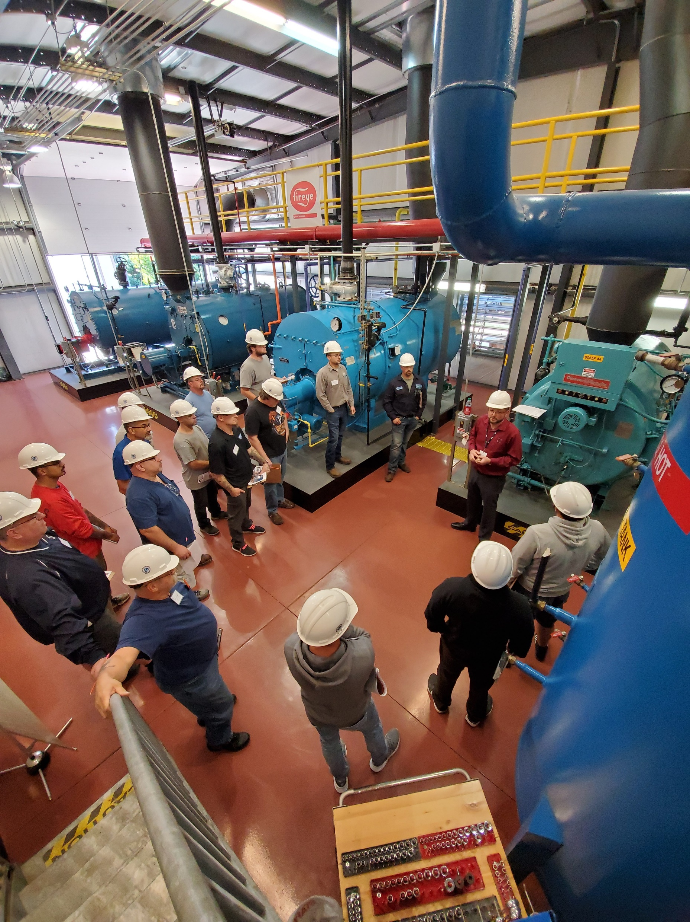
Support partners
L&I Apprenticeship Consultant
Compliance expectations
Tips and tricks to be most prepared
Where to start
Seattle City Light
Has an established program
How they’re funded
Standards and instruction suggestions
Notes:
Our L&I Apprenticeship Consultant and I talked often about where we need to start to be most successful – creating our committee of equal parts labor and management. He recommended we put the management of the program at a high level place in the organization to ensure continuity in case of turnover (recommended HR). Seattle City Light has a well-established program with many trades, so we connected on how they fund all the salaries, uniform requirements, coursework, etc. They also provided some suggestions of working with a local college to provide the instruction and other “classroom” instruction like field trips, SME speakers, etc.

Slide 5
Standards we considered
144 hours of classroom instruction required
Do we want to pay for that (incentive)?
Do we want to partner with an educational institution to get an instruction to come to us for this instruction (Bates Tech, Clover Park Tech, etc.)
8,000 hour program standard (4 years)
Standard of 1:1 journey-level worker to apprentice (WAC 296-05-015(5)).
Our Stationary Engineer team is 7 people strong
Because this position had the highest rate of turnover in our trades, would we be able to meet the 1:1 standard and provide optimal experience for apprentice throughout their 4 years?
Union-represented positions
Program management continuity – if one person leaves, will the program continue on?
Notes:
We looked at ways to make the program attractive – paying for the coursework, boots, etc. We also met with Bates Technical College a few times to start collaborations in supplying the classroom instruction piece of the puzzle.

Slide 6



Why we paused efforts
Council Make-up
Cost
Program Impact
We struggled to get our council together and have the time available to invest in standing up the program in equal parts labor & management.
For the entirety of the four required years of the program, we were looking at around a $1M investment.
We only had capacity for two apprentices at a time, which, as Jordan mentioned, was not effective use of an apprenticeship program.

Slide 7
thank you
Bailey.adams@des.wa.gov
(360) 407-7932
Des.wa.gov

